Slide 1
Intermediate Lab PHYS 3870
An Exercise in Reference Management and Use
Use Google Scholar to find:
A physics related article by an author with your last name
An article in American Journal of Physics related to this topic
An article from within the last 2 years related to this topic
An article from before you were born related to this topic
Use Google Scholar and EndNote to:
Use Google Scholar to save citations to these 4 articles in EndNote Basic format
Write a sort paragraph about the physics topic in Word.
Use EndNote Basic Cite-While-You-Write to provide citations for your paragraph.
Use EndNote Basic to create a bibliography for your paragraph using the AIP Style.
Save your Word file as a PDF file, with a filename LastnameFirstInitial_Endnote.pdf (e.g., DennisonJ_EndNote.pdf).

Slide 2
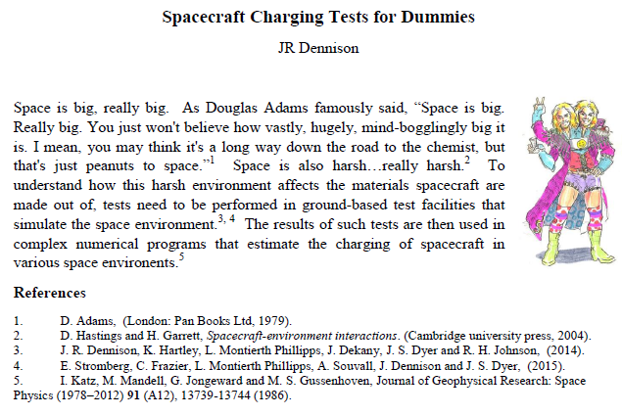
Intermediate Lab PHYS 3870
An Example of an Exercise in Reference Management and Use

