Slide 1
Intermediate Lab
PHYS 3870
CONVEYING INFORMATION
Gathering Information
References: PHYS 3870 Web Site
USU Library

Slide 2
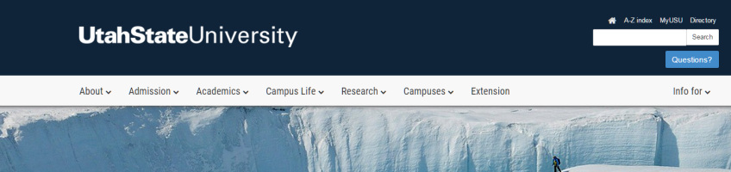

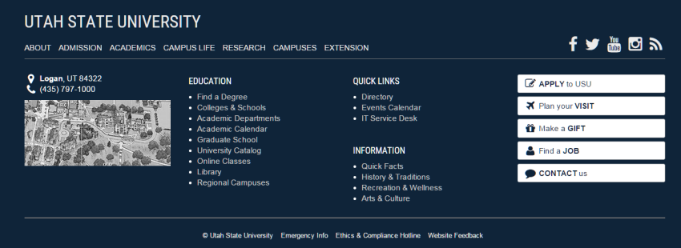
Access the USU Library Home Web Page
http://library2.usu.edu/howto/

Slide 3
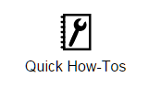
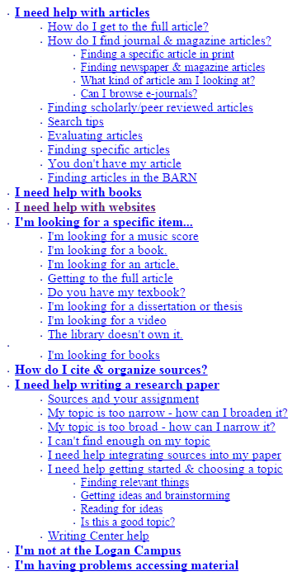
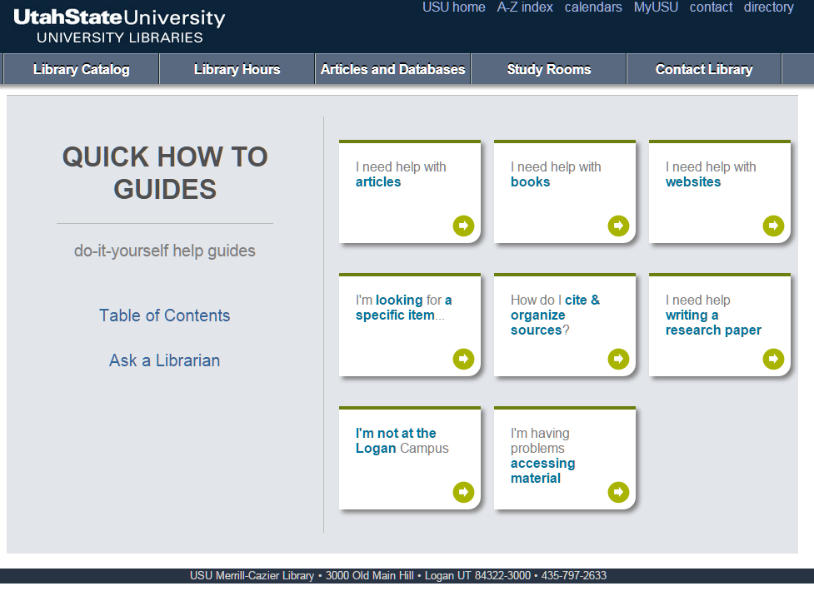
Access the USU Library How-Tos
http://library2.usu.edu/howto/
http://library2.usu.edu/howto/sitemap.php

Slide 4
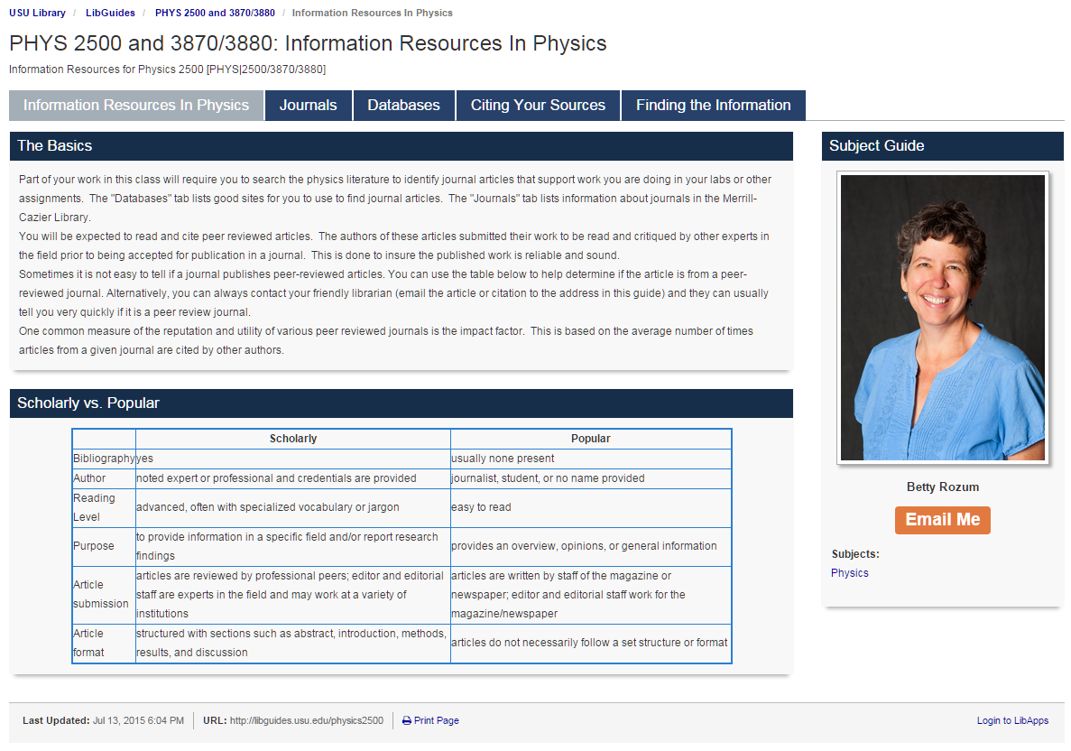
Access the USU Library Home Web Page
http://libguides.usu.edu/content.php?pid=246165

Slide 5
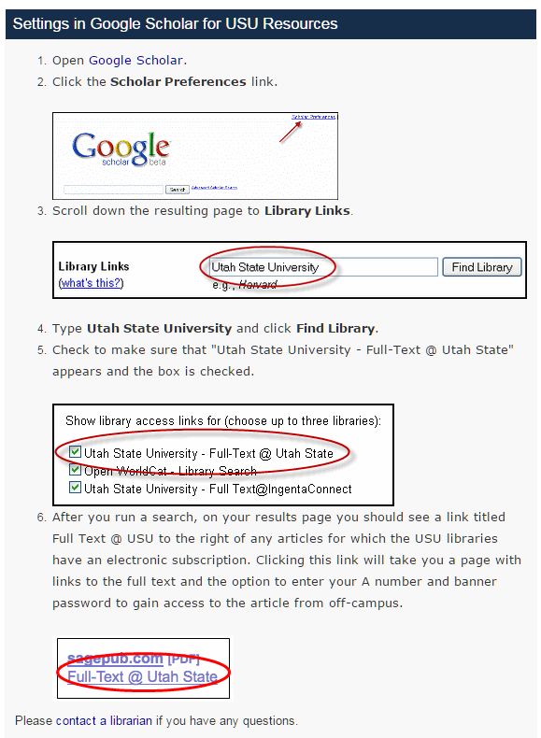
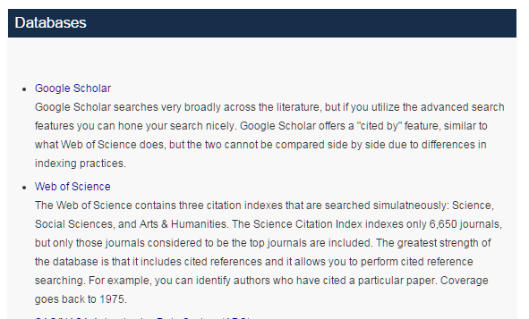
Setting Up Google Search at USU
Good information on electronic journals, Endnote and Google Scholar
http://libguides.usu.edu/c.php?g=52461&p=338450
USU set up instructions:
http://libguides.usu.edu/c.php?g=52461&p=338450
Google Scholar Home Page:
http://scholar.google.com

Slide 6
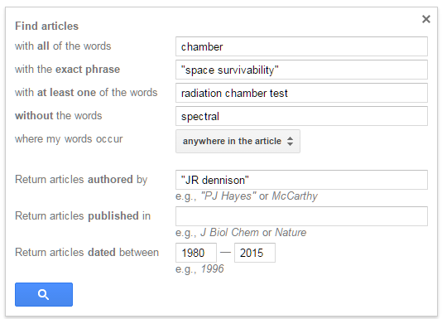
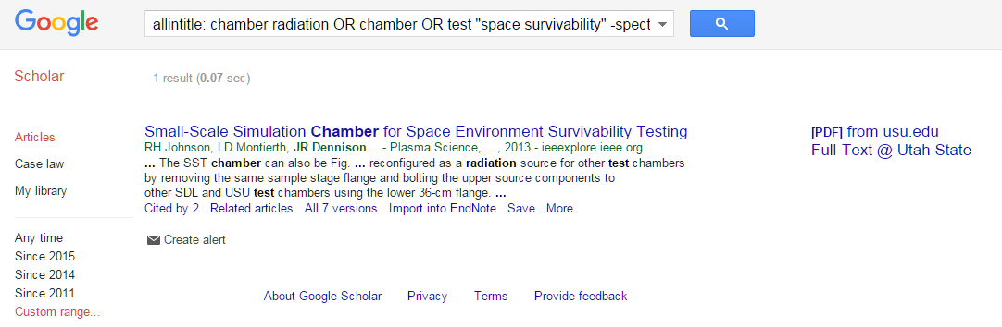
Searching with Google Scholar
1
Google Scholar Home Page:
http://scholar.google.com
5
Search Criteria
Select words
Select authors
Select journal
Select date
Select fields
2
3
4

Slide 7
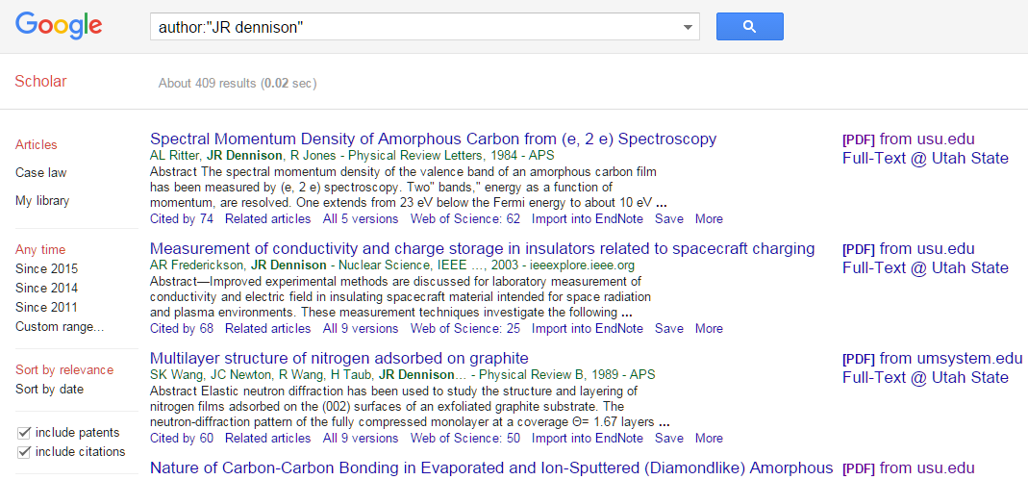
Articles from Google Scholar
Cited by
Related articles
Import into Endnote
Get Text in PDF

Slide 8
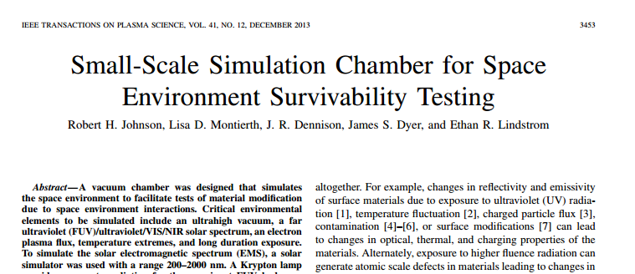

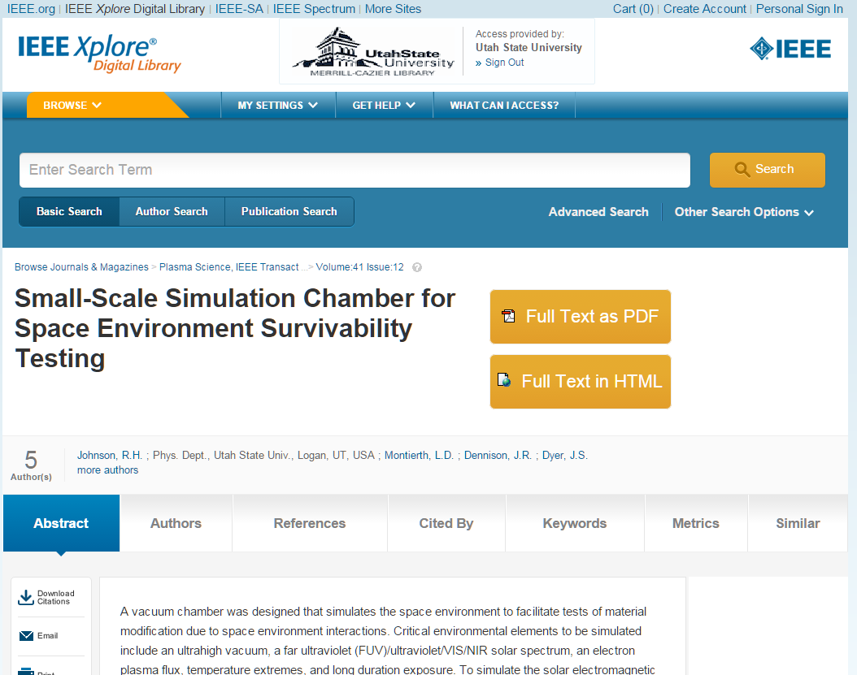
Getting the Article
Access article
Access Journal
Article as PDF

Slide 9
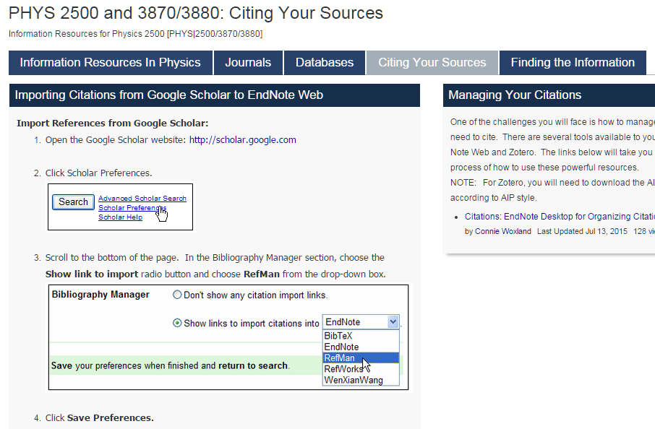
Importing Articles from Google Scholar to EndNote Web
Set up Goggle Scholar to Work with EndNote Web.
Import into Endnote
Import to RefMan

Slide 10
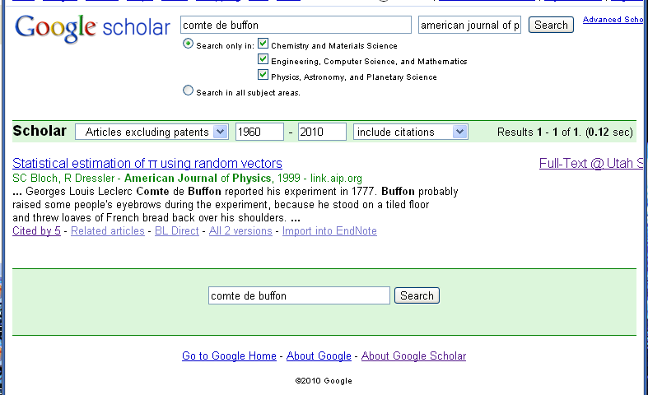
Importing Articles from Google Scholar to EndNote Basic
Import into Endnote
Import to RefMan

Slide 11
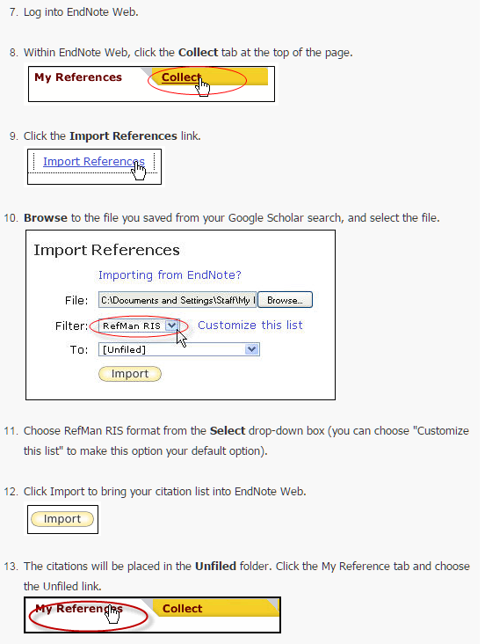
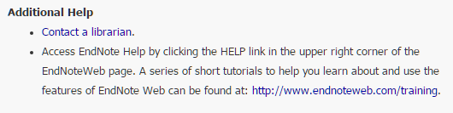
Importing Articles from Google Scholar to EndNote Web
Saving into EndNoteWeb
http://libguides.usu.edu/endnote

Slide 12

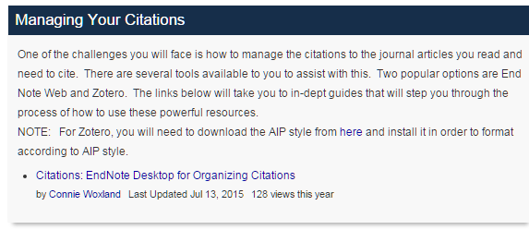
Importing Articles from Google Scholar to EndNote Web
Citations on EndNoteWeb
http://libguides.usu.edu/EndNoteBasic
http://libguides.usu.edu/endnote
http://www.endnoteweb.com/training

Slide 13
Intermediate Lab
PHYS 3870
An Exercise in Reference Management and Use
Use Google Scholar to find:
A physics related article by an author with your last name
An article in American Journal of Physics related to this topic
An article from within the last 2 years related to this topic
An article from before you were born related to this topic
Use Google Scholar and EndNote to:
Use Google Scholar to save citations to these 4 articles in EndNote format
Write a sort paragraph about the physics topic.
Use EndNote Cite-While-You-Write to provide citations for your paragraph.
Use EndNote to create a bibliography for your paragraph using the AIP Style

Slide 14
Intermediate Lab
PHYS 3870
CONVEYING INFORMATION
Gathering Information
References:
PHYS 3870 Web Site
USU Library Class Web Site

Slide 15
Access the USU Library Home Web Page
http://library2.usu.edu/howto/

Slide 16
Access the USU Library How-Tos
http://library2.usu.edu/howto/
http://library2.usu.edu/howto/sitemap.php

Slide 17
Access the USU Library Home Web Page
This page provides an up to date link to the USU library resources tailored to these classes!
http://libguides.usu.edu/content.php?pid=246165

Slide 18
Setting Up Google Search at USU
Good information on electronic journals, Endnote and Google Scholar
http://libguides.usu.edu/c.php?g=52461&p=338450
USU set up instructions:
http://libguides.usu.edu/c.php?g=52461&p=338450
Google Scholar Home Page:
http://scholar.google.com

Slide 19
Searching with Google Scholar
1
Google Scholar Home Page:
http://scholar.google.com
5
Search Criteria
Select words
Select authors
Select journal
Select date
Select fields
2
3
4

Slide 20
Articles from Google Scholar
Cited by
Related articles
Import into Endnote
Get Text in PDF

Slide 21
Getting the Article
Access article
Access Journal
Article as PDF

Slide 22
Setting Google Scholar to Work with EndNote Basic
(3) Set up Goggle Scholar to work with EndNote Basic.
Import to RefMan or EndNote
Video tutorial https://www.youtube.com/watch?v=35t9RB8G558

Slide 23
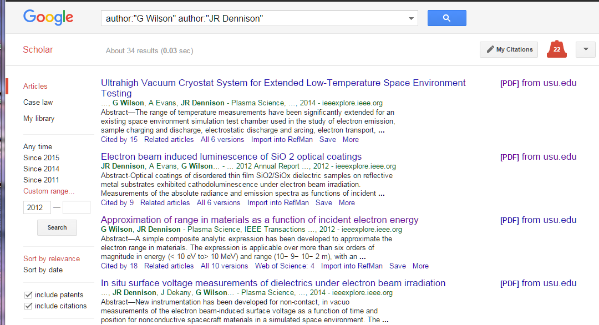
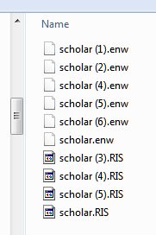
Importing Articles from Google Scholar into EndNote Basic
(4) Collect reference files for import into EndNote Basic
After performing a search on Google Scholar click on the "Import into RefMan“ or “Import to EndNote” link to import the reference you want.
This will download a RefMan file (file type .RIS) or EndNote file (file type .ENW). Collect these files in a temporary directory to upload into EndNote Basic.
Alternately, when you are presented with a window asking if you want to "Open" or "Save" the file, choose to Save the file.
Import to RefMan
or EndNote

Slide 24
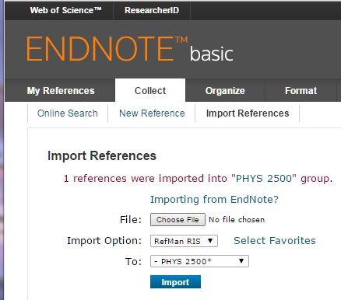
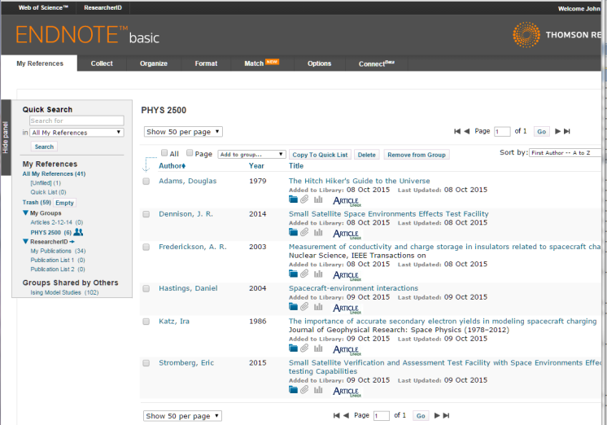
Importing Search Results from Google Scholar into EndNote Basic
https://www.myendnoteweb.com/EndNoteWeb.html
(5) Follow these steps to import search results into EndNote Basic:
Log into your EndNote Basic account
In EndNote Basic, click on Collect/Import Reference in the Import window
Select the .RIS or .ENW file you downloaded from your temporary by clicking on the Choose File button.
In the dropdown for Import Option, choose "RefMan (RIS)“ or “EndNote Import”.
Select the EndNote Basic reference folder to import To
Click the Import button and your references will be imported into the specified EndNote Basic folder.
Repeat this process for each new file.
Aside: You may have to add “EndNote Import” as an option using the Select Favorites button.
Import from RefMan or EndNote files

Slide 25
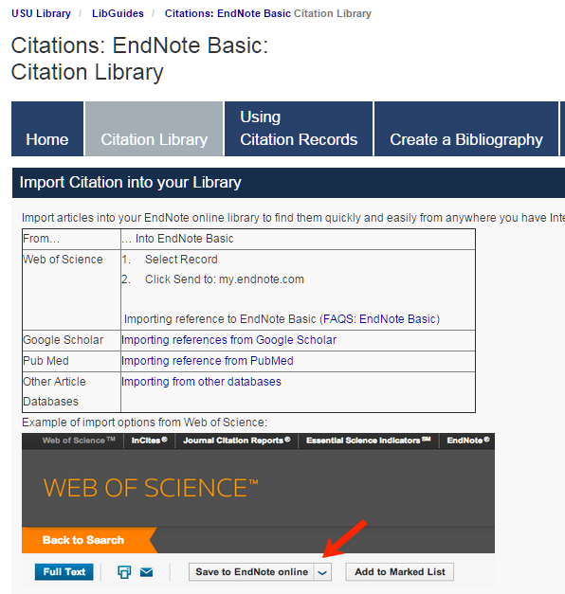
Importing Search Results into EndNote Basic
(5) Steps to import search results from alternate sources into EndNote Basic:
http://libguides.usu.edu/c.php?g=52841&p=339445
https://www.myendnoteweb.com/EndNoteWeb.html

Slide 26
Intermediate Lab
PHYS 3870
An Exercise in Reference Management and Use
Use Google Scholar to find:
A physics related article by an author with your last name
An article in American Journal of Physics related to this topic
An article from within the last 2 years related to this topic
An article from before you were born related to this topic
(see extensions to this exercise using EndNote Basic below)

