Slide 1
Intermediate Lab PHYS 3870
CONVEYIMG INFORMATION
Gathering Information
An Exercise in DataThief, Plotting and Curve Fitting
References:
PHYS 3870 Web Site
USU Library Class Web Site
DataThief Manual
DataThief Web Site

Slide 2
Introduction to Scientific Computing PHYS 2500
An Exercise In Data Analysis
Use DataThief to “steal” data from the graph in DennisonInFreefall.jpg and save the data in the file YOURNAMEInFreefall.txt:
In your favorite plotting and curve fitting program:
Import the data from DennisonInFreefall.jpg stored in YOURNAMEInFreefall.txt
Import the data from FreefallLab.txt
Create a single graph of position vs time with:
Data points and error bars from FreefallLab.txt
Data points (the slacker has no error estimates here!) from DennisonInFreefall.jpg
A mathematical model for free fall plotted as a line
List your best estimates for values and errors for you model fitting parameters
BONUS:
Lineraize your model, that is plot the dependant variable versus some function (e.g., square, square root) of the dependant variable such that the plot yields a straight line
Plot both data sets (with appropriate errors) and your linear model on a linearized graph
Do an automated fit with your linear model to the FreefallLab data. List your best estimates of the slope and intercept (with errors) and from these the best estimates (with errors) for you original model fitting parameters.

Slide 3
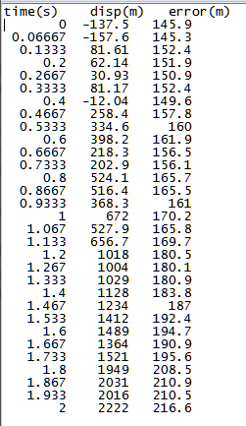
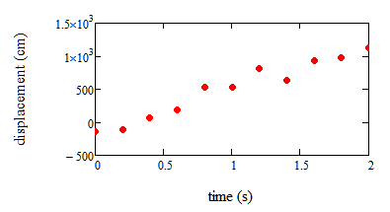
Data for An Exercise In Data Analysis
Freefall.txt
DennisonInFreefall.jpg

Slide 4
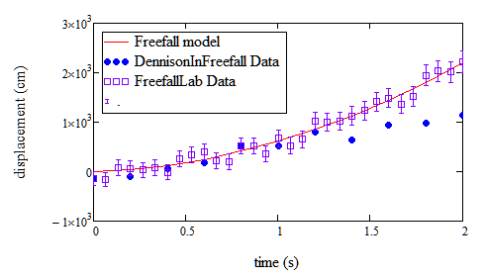
Results for An Exercise In Data Analysis
Model is y(t)=(1/2)at² + v_{o}t + y_{o}

Slide 5
Intermediate Lab PHYS 3870
CONVEYIMG INFORMATION
Analyzing and Plotting Data with Mathcad
References:
PHYS 3870 Web Site
USU Library Class Web Site

Slide 6
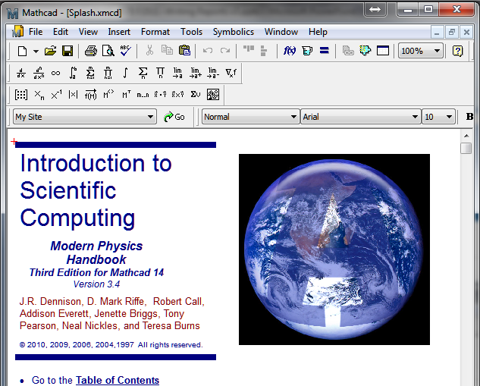
PHYS 2500 Introduction to Scientific Computing
Mathcad Tutorials

Slide 7
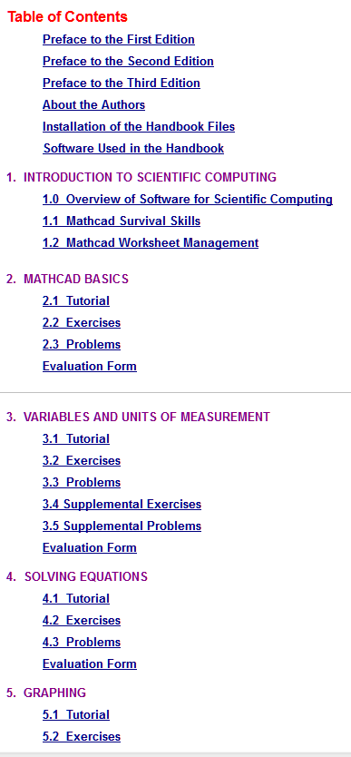
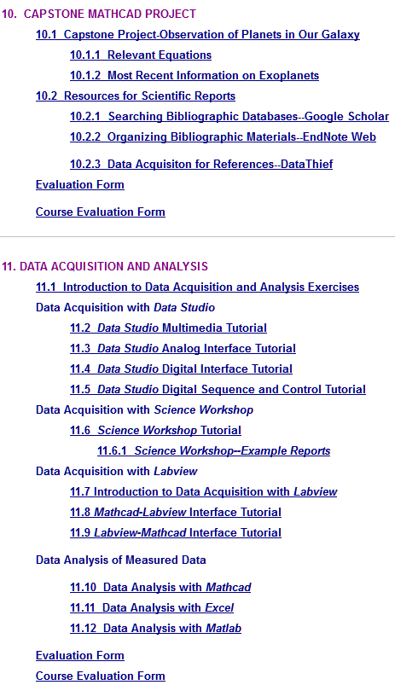
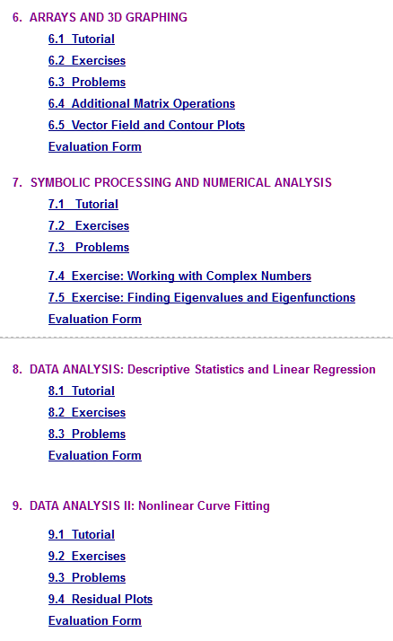
PHYS 2500 Introduction to Scientific Computing
Mathcad Tutorials

Slide 8
Intermediate Lab PHYS 3870
CONVEYIMG INFORMATION
Analyzing and Plotting Data with Excel
References:
PHYS 3870 Web Site
USU Library Class Web Site

Slide 9
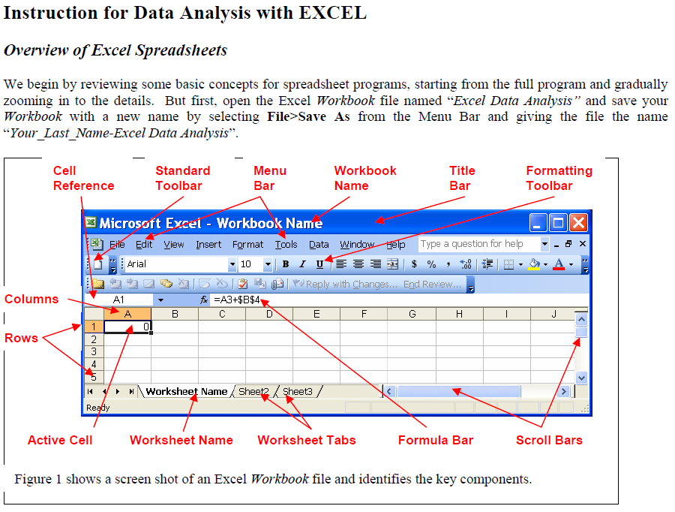
Instructions for an Excel Tutorial Exercise
Follow the detailed (if boring) instructions to create an Excel worksheet to analyze and plot a sample data set and prepare a simple report.

Slide 10
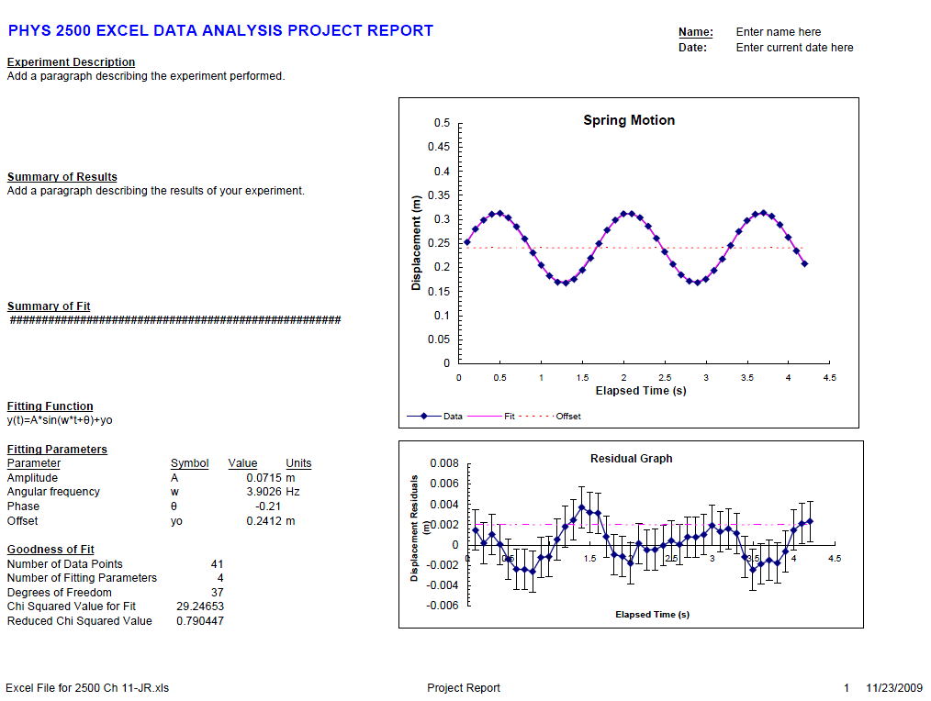
Report from an Excel Tutorial Exercise
Follow the detailed (if boring) instructions to create an Excel worksheet to analyze and plot a sample data set and prepare a simple report.

Slide 11
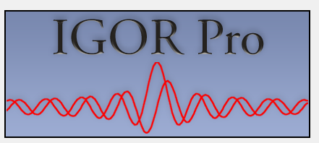
Intermediate Lab PHYS 3870
CONVEYIMG INFORMATION
Analyzing and Plotting Data with IGOR Pro
References:
PHYS 3870 Web Site
USU Library Class Web Site
IGOR Pro https://www.wavemetrics.com

Slide 12
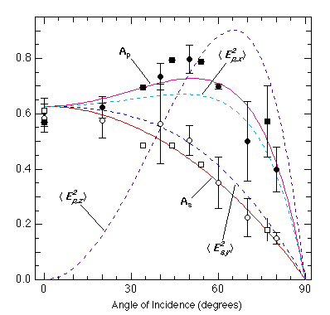
IGOR Pro Overview
IGOR Pro 6 is an extraordinarily powerful and extensible scientific graphing, data analysis, image processing and programming software tool for scientists and engineers. It combines both a graphical interface for quick plotting and a command line interface that can be easily used to create script macros for repeated analysis of similar data. The outputs are extremely versatile and of the highest publication quality.
Refer to https://www.wavemetrics.com/products/igorpro/Igor6Brochure.pdf for a summary of the capabilities of IGORPro.
Additional information is available at https://www.wavemetrics.com/ .

Slide 13
Program Installation
The USU Physics Department has a department Coursework License site IGOR Pro 6.3
The special coursework license is intended to facilitate the use of Igor as a teaching tool and to introduce students to Igor under the following conditions:
The software may be used only by students and only for assigned coursework. It may not be used for research.
All technical support must go through a single individual who is usually the instructor/ registered licensee.
The license covers both Macintosh and Windows operating systems.
Igor Pro can be installed on multiple computers. All that is required is that you make a good-faith effort to ensure that the license is used for coursework only. The terms of the license require that if they want to use Igor for research, they can purchase a student or academic license.
WaveMetrics offers an inexpensive student personal purchase copy of IGOR Pro which students can purchase with their own personal funds for their own personal work when their use of IGOR extends beyond assigned coursework.
To install the software, please visit the Wavemetrics web page to download the latest version of IGOR Pro 6.3 at https://www.wavemetrics.com/order/order_igordownloads.htm
The activation information for our IGOR Pro license is available from the USU Physics Department.

Slide 14
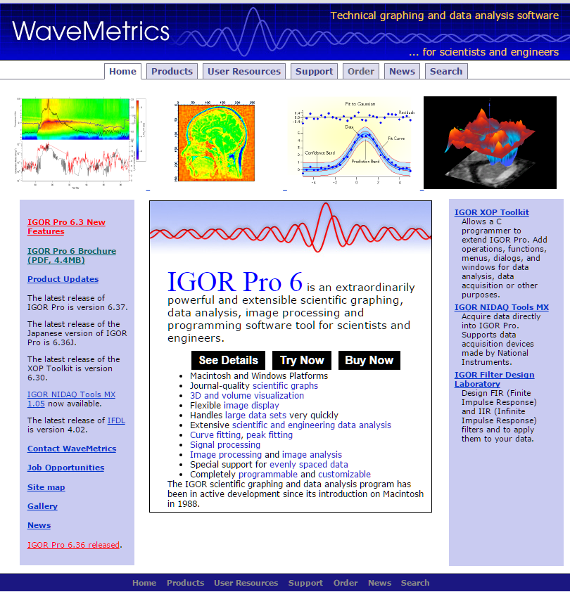
IGOR Pro Web Site
Additional information is available at the Wavemetrics web site https://www.wavemetrics.com/ shown at right.
This is an excellent resource!

Slide 15
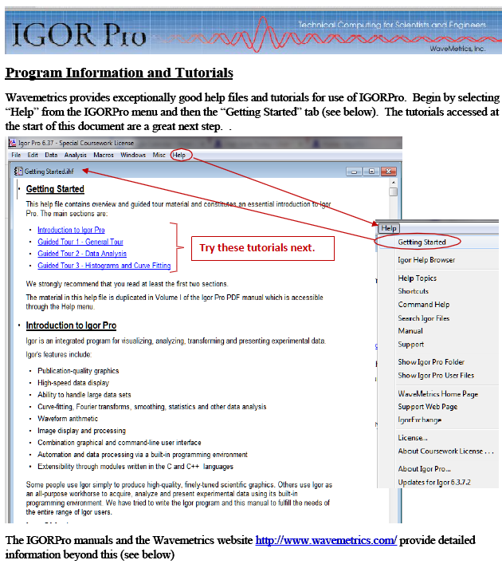
IGOR Pro Tutorials
IGOR Pro offers excellent tutorials accessed through the Help menu of the program under Getting Started.
For PHYS 2500 the recommended tutorials include:
Introduction to IGOR Pro
Guided Tour 1: General Tour (up to Offsetting a Trace)
Guided Tour 2: Data Analysis
The same material in the written tutorials is available in video (YouTube) format at the Wavemetrics web site https://www.wavemetrics.com/.
There is an extensive manual available in PDF format accessible from the IGOR Pro Help menu.
This same menu offers:
A Help Browser
Explanation of shortcut key strokes
Command help
Example files
Access to excellent User Group
Wavemetric support (they actually respond to your queries!)

Slide 16
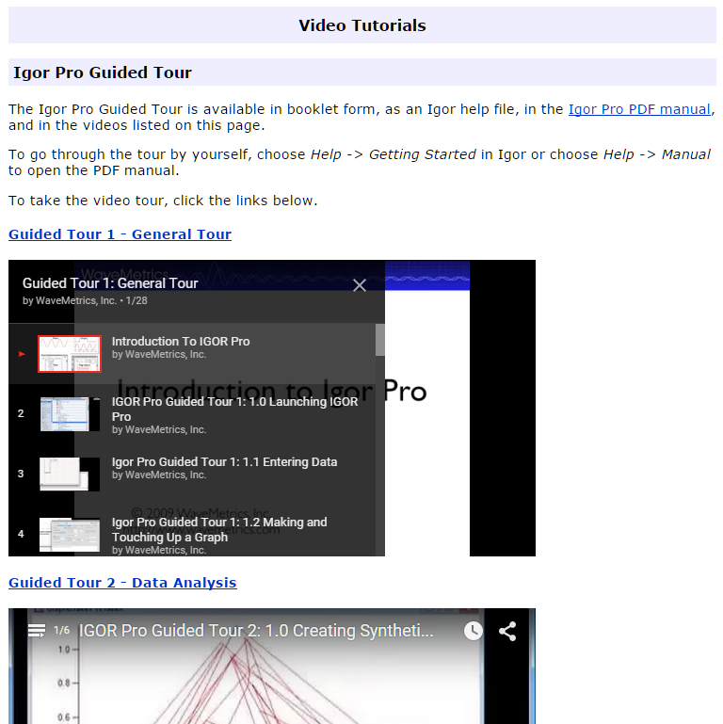
IGOR Pro Tutorials
IGOR Pro offers excellent tutorials accessed through the Wavemetrics web site at https://www.wavemetrics.com/.
For PHYS 2500 the recommended video (YouTube) tutorials include:
Introduction to IGOR Pro (Part of the General Tour) (~13 min)
Guided Tour 1: General Tour (Through Video 2.1 and Video 3.0 (~30 min)
Guided Tour 2: Data Analysis (~15 min)

Slide 17
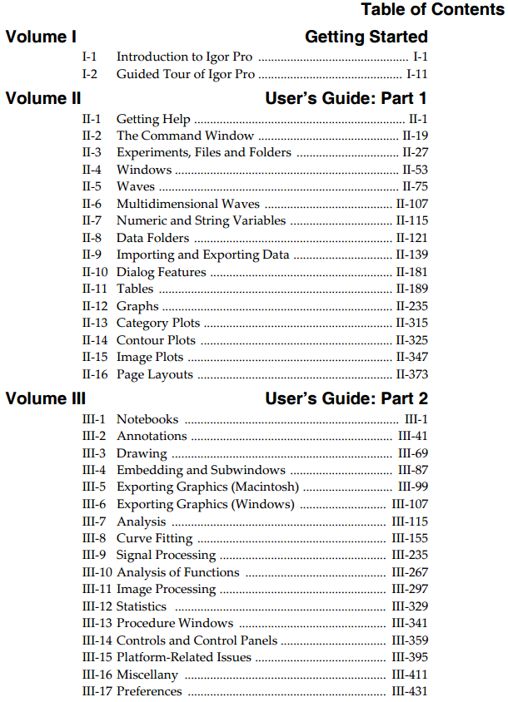
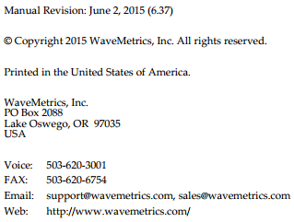
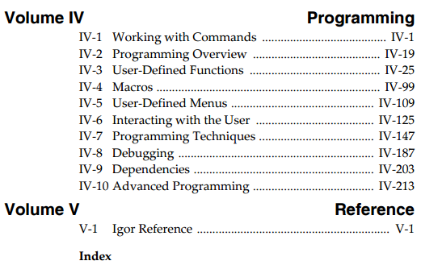
IGOR Pro Manual
http://www.wavemetrics.net/doc/igorman/IgorMan.pdf

Slide 18
See Igor6Brochure.pdf at https://www.wavemetrics.com/products/igorpro/Igor6Brochure.pdf

Slide 19
See Igor6Brochure.pdf at https://www.wavemetrics.com/products/igorpro/Igor6Brochure.pdf

Slide 20
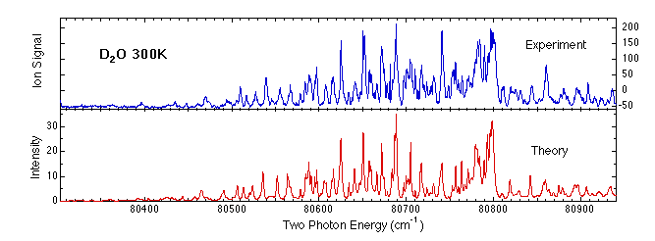
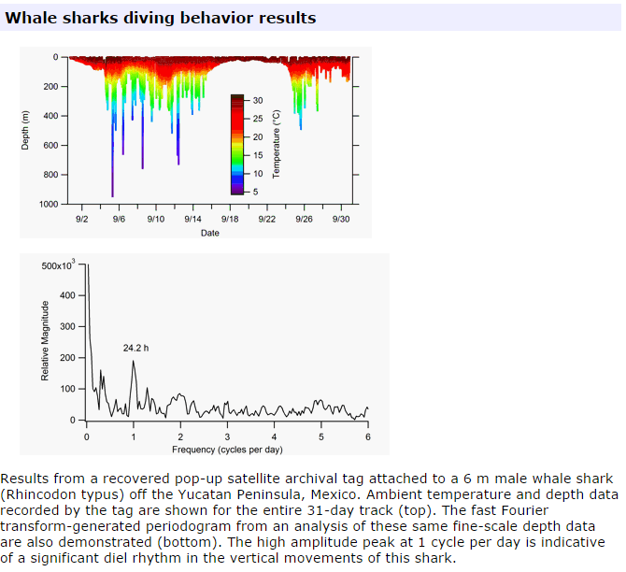
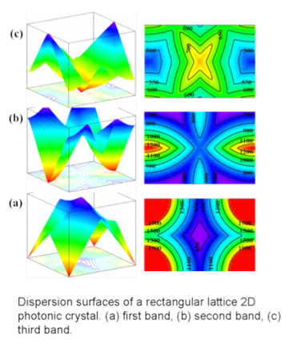
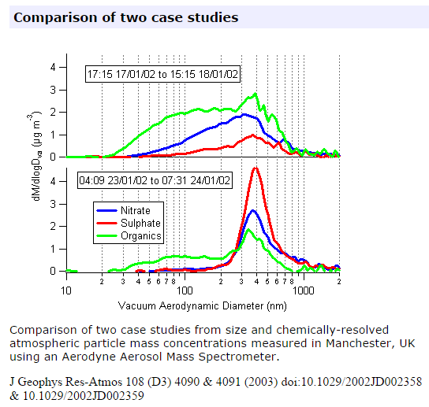
Example of Publication Quality Graphs with IGOR Pro
More examples at
https://www.wavemetrics.com/products/igorpro/gallery/user.htm

Slide 21
Introduction to Scientific Computing PHYS 3870
An Exercise in Analyzing and Plotting Data
with IGOR Pro
References:
PHYS 3870 Web Site
USU Library Class Web Site
IGOR Pro https://www.wavemetrics.com

Slide 22
Introduction to Scientific Computing PHYS 2500
An Exercise In Data Analysis
Using IGOR Pro
In the IGOR Pro plotting and curve fitting program:
Import the data derived from the DataThief exercise from DennisonInFreefall.jpg stored in YOURNAMEInFreefall.txt.
Import the data from FreefallLab.txt
Do an automated fit with a quadratic model to the FreefallLab data.
Create a single graph of position vs time with:
Data points and error bars from FreefallLab.txt
Data points from DennisonInFreefall.jpg
A mathematical model for free fall plotted as a line
List your best estimates for values and errors for you model fitting parameters
Create an IGOR Pro layout displaying the graph, data table and annotations exactly as shown on the next page. Print the layout page as a pdf file.
Save the IGOR Pro experiment.
Submit the IGOR Pro experiment file (LastnameFI_IGOR.pxp) and the layout page printout (LastnameFI_IGOR.ppt).

Slide 23
Data for An Exercise In Data Analysis
Using IGOR Pro
Freefall.txt
DennisonInFreefall.jpg

Slide 24
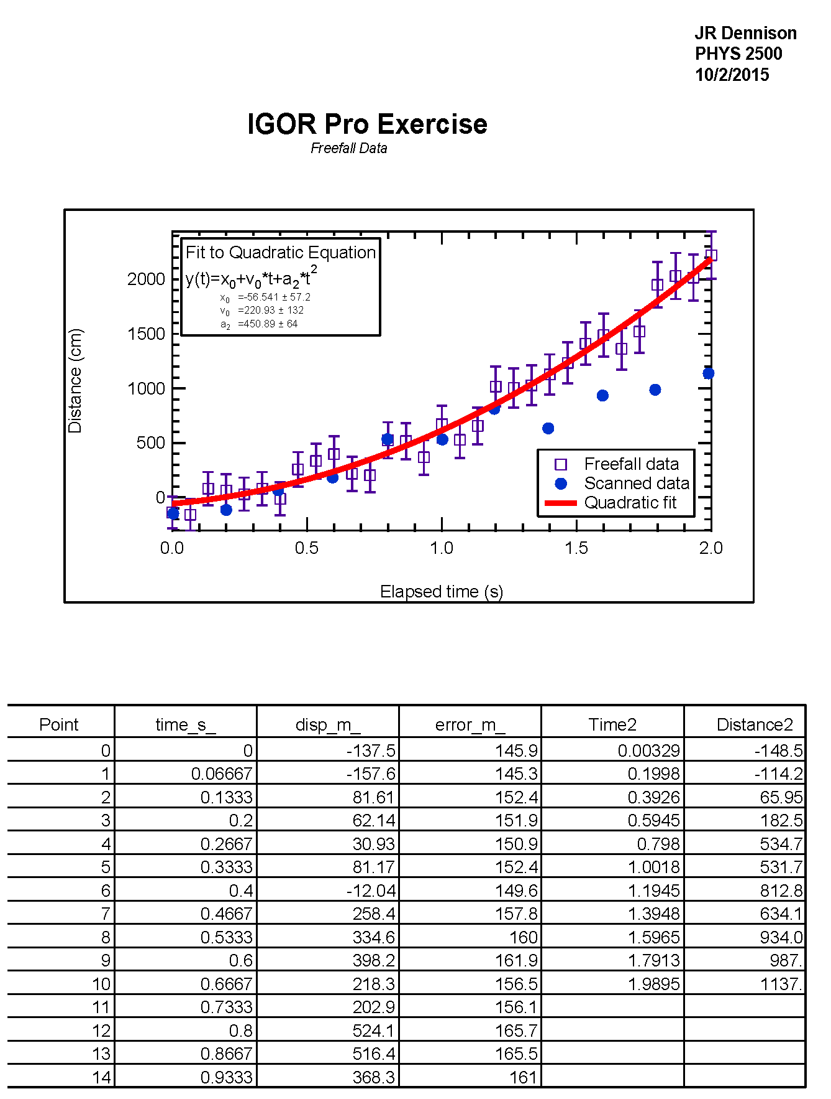
Results for An Exercise In Data Analysis
Using IGOR Pro
Model is y(t)=at² + v_{o}t + x_{o}

