Slide 1
Intermediate Lab PHYS 3870
CONVEYING INFORMATION
Gathering Information
References:
PHYS 3870 Web Site
USU Library Class Web Site

Slide 2
Introduction to EndNote and EndNote Basic
EndNote Desktop is a software program that program that stores and organizes citations, and enables you to import citations directly into a Word document. This extended version is expensive and note necessary.
Endnote Basic is a free version of this software accessible to USU students, with almost all of the functionality of the main program.
Create a Citation Library
Stores and organizes figures and equations
Can link papers to citations
Can search bibliographic databases
Log On
Tutorials
https://www.myendnoteweb.com/EndNoteWeb.html
http://libguides.usu.edu/EndNoteBasic
http://www.endnote.com/training/

Slide 3
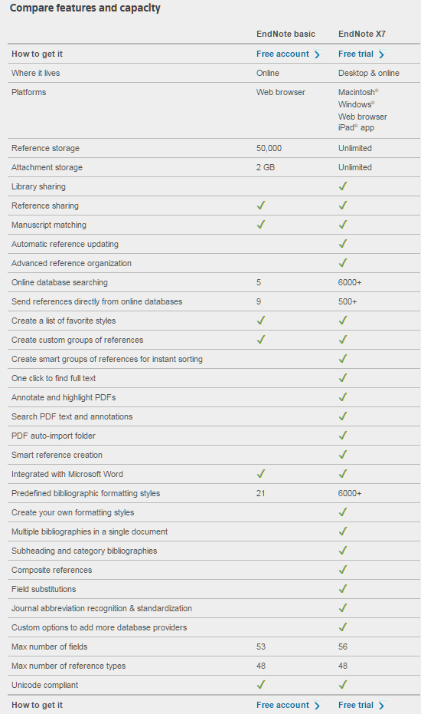
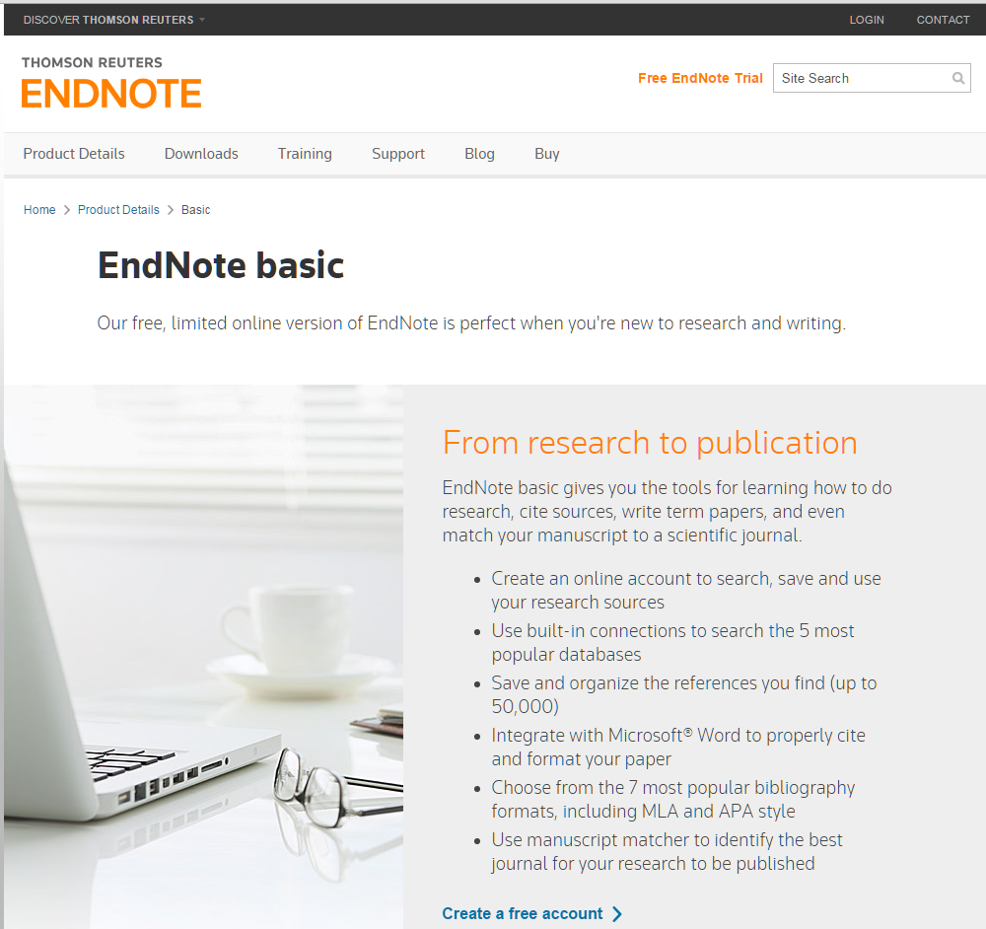
Comparing EndNote Desktop and EndNote Basic
http://endnote.com/product-details/basic

Slide 4
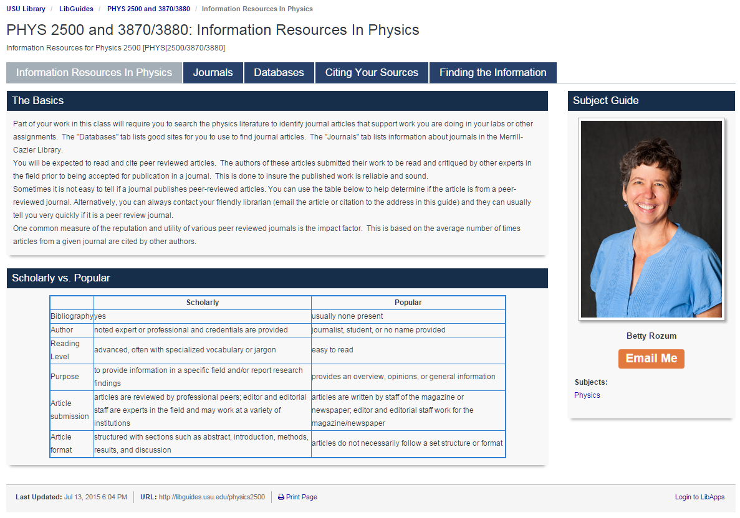
Access the USU Library Home Web Page
This page provides an up to date link to the USU library resources tailored to these classes!
http://libguides.usu.edu/content.php?pid=246165

Slide 5
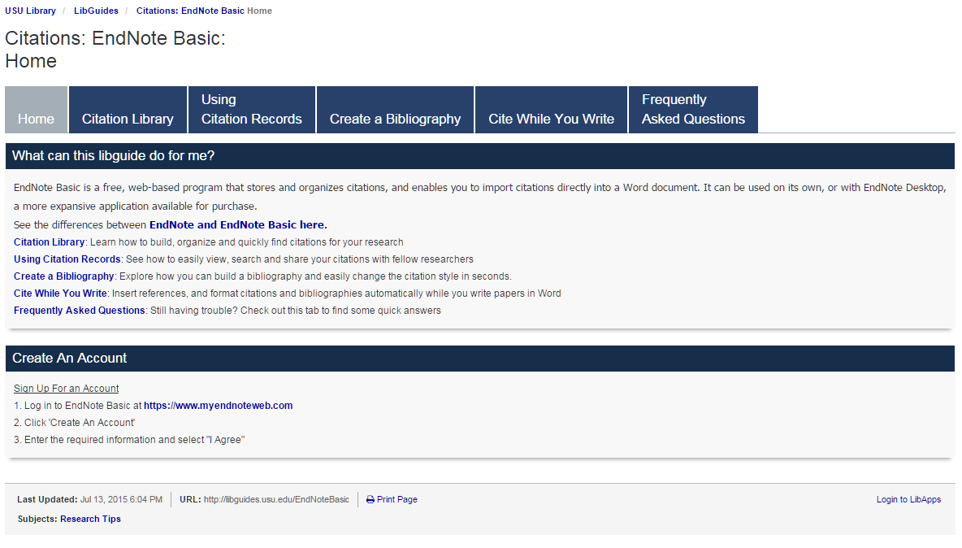
Using EndNote Basic at USU
This page provides an up to date link to the USU library resources for using EndNote Basic
http://libguides.usu.edu/EndNoteBasic

Slide 6
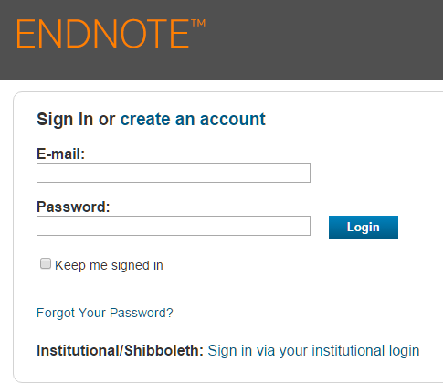
Creating an Account for EndNote Basic
(1) Begin on the USU EndNote Basic home page http://libguides.usu.edu/EndNoteBasic
(2) Create an EndNote account
Select “create and account”.
Enter your preferred email and a new password specifically for your EndNote Basic account.
https://www.myendnoteweb.com/EndNoteWeb.html

Slide 7
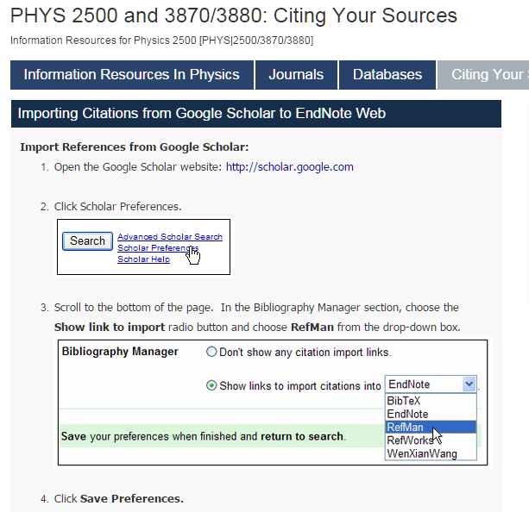
Setting Google Scholar to Work with EndNote Basic
(3) Set up Goggle Scholar to work with EndNote Basic.
Import to RefMan or EndNote
Video tutorial https://www.youtube.com/watch?v=35t9RB8G558

Slide 8
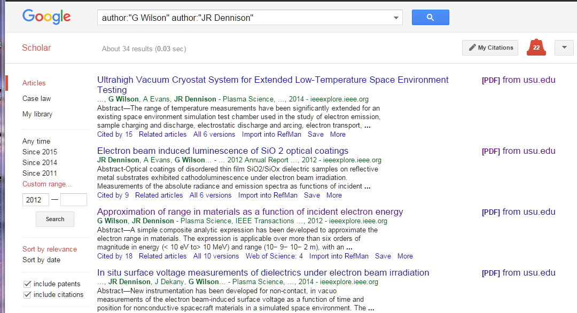
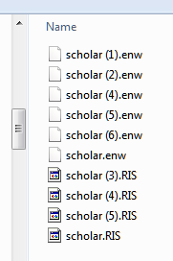
Importing Articles from Google Scholar into EndNote Basic
(4) Collect reference files for import into EndNote Basic
After performing a search on Google Scholar click on the "Import into RefMan“ or “Import to EndNote” link to import the reference you want.
This will download a RefMan file (file type .RIS) or EndNote file (file type .ENW). Collect these files in a temporary directory to upload into EndNote Basic.
Alternately, when you are presented with a window asking if you want to "Open" or "Save" the file, choose to Save the file.
Import to RefMan
or EndNote

Slide 9
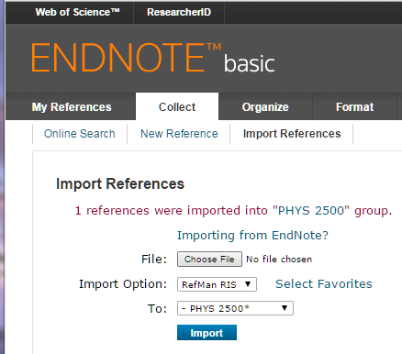
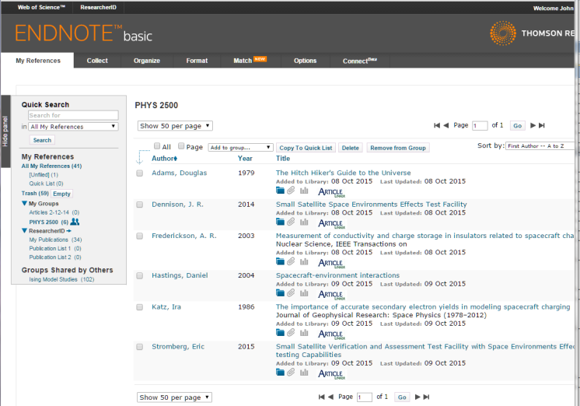
Importing Search Results from Google Scholar into EndNote Basic
https://www.myendnoteweb.com/EndNoteWeb.html
(5) Follow these steps to import search results into EndNote Basic:
Log into your EndNote Basic account
In EndNote Basic, click on Collect/Import Reference in the Import window
Select the .RIS or .ENW file you downloaded from your temporary by clicking on the Choose File button.
In the dropdown for Import Option, choose "RefMan (RIS)“ or “EndNote Import”.
Select the EndNote Basic reference folder to import To
Click the Import button and your references will be imported into the specified EndNote Basic folder.
Repeat this process for each new file.
Aside: You may have to add “EndNote Import” as an option using the Select Favorites button.
Import from RefMan or EndNote files

Slide 10
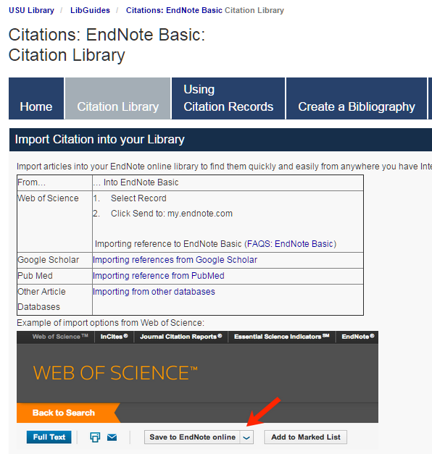
Importing Search Results into EndNote Basic
(5) Steps to import search results from alternate sources into EndNote Basic:
http://libguides.usu.edu/c.php?g=52841&p=339445
https://www.myendnoteweb.com/EndNoteWeb.html

Slide 11
Managing Your Citations within Your EndNote Basic Library
(6) The downloaded references are now available in the EndNote Basic library:
Log into your EndNote Basic account
Select My References and the subgroup from My Groups to view the references
https://www.myendnoteweb.com/EndNoteWeb.html

Slide 12
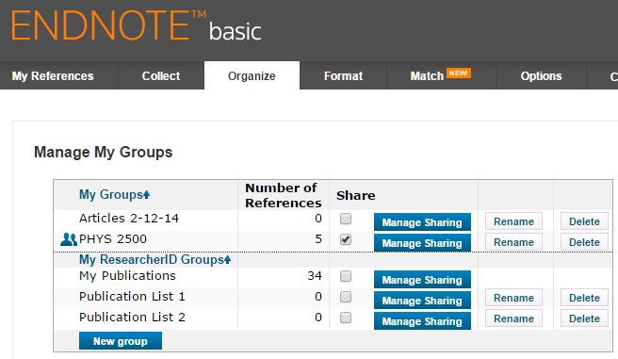
Managing Your Citations within Your EndNote Basic Library
(6) The downloaded references are now available in the EndNote Basic library:
Detailed instructions for organizing and managing your references are shown at right
The EndNote Basic Organize tab is shown below.
http://libguides.usu.edu/c.php?g=52841&p=339445
https://www.myendnoteweb.com/EndNoteWeb.html

Slide 13
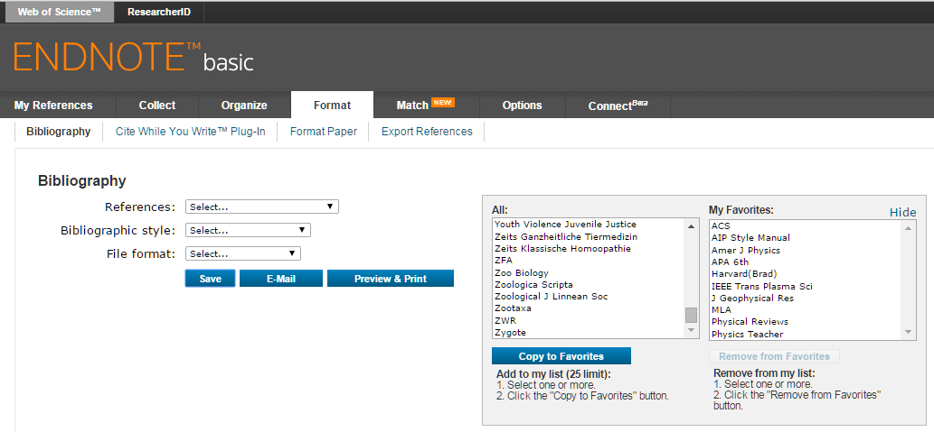
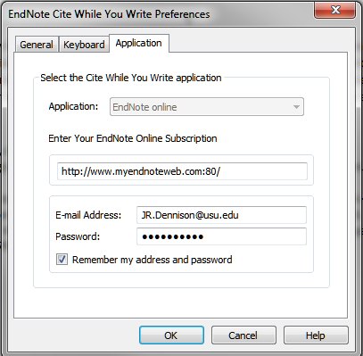
Setting Up Cite While You Write
Aside: The bibliographic styles selected here include:
American Chemical Society
American Institute of Physics (APS)
American Journal of Physics
IEEE Transactions on Plasma Science
Journal of Geophysical Research
Physical Review
Physics Teacher
(8) To use EndNote Basic in Word:
Select your choices on the EndNote Basic web site for Bibliographic Styles
Click on “Select Favorites” next to Bibliographic Styles
Highlight your choices and click Copy to Favorites
These choices will show up in Word in the Style pulldown list in the EndNote tab.
When you first open the EndNote tab in Word you will be prompted to enter the email address and password you associated with EndNote. You can save this in Word using the Preferences selection

Slide 14
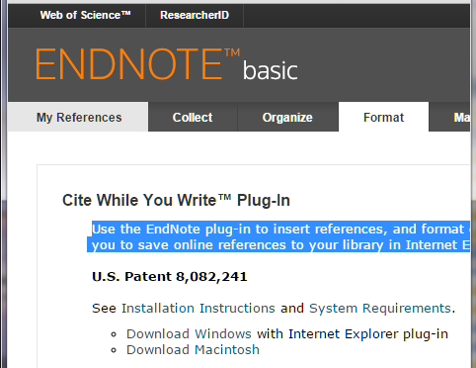
Cite While You Write Plug In for Word
(7) To use EndNote Basic in Word:
Download the appropriate plug in using the links in the Format tab
See the Installation Instructions for different operating systems below
Select your choices for Bibliographic Styles (see next slide)
Use the EndNote plug-in to insert references, and format citations and bibliographies automatically while you write your papers in Word. This plug-in also allows you to save online references to your library in Internet Explorer for Windows.
http://libguides.usu.edu/c.php?g=52841&p=339445
https://www.myendnoteweb.com/EndNoteWeb.html

Slide 15
Cite While You Write in Word
(8) Use the EndNote Basic Cite While You Write plug-in to insert references, and format citations and bibliographies automatically while you write papers in Word.
Inserting cited references in your Word document
With your Word document open, place the cursor in the location where you would like the citation to appear
Select EndNote Web at the top of the screen (some Word processors will place it under the Tools menu)
Click Find Citations (this tool searches your entire EndNote Basic library)
Enter a search term in the Find Citations box to find the citation record to insert.
Click Search or Find
Select the desired reference. More than one record can be selected at any given time - simply hold the Ctrl key while clicking each reference.
Click Insert

Slide 16
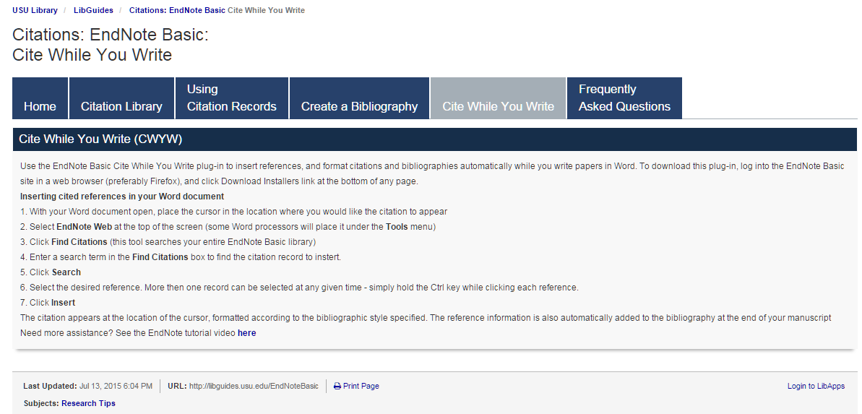
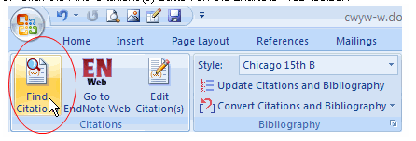
Cite While You Write
http://libguides.usu.edu/c.php?g=52841&p=339449

Slide 17
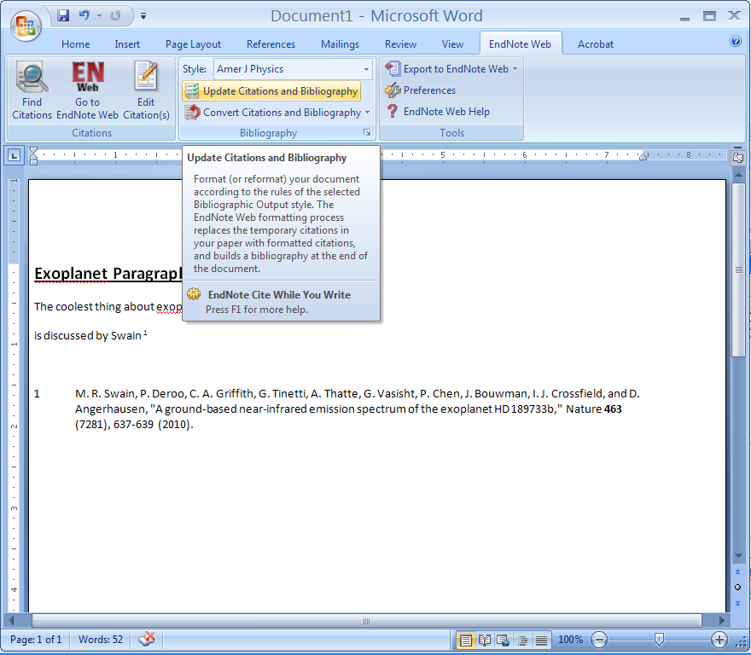
Formating the Bibliography with EndNote Basic
(9) Use the EndNote Basic Cite While You Write plug-in to format citations and bibliographies in Word.
Inserting cited references in your Word document
Select EndNote at the top of the screen (some Word processors will place it under the Tools menu)
Select the style for citations and the bibliography from the pull down menu.
Click on Update Citations and Bibliography.
http://www.endnote.com/training/tutorials/enweb2/English/EndNote_Web-English/EndNote_Web.asp

Slide 18
Intermediate Lab PHYS 3870
An Exercise in Reference Management and Use
Use Google Scholar to find:
A physics related article by an author with your last name
An article in American Journal of Physics related to this topic
An article from within the last 2 years related to this topic
An article from before you were born related to this topic
Use Google Scholar and EndNote to:
Use Google Scholar to save citations to these 4 articles in EndNote Basic format
Write a sort paragraph about the physics topic in Word.
Use EndNote Basic Cite-While-You-Write to provide citations for your paragraph.
Use EndNote Basic to create a bibliography for your paragraph using the AIP Style.
Save your Word file as a PDF file, with a filename LastnameFirstInitial_Endnote.pdf (e.g., DennisonJ_EndNote.pdf).

Slide 19
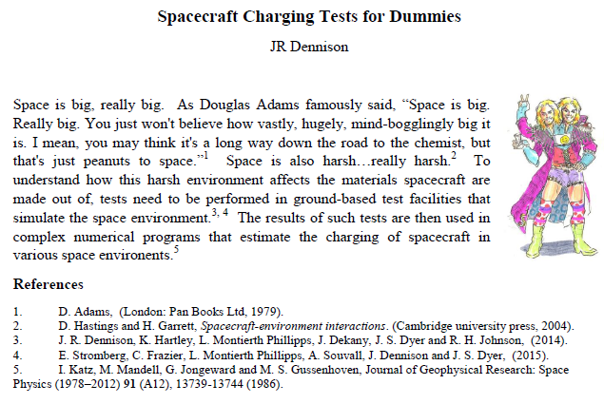
Intermediate Lab PHYS 3870
An Example of an Exercise in Reference Management and Use

