Slide 1
Intermediate Lab PHYS 3870
CONVEYIMG INFORMATION
Gathering Information
An Exercise in DataThief, Plotting and Curve Fitting
References:
PHYS 3870 Web Site
USU Library Class Web Site
DataThief Manual
DataThief Web Site

Slide 2
Introduction to Scientific Computing PHYS 38700
An Exercise In Data Analysis
Use DataThief to “steal” data from the graph in DennisonInFreefall.jpg and save the data in the file YOURNAMEInFreefall.txt:
In your favorite plotting and curve fitting program:
Import the data from DennisonInFreefall.jpg stored in YOURNAMEInFreefall.txt
Import the data from FreefallLab.txt
Create a single graph of position vs time with:
Data points and error bars from FreefallLab.txt
Data points (the slacker has no error estimates here!) from DennisonInFreefall.jpg
A mathematical model for free fall plotted as a line
List your best estimates for values and errors for you model fitting parameters
BONUS:
Lineraize your model, that is plot the dependant variable versus some function (e.g., square, square root) of the dependant variable such that the plot yields a straight line
Plot both data sets (with appropriate errors) and your linear model on a linearized graph
Do an automated fit with your linear model to the FreefallLab data. List your best estimates of the slope and intercept (with errors) and from these the best estimates (with errors) for you original model fitting parameters.

Slide 3
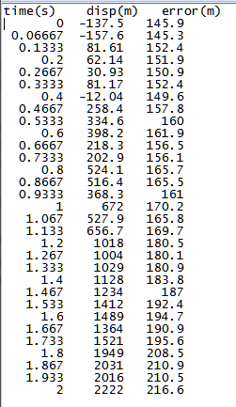
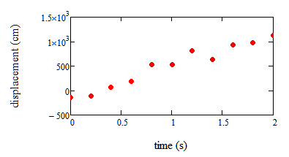
Data for An Exercise In Data Analysis
Freefall.txt
DennisonInFreefall.jpg

Slide 4
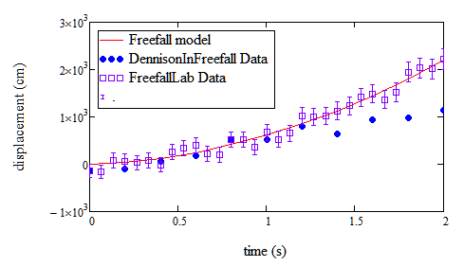
Results for An Exercise In Data Analysis
Model is y(t)=(1/2)at² + v_{o}t + y_{o}

