Slide 1
Intermediate Lab PHYS 3870
CONVEYIMG INFORMATION
Gathering Information
Installing and Using DataThief
References:
PHYS 3870 Web Site
USU Library Class Web Site
DataThief Manual
DataThief Web Site

Slide 2
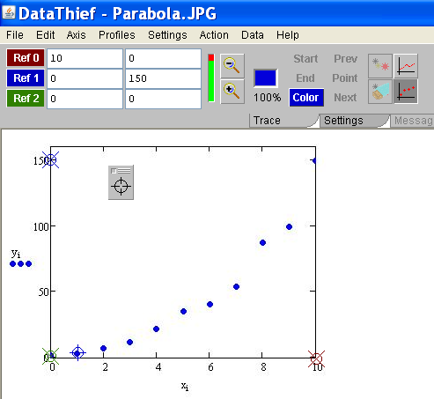
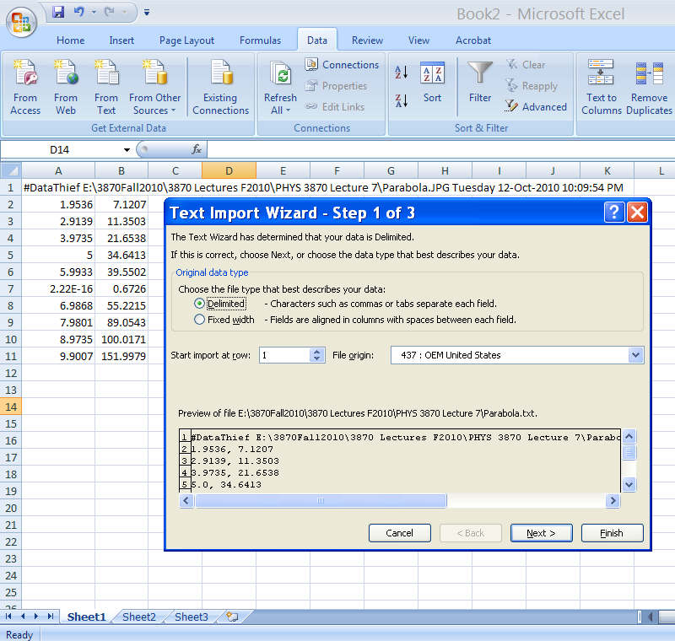
DataThief
DataThief III is program to digitize data in various forms for subsequent plotting and analysis. It is often used to “borrow” data from scanned graphs in articles. DataThief is a “free” shareware program and is very easy to use.
The presentation includes:
Instructions on how to download and install the program and where to get supporting documentation.
A detailed set of instruction on how to use the program to digitize data from a picture of a graph.
A simple example of acquiring digitized data from a photograph .
A simple exercise in use of DataThief is described in the file
PHYS 2500 Sec5-Graphing DataThief Exercise.ppt.

Slide 3
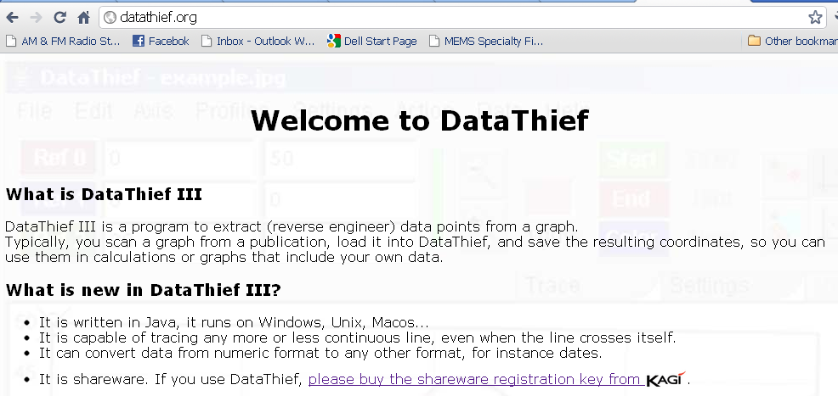
Acquiring DataThief III
DataThief III is already installed and running on the PHYS 2500 CITRIX page.
To acquire and install your own copy of the shareware program DataThief III and its accompanying documentation, simply follow the numbered steps listed here.
(1) Go to Datathief.com
(2) Review the program
Description
(3) (Download Java as well, if you need it.)
Download the executable program file Datathief.jar by
Clicking here
(4) Download the manual
(5) Review some examples, if you like.

Slide 4
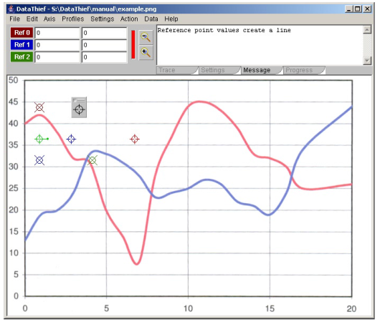
Orientation to DataThief III
DataThief III is written in Java. This means, that apart from the "executable" called Datathief.jar, you will have to have the Java Virtual Machine. The Java Virtual Machine can be downloaded from www.java.com. Follow the instructions that are appropriate for your machine.
Once the virtual machine is installed, you may start DataThief.
On Windows, double click the Datathief.jar icon.
On Macintoshes with MacOS 8 or MacOS 9, double click the Datathief application icon.
On Macintoshes with MacOS X and on Linux or Unix either double click the Datathief icon, or go to the directory where you installed DataThief and type Datathief.
Once you have a running DataThief, select "Open..." from the File menu, and select the file you want to take data from. In this example, we used "example.png“. Key features of DataThief are shown below.
3 point indicators used to find the corresponding coordinate indicator
tool bar
menu bar
Start location indicator (green with a + through its center)
"Dump", used to define data points
Color location indicator (blue with a + through its center)
3 coordinate indicators have an X through there center
White area with the image in it is the image area
Stop location indicator (red with a + through its center)

Slide 5
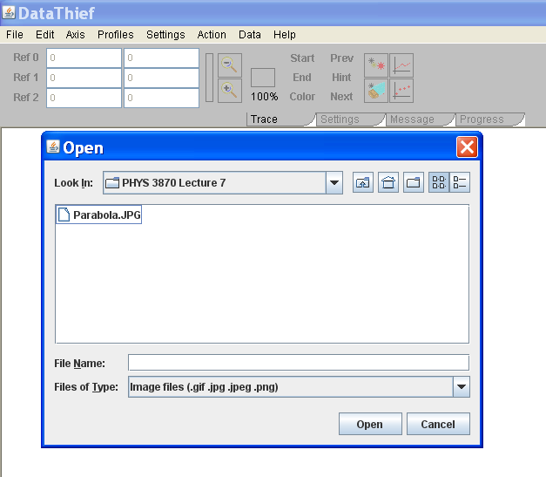
DataThief in Action
To use DataThiefIII to digitize data from a graph:
(1) Open DatathiefIII.
(2) Select an image file using Open from the File menu. Allowed file types include gif, jpg, and png.
(3) Select whether to digitize a point graph or line graph
(4) Define the graph axes by tagging 3 axis coordinate indicators by dragging and dropping the 3 circled X icons onto the axes points and entering the corresponding numerical values.
Note: If the 3 axes points are not visible on the graph, select Reset from the Actions menu. Click a colored button (e.g., Ref 0) to flash the corresponding axis point
Note: For pictures you can use this to put the digitized values in the correct units if you know the values of these three points.
Note: This can correct for skewed axes by selecting non-orthogonal axes.

Slide 6
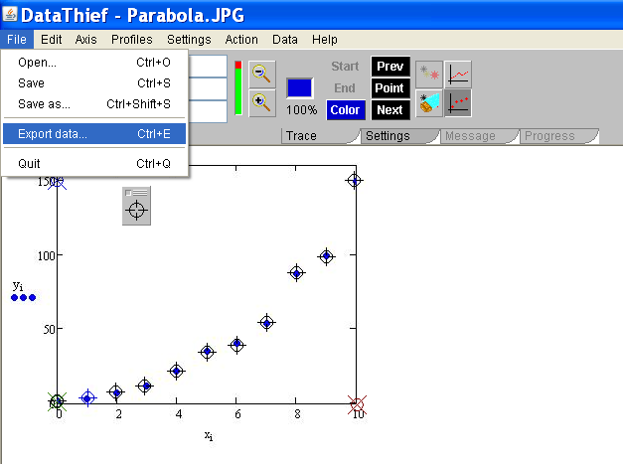
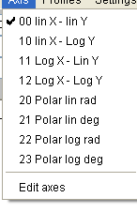
Setting DataThief
Simply follow the remaining numbered steps listed here.
(7) Export
The data to a file using the File menu
(5) Select axes
type using the Axis menu
(6) To “borrow” discrete data points, select the Point mode icon and then tag each data point by dragging crosshairs from the “Dump” on top of the point
(5 Alternate) To “borrow” data from traces (lines):
Select the Trace mode icon,
Tag the beginning and end of the trace to “steal” with the green and red icons, respectively
Set the color of the line by dropping the blue icon on a well isolated portion of the trace
Use the three point indicators “Start”, “End” and “Color” to locate the icons to drag.
The density of data points digitized can be adjusted using the “Output Distance” selection from the Settings tab.

Slide 7
Reading DataThief Txt Files
(8) Read into an Excel file as comma delimited text using the Excel Text Import Wizard called up from the “From Text” icon on the Data ribbon in Excel.

