Slide 1
Intermediate Lab PHYS 3870
Section 0
Getting Started

Slide 2
Intermediate Lab PHYS 3870
Section 0
Getting Started
Box

Slide 3
Hints for Using Box at USU
You need to have and Aggiemail account to get a Box account. See https://usu.service-now.com/services/kb_view.do?sysparm_article=KB0010201 . You don't have to use it, just have one. This may preclude USU students from using Box.
You need to create a Box account. You can simply log in to Box with the BOX.USU.EDU browser link; this asks for your A# and password. See the PowerPoint pages below for links and instructions. You do not have to be on campus or running VPN off campus to access Box, or Citrix or to create a Box account.
Once you have a Box account, you need to move a copy of the courseware files for PHYS 2500 into your Box. See the notes in the PowerPoint slide above. Before you try to try establishing links to Box via Citrix, I suggest you call up BOX.USU.EDU and verify that the courseware files have been copied in to your Box account. Specifically, in the root directory look for the file Content.xmcd.
Establish a link between Box and Citrix. I have been working with IT to figure out access to Box once in Citrix. This seems intermittent at best. They are still working on it. I have a theory though. I think you need to in order do the following the first time you access Box via Citrix.
1. Log in to Box with BOX.USU.EDU to establish a connection to Box. (You may have to do this manually each time if you are off campus; I am not sure about this.)
2. Establish the Box link to Citrix by running Kumo.USU.EDU. (You should have to only do this once, though it has been rumored that sometimes Citrix gets confused and you will need to Deactivate and then Reactivate the Box link with Kumo). Kumo is a service that allows you to open and save files directly to Box or Google drive without having to install the client. See slide below.
3. Connect to Citrix with APPS.USU.EDU. I think Box should now show up when you click on the open file icon in either Office or Mathcad and select the computer icon.
Once you have established a Box account, run Kumo once, and installed Citrix once (may have to install Citrix and Kumo once for each browser on each computer) you should only have to run APPS.USU.EDU to access things. (If a window pops up and asks about installing or executing things, select the "Log On" option or just closing the window. If you must enter a domain, try "Aggies".) (Also see the notes in IV.1 and IV.2 about running BOX.USU.EDU and KUMO.USU.EDU as needed.)

Slide 4
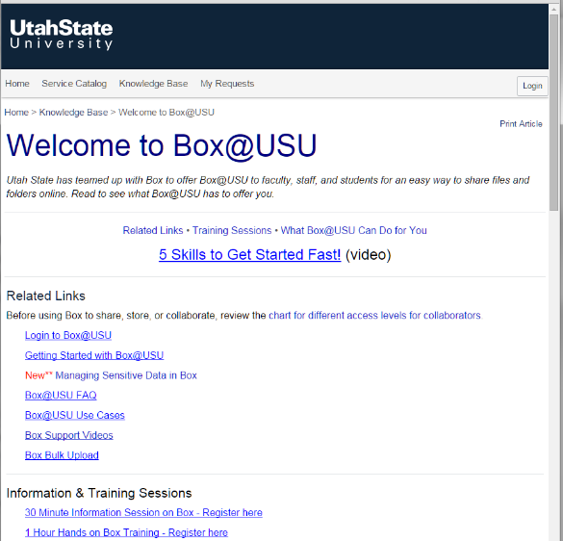
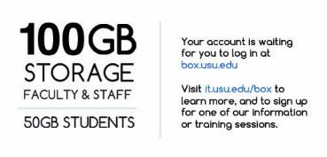
File Storage for PHYS 3870
File storage for PHYS 2500 is handled with Box. All USU students can have 50 GB of online storage. Individual copies of the class curriculum materials are downloaded to Box.
Instructions for using Box at USU are found at the web site shown below.

Slide 5
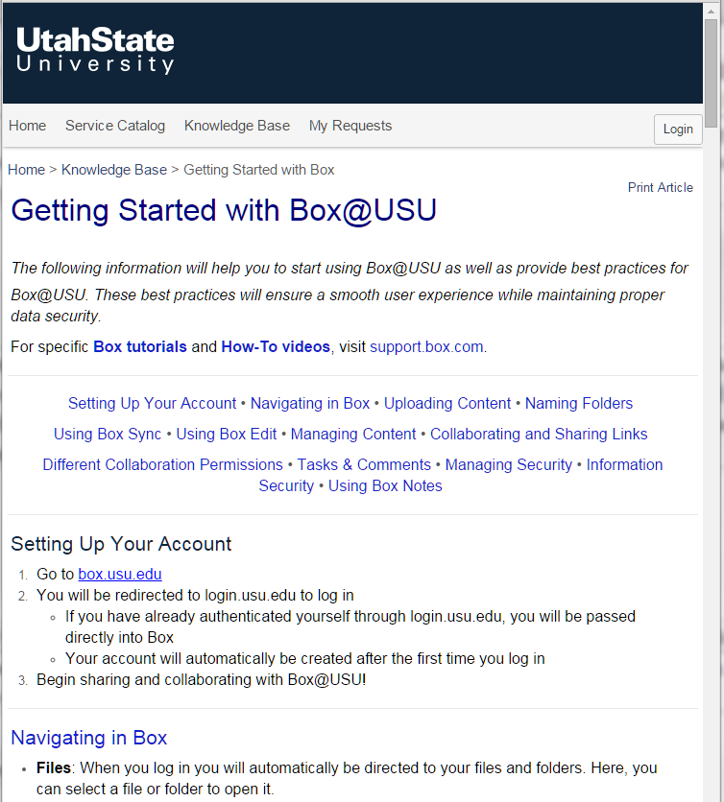
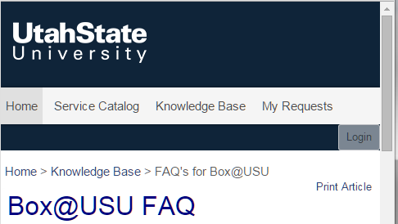
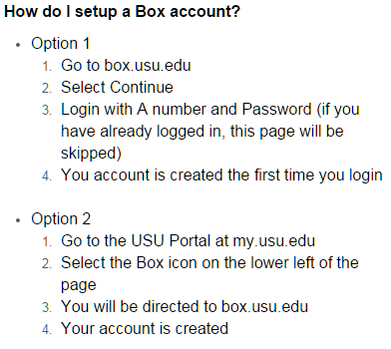
Details of how to start with Box at USU and install and access Box are shown below.
Link to Box@USU FAQ

Slide 6
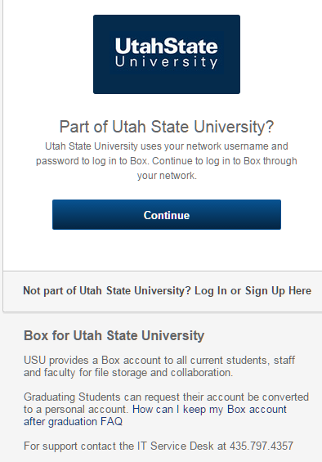
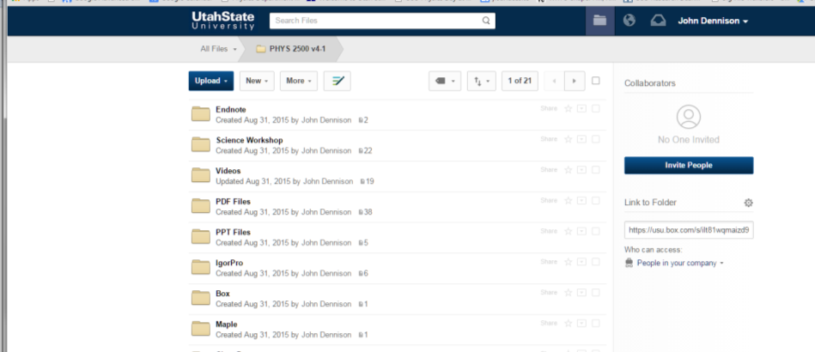
Accessing Box for PHYS 3870
Once Box@USU is set up, you access it through your browser with https://usu.app.box.com/login or box.usu.edu
Box login
Typical file structure of Box@USU in a browser
Simply “drag and drop” this folder to your storage drive. Be sure to get all the folders and files; there are a bunch of them!

Slide 7
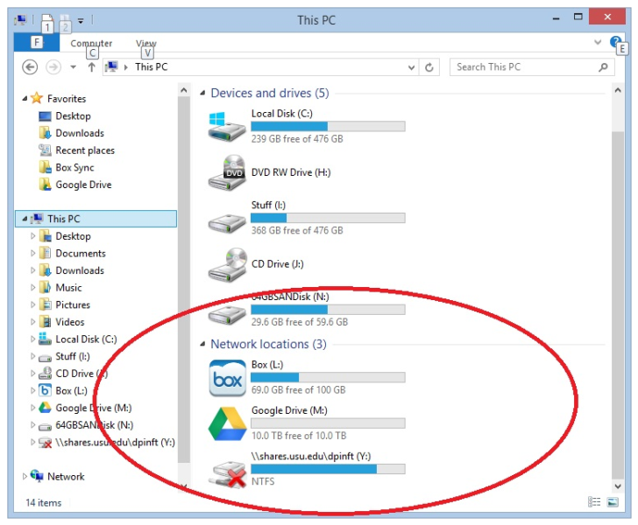
Using Kumo to Access Box in Citrix
Kumo is a service that allows you to open and save files directly to Box or Google drive without having to install the client.
Once set up with Kumo all applications in Citrix and it labs can save straight to your Box or Google drive. It will appear in your drive list under network locations like the picture below.
Kumo is only available on Windows machines. If you are using apps.usu.edu using a mac you will still see your box or google drive in the apps.
Instructions to set up Kumo are shown on the next page.

Slide 8
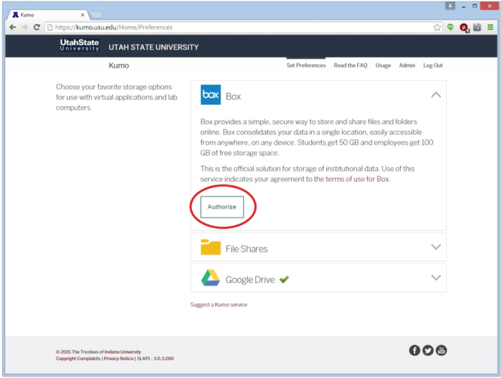
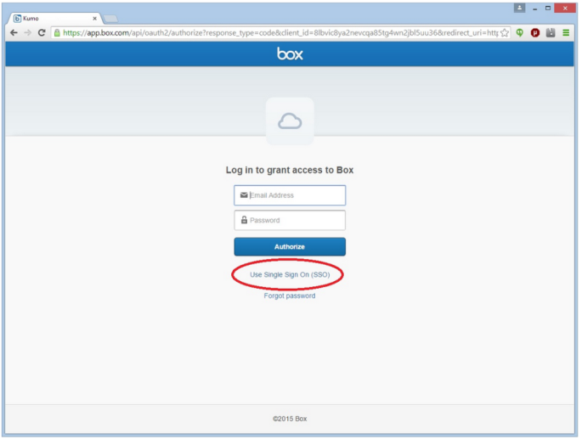
Using Kumo to Access Box in Citrix
How to configure Kumo
Step 1: Navigate to kumo.usu.edu in your web browser.
Step 2: Click “Log in”.
Step 3: Enter your a# and password.
Step 4: Select box
Step 5: Click authorize
Step 6: Click “Use single sign on (SSO)”
Step 7: Enter your @aggiemail.usu.edu or @usu.edu address. (Whichever you use to access box.)
Step 8: Click “Grant access to Box”.
Step 9: If you want to authorize Google drive as well follow the same procedure.
Details for Installing Kumo

Slide 9
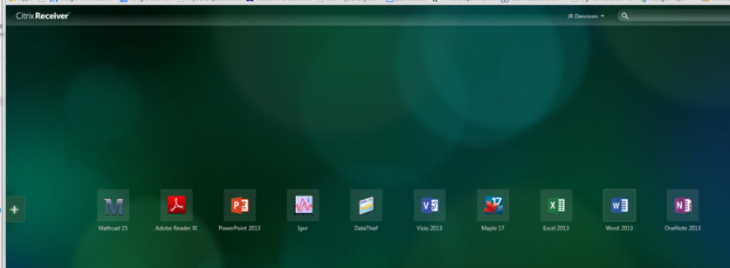
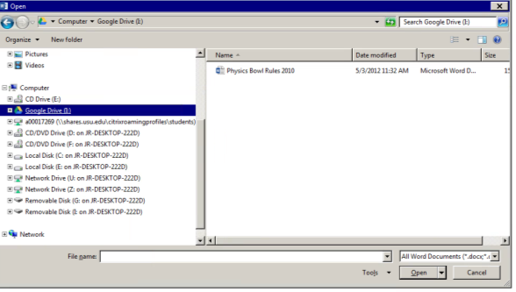
Using Kumo to Access Box in Citrix
Once Kumo is installed Box, Google Drive, or Drop Box will show up as an accessible drive when you click on any program launched by Citrix

Slide 10
Intermediate Lab PHYS 3870
Section 0
Getting Started
Citrix

Slide 11
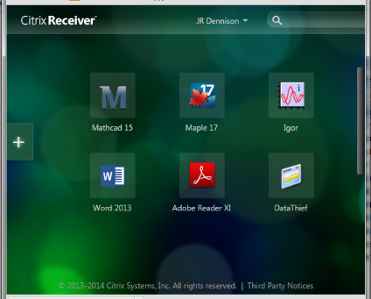
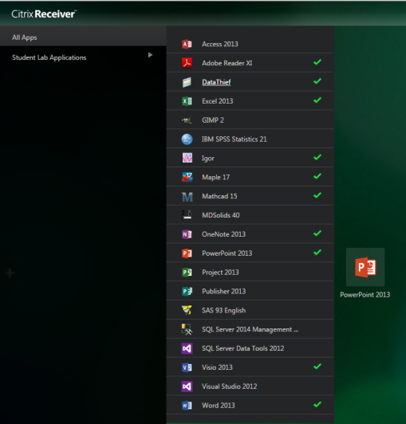
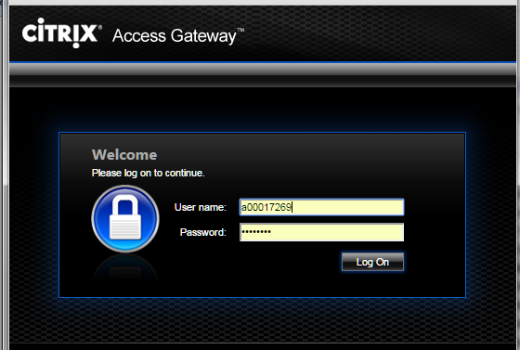
Citrix Usage in PHYS 38700
The Citrix Mobile Workspace provides a browser-based platform with all software applications used in PHYS 2500 loaded on a USU server. Once in this shell, you can launch the programs and run various files (e.g., Mathcad Worksheets, Excel Worksheets, etc.) provided in the courseware. Because the applications are run on a Windows-based server rather than your individual computer, the programs are essentially platform-independent, requiring only that the browser on you computer is compatible with Citrix.
Link to Help with Citrix at USU
Instructions for Opening, Saving, and Printing Files in Citrix Receiver
Instructions for installing and using Citrix at USU are on the next page.
Link To Open Citrix at USU
There is a unique home page on the Citrix server for each user. You can save your annotated copies of the files in a Box storage folder provided by USU; this Citirx home page and Box storage will be available to you throughout your matriculation at USU.

Slide 12
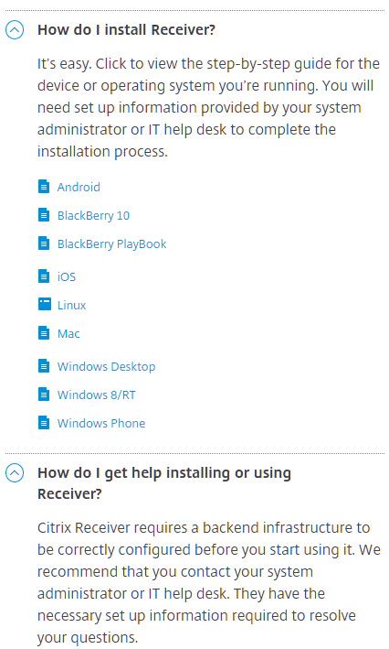
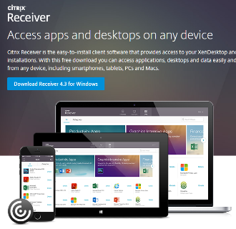
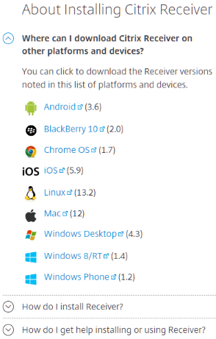
Installation of Citrix
Instructions to install Citrix Receiver

Slide 13
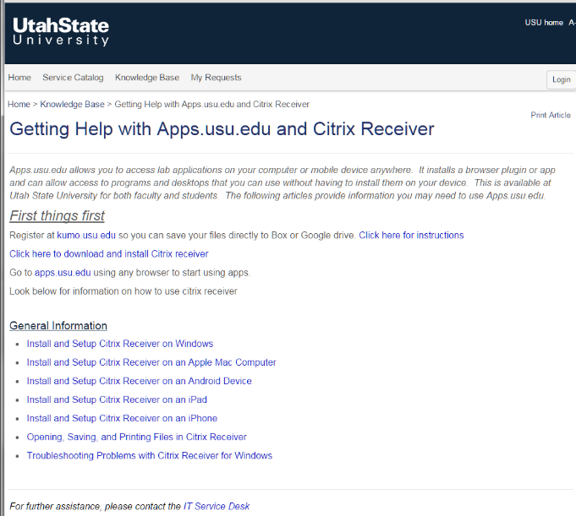
Installing Citrix for Use at USU
Detailed Instructions for installing and using Citrix at USU are available as shown at right.

Slide 14
Intermediate Lab PHYS 3870
Section 0
Getting Started
Mathcad

Slide 15
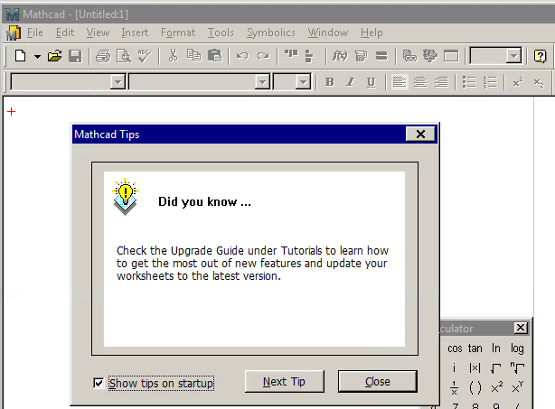
Launching Programs for PHYS 3870
To work on the class assignments you will need to have open on your home computer:
a browser window to access Box@USU and other online content
A Citrix Mobile Workspace window to launch needed programs.
Once the program is up, you can run various files (e.g., Mathcad worksheets, Excel worksheets) provided in the courseware and stored in your Box@USU storage.
Once in this Citrix browser shell, you can launch the programs (e.g., Mathcad, Excel, Maple) to support PHYS 2500 by clicking on the appropriate desktop icon.

Slide 16
Mathcad Program Availability
Mathcad (and the other programs) will be available to you throughout this class via Citrix.
The full version of Mathcad 14 or 15 is available on-line, with education discounts, for between $40 and $100. This is well worth the money, after having invested your time in this class to learn how to use it.
If you are a USU Physics Major, this Citirx home page and Box storage will be available to you throughout your matriculation at USU.
Physics majors may also get a full version of Mathcad that can be used while you are a student and have access to the university servers; this is free for students.

