Slide 1
Intermediate Lab PHYS 3870
Lecture 8
Oral Presentations

Slide 2
Oral Preparation for PHYS 3870
We will meet as a group on Monday Nov 23 at 12:00 in SER 244 for about 20 minutes to discuss to oral presentations for the final experiment.
Will go over formatting and presentation issues, share a couple examples and answer questions.
You can sign up for a time slot for your presentation at this meeting. Other times outside Dec 9 can be arranged then.
We will meet on Wednesday December 9 (the last day of class) as a group to go over the presentations. Other times will be scheduled at our Nov. 23 meeting.
You should prepare one presentation for the group.
We will project the presentations on the large screen. Each group will have:
10 min for presentation,
5-10 minutes for discussion and questions from the audience. This will include comments from the instructors and peers on both content and presentation.
Do not overrun you time allotment. We are on a tight schedule.
Please submit your presentation by the morning of the presentation so I can print out a copy to make notes on for feedback.
Please plan on attending the full session. You will learn a lot critiquing other presentations.

Slide 3
Preparation of a Talk

Slide 4
Format of a Talk

Slide 5
Content of a Talk

Slide 6
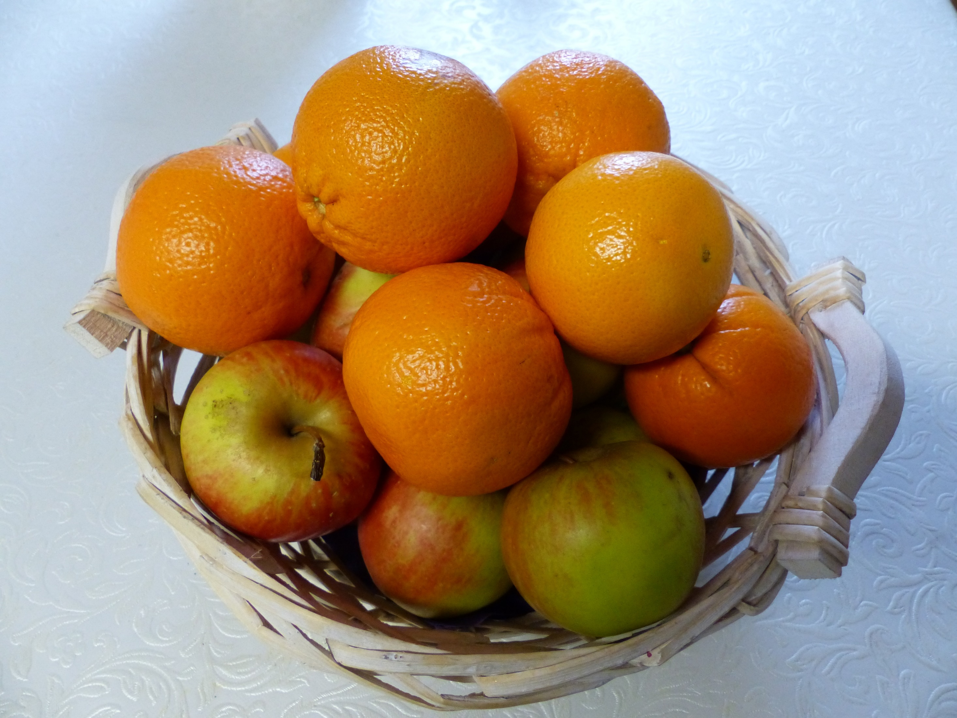
How can I tell if two things are related?
Q-Q plots can
Compare the distribution of two observables. (N need not be the same.)
Compare theoretical curves.
Compare data to a theoretical curve.
Notes:
Very versatile. Non-parameterized visual tool.
Common parameter (t, T, flux, etc.) can be good but not needed for correlation only. “Correlation vs Causation”
Give you and intro using an example from my research.

Slide 7
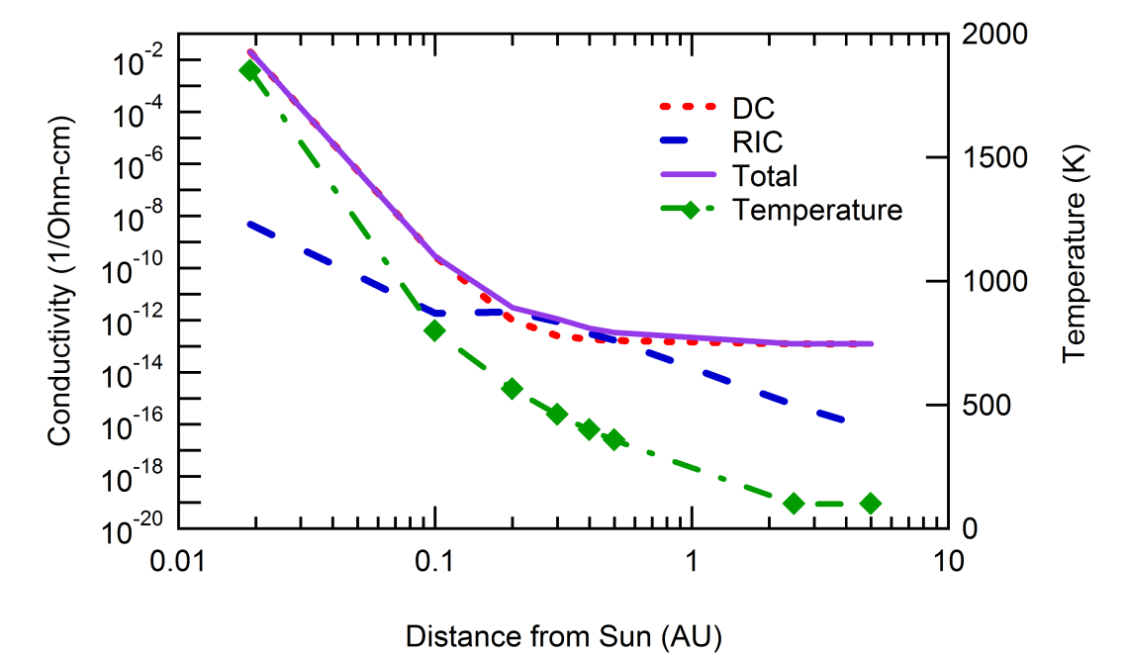
Case V: Temperature and Dose Effects
General Trends
Dose rate decreases as ~r⁻²
T decreases as ~e^{-r}
σ_{DC} decreases as ~ e^{-1/T}
σ_{RIC} decreases as ~ e^{-1/T}
and decreases as ~r⁻²
A fascinating trade-off
Charging increases from increased dose rate at closer orbits
Charge dissipation from T-dependant conductivity increases faster at closer orbits
Notes:
Fig 5. Conductivity and heat shield temperature for Al₂O₃ with α_{S}/ε_{IR} = 0.6 as a function of spacecraft distance from the Sun. [Donegan]

Slide 8
Extension to Flux Energy Distributions
For energy independent flux densities
electrons
ions
photons
Weighting for energy dependant flux densities (#/m²-s-eV)
electrons in
electrons out
ions in
photons in
Determines net charge
Separates environment and materials effects (mostly)
Positive charging terms ranked in importance:
Ion effect usually small
Photon effect often dominates in sunlight
In eclipse, driven by δ+η

Slide 9
Conductivity vs Time
AC
Polarization
Diffusion
Dark Current
Pre-Transit
Post-Transit
RIC
RIC Rise
Persistent RIC

Slide 10
Help with Talk

Slide 11
Testing a Model?

