Slide 1
Intermediate Lab
PHYS 3870
Lecture 5
Comparing Data and Models—Quantitatively
Non-linear Regression
References: Taylor Ch. 9, 12
Also refer to “Glossary of Important Terms in Error Analysis”

Slide 2
Intermediate Lab
PHYS 3870
Errors in Measurements and Models
A Review of What We Know

Slide 3
Quantifying Precision and Random (Statistical) Errors

Slide 4
Single Measurement: Comparison with Other Data
Comparison of precision or accuracy?

Slide 5
Single Measurement: Direct Comparison with Standard
Comparison of precision or accuracy?

Slide 6
Multiple Measurements of the Same Quantity

Slide 7
Multiple Measurements of the Same Quantity
Standard Deviation

Slide 8
Multiple Measurements of the Same Quantity
Standard Deviation of the Mean

Slide 9
Errors in Models—Error Propagation

Slide 10
Specific Rules for Error Propogation

Slide 11
General Formula for Error Propagation

Slide 12
General Formula for Multiple Variables

Slide 13
Error Propagation: General Case
Consider the arbitrary derived quantity
q(x,y) of two independent random variables x and y.
Expand q(x,y) in a Taylor series about the expected values of x and y (i.e., at points near X and Y).
Fixed, shifts peak of distribution
Fixed
Distribution centered at X with width σ_{X}
Error for a function of Two Variables: Addition in Quadrature

Slide 14
Independent (Random) Uncertaities and Gaussian Distributions

Slide 15
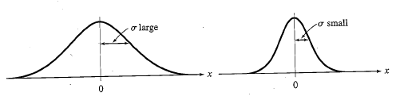
Gaussian Distribution Function
Independent
Variable
Center of Distribution
(mean)
Distribution
Function
Normalization
Constant
Width of Distribution
(standard deviation)
Gaussian Distribution Function

Slide 16
Standard Deviation of Gaussian Distribution
See Sec. 10.6: Testing of Hypotheses
5 ppm or ~5σ “Valid for HEP”
1% or ~3σ “Highly Significant”
5% or ~2σ “Significant”
1σ “Within errors”
Area under curve (probability that
–σ<x<+σ) is 68%

Slide 17



Mean of Gaussian Distribution as “Best Estimate”
Principle of Maximum Likelihood
To find the most likely value of the mean (the best estimate of ẋ),
find X that yields the highest probability for the data set.
Consider a data set
{x₁, x₂, x₃ …x_{N} }
Each randomly distributed with
The combined probability for the full data set is the product
Best Estimate of X is from maximum probability or minimum summation
Minimize Sum
Solve for derivative set to 0
Best estimate of X

Slide 18

Uncertaity of “Best Estimates” of Gaussian Distribution
Principle of Maximum Likelihood
To find the most likely value of the mean (the best estimate of ẋ),
find X that yields the highest probability for the data set.
Consider a data set
{x₁, x₂, x₃ …x_{N} }
The combined probability for the full data set is the product
Best Estimate of X is from maximum probability or minimum summation
Minimize Sum
Solve for derivative
wrst X set to 0
Best estimate of X
Best Estimate of σ is from maximum probability or minimum summation
Solve for derivative
wrst σ set to 0
Best estimate of σ
Minimize Sum
See
Prob. 5.26

Slide 19
Weighted Averages
Question: How can we properly combine two or more separate independent measurements of the same randomly distributed quantity to determine a best combined value with uncertainty?

Slide 20



Weighted Averages
Best Estimate of χ is from maximum probibility or minimum summation
Minimize Sum
Solve for derivative wrst χ set to 0
Solve for best estimate of χ
Note: If w₁=w₂, we recover the standard result X_{wavg}= (1/2) (x₁+x₂)

Slide 21
Intermediate Lab
PHYS 3870
Comparing Measurements to Linear Models
Summary of Linear Regression

Slide 22
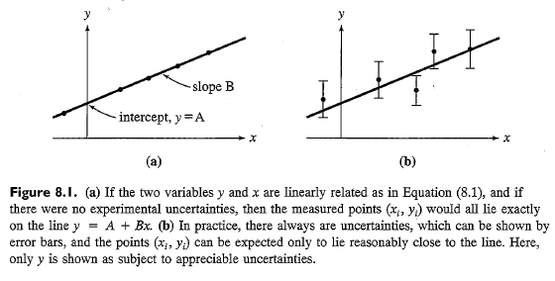
Question 1: What is the Best Linear Fit (A and B)?
Best Estimate of intercept, A , and slope, B,
for
Linear Regression or Least Squares-Fit for Line

Slide 23





“Best Estimates” of Linear Fit
Best Estimates of A and B are from maximum probibility or minimum summation
Minimize Sum
Solve for derivative wrst A and B set to 0
Best estimate of A and B

Slide 24
“Best Estimates” of Linear Fit
Best Estimates of A and B are from maximum probibility or minimum summation
Minimize Sum
Solve for derivative wrst A and B set to 0
Best estimate of A and B

Slide 25




Correlation Coefficient
Combining the Schwartz inequality
With the definition of the covariance
The uncertainty in a function q(x,y) is
With a limiting value
At last, the upper bound of errors is
And for independent and random variables

Slide 26
Question 2: Is it Linear?
y(x) = A + B x
Consider the limiting cases for:
r=0 (no correlation) [for any x, the sum over y-Y yields zero]
r=±1 (perfect correlation). [Substitute yi-Y=B(xi-X) to get r=B/|B|=±1]

Slide 27
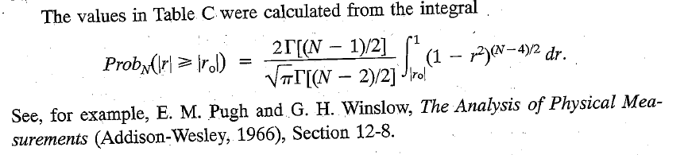
Tabulated Correlation Coefficient
r value
N data points
Consider the limiting cases for:
r=0 (no correlation)
r=±1 (perfect correlation).
To gauge the confidence imparted by intermediate r values consult the table in Appendix C.
Probability that analysis of N=70 data points with a correlation coefficient of r=0.5 is not modeled well by a linear relationship is 3.7%.
Therefore, it is very probably that y is linearly related to x.
If
Prob_{N}(|r|>r_{o})<32% ➔ it is probably that y is linearly related to x
Prob_{N}(|r|>r_{o})<5% ➔ it is very probably that y is linearly related to x
Prob_{N}(|r|>r_{o})<1% ➔ it is highly probably that y is linearly related to x

Slide 28


Uncertainties in Slope and Intercept
Taylor:
Relation to R² value:

Slide 29
Intermediate Lab
PHYS 3870
Comparing Measurements to Models
Non-Linear Regression

Slide 30

Motivating Regression Analysis
Question: Consider now what happens to the output of a nearly ideal experiment, if we vary how hard we poke the system (vary the input).
Uncertainties in Observations
Input
SYSTEM
Output
The Universe
A more general model of response is a nonlinear response model
y(x) = f(x)

Slide 31
Questions for Regression Analysis
A more general model of response is a nonlinear response model
y(x) = f(x)
Two principle questions:
What are the best values of a set of fitting parameters,
What confidence can we place in how well the general model fits the data?
The solutions is familiar:
Evoke the Principle of Maximum Likelihood,
Minimize the summation of the exponent arguments, that is chi squared?
Recall what this looked like for a model with a constant value, linear model, polynomial model, and now a general nonlinear model

Slide 32
Chi Squared Analysis for Least Squares Fit
General definition for Chi squared (square of the normalized deviations)
Perfect model
Good model
Poor model
Discrete distribution
Continuous distribution

Slide 33


Expected Values for Chi Squared Analysis
or
If the model is “good”, each term in the sum is ~1, so
i
More correctly the sum goes to the number of degrees of freedom, d≡N-c.
The reduced Chi-squared value is
So Χ_{red}²=0 for perfect fit
Χ_{red}²<1 for “good” fit
Χ_{red}²>1 for “poor” fit
(looks a lot like r for linear fits doesn’t it?)
i

Slide 34
Chi Squared Analysis for Least Squares Fit
From the probability table ~99.5% (highly significant) confidence

Slide 35
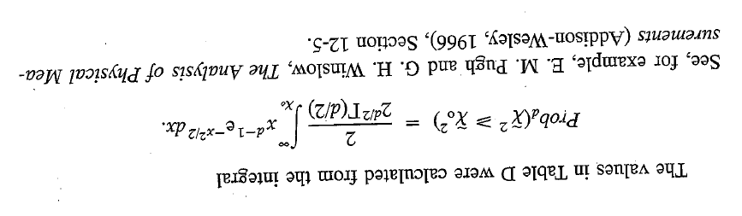
Probabilities for Chi Squared

Slide 36
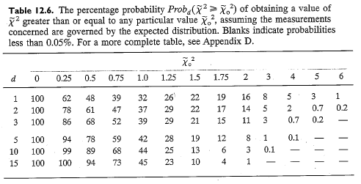
Reduced Chi Squared Analysis

Slide 37
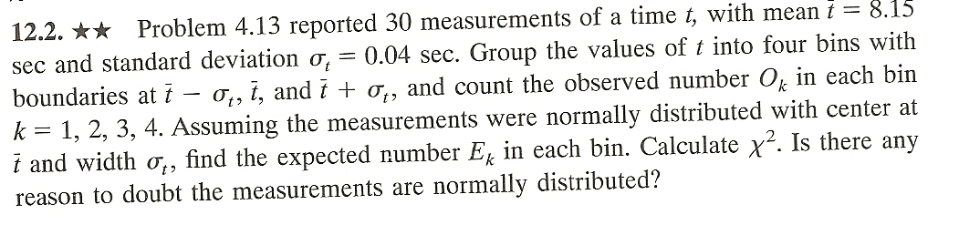
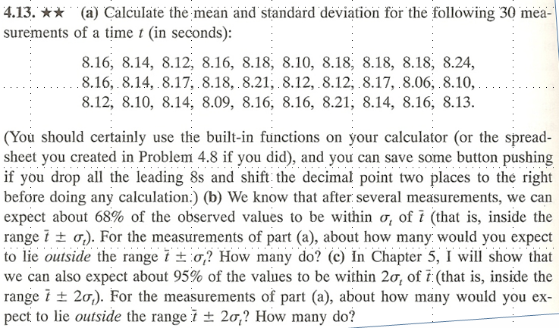
Problem 12.2

Slide 38
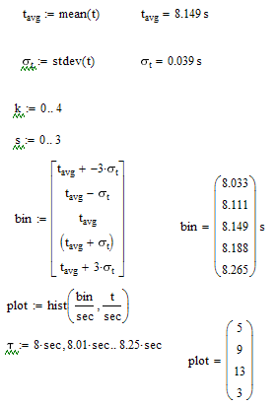
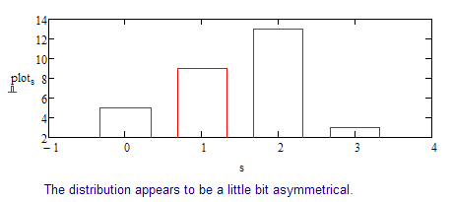
Problem 12.2

