Slide 1
Intermediate Lab
PHYS 3870
Lecture 4
Comparing Data and Models—Quantitatively
Linear Regression
References: Taylor Ch. 8 and 9
Also refer to “Glossary of Important Terms in Error Analysis”

Slide 2
Intermediate Lab
PHYS 3870
Errors in Measurements and Models
A Review of What We Know

Slide 3
Quantifying Precision and Random (Statistical) Errors

Slide 4
Single Measurement: Comparison with Other Data
Comparison of precision or accuracy?

Slide 5
Single Measurement: Direct Comparison with Standard
Comparison of precision or accuracy?

Slide 6
Multiple Measurements of the Same Quantity

Slide 7
Multiple Measurements of the Same Quantity
Standard Deviation

Slide 8
Multiple Sets of Measurements of the Same Quantity
Standard Deviation of the Mean

Slide 9
Errors Propagation—Error in Models or Derived Quantities

Slide 10
Specific Rules for Error Propagation
(Worst Case)

Slide 11
General Formula for Error Propagation

Slide 12
General Formula for Multiple Variables
Worst case
Best case

Slide 13
Error Propagation: General Case
Consider the arbitrary derived quantity
q(x,y) of two independent random variables x and y.
Expand q(x,y) in a Taylor series about the expected values of x and y (i.e., at points near X and Y).
Fixed, shifts peak of distribution
Fixed
Distribution centered at X with width σ_{X}
Error for a function of Two Variables: Addition in Quadrature
Best case

Slide 14
Independent (Random) Uncertaities and Gaussian Distributions

Slide 15
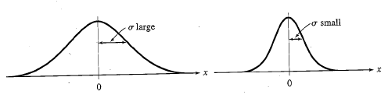
Gaussian Distribution Function
Independent
Variable
Center of Distribution
(mean)
Distribution
Function
Normalization
Constant
Width of Distribution
(standard deviation)
Gaussian Distribution Function

Slide 16
Standard Deviation of Gaussian Distribution
See Sec. 10.6: Testing of Hypotheses
5 ppm or ~5σ “Valid for HEP”
1% or ~3σ “Highly Significant”
5% or ~2σ “Significant”
1σ “Within errors”
Area under curve (probability that
–σ<x<+σ) is 68%
More complete Table in App. A and B

Slide 17



Mean of Gaussian Distribution as “Best Estimate”
Principle of Maximum Likelihood
To find the most likely value of the mean (the best estimate of ẋ),
find X that yields the highest probability for the data set.
Consider a data set
{x₁, x₂, x₃ …x_{N} }
Each randomly distributed with
The combined probability for the full data set is the product
Best Estimate of X is from maximum probability or minimum summation
Minimize Sum
Solve for derivative set to 0
Best estimate of X

Slide 18

Uncertaity of “Best Estimates” of Gaussian Distribution
Principle of Maximum Likelihood
To find the most likely value of the mean (the best estimate of ẋ),
find X that yields the highest probability for the data set.
Consider a data set
{x₁, x₂, x₃ …x_{N} }
The combined probability for the full data set is the product
Best Estimate of X is from maximum probability or minimum summation
Minimize Sum
Solve for derivative
wrst X set to 0
Best estimate of X
Best Estimate of σ is from maximum probability or minimum summation
Solve for derivative
wrst σ set to 0
Best estimate of σ
Minimize Sum
See
Prob. 5.26

Slide 19
Weighted Averages
Question: How can we properly combine two or more separate independent measurements of the same randomly distributed quantity to determine a best combined value with uncertainty?

Slide 20



Weighted Averages
Best Estimate of χ is from maximum probibility or minimum summation
Minimize Sum
Solve for derivative wrst χ set to 0
Solve for best estimate of χ
Note: If w₁=w₂, we recover the standard result X_{wavg}= (1/2) (x₁+x₂)

Slide 21
Intermediate Lab
PHYS 3870
Comparing Measurements to Models
Linear Regression

Slide 22

Motivating Regression Analysis
Question: Consider now what happens to the output of a nearly ideal experiment, if we vary how hard we poke the system (vary the input).
Uncertainties in Observations
Input
SYSTEM
Output
The Universe
The simplest model of response (short of the trivial constant response) is a linear response model
y(x) = A + B x

Slide 23
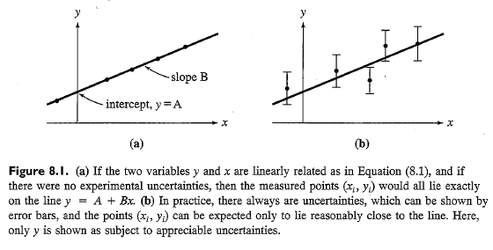
Questions for Regression Analysis
The simplest model of response (short of the trivial constant response) is a linear response model
y(x) = A + B x
Three principle questions:
What are the best values of A and B, for: (see Taylor Ch. 8)
  A perfect data set, where A and B are exact?
  A data set with uncertainties?
What are the errors in the fitting parameters A and B?
What confidence can we place in how well a linear model fits the data? (see Taylor Ch. 9)

Slide 24
Intermediate Lab
PHYS 3870
Review of
Graphical Analysis

Slide 25
Graphical Analysis
An “old School” approach to linear fits.
Rough plot of data
Estimate of uncertainties with error bars
A “best” linear fit with a straight edge
Estimates of uncertainties in slope and intercept from the error bars
This is a great practice to get into as you are developing an experiment!

Slide 26
Is it Linear?
A simple model is a linear model
You know it when you see it (qualitatively)
Tested with a straight edge
Error bar are a first step in gauging the “goodness of fit”
Adding 2D error bars is sometimes helpful.

Slide 27
Making It Linear or Linearization
A simple trick for many models is to linearize the model in the independent variable.
Refer to Baird Ch.5 and the associated homework problems.

Slide 28
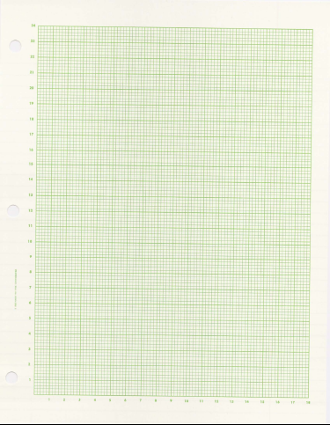
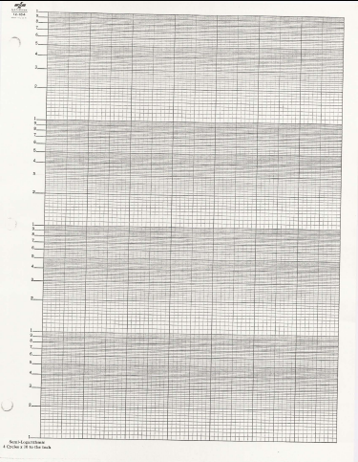

Special Graph Paper
Log-log paper tests for power law models.
Both Semi-log and log -log paper are handy for displaying details of data spread over many orders of magnitude.
Semi-log paper tests for exponential models.
Linear
“Old School” graph paper is still a useful tool, especially for reality checking during the experimental design process.
Semilog
Log-Log

Slide 29
Intermediate Lab
PHYS 3870
Linear Regression
References: Taylor Ch. 8

Slide 30
Basic Assumptions for Regression Analysis
We will (initially) assume:
The errors in how hard you poke something (in the input) are negligible compared with errors in the response (see discussion in Taylor Sec. 9.3)
The errors in y are constant (see Problem 8.9 for weighted errors analysis)
The measurements of y_{i} are governed by a Gaussian distribution with constant width σ_{y}

Slide 31
Question 1: What is the Best Linear Fit (A and B)?
Best Estimate of intercept, A , and slope, B,
for
Linear Regression or Least Squares-Fit for Line

Slide 32





“Best Estimates” of Linear Fit
Best Estimates of A and B are from maximum probibility or minimum summation
Minimize Sum
Solve for derivative wrst A and B set to 0
Best estimate of A and B

Slide 33





“Best Estimates” of Linear Fit
Best Estimates of A and B are from maximum probibility or minimum summation
Minimize Sum
Solve for derivative wrst A and B set to 0
Best estimate of A and B
In a linear algebraic form
This is a standard eigenvalue problem
With solutions
is the uncertainty in the measurement of y, or the rms deviation of the measured to predicted value of y

Slide 34
Least Squares Fits to Other Curves

Slide 35
Least Squares Fits to Other Curves

Slide 36
Least Squares Fits to Other Curves

Slide 37
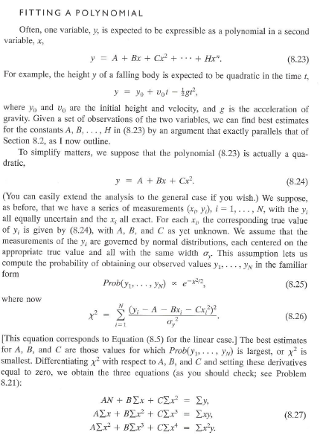
Fitting a Polynomial
Extend the linear solution to include on more tem, for a second order polynomial
This looks just like our linear problem, with the deviation in the summation replace by
This leads to a standard 3x3 eigenvalue problem,
Which can easily be generalized to any order polynomial

Slide 38
Least Squares Fits to Other Curves

Slide 39
Least Squares Fits to Other Curves

Slide 40
Least Squares Fits to Other Curves

Slide 41
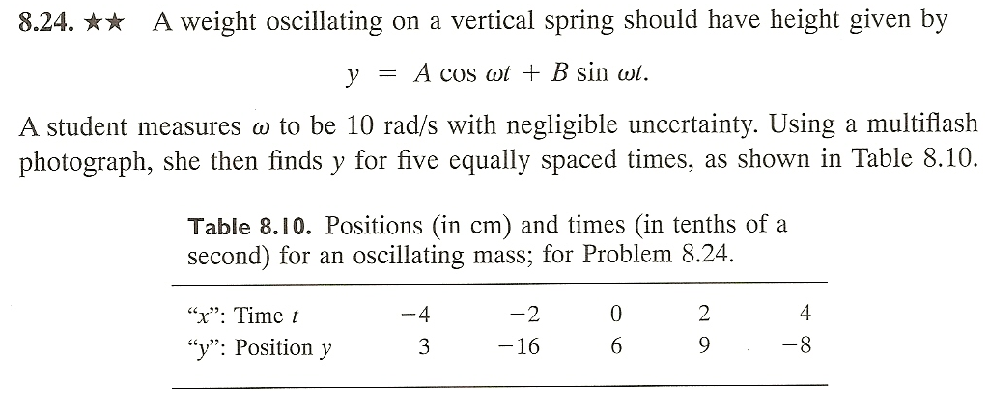
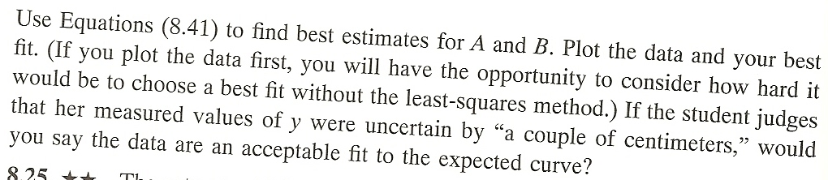
Problem 8.24

Slide 42
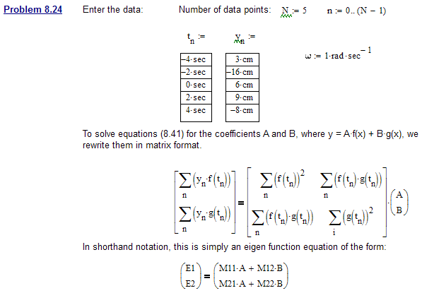
Problem 8.24

Slide 43
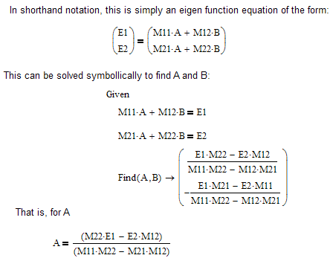
Problem 8.24

Slide 44
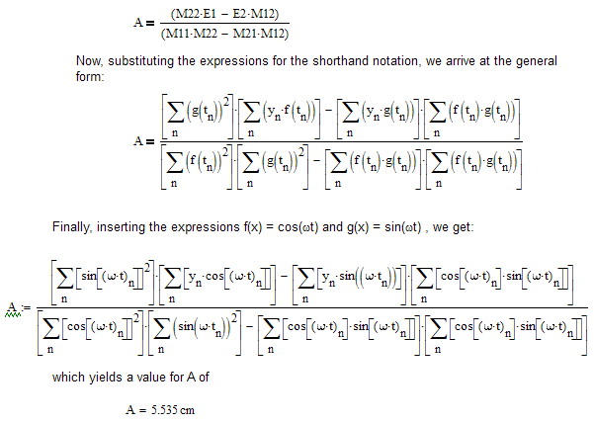
Problem 8.24

Slide 45
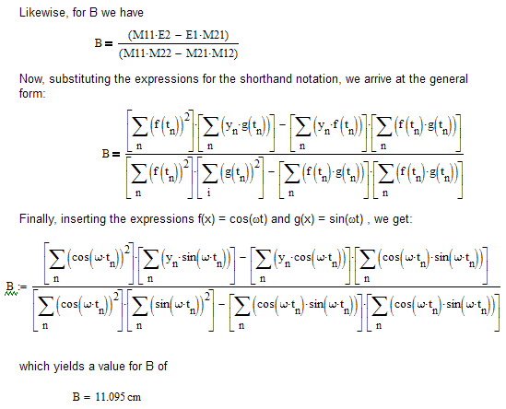
Problem 8.24

Slide 46
Intermediate Lab
PHYS 3870
Correlations

Slide 47
Uncertaities in a Function of Variables
Consider an arbitrary function q with variables x,y,z and others.
Expanding the uncertainty in y in terms of partial derivatives, we have
If x,y,z and others are independent and random variables, we have
If x,y,z and others are independent and random variables governed by normal distributions, we have
We now consider the case when x,y,z and others are not independent and random variables governed by normal distributions.

Slide 48
Covariance of a Function of Variables
We now consider the case when x and y are not independent and random variables governed by normal distributions.
Assume we measure N pairs of data (x_{i},y_{i}), with small uncertaities so that all x_{i} and y_{i} are close to their mean values X and Y.
Expanding in a Taylor series about the means, the value q_{i} for (x_{i},y_{i}),
Note partial derivatives are all taken at X or Y and are hence the same for each i
We then find the simple result for the mean of q
0
0
The standard deviation of the N values of q_{i} is

Slide 49

Covariance of a Function of Variables
The standard deviation of the N values of q_{i} is
If x and y are independent

Slide 50
Schwartz
Inequality
Show that
See problem 9.7

Slide 51





Schwartz Inequality
Combining the Schwartz inequality
With the definition of the covariance
yields
Then completing the squares
And taking the square root of the equation, we finally have
At last, the upper bound of errors is
And for independent and random variables

Slide 52
Another Useful Relation

Slide 53
Question 2: Is it Linear?
y(x) = A + B x
Consider the limiting cases for:
r=0 (no correlation) [for any x, the sum over y-Y yields zero]
r=±1 (perfect correlation). [Substitute yi-Y=B(xi-X) to get r=B/|B|=±1]

Slide 54
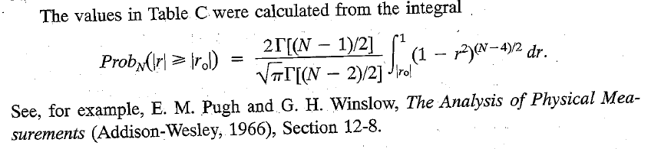
Tabulated Correlation Coefficient
r value
N data points
Consider the limiting cases for:
r=0 (no correlation)
r=±1 (perfect correlation).
To gauge the confidence imparted by intermediate r values consult the table in Appendix C.
Probability that analysis of N=70 data points with a correlation coefficient of r=0.5 is not modeled well by a linear relationship is 3.7%.
Therefore, it is very probably that y is linearly related to x.
If
Prob_{N}(|r|>r_{o})<32% ➔ it is probably that y is linearly related to x
Prob_{N}(|r|>r_{o})<5% ➔ it is very probably that y is linearly related to x
Prob_{N}(|r|>r_{o})<1% ➔ it is highly probably that y is linearly related to x

Slide 55



Uncertainties in Slope and Intercept
Taylor:
Relation to R² value:

