Slide 1
Intermediate Lab
PHYS 3870
Lecture 3
Distribution Functions
References: Taylor Ch. 5 (and Chs. 10 and 11 for Reference)
Taylor Ch. 6 and 7
Also refer to “Glossary of Important Terms in Error Analysis”
“Probability Cheat Sheet”

Slide 2
Intermediate Lab
PHYS 3870
Distribution Functions

Slide 3
Practical Methods to Calculate Mean and St. Deviation
We need to develop a good way to tally, display, and think about a collection of repeated measurements of the same quantity.
Here is where we are headed:
Develop the notion of a probability distribution function, a distribution to describe the probable outcomes of a measurement
Define what a distribution function is, and its properties
Look at the properties of the most common distribution function, the Gaussian distribution for purely random events
Introduce other probability distribution functions
We will develop the mathematical basis for:
Mean
Standard deviation
Standard deviation of the mean (SDOM)
Moments and expectation values
Error propagation formulas
Addition of errors in quadrature (for independent and random measurements)
Schwartz inequality (i.e., the uncertainty principle) (next lecture)
Numerical values for confidence limits (t-test)
Principle of maximal likelihood
Central limit theorem

Slide 4





Two Practical Exercises in Probabilities
Flip Penny 50 times and record the results
Flip a penny 50 times and record the results
Roll a pair of dice 50 times and record the results
Grab a partner and a set of instructions and complete the exercise.

Slide 5
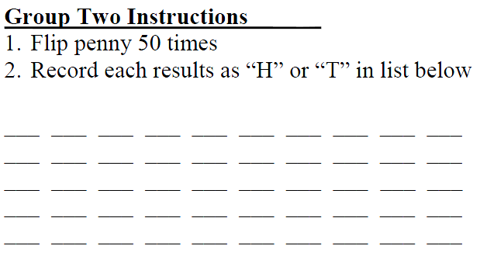
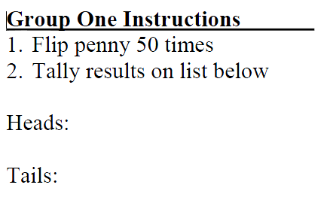
Two Practical Exercises in Probabilities
Flip a penny 50 times and record the results
What is the asymmetry of the results?

Slide 6
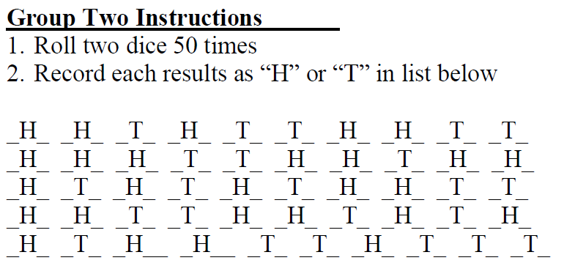
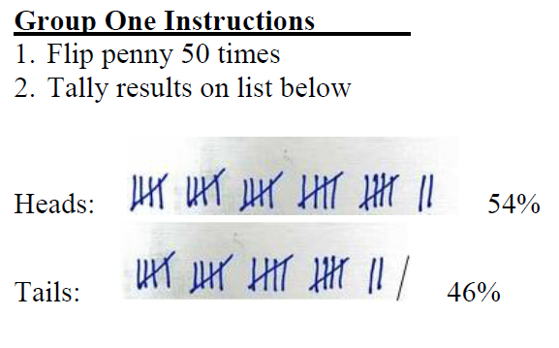
Two Practical Exercises in Probabilities
Flip a penny 50 times and record the results
??% asymmetry
4% asymmetry
What is the asymmetry of the results?

Slide 7
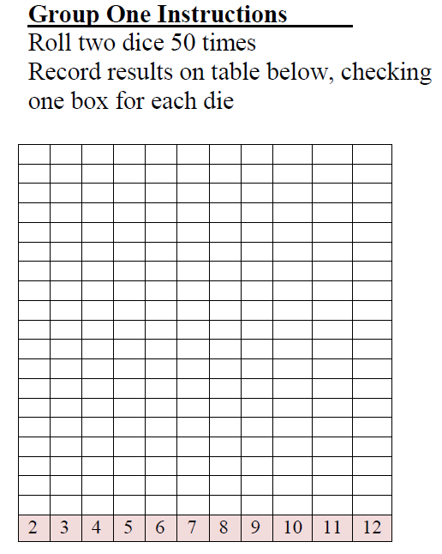
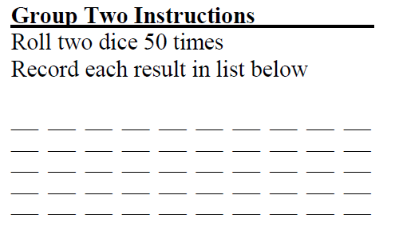
Two Practical Exercises in Probabilities
Roll a pair of dice 50 times and record the results
What is the mean value?
The standard deviation?

Slide 8
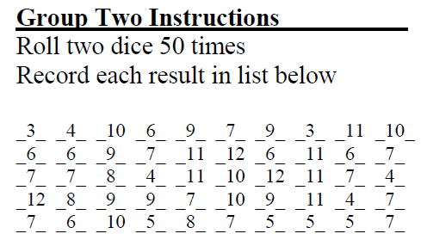
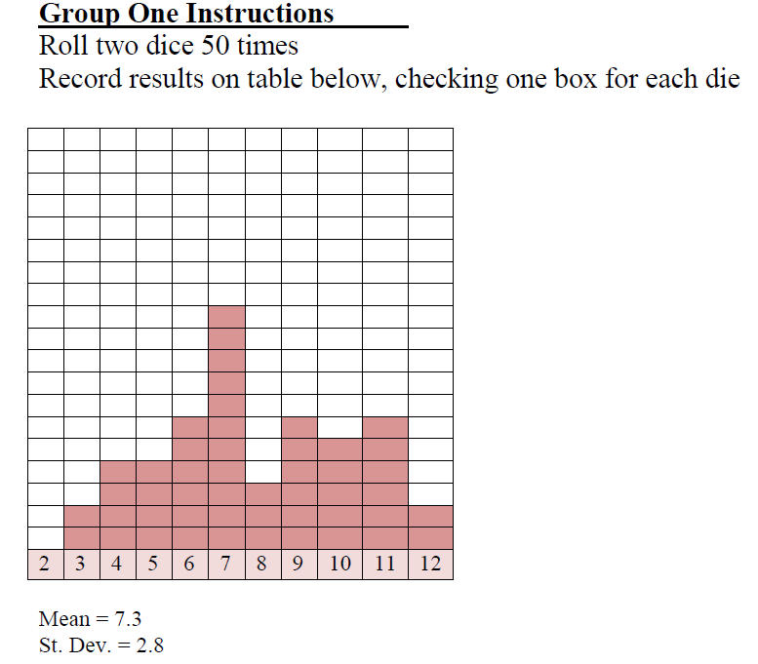
Two Practical Exercises in Probabilities
Roll a pair of dice 50 times and record the results
What is the mean value?
The standard deviation?
What is the asymmetry (kurtosis)?
What is the probability of rolling a 4?

Slide 9





Discrete Distribution Functions
A data set to play with
Written in terms of “occurrence” F
The mean value
In terms of fractional expectations
Fractional expectations
Normalization condition
Mean value
➔
(This is just a weighted sum.)

Slide 10
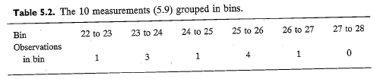
Limit of Discrete Distribution Functions
Binned data sets
“Normalizing” data sets
f_{k} ≡ fractional occurrence
∆_{k} ≡ bin width
Mean value:
Normalization:
Expected value:

Slide 11
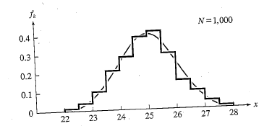
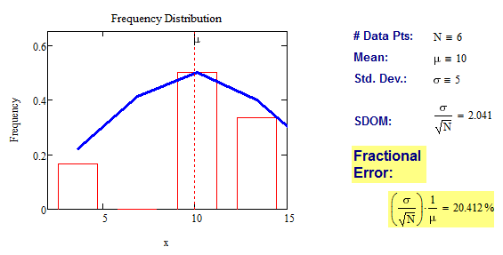
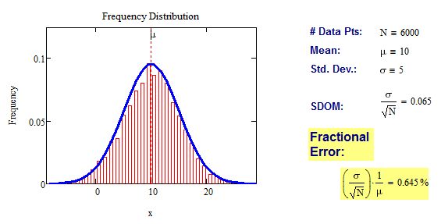
Limits of Distribution Functions
Consider the limiting distribution function as N →ȸ and ∆_{k}→0
Larger data sets
Mathcad Games:
Notes:
Copy from handout

Slide 12
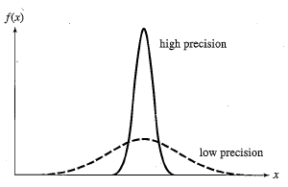
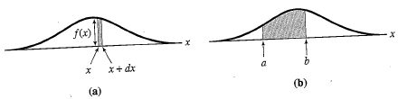








Continuous Distribution Functions
Meaning of Distribution Interval
Thus
= fraction of measurements that fall within a<x<b
Normalization of Distribution
➔
and by extension
Central (mean) Value
Width of Distribution
➔
➔

Slide 13
Moments of Distribution Functions
0 (for a centered distribution)
Notes:
Copy from handout

Slide 14
Moments of Distribution Functions
0
Notes:
Copy from handout

Slide 15
Example of Continuous Distribution Functions and Expectation Values
Harmonic Oscillator: Example from Mechanics
Expected Values ➔
Notes:
Add list of Expectation value theorems from handout

Slide 16
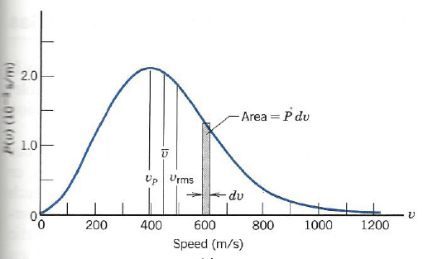
Example of Continuous Distribution Functions and Expectation Values
Boltzmann Distribution: Example from Kinetic Theory
Expected Values ➔
Notes:
Add list of Expectation value theorems from handout

Slide 17
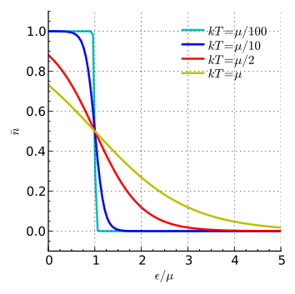
Example of Continuous Distribution Functions and Expectation Values
Fermi-Dirac Distribution: Example from Kinetic Theory
Notes:
Add list of Expectation value theorems from handout

Slide 18
Example of Continuous Distribution Functions and Expectation Values
Finite Square Well: Example from Quantum Mechanics
Expectation Values
Notes:
Add list of Expectation value theorems from handout

Slide 19
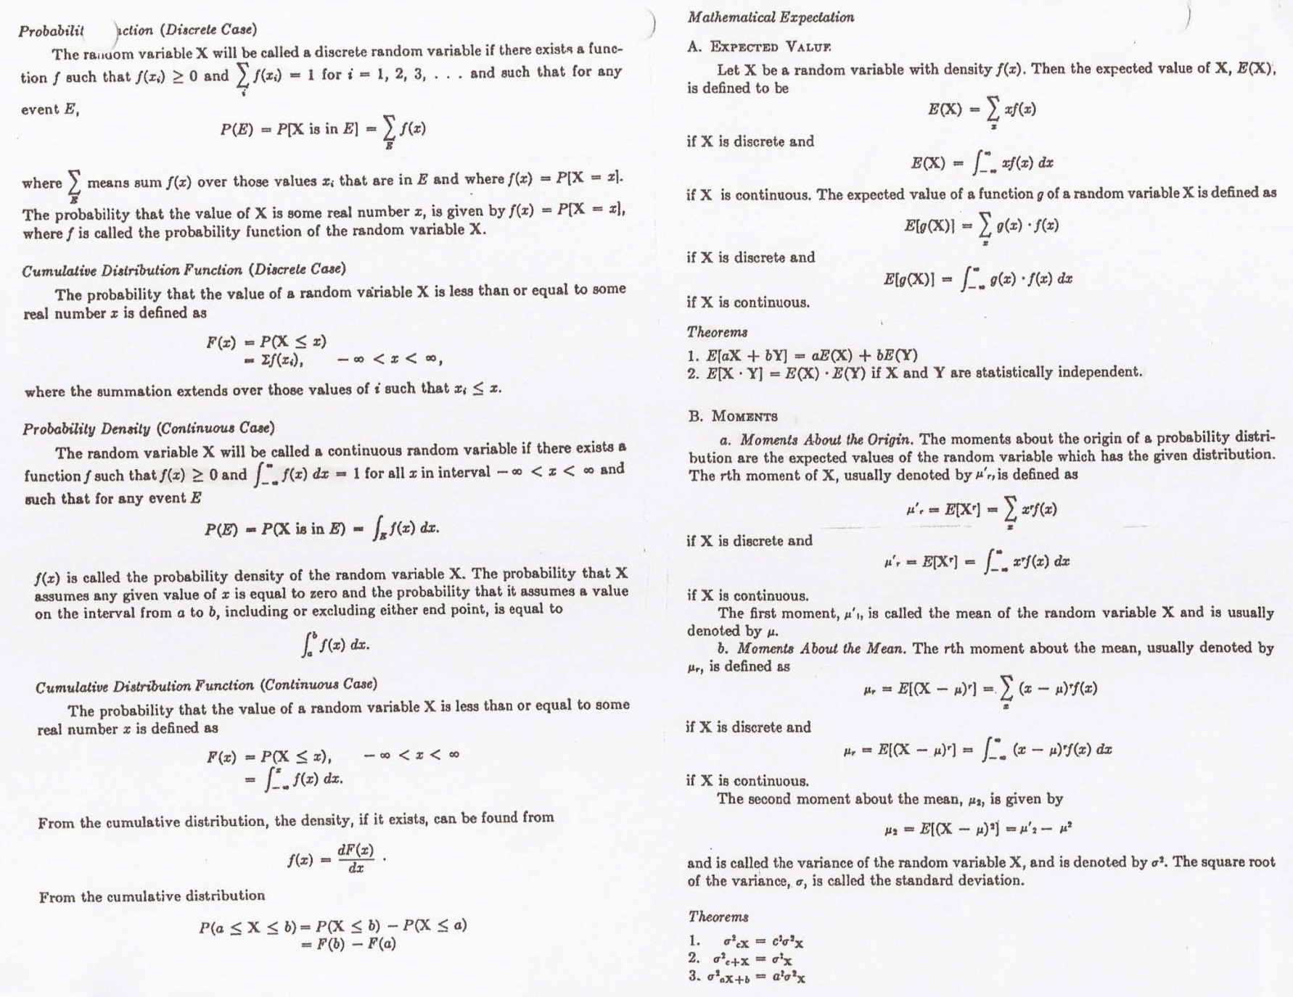
Summary of Distribution Functions
Available on web site
Notes:
Add list of Expectation value theorems from handout

Slide 20
Intermediate Lab
PHYS 3870
The Gaussian Distribution Function
References: Taylor Ch. 5

Slide 21
Gaussian Integrals
Notes:
Copy from handout

Slide 22
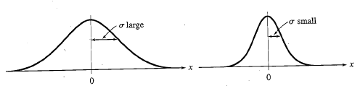
Gaussian Distribution Function
Independent
Variable
Center of Distribution
(mean)
Distribution
Function
Normalization
Constant
Width of Distribution
(standard deviation)
Gaussian Distribution Function

Slide 23
Effects of Increasing N on Gaussian Distribution Functions
Consider the limiting distribution function as N →∞ and dx→0
Notes:
Copy from handout

Slide 24
Defining the Gaussian distribution function in Mathcad
I suggest you “investigate” these with the Mathcad sheet on the web site

Slide 25
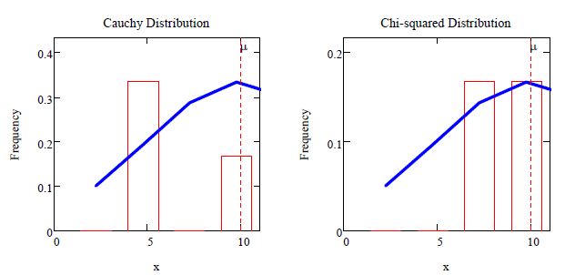
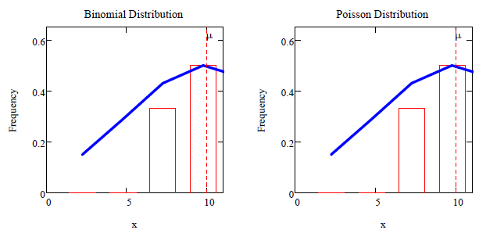
Using Mathcad to define other common distribution functions.
Consider the limiting distribution function as N →ȸ and ∆_{k}→0

Slide 26

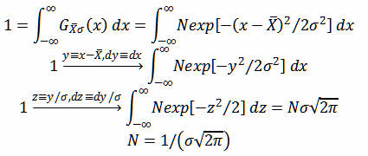


Gaussian Distribution Moments
Consider the Gaussian distribution function
Use the normalization condition to evaluate the normalization constant (see Taylor, p. 132)
The mean, Ẋ, is the first moment of the Gaussian distribution function (see Taylor, p. 134)
The standard deviation, σ_{x}, is the standard deviation of the mean of the Gaussian distribution function (see Taylor, p. 143)
Notes:
Copy from handout

Slide 27
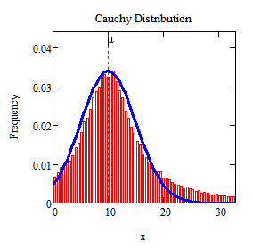
When is mean x not X_{best}?
Answer: When the distribution is not symmetric about X.
Example: Cauchy Distribution

Slide 28
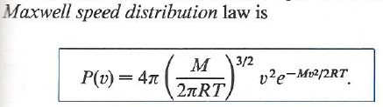
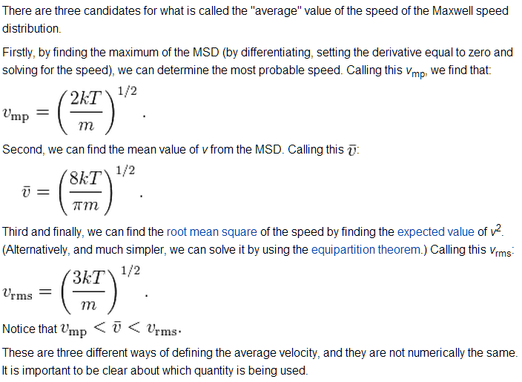
When is mean x not X_{best}?

Slide 29
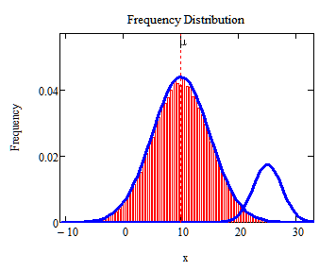
When is mean x not X_{best}?
Answer: When the distribution is has more than one peak.

Slide 30
Intermediate Lab
PHYS 3870
The Gaussian Distribution Function and Its Relation to Errors

Slide 31



A Review of Probabilities in Combination
1 head AND 1 Four
P(H,4) = P(H) * P(4)
1 Six OR 1 Four
P(6,4) = P(6) + P(4)
(true for a “mutually exclusive” single role)
1 head OR 1 Four
P(H,4) = P(H) + P(4) - P(H and 4)
(true for a “non-mutually exclusive” events)
NOT 1 Six
P(NOT 6) = 1 - P(6)
Probability of a data set of N like measurements, (x₁,x₂,…x_{N})
P (x₁,x₂,…x_{N}) = P(x)₁*P(x₂)*…P(x_{N})

Slide 32
The Gaussian Distribution Function and Its Relation to Errors
We will use the Gaussian distribution as applied to random variables to develop the mathematical basis for:
Mean
Standard deviation
Standard deviation of the mean (SDOM)
Moments and expectation values
Error propagation formulas
Addition of errors in quadrature (for independent and random measurements)
Numerical values for confidence limits (t-test)
Principle of maximal likelihood
Central limit theorem
Weighted distributions and Chi squared
Schwartz inequality (i.e., the uncertainty principle) (next lecture)

Slide 33
Gaussian Distribution Moments
Consider the Gaussian distribution function
Use the normalization condition to evaluate the normalization constant (see Taylor, p. 132)
The mean, Ẋ, is the first moment of the Gaussian distribution function (see Taylor, p. 134)
The standard deviation, σ_{x}, is the standard deviation of the mean of the Gaussian distribution function (see Taylor, p. 143)
Notes:
Copy from handout

Slide 34


Standard Deviation of Gaussian Distribution
See Sec. 10.6: Testing of Hypotheses
5 ppm or ~5σ “Valid for HEP”
1% or ~3σ “Highly Significant”
5% or ~2σ “Significant”
1σ “Within errors”
Area under curve (probability that
–σ<x<+σ) is 68%
Ah, that’s highly significant!
More complete Table in App. A and B

Slide 35
Error Function of Gaussian Distribution
Error Function: (probability that –tσ<x<+tσ ).
Complementary Error Function:
(probability that –x<-tσ AND x>+tσ ).
Prob(x outside tσ) = 1 - Prob(x within tσ)
Probable Error: (probability that
–0.67σ<x<+0.67σ) is 50%.
Error Function: Tabulated values-see App. A.
Area under curve (probability that
–tσ<x<+tσ) is given in Table at right.
More complete Table in App. A and B

Slide 36
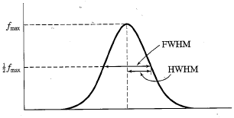
Useful Points on Gaussian Distribution
Full Width at Half Maximum
FWHM
(See Prob. 5.12)
Points of Inflection
Occur at ±σ
(See Prob. 5.13)

Slide 37
Error Analysis and Gaussian Distribution
Adding a Constant
Multiplying by a Constant
X→X+A
X→BX and σ→B σ

Slide 38
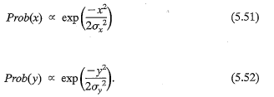
Error Propagation: Addition
Sum of Two Variables
Consider the derived quantity
Z=X + Y
(with X=0 and Y=0)
Error in Z:
Multiple two probabilities
ICBST (Eq. 5.53)
X+Y→Z and σ_{x}² + σ_{y}² → σ_{z}²
(addition in quadrature for random, independent variables!)
Integrates to √2π

Slide 39
General Formula for Error Propagation
How do we determine the error of a derived quantity Z(X,Y,…) from errors in X,Y,…?

Slide 40
General Formula for Error Propagation

Slide 41
General Formula for Multiple Variables

Slide 42
Error Propagation: General Case
How do we determine the error of a derived quantity Z(X,Y,…) from errors in X,Y,…?
Consider the arbitrary derived quantity
q(x,y) of two independent random variables x and y.
Expand q(x,y) in a Taylor series about the expected values of x and y (i.e., at points near X and Y).
Fixed, shifts peak of distribution
Fixed
Distribution centered at X with width σ_{X}
Product of Two Variables
0

Slide 43
SDOM of Gaussian Distribution
Standard Deviation of the Mean
Each measurement has similar σ_{Xi=} σ_{Ẋ}
and similar partial derivatives
Thus…
The SDOM decreases as the square root of the number of measurements.
That is, the relative width, σ/Ẋ, of the distribution gets narrower as more measurements are made.

Slide 44
Two Key Theorems from Probability
Central Limit Theorem
For random, independent measurements (each with a well-define expectation value and well-defined variance), the arithmetic mean (average) will be approximately normally distributed.
Principle of Maximum Likelihood
Given the N observed measurements, x₁, x₂,…x_{N}, the best estimates for Ẋ and σ are those values for which the observed x₁, x₂,…x_{N}, are most likely.

Slide 45



Mean of Gaussian Distribution as “Best Estimate”
Principle of Maximum Likelihood
To find the most likely value of the mean (the best estimate of ẋ),
find X that yields the highest probability for the data set.
Consider a data set
{x₁, x₂, x₃ …x_{N} }
Each randomly distributed with
The combined probability for the full data set is the product
Best Estimate of X is from maximum probability or minimum summation
Minimize Sum
Solve for derivative wrst X set to 0
Best estimate of X

Slide 46

Uncertainty of “Best Estimates” of Gaussian Distribution
Principle of Maximum Likelihood
To find the most likely value of the standard deviation (the best estimate of the width of the x distribution), find σ_{x} that yields the highest probability for the data set.
Consider a data set
{x₁, x₂, x₃ …x_{N} }
The combined probability for the full data set is the product
Best Estimate of X is from maximum probability or minimum summation
Minimize Sum
Solve for derivative
wrst X set to 0
Best estimate of X
Best Estimate of σ is from maximum probability or minimum summation
Solve for derivative
wrst σ set to 0
Best estimate of σ
Minimize Sum
See
Prob. 5.26

Slide 47
Intermediate Lab
PHYS 3870
Combining Data Sets
Weighted Averages
References: Taylor Ch. 7

Slide 48
Weighted Averages
Question: How can we properly combine two or more separate independent measurements of the same randomly distributed quantity to determine a best combined value with uncertainty?

Slide 49
Weighted Averages
Assume negligible systematic errors.
Note: χ² , or Chi squared, is the sum of the squares of the deviations from the mean, divided by the corresponding uncertainty.
Such methods are called “Methods of Least Squares”. They follow directly from the Principle of Maximum Likelihood.

Slide 50



Weighted Averages
Best Estimate of χ is from maximum probibility or minimum summation
Minimize Sum
Solve for derivative wrst χ set to 0
Solve for best estimate of χ
Note: If w₁=w₂, we recover the standard result X_{wavg}= (1/2) (x₁+x₂)

Slide 51
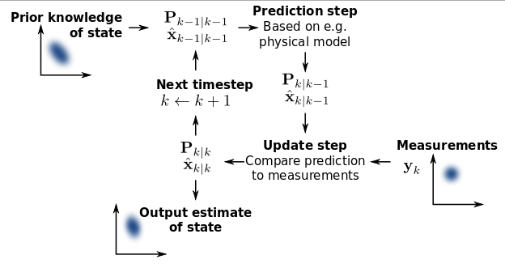
Weighted Averages on Steroids
A very powerful method for combining data from different sources with different methods and uncertainties (or, indeed, data of related measured and calculated quantities) is Kalman filtering.
The Kalman filter, also known as linear quadratic estimation (LQE), is an algorithm that uses a series of measurements observed over time, containing noise (random variations) and other inaccuracies, and produces estimates of unknown variables that tend to be more precise than those based on a single measurement alone.
The Kalman filter keeps track of the estimated state of the system and the variance or uncertainty of the estimate. The estimate is updated using a state transition model and measurements. x_{k|k-1} denotes the estimate of the system's state at time step k before the k^{th} measurement y_{k} has been taken into account; P_{k|k-1} is the corresponding uncertainty. --Wikipedia, 2013.
Ludger Scherliess, of USU Physics, is a world expert at using Kalman filtering for the assimilation of satellite and ground-based data and the USU GAMES model to predict space weather .

Slide 52
Intermediate Lab
PHYS 3870
Rejecting Data
Chauvenet’s Criterion
References: Taylor Ch. 6

Slide 53
Rejecting Data
What is a good criteria for rejecting data?
Question: When is it “reasonable” to discard a seemingly “unreasonable” data point from a set of randomly distributed measurements?
Never
Whenever it makes things look better
Chauvenet’s criterion provides a (quantitative) compromise

Slide 54
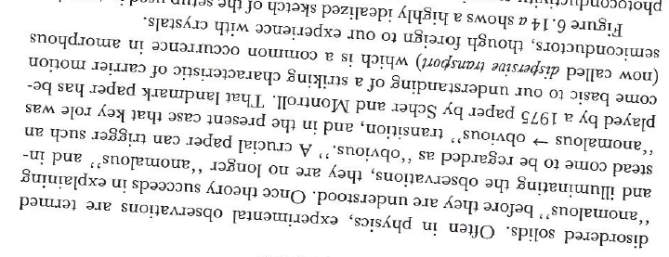
Rejecting Data
Zallen’s Criterion
Question: When is it “reasonable” to discard a seemingly “unreasonable” data point from a set of randomly distributed measurements?
Never

Slide 55

Rejecting Data
Disney’s Criterion
Question: When is it “reasonable” to discard a seemingly “unreasonable” data point from a set of randomly distributed measurements?
Whenever it makes things look better
Disney’s First Law
Wishing will make it so.
Disney’s Second Law
Dreams are more colorful than reality.

Slide 56
Rejecting Data
Chauvenet’s Criterion
Data may be rejected if the expected number of measurements at least as deviant as the suspect measurement is less than 50%.

Slide 57
Error Function of Gaussian Distribution
Error Function: (probability that –tσ<x<+tσ ).
Error Function: Tabulated values-see App. A.
Area under curve (probability that
–tσ<x<+tσ) is given in Table at right.
Probable Error: (probability that
–0.67σ<x<+0.67σ) is 50%.

Slide 58
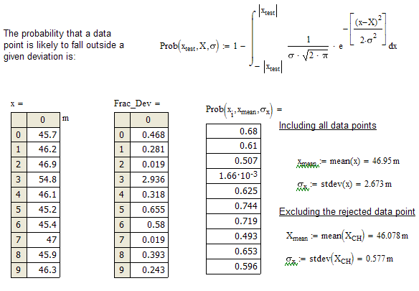
Chauvenet’s Criterion

Slide 59
Chauvenet’s Criterion—Example 1

Slide 60
Chauvenet’s Details (1)

Slide 61
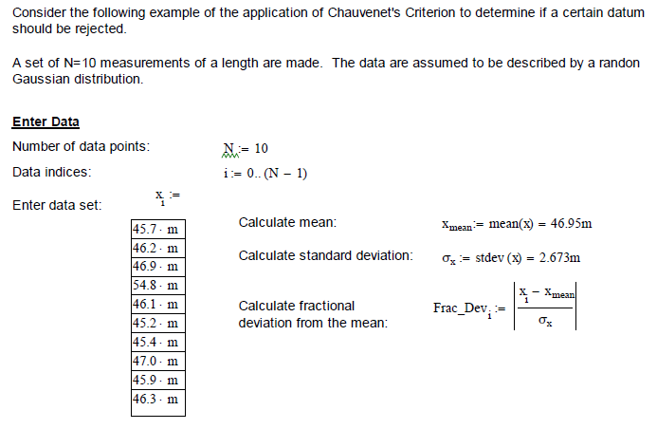
Chauvenet’s Criterion—Details (2)

Slide 62
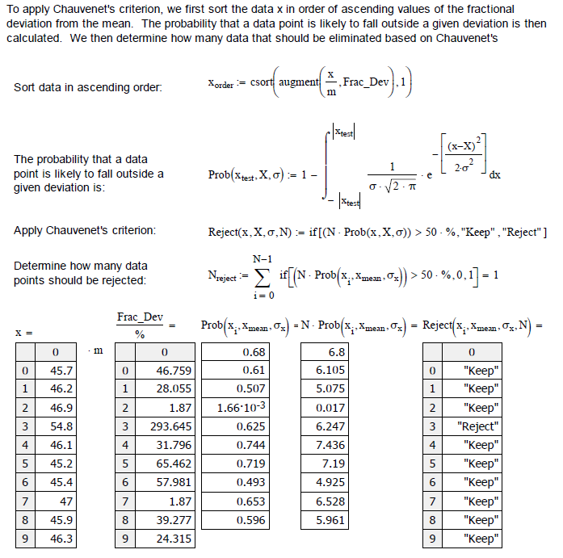
Chauvenet’s Criterion—Details (3)

Slide 63
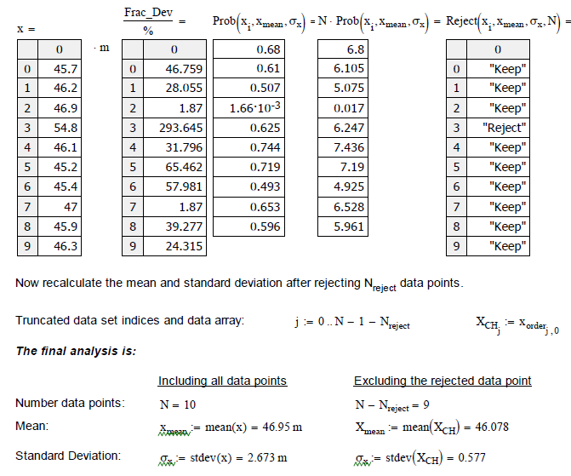
Chauvenet’s Criterion—Example 2

Slide 64
Intermediate Lab
PHYS 3870
Summary of Probability Theory

Slide 65
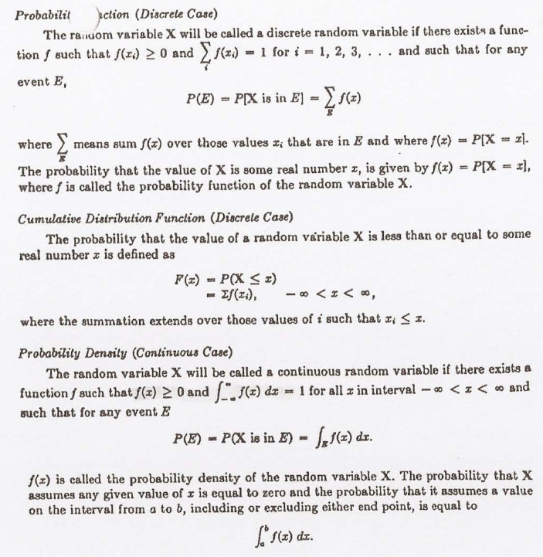
Summary of Probability Theory-I

Slide 66
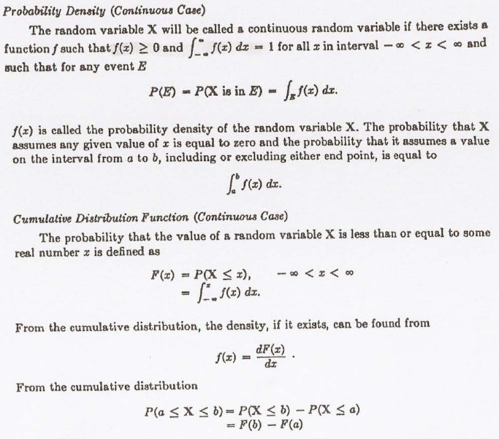
Summary of Probability Theory-II

Slide 67
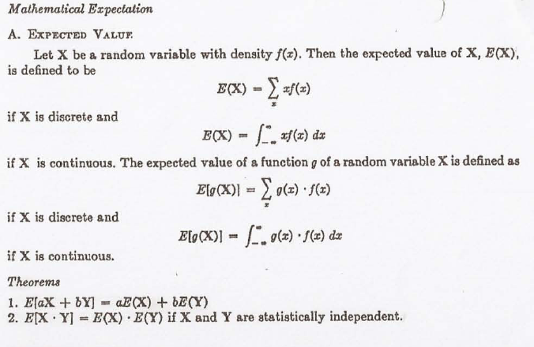
Summary of Probability Theory-III

Slide 68
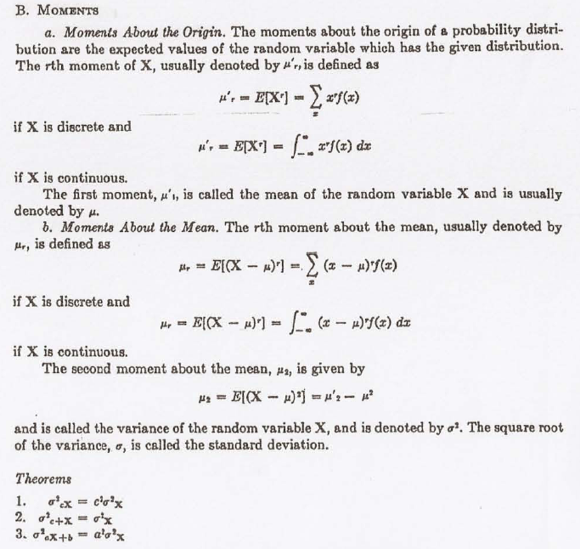
Summary of Probability Theory-IV

