Slide 1
Intermediate Lab
PHYS 3870
Lecture 2
Defining Errors
References: Taylor Ch. 1, 2, 3
Baird Problems (Ch 5-See web site)
Also refer to [HANDOUT]
“Glossary of Important Terms in Error Analysis”

Slide 2
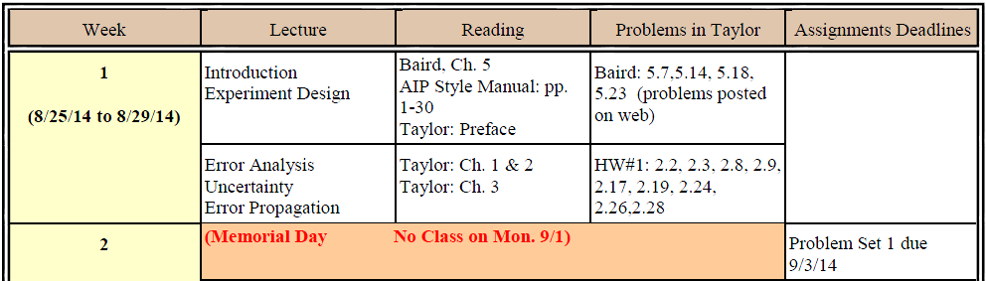
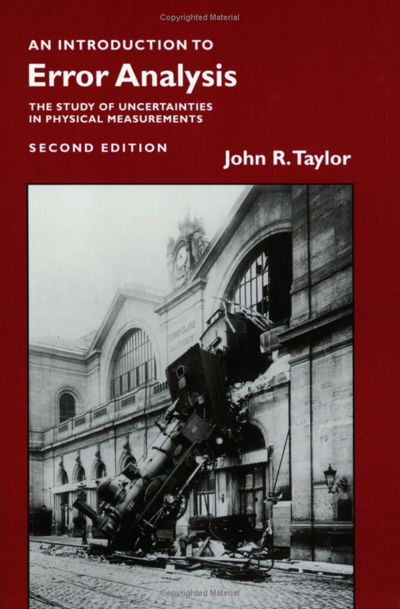
Problem Set #1
Due Next Week

Slide 3
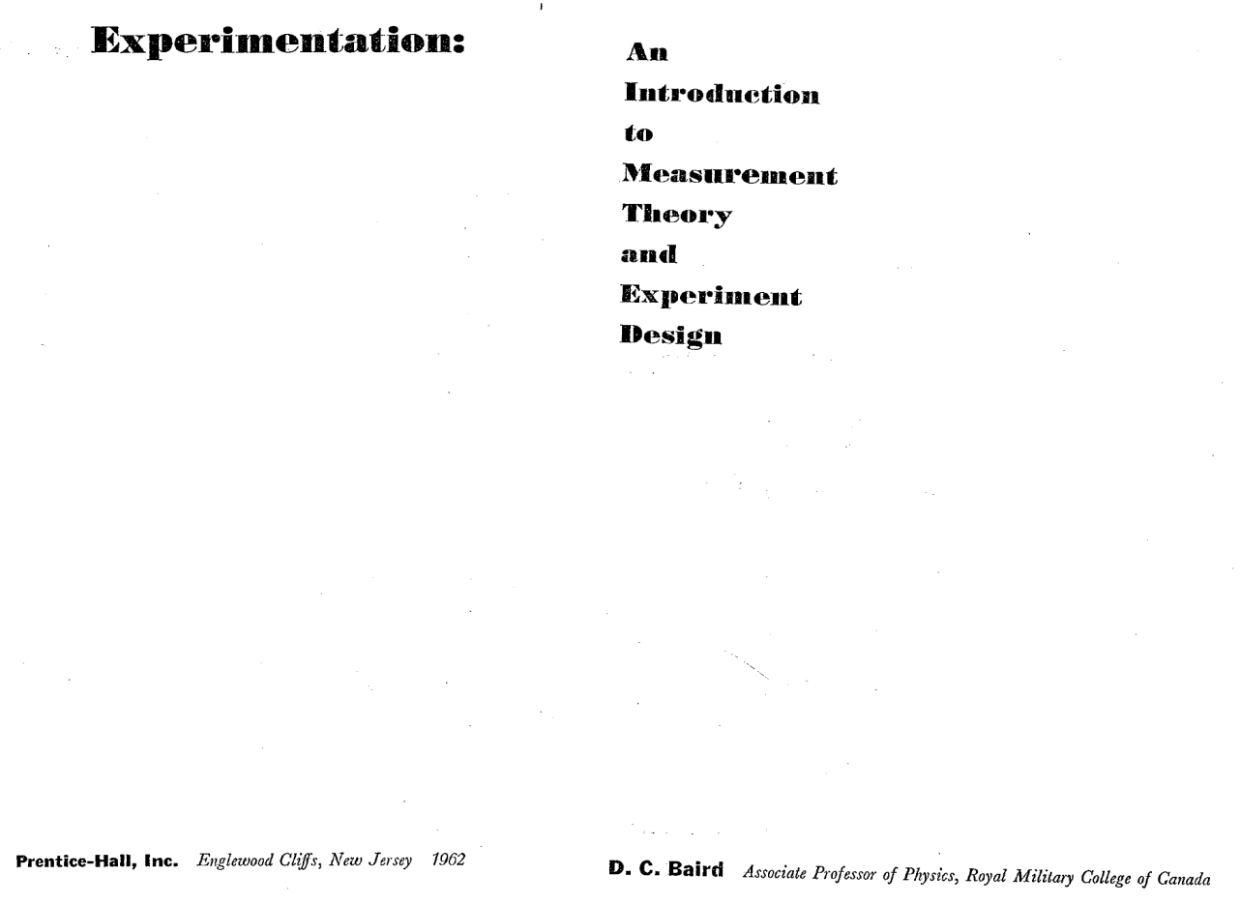
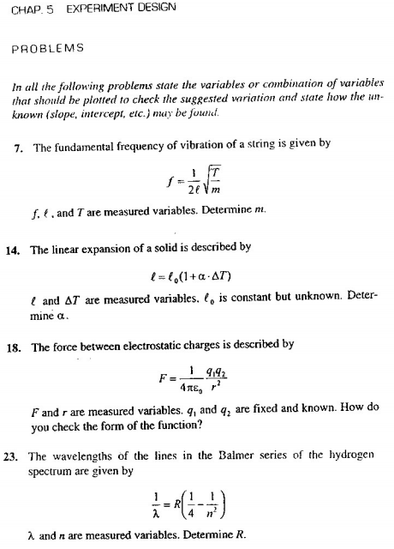
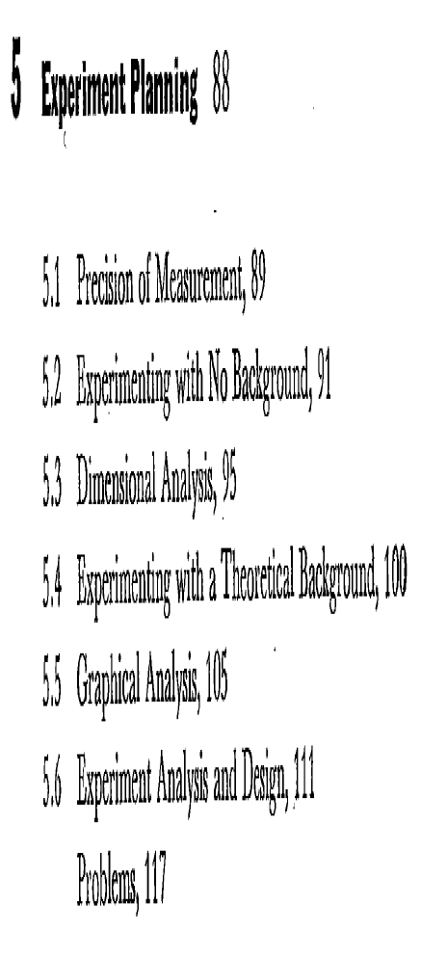

Slide 4
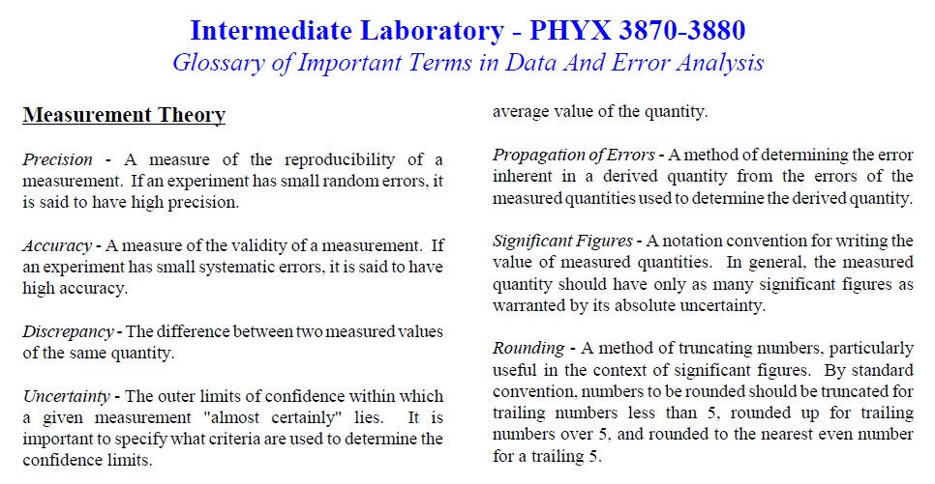
Useful Handout on Web

Slide 5
What is Science?
        The scientific method goes further in:
        Developing a description (model) of the system behavior based on observation
        Generalizing this description (model) to other behavior and other systems
        That is to say, the scientific method is experimentation and modeling intertwined
        It is the scientific method that distinguishes science from other forms of endeavor

Slide 6
Scientific Method:
Leads to new discoveries → how scientific progress is made!
Careful measurements,
Experiments
Models, Empirical
Laws, Generalization
Hypothesis, Theory
Notes:
http://www.physics.usu.edu/dennison/3870Fall2011/Class_Notes/Class_Notes.htm

Slide 7

Uncertainties in Observations
Input
SYSTEM
Output
The Universe
Observations characterize the system to within the uncertainty of the measurements
Uncertainties can arise from:
  Limitations of instrumentation or measurement methods
  Statistical fluctuations of the system
  Inherent uncertainties of the system
  - Quantum fluctuations
  - Non-deterministic processes (e.g., chaos):
    - There are systems where uncertainties dominate and preclude models predicting the outcome
    - We will not (intentionally) deal with this type of system.

Slide 8
What is a Model?

Slide 9
What is a Model?

Slide 10
Intermediate Lab
PHYS 3870
Designing “Good” Experiments
What is “Good”? One that:
Gives “good” unambiguous results
Gets a “good” grade

Slide 11
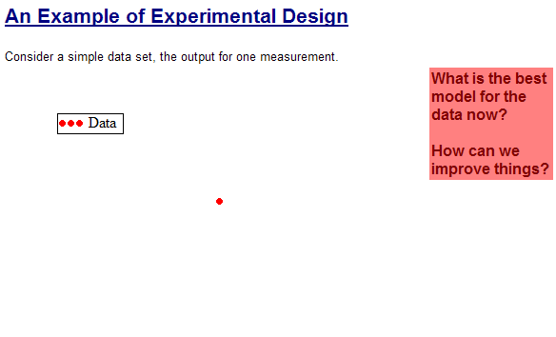
An Exercise in Experimental Design
Lecture 2-Exp Design.xmcd

Slide 12
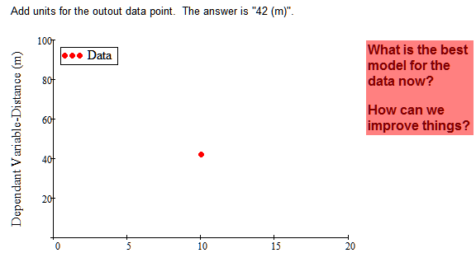
An Exercise in Experimental Design
Lecture 2-Exp Design.xmcd

Slide 13
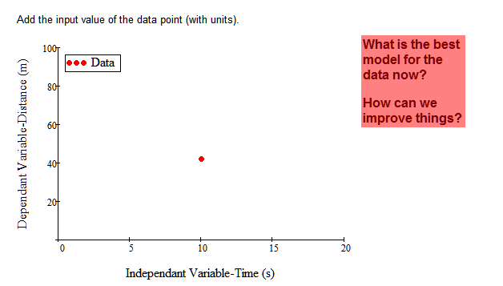
An Exercise in Experimental Design
Lecture 2-Exp Design.xmcd

Slide 14
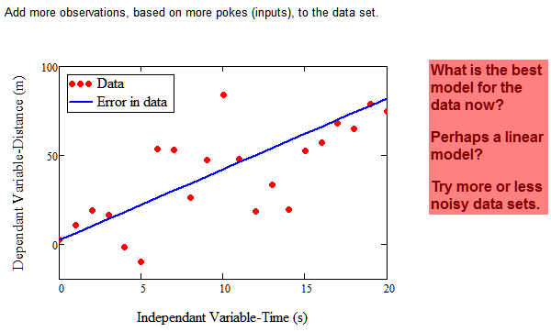
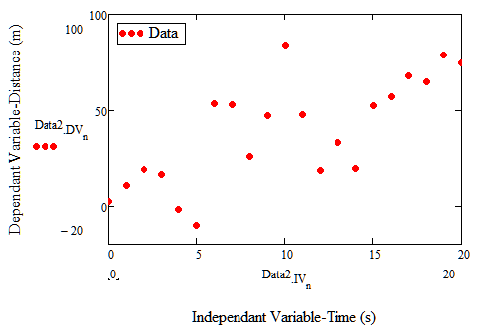
An Exercise in Experimental Design
Lecture 2-Exp Design.xmcd

Slide 15
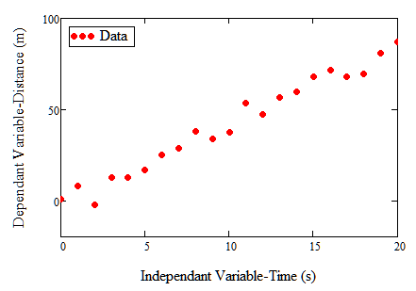
An Exercise in Experimental Design
Lecture 2-Exp Design.xmcd

Slide 16
An Exercise in Experimental Design
Lecture 2-Exp Design.xmcd

Slide 17
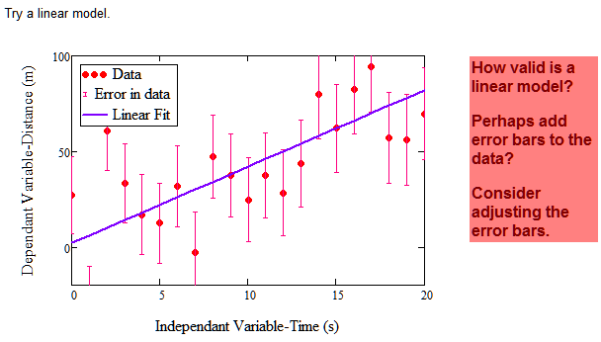
An Exercise in Experimental Design
Lecture 2-Exp Design.xmcd

Slide 18
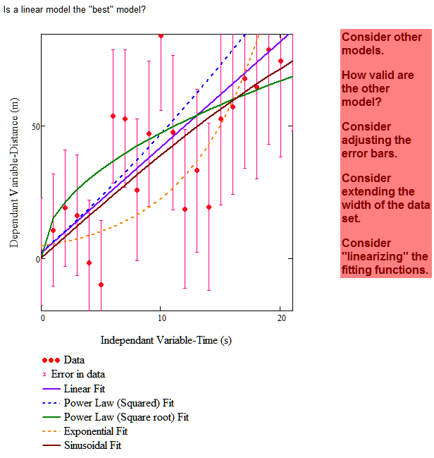
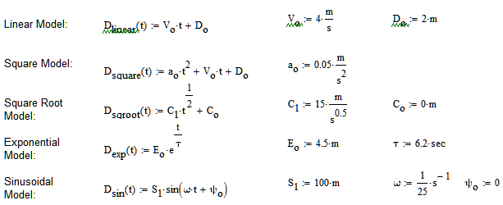
An Exercise in Experimental Design
Is the linear fit the “best” model?
Lecture 2-Exp Design.xmcd

Slide 19
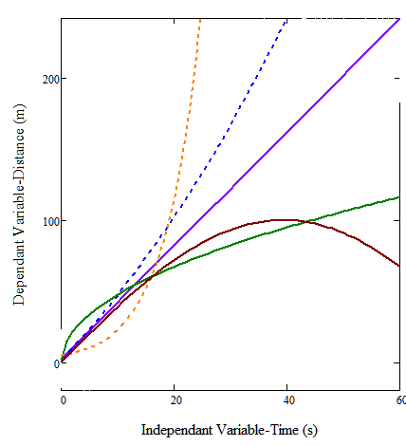
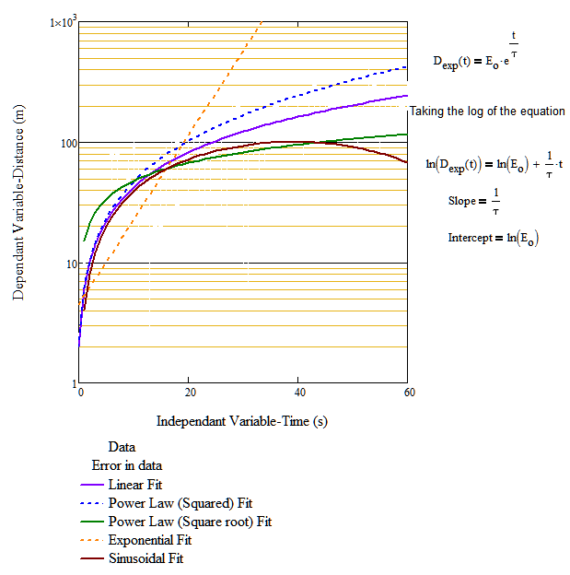
An Exercise in Experimental Design
Lecture 2-Exp Design.xmcd

Slide 20
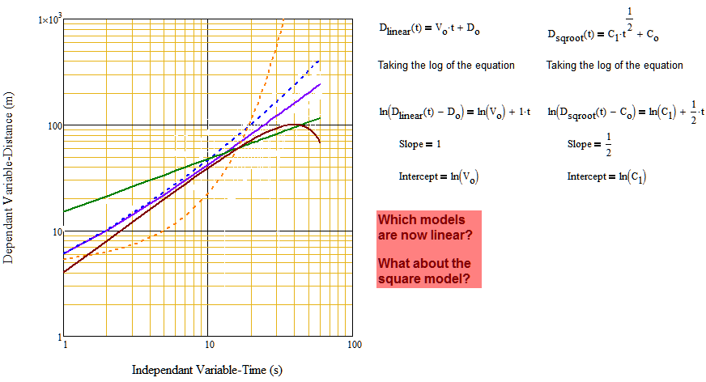
An Exercise in Experimental Design
Lecture 2-Exp Design.xmcd

Slide 21
Intermediate Lab
PHYS 3870
Comparing Measurements to Models
Qualitatively

Slide 22
Intermediate Lab
PHYS 3870
Dimensional Analysis

Slide 23
Units and Dimensions

Slide 24
Dimensional Analysis

Slide 25
Units and Dimensions--A Whole New World!

Slide 26
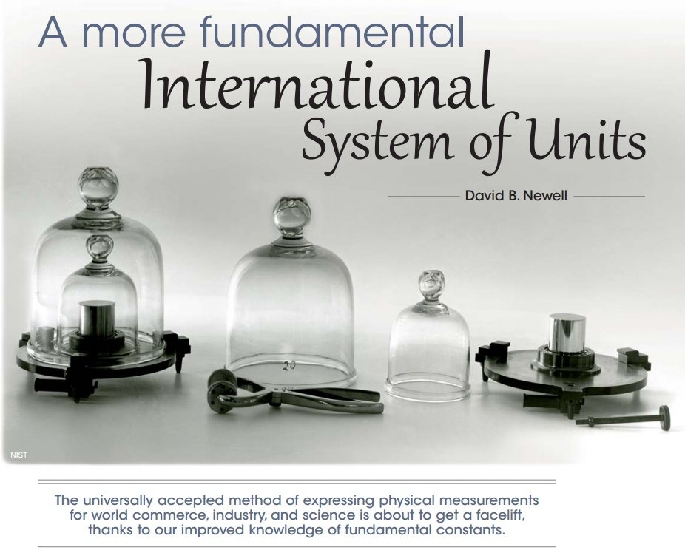

Slide 27
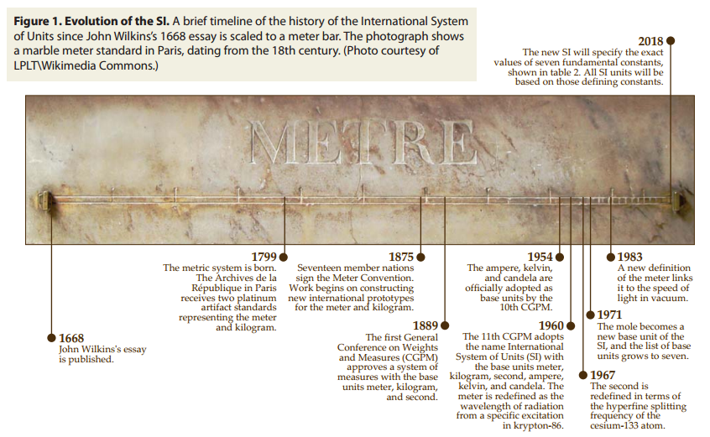
Units and Dimensions--A Whole New World!

Slide 28
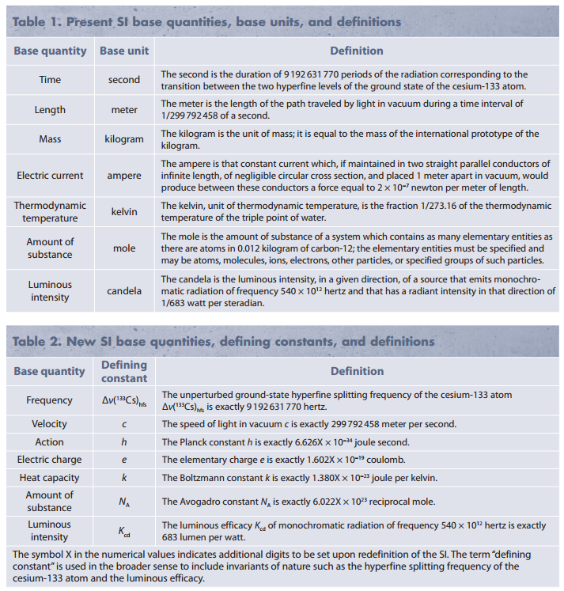
Units and Dimensions--A Whole New World!

Slide 29
Intermediate Lab
PHYS 3870
Graphical Analysis

Slide 30
Graphical Analysis
An “old School” approach to linear fits.
Rough plot of data
Estimate of uncertainties with error bars
A “best” linear fit with a straight edge
Estimates of uncertainties in slope and intercept from the error bars
This is a great practice to get into as you are developing an experiment!

Slide 31
Is it Linear?
A simple model is a linear model
You know it when you see it (qualitatively)
Tested with a straight edge
Error bar are a first step in gauging the “goodness of fit”
Adding 2D error bars is sometimes helpful.

Slide 32
Making It Linear or Linearization
A simple trick for many models is to linearize the model in the independent variable.
Refer to Baird Ch.5 and the associated homework problems.

Slide 33
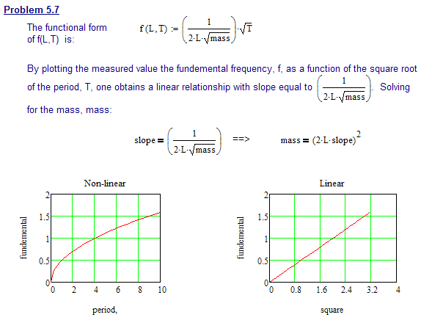
Linearizing Equations (1)
Determine a value for mass.

Slide 34
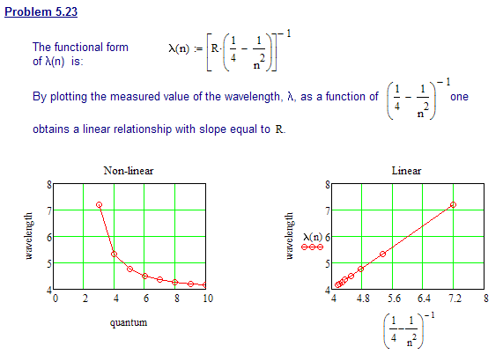
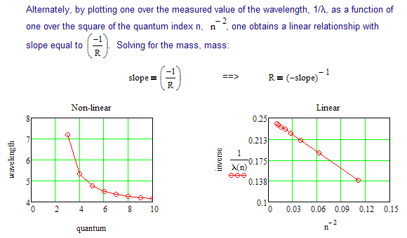
Linearizing Equations (2)
Determine a value for the Rydberg constant, R.

Slide 35
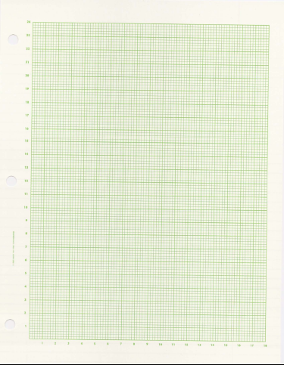
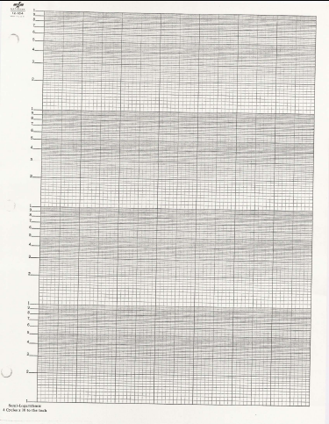
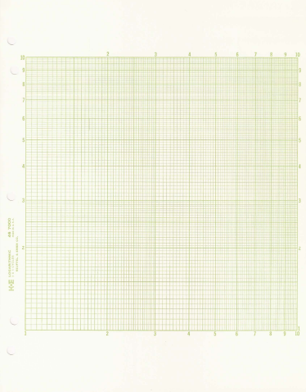
Special Graph Paper
Log-log paper tests for power law models.
Both Semi-log and log -log paper are handy for displaying details of data spread over many orders of magnitude.
Semi-log paper tests for exponential models.
Linear
“Old School” graph paper is still a useful tool, especially for reality checking during the experimental design process.
Semilog
Log-Log

Slide 36
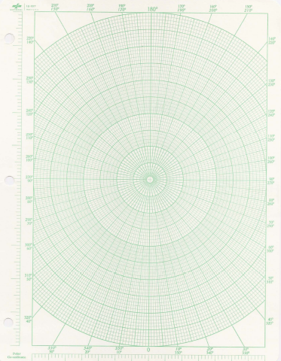
Special Graph Paper
Linear
Polar

Slide 37
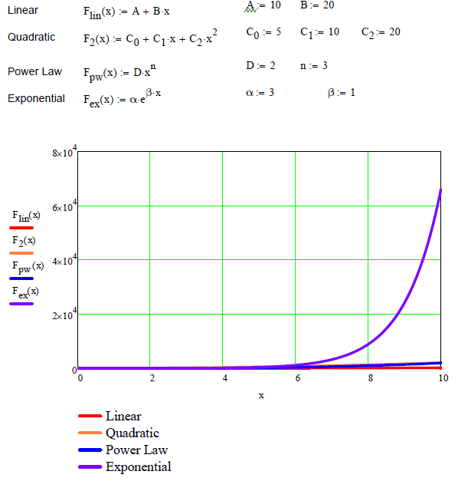
Linearizing Equations and “Magic Graph Paper”

Slide 38
Some Common Models

Slide 39
Intermediate Lab
PHYS 3870
Comparing Measurements to Models
Errors as a Quantitative Tool

Slide 40
Intermediate Lab
PHYS 3870
Defining Errors

Slide 41
What Is Error?
The term “error” does not mean mistake in science.
Rather, it means the inevitable uncertainty related to an observation or measurement of any physical quantity.
It is a best guess at the range of values of subsequent measurements.
Example: x = 1.0 ± 0.1 m
This is shorthand for “the best estimate of x is 1.0 m. Subsequent measurements of x will ‘almost certainly’ lie between 0.9 m and 1.1 m

Slide 42
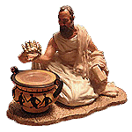
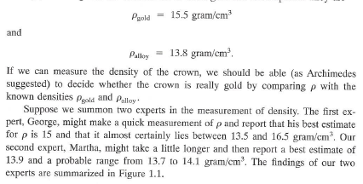
Why Are Errors Important?
http://www.math.nyu.edu/~crorres/Archimedes/Crown/CrownIntro.html

Slide 43
A Timely Example of Errors in Measurements
What time is it now?

Slide 44
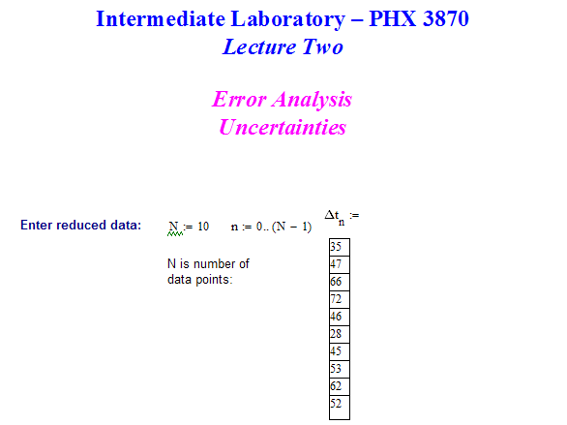
A Timely Example of Errors in Measurements
Analysis with Mathcad sheet?
Enter the data.

Slide 45
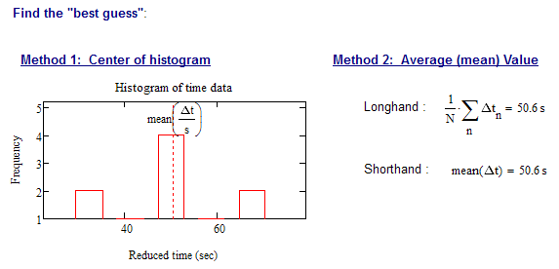
A Timely Example of Errors in Measurements
Analysis with Mathcad sheet?

Slide 46
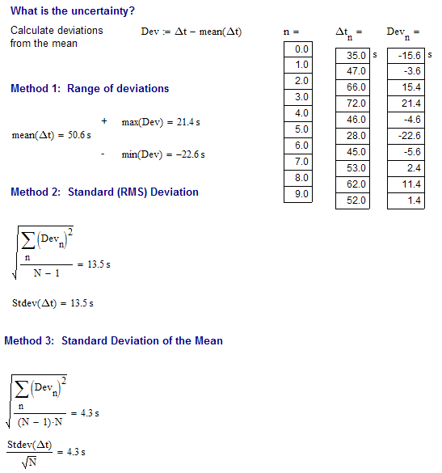
A Timely Example of Errors in Measurements
Analysis with Mathcad sheet?
What is the uncertainty?.

Slide 47
A Timely Example of Errors in Measurements
What time is it now?
And the “best” answer is:
( 53 ± 9 ) sec [absolute error]
or
( 53 sec ± 20% ) [relative (fractional) error]
This is the best value and estimated uncertainty for a set of N measurements of the time.

Slide 48
Summary of Stating Errors in Measurements
Correct
1.23±0.02 m (±2%)
Incorrect
1.234567±0.024 m

Slide 49
Intermediate Lab
PHYS 3870
Accuracy and Systematic Errors

Slide 50
Random and Systematic Errors
Precision is defined as a measure of the reproducibility of a measurement
Such errors are called random (statistical) errors.
If an experiment has small random error, it is said to have high precision.
Accuracy is a measure of the validity of a measurement.
If an experiment has small systematic error, it is said to have high accuracy.

Slide 51
Accuracy and Systematic Error
Consider 4 “dart experiments”
Which experiments are precise (have good reproducibility or low random error)?
Which experiments are accurate (are close to “true” result or have low systematic error)?

Slide 52
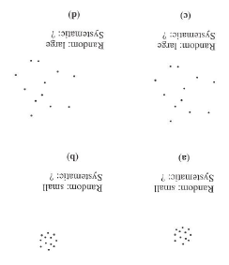
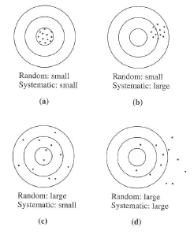
Precision and Accuracy

Slide 53
Accuracy and Systematic Error

Slide 54
A Timely Example of Errors in Measurements
What time is it?
Log on to the National Institute of Standards and Technology (NIST) web site.
GOOD: A low resolution time stamp to 0.3 s http://nist.time.gov/
BETTER: “The NIST servers listen for a NTP request on port 123, and respond by sending a udp/ip data packet in the NTP format. The data packet includes a 64-bit (1 part in 2 10¹⁹) timestamp containing the time in UTC seconds since Jan. 1, 1900 with a resolution of 200 ps. http://www.boulder.nist.gov/timefreq/service/its.htm
BEST: If that isn’t good enough, try these details on current research, with proposed precision of ±1x10⁻¹⁸ s (±1 as!!!) (also see Sc. American, 2002 special issue on time keeping). http://www.boulder.nist.gov/timefreq/

Slide 55
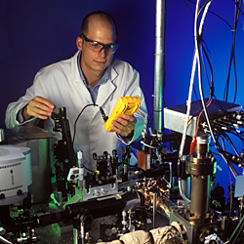
A Timely Example of Errors in Measurements
What time is it?
EVEN BETTER: NIST's Second "Quantum Logic Clock" is World's Most Precise Clock
NIST scientists have built a second "quantum logic clock," using quantum information processing techniques on a single ion of aluminum to make a clock that would not gain or lose more than one second in about 3.7 billion years.
For more information, please see http://www.nist.gov/pml/div688/logicclock_020410.cfm .

Slide 56
Intermediate Lab
PHYS 3870
Precision and Random (Statistical) Errors

Slide 57
Precision of Measurements

Slide 58
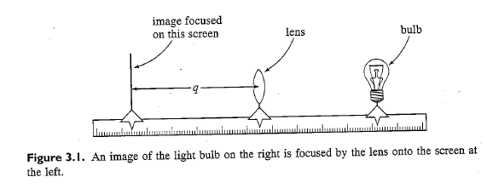
Precision and Random (Statistical) Error
123.45
1
2
3
…

Slide 59
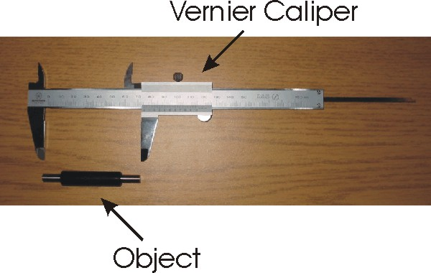
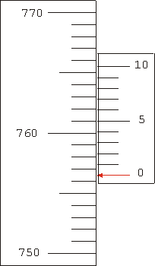
Reading a Vernier Scale
A vernier scale provides a way to gain added precision from an instrument scale
Notes:
http://www.upscale.utoronto.ca/PVB/Harrison/Vernier/Images/Vernier2.png

Slide 60
Intermediate Lab
PHYS 3870
The Ruler Exercise

Slide 61
The Ruler Exercise

Slide 62
The Ruler Exercise
Measure the width of the conference table.
Record you measured value and associated error on the white board.
Name Ruler Type Measured Value Uncertantity.

Slide 63
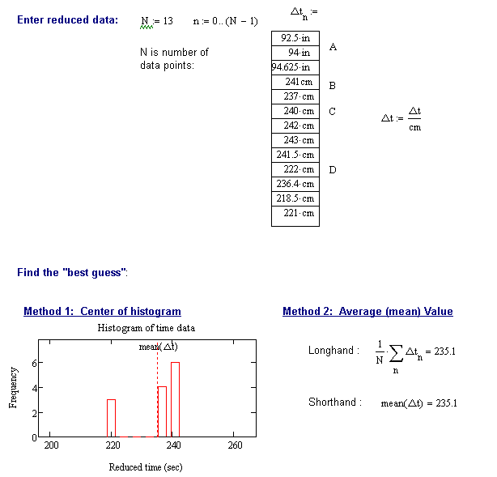
The Ruler Exercise

Slide 64
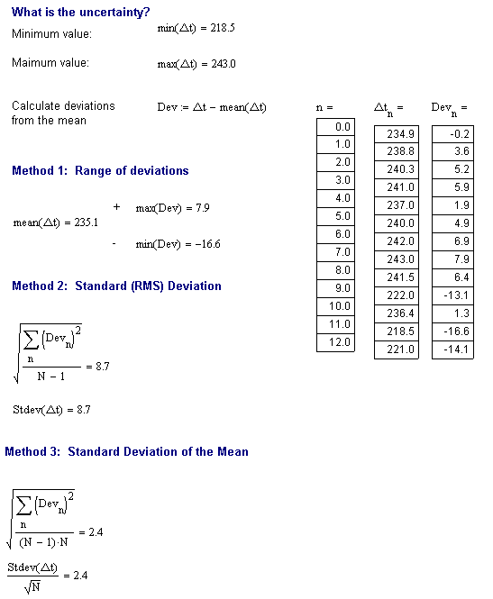
The Ruler Exercise

Slide 65
Precision, Accuracy and Systematic Errors
Precision is defined as a measure of the reproducibility of a measurement
Such errors are called random (statistical) errors. If an experiment has small random error, it is said to have high precision.
Accuracy is a measure of the validity of a measurement.
If an experiment has small systematic error, it is said to have high accuracy.

Slide 66
Intermediate Lab
PHYS 3870
Comparing Measurements to Models
Quantitatively

Slide 67
Comparison with Other Data
Is there agreement? (With what?)
Are these comparisons of precision or accuracy?

Slide 68
Direct Comparison with Standard
Is there agreement? (With what?)
Are these comparisons of precision or accuracy?

Slide 69
Intermediate Lab
PHYS 3870
Using Errors to
Quantitatively Test Models
Basic Approach [Baird, Ch 4.1].
Know data and uncertainties (presumably)
Use this to identify system, inputs and outputs
Now develop a model
Then test model by comparison with data (first qualitatively, then quantitatively)

Slide 70
Testing a Model?

Slide 71
Summary of Stating Errors in Measurements
Correct
1.23±0.02 m (±2%)
Incorrect
1.234567±0.024 m

Slide 72
Quantifying Precision and Random (Statistical) Errors

Slide 73
Standard Deviation

Slide 74
Standard Deviation of the Mean

Slide 75
Errors in Models—Error Propagation

Slide 76
Specific Rules for Error Propogation

Slide 77
Independent Uncertainties

Slide 78
Specific Rules for Independent Error Propagation

Slide 79
Independent (Random) Uncertaities and Gaussian Distributions

Slide 80
General Formula for Error Propagation

Slide 81
General Formula for Error Propagation

Slide 82
General Formula for Multiple Variables

Slide 83
A Complex Example for Multiple Variables

