Slide 1
Intermediate Lab
PHYS 3870
Lecture 1
Introduction

Slide 2
Intermediate Lab
PHYS 3870
Class Administration
and
Syllabus

Slide 3
Intermediate Lab
PHYS 3870
  Class: MW 11:30 - 2:20 SER 109/132/138
  Instructor: J.R. Dennison SER 222D
  797-2936 JR.Dennison@usu.edu
  Office Hours: MW 2:30-3:30
  Assistant Jonathan Price SER 209
  Instructor: jonathanprice1@live.com
  Class Web Site: http://www.physics.usu.edu/dennison/3870-3880/IntermediateLab.htm

Slide 4
Intermediate Lab Philosophy
PHYS 3870
It is important that students bring a certain ragamuffin barefoot irreverence to their studies; they are not here to worship what is known, but to question it.
–Jacob Bronowski, The Ascent of Man 1973
If you’re not prepared to be wrong, you’ll never come up with anything original.
–Sir Ken Robertson, TED Talk 2006
Take chances, make mistakes, get messy.
–Miss Frizzle, The Magic School Bus 1994

Slide 5
Intermediate Lab
PHYS 3870

Slide 6
Intermediate Lab
PHYS 3870

Slide 7
Intermediate Lab
PHYS 3870

Slide 8
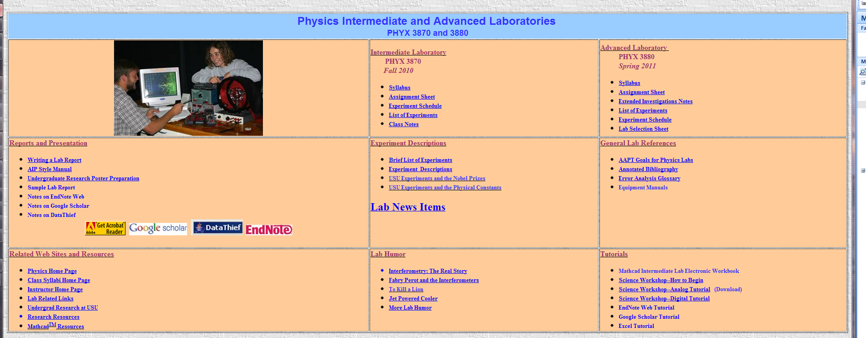
Intermediate Lab
PHYS 3870
  Class Web Site: http://www.physics.usu.edu/
  Go to Classes/Class Websites

Slide 9
Intermediate Lab
PHYS 3870

Slide 10
Intermediate Lab
PHYS 3870

Slide 11
Intermediate Lab
PHYS 3870

Slide 12
Intermediate Lab
PHYS 3870

Slide 13
Intermediate Lab
PHYS 3870

Slide 14
Intermediate Lab
PHYS 3870

Slide 15
Intermediate and Advanced Lab
PHYS 3870-3880
Intermediate Lab
PHYS 3870
Error Analysis
& Experimental Design
Experiment 2
3 Weeks
Long Report
Experiment 3
3 weeks
Oral Presentation
Experiment 1
3 weeks
Short Report
Advanced Lab
PHYS 3880
Experiment 4
3 weeks
Short Report
Experiment 6
3 weeks
Poster Presentation
Experiment 5
Extended Investigation
7 weeks
Long Report

Slide 16
Intermediate Lab
PHYS 3870
We’re going to “do physics” in this lab!
So this begs the question:
What is Experimental Physics?

Slide 17
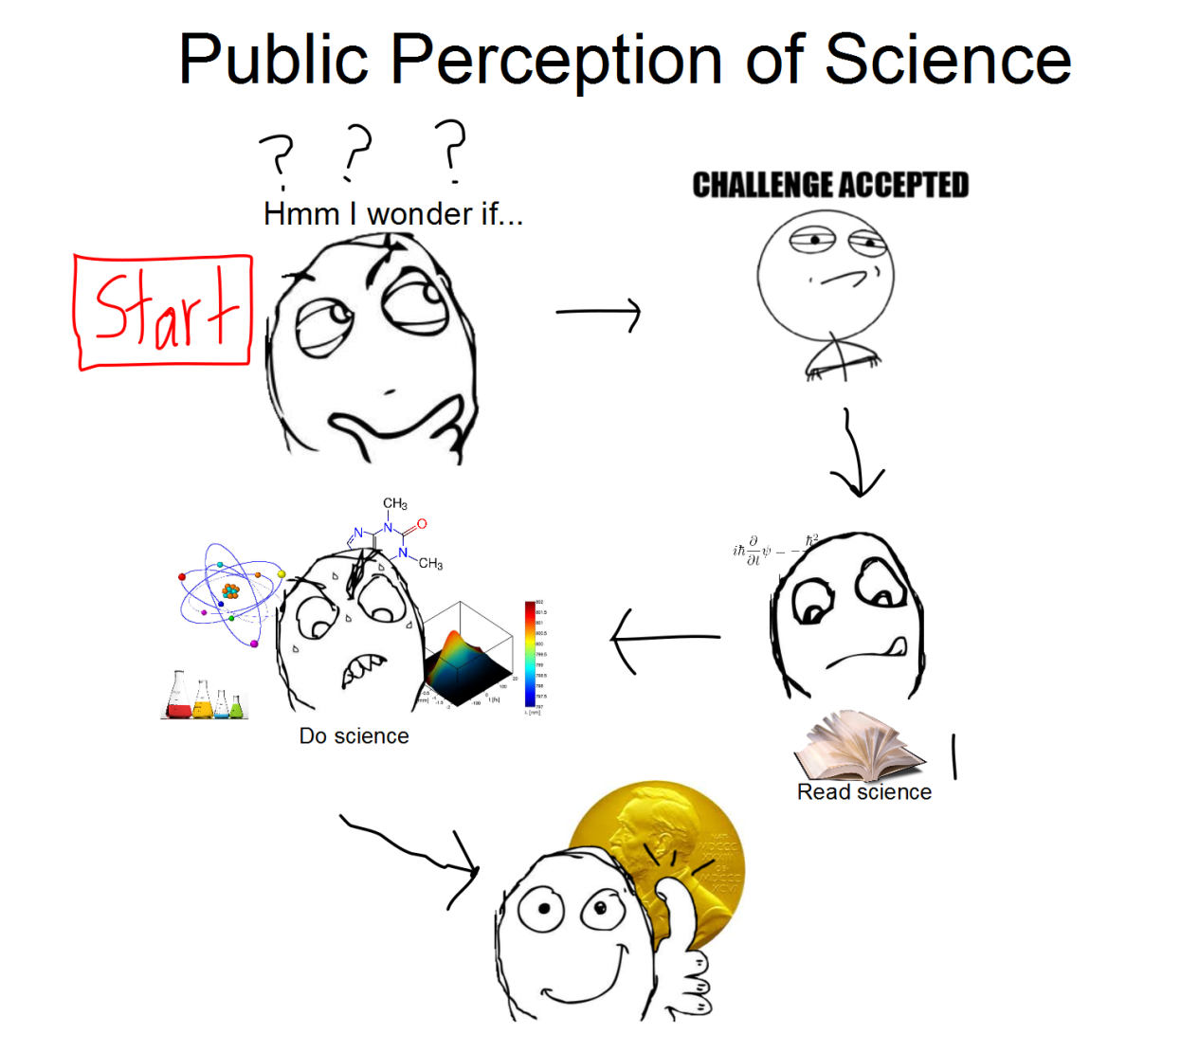
What is “Doing Physics”?

Slide 18
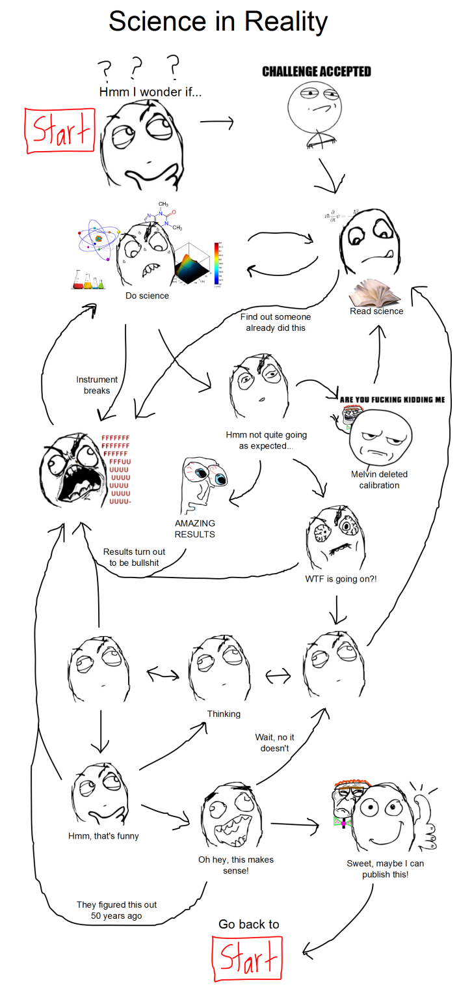
What is Really
“Doing Physics”?

Slide 19
What is Physics?
“Study of the basic nature of matter and the interactions that govern its behavior.”
BORING!!!
“How Stuff Works.”
True, but vague.
  “Common Sense Approach to How Things Work”
  (with units!)
Common Sense—A minimal set of simple, straightforward guides.
Units—Predictions on a quantitative level

Slide 20
What are the major subfields in Physics?
Classical Physics (pre-20th century)
  Mechanics → forces, motion
  Thermodynamics → heat, temperature
  Electricity and magnetism → charge, currents
  Optics → light, lenses, telescopes
Modern Physics (20th and 21st centuries)
  Atomic and nuclear → radioactivity, atomic power
  Quantum mechanics } _{→ basic structure of matter}
  Particle physics
  Condensed matter → solids & liquids, computers, lasers
  Complex systems→ chaos, complexity, fractals, critical exponents
  Relativity, Cosmology → universe, life!

Slide 21
State of Physics cira 1895
Statistical Mechanics
3 Laws of Thermodynamics
Kinetic Theory
Conservation Laws
Energy
Linear & Angular Momentum
Notes:
Good history of physics books:
George Gamow, “Thirty Years That Shook Physics,” (Doubleday, Garden City, NY, 19??).
Abraham Pais, “Inward Bound: Of Matter and Forces in the Physical World,” (Oxford Press, New York, 1986).
Emilio Segre, “From x-rays to quarks: Modern physicists and their discoveries,” (W.H. Freeman, New York, 1980).
Emilio Segre, “From falling bodies to radio waves,” (W.H. Freeman, New York, 1984).

Slide 22
Limits of pre-Modern Physics
Dimension | Range of Applicability | Range of Application
Length | 10⁻⁶ to 10⁺⁸ m | Smoke particle (Brownian Motion) to the solar system
Mass | 10⁻⁹ to 10⁺³¹ kg | Dust particles to solar mass
Time | 10⁺¹⁰ to 10⁺¹⁷ sec⁻¹ 10⁻³ to 10⁺⁹ sec | Microwave to UV light Smallest timing increments (msec) to celestial motions (centuries)
Velocity | 10⁻⁶ to 10⁺⁵ m/s | Small particles to celestial motion

Slide 23
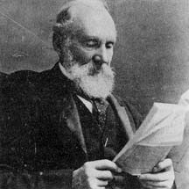
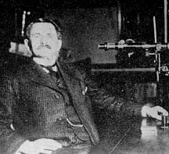
State of Physics cira 1895
Lord Kelvin—arguably the greatest physicist of his day:
Strong opponent of existence of atoms
“There is nothing new to be discovered in physics now. All that remains is more and more precise measurement." (British Assoc., 1900)
Albert A Michleson—the first US Physics Nobel laureate:
“The grand underlying principles have been firmly established...further truths of physics are to be looked for in the sixth place of decimals" (Science, 1892)
Notes:
Kelvin is also known for an address to an assemblage of physicists at the British Association for the advancement of Science in 1900 in which he stated, "There is nothing new to be discovered in physics now. All that remains is more and more precise measurement." A similar statement is attributed to the American physicist Albert Michelson.
http://scienceworld.wolfram.com/biography/Kelvin.html
Michelson is quoted as quipping "the grand underlying principles have been firmly established...further truths of physics are to be looked for in the sixth place of decimals" (Science, 1992), but a similar quote is also attributed to Kelvin.
http://scienceworld.wolfram.com/biography/Michelson.html

Slide 24
Inconsistencies in Physics cira 1900
Statistical Mechanics
Boltzmann Distribution
Entropy and counting states
Blackbody radiation
Wein’s Law
Photoelectric effect
Diffraction of x rays
Discrete atomic spectra
Radioactive decay
Brownian motion
Existence of Atoms!
Notes:
Good history of physics books:
George Gamow, “Thirty Years That Shook Physics,” (Doubleday, Garden City, NY, 19??).
Abraham Pais, “Inward Bound: Of Matter and Forces in the Physical World,” (Oxford Press, New York, 1986).
Emilio Segre, “From x-rays to quarks: Modern physicists and their discoveries,” (W.H. Freeman, New York, 1980).
Emilio Segre, “From falling bodies to radio waves,” (W.H. Freeman, New York, 1984).

Slide 25
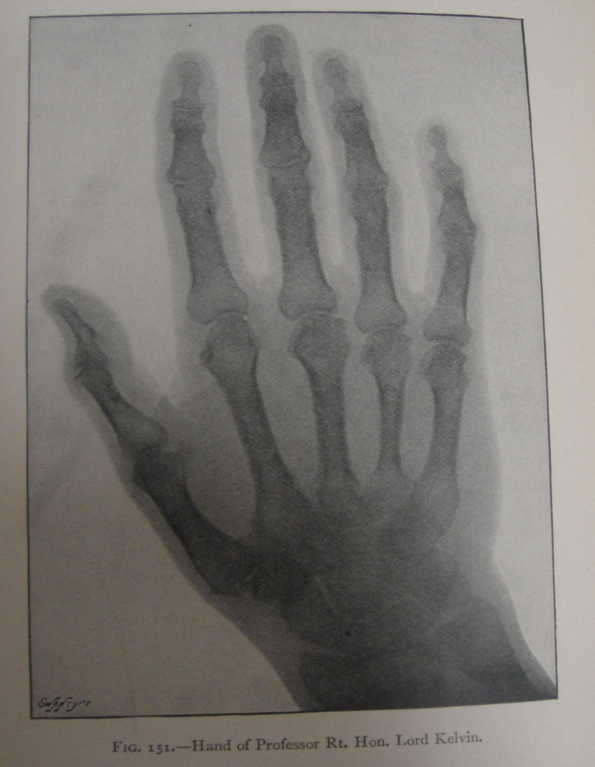
Then All Hell Broke Lose
“Thirty Years That Shook Physics”
1887 Michelson-Morley exp. debunks “ether”
1895 Rontgen discovers x rays
1897 Becquerel discovers radioactivity
1897 Thomson discovers the electron
1900 Planck proposes energy quantization
1905 Einstein proposes special relativity
1915 Einstein proposes general relativity
1911 Rutherford discovers the nucleus
1911 Braggs and von Laue use x rays
to determine crystal structures
1911 Ones finds superconductors
1913 Bohr uses QM to explain hydrogen spectrum
1923 Compton demonstrates particle nature of light
1923 de Broglie proposes matter waves
1925 Davisson & Germer prove matter is wavelike
1925 Heisenberg states uncertainty principle
1926 Schrodinger develops wave equation
1924-6 Boson and Fermion distributions developed
1949 Murphy's Law stated
Silvanus P. Thompson, Light: Visible and Invisible,
(MacMillan, New York, 1897).
Notes:
George Gamow, “Thirty Years That Shook Physics,” (Doubleday, Garden City, NY, 19??).
Photo from Silvanus P. Thompson, Light: Visible and Invisible, (MacMillan, New York, 1897).

Slide 26
Current State of Physics cira 2014
Statistical Mechanics (1860-1900s)
Physics of many particles
Fermions and Bosons
Partitioning of Energy
Thermodynamics
Time and Entropy
Conservation Laws
Energy
Linear & Angular Momentum
Charge, Spin, Parity
Lepton and Baryon Number
Weinburg-Salom Model
Unites E&M, Weak NF
QED (1960s)
Quantum Mechanics
Schrodinger/Dirac Equation (1920-30s)
Probabilistic approach
Grand Unified Theories
Unifies E&M, Weak NF, Strong NF
String Theories
QCD (1970s)
Theories of Everything
Unifies E&M, Weak NF,
Strong NF and Gravity
Notes:
Remarkably, it is SM, E&M and the conservation laws that have stood the test of time (so far).
“A theory is more impressive the greater the simplicity of its premises, the more different kinds of things it relates, and the more extended its area of applicability. Therefore the deep impression that classical thermodynamics made upon me. It is the only physical theory of universal content which I am convinced will never be overthrown, within the framework of applicability of its basic concepts.” Albert Einstein

Slide 27
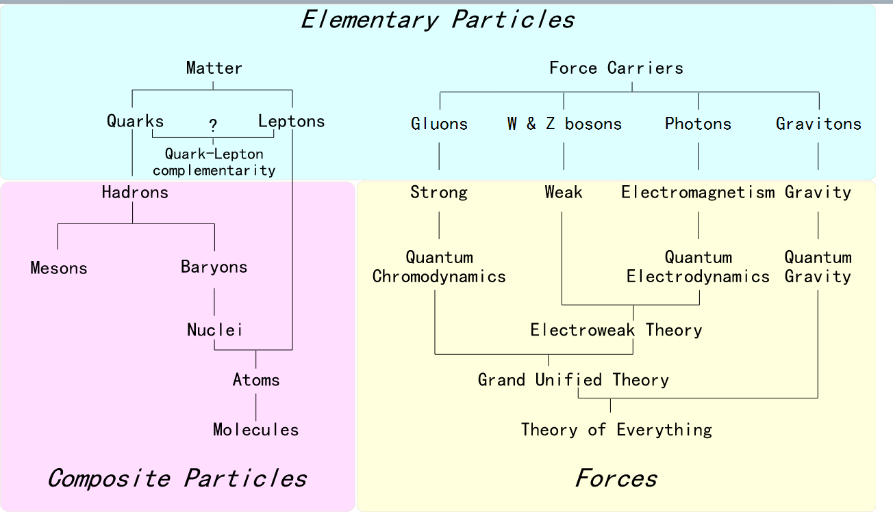
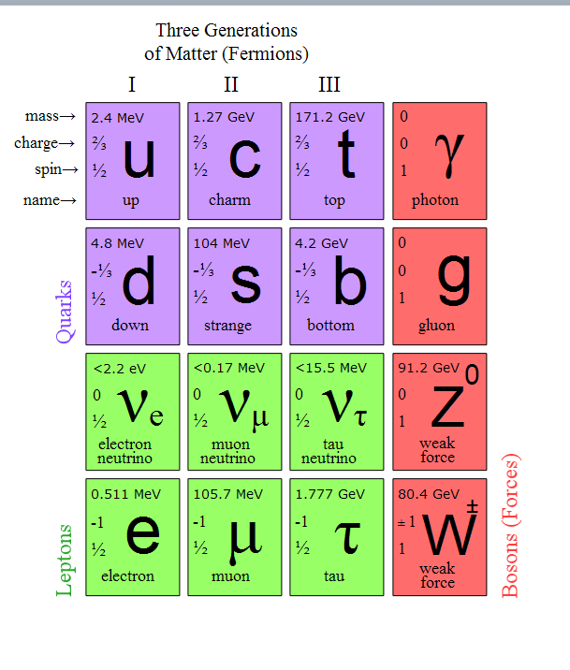
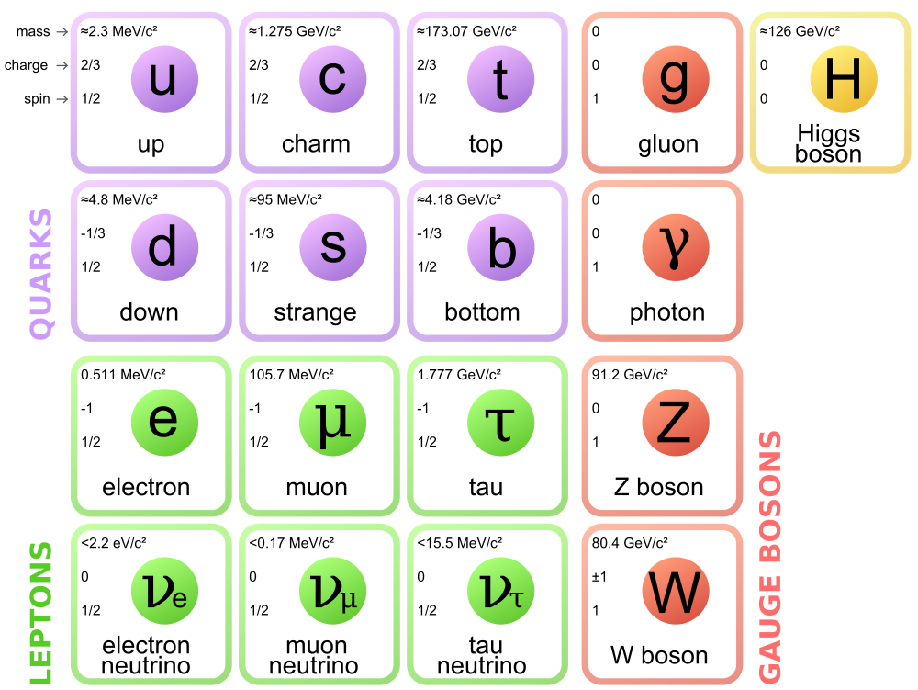
Current State of Physics cira 2014
Notes:
An overview of the various families of elementary and composite particles, and the theories describing their interactions. Fermions are on the left, and Bosons are on the right.
The Standard Model of elementary particles, with the fermions in the first three columns and the gauge bosons in the fourth column. The Higgs particle is in the fifth column
Wikipedia, “Fundamental Forces” 8/2013.

Slide 28
Limits of Current Modern Physics
Dimension | Range of Applicability | Range of Application
Length | 10⁻¹⁸ to 10⁺²⁶ m | Quark size to the universe size
Mass | 10⁻³¹ to 10⁺⁴⁰ kg | Electrons to galactic clusters
Time | 10⁺³ to 10⁺²² sec⁻¹ 10⁻¹⁶ to 10⁺¹⁷ sec | Radio to Gamma rays Sub-femtosecond spectroscopy to age of universe
Velocity | 10⁻⁸ to 10⁺⁸ m/s | Sub-atomic particles to speed of light

Slide 29
Inconsistencies in Physics cira 2009
Statistical Mechanics
Fermions, Bosons and Anyons
Bose-Einstein Condensates
Superconductivity
Stellar Evolution
SM of Black Holes
Time and Entropy
Conservation Laws
Energy
Linear & Angular Momentum
Charge, Spin
Lepton and Baryon Number
Chaotic and complex systems
Quantum Mechanics
Existence of atoms
Schrodinger/Dirac Equation
Sub-atomic particles
Probabilistic approach
Teleportation
Entwined states
Sub-Planck length physics
Notes:
Remarkably, it is SM, E&M and the conservation laws that have stood the test of time (so far).
“A theory is more impressive the greater the simplicity of its premises, the more different kinds of things it relates, and the more extended its area of applicability. Therefore the deep impression that classical thermodynamics made upon me. It is the only physical theory of universal content which I am convinced will never be overthrown, within the framework of applicability of its basic concepts.” Albert Einstein

Slide 30
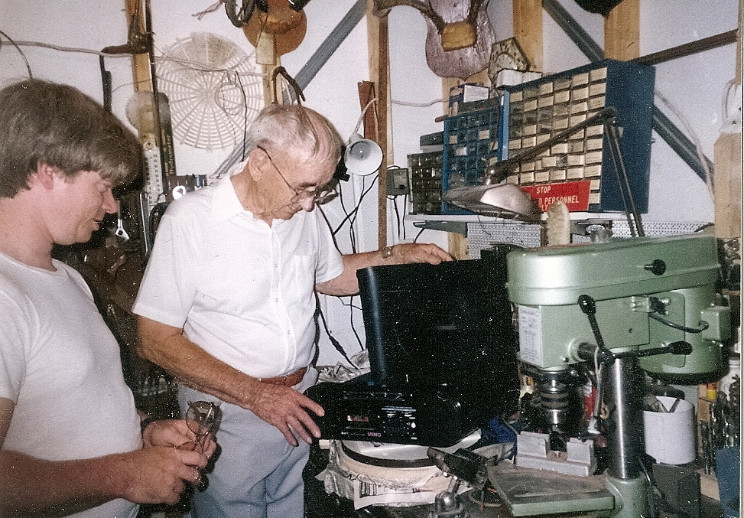
I learned my best physics in a shed.
Speaking of shed…see http://www.physics.usu.edu/dennison/3870-3880/Humor/jet%20powered%20beer%20cooler__.pdf
Notes:
Speaking of shed…see http://www.physics.usu.edu/dennison/3870-3880/Humor/jet%20powered%20beer%20cooler__.pdf

Slide 31
What is Experimentation?
Baird defines experimentation as the process of:
  Identifying a portion of the world to study (the system)
  Obtaining information from this system
  Interpreting this result

Slide 32

Observations of the Physical World
The
Simplest (Ideal) System
Input
SYSTEM
Output
The Universe
The system (portion of the world being studied) is well defined
Single input (things we can control) affects system
Single output (things we cannot control directly) results from interaction of system with input(s)
Observations characterize the system to within the uncertainty of the measurements

Slide 33
A Complex System
Inputs
SYSTEM
Outputs
The Universe
Complex (or ill defined) system and system boundaries
Multiple inputs
Multiple outputs
Possible complicating interactions:
- Between inputs
- Between outputs
- Between inputs and outputs
- Between outputs and inputs
- Between outputs and system
- Between inputs and system
- Between observations and system, inputs and outputs

Slide 34
Uncertainties in Observations
Input
SYSTEM
Output
The Universe
Observations characterize the system to within the uncertainty of the measurements
Uncertainties can arise from:
  Limitations of instrumentation or measurement methods
  Statistical fluctuations of the system
  Inherent uncertainties of the system
  - Quantum fluctuations
  - Non-deterministic processes (e.g., chaos):
    - There are systems where uncertainties dominate and preclude models predicting the outcome
    - We will not (intentionally) deal with this type of system this semester.

Slide 35
What is Science?
The scientific method goes further in:
Developing a description (model) of the system behavior based on observation
Generalizing this description (model) to other behavior and other systems
That is to say, the scientific method is experimentation and modeling intertwined
It is the scientific method that distinguishes science from other forms of endeavor
        As Neils Bohr famously said,
        “All science is either physics or stamp collecting.”

Slide 36
Objectives of Science?
Science is:
Science is the process of modeling the a portion of the physical world and using those models to predict the behavior of a larger portion of the physical world.
Science is by nature an experimental endeavor (based on observation).
Interpretation of observations to produce models (theories).
Interpretation of models (theories) to predict system behavior.
Good science is generalized to other (and often more complex) systems.
Good science prefers the simplest model (This is referred to as the Principle of Occam's Razor).
Einstein Principle: A scientific theory should be as simple as possible, but no simpler. – Albert Einstein

Slide 37
What is a Model?

Slide 38
What is a Model?

Slide 39
What is Science?
        The scientific method goes further in:
        Developing a description (model) of the system behavior based on observation
        Generalizing this description (model) to other behavior and other systems
        That is to say, the scientific method is experimentation and modeling intertwined
        It is the scientific method that distinguishes science from other forms of endeavor
        As Neils Bohr famously said,
        “All science is either physics or stamp collecting.”

Slide 40
Scientific Method:
Leads to new discoveries → how scientific progress is made!
Careful measurements,
Experiments
Models, Empirical
Laws, Generalization
Hypothesis, Theory

Slide 41
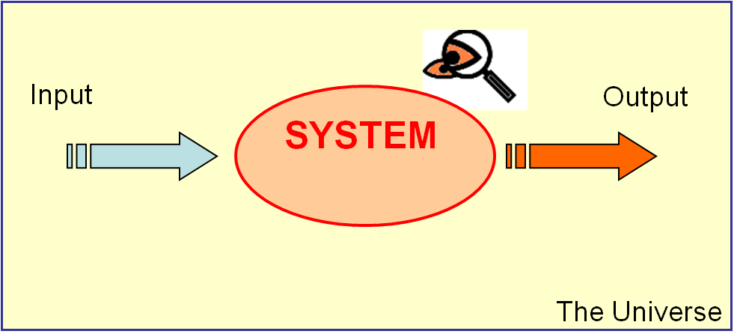
Testing a Model?

Slide 42
Intermediate Lab
PHYS 3870
The principle of science, the definition, almost, is the following: The test of all knowledge is experiment. Experiment is the sole judge of scientific "truth." But what is the source of knowledge? Where do the laws that are to be tested come from? Experiment, itself, helps to produce these laws, in the sense that it gives us hints. But also needed is imagination to create from these hints the great generalizations-to guess at the wonderful, simple, but very strange patterns beneath them all. and then to experiment to check again whether we have made the right guess.
–R. P. Feynman
The Feynman Lectures on Physics (Addison-Wesley, Read­ing, MA, 1963), Vol.1, Chap. I.

Slide 43
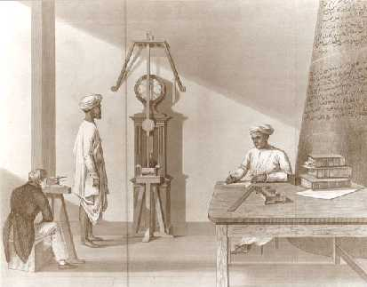
Design of Experiments to Study Specific Aspects of a Problem
Pendulum Labs
Simple Pendulum (PHYS 2220)
Physical (Kater) Pendulum
Compound (Wilberforce) Pendulum
Cavendish Balance
Chaotic Pendula
Focus of Experiment
Length standard
Materials properties
Measuring “little g”
Measuring “big G”
Gravitational anomalies (fifth force?)
Shape of orbits or the Earth
Coupling of forces
Kater, H., Phil. Trans., 108, 33 (1818).
Measured “little g” to a few ppm.
Became the defining standard for the British “yard”.
Vastly improved geodetic surveying accuracies.
Notes:
http://en.wikipedia.org/wiki/Kater's_pendulum

Slide 44
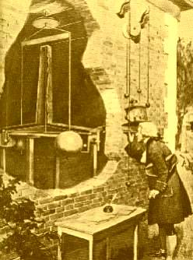
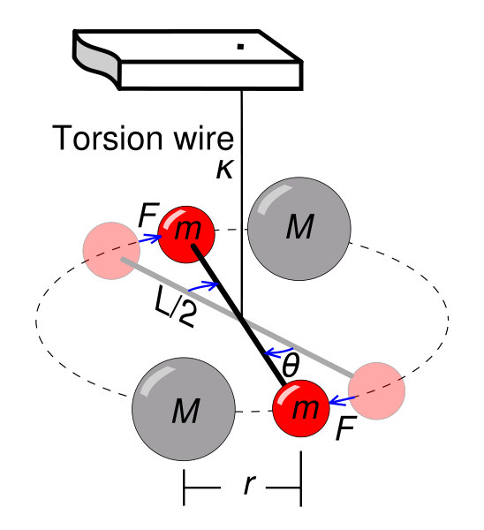
Historical Perspective on Gravity
Cavendish
Developed a clever way to measure the weak gravitational force between small masses.
Confirmed Newton’s Law of Universal Gravitation (and in essence measured the mass of the Earth in comparison to the kg mass standard).
The effect the 320 kg balls on the 1.5 kg balls was about that of a grain of sand!
That’s 20 parts per billion precision!!!
Wikeapedia has a nice description of the experiment.
Notes:
http://en.wikipedia.org/wiki/Cavendish_experiment

Slide 45
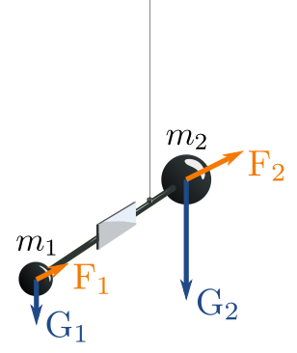
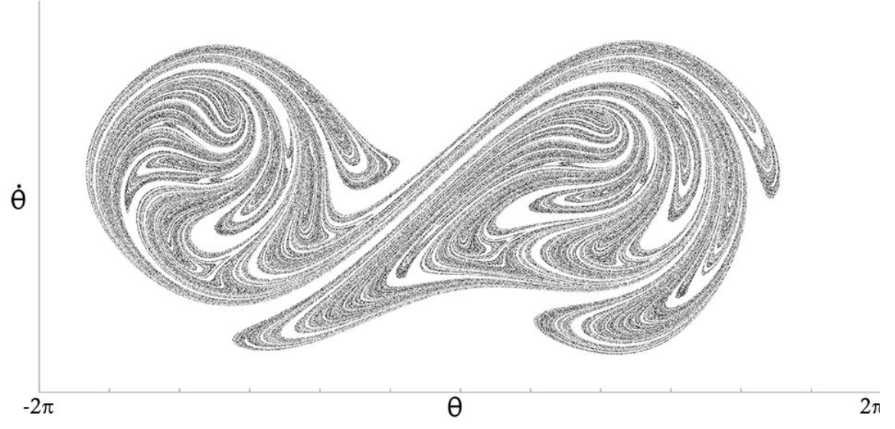
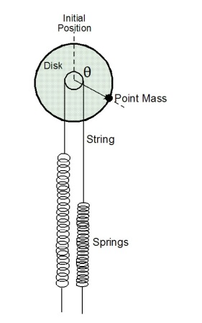
Design of Experiments to Study Specific Aspects of a Problem
Eötvös and Fishback
Correlation between inertial mass and gravitational mass
Gravitational anomalies (fifth force?)
The original Eötvös data of these ~1880’s experiments were re-examined , including detailed studies of the local stratigraphy, the physical layout of the Physics Institute (which Eötvös had personally designed), and even the weather and other effects. The experiment is therefore well recorded.
Chaotic
Pendula
Notes:
http://en.wikipedia.org/wiki/Kater's_pendulum

