Slide 1
Intermediate Lab
PHYS 3870
CONVEYING INFORMATION
Writing Reports
Gathering Information
References: PHYS 3870 Web Site
USU Library Web Site

Slide 2
Intermediate Lab
PHYS 3870
CONVEYING INFORMATION
Writing Reports
References: PHYS 3870 Web Site

Slide 3
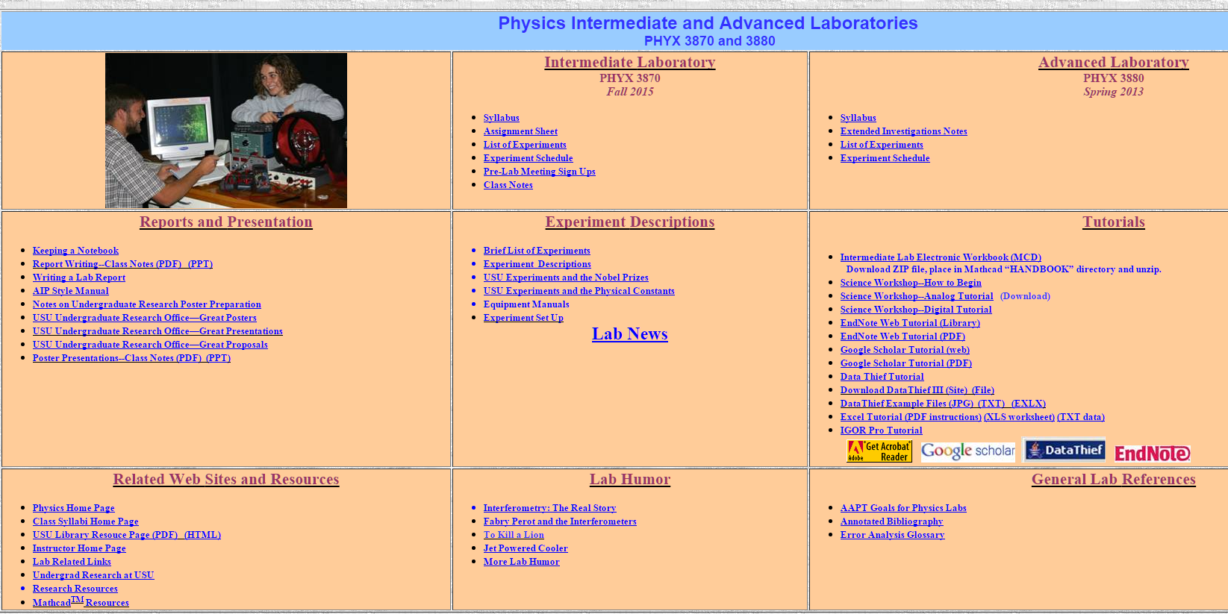
PHYS 3870 Web Site
Writing page
Poster page
But first…the most important page

Slide 4
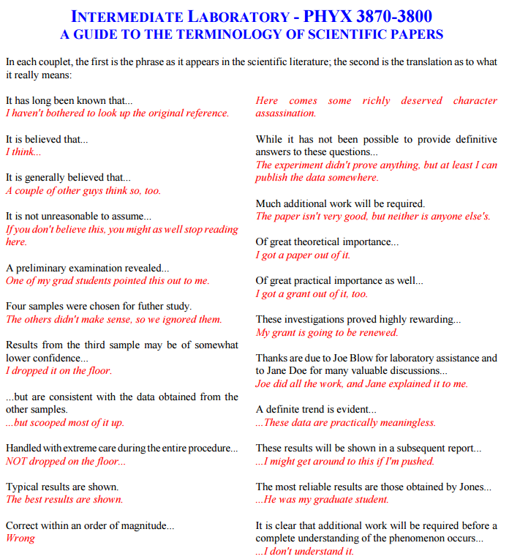
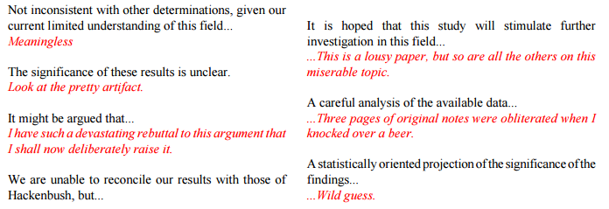
PHYS 3870 Web Site
The Real Story
http://www.physics.usu.edu/dennison/3870-3880/Humor/science%20terminology%20humor.pdf

Slide 5
Intermediate Lab
PHYS 3870
CONVEYIMG INFORMATION
Writing Styles
References: PHYS 3870 Web Site

Slide 6
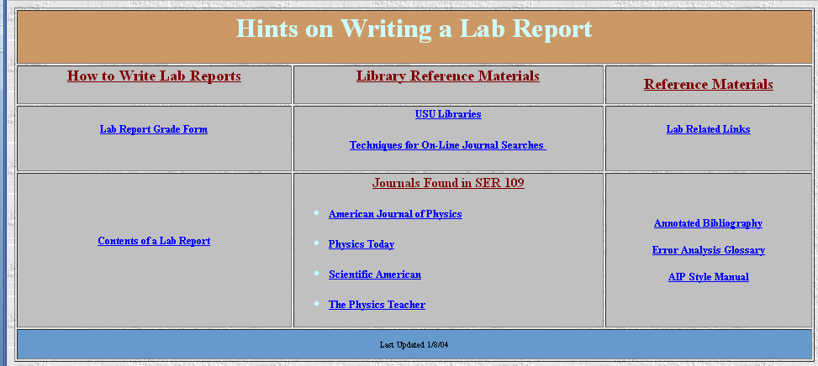
PHYS 3870 Web Site
Grade Rubric
Notes on contents of a lab report
The AIP Style Manual
AIP Style Manual: http://www.aip.org/pubservs/style/4thed/toc.html
AIP Journals: http://www.aip.org/pubservs/compuscript.html
American Journal of Physics: http://ajp.dickinson.edu/Contributors/manFormat.html

Slide 7
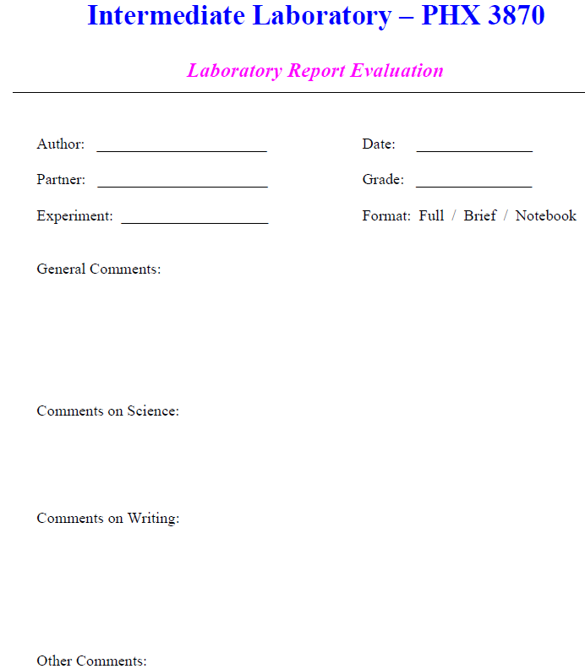
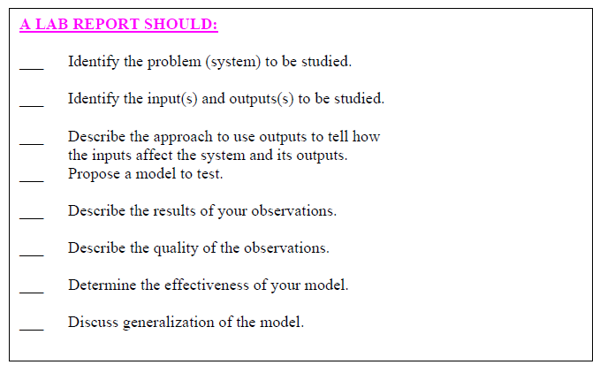
PHYS 3870 Report Rubric
Grade Rubric
http://www.physics.usu.edu/dennison/3870-3880/References/Lab_Report_Rubric.pdf

Slide 8
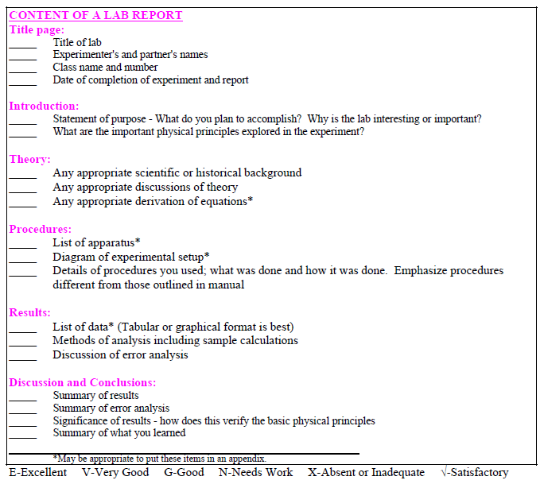
PHYS 3870 Report Rubric
Grade Rubric
http://www.physics.usu.edu/dennison/3870-3880/References/Lab_Report_Rubric.pdf

Slide 9
PHYS 3870 Web Site
Content of a Lab Report
Notes on contents of a lab report
http://www.physics.usu.edu/dennison/3870-3880/References/Content%20of%20Lab%20Report.pdf

Slide 10
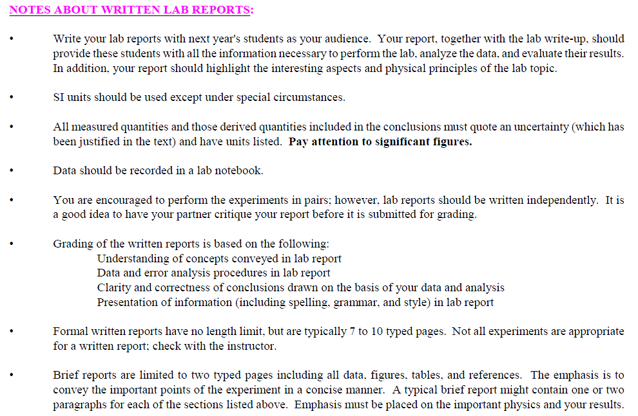
PHYS 3870 Web Site
Content of a Lab Report

Slide 11
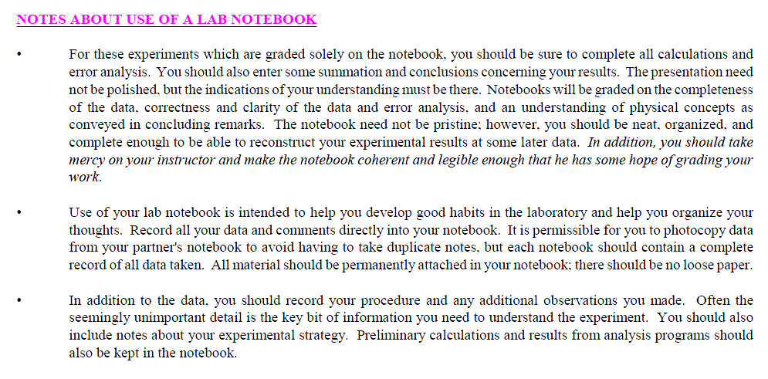
PHYS 3870 Web Site
Use of a Lab Notebook

Slide 12
PHYS 3870 Web Site
Writing Resources
Notes on “Old School” Technical Writing
“The Scientific Attitude”

Slide 13
PHYS 3870 Web Site
Writing Resources
Notes on “Old School” Technical Writing
Tense in Scientific Writing
Active Vs Passive Voice
Singulars and Plurals

Slide 14
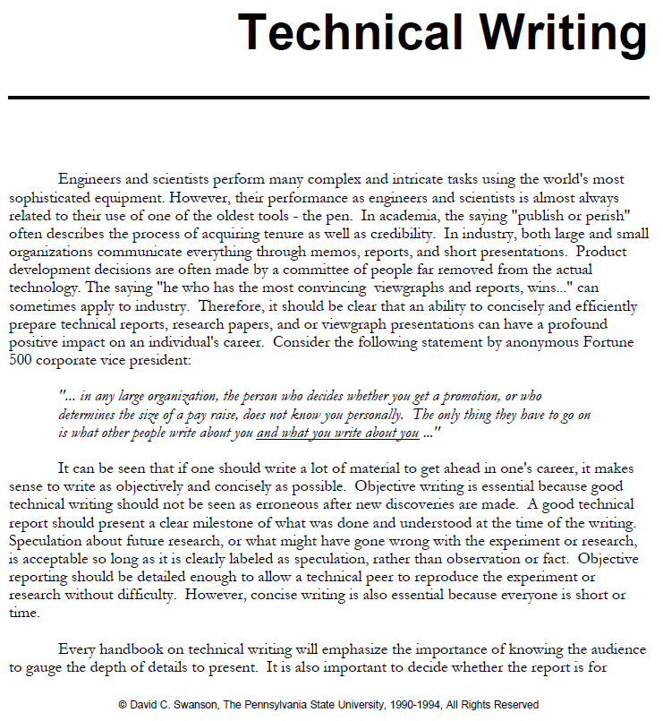
PHYS 3870 Web Site
Notes on Technical Writing

Slide 15
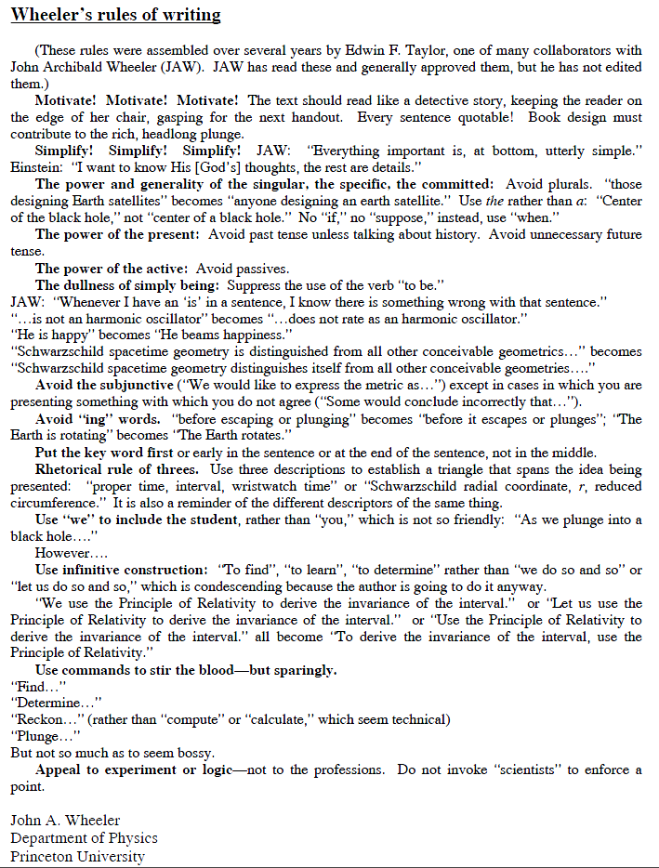
PHYS 3870 Web Site
Wheeler’s Rules of Writing

Slide 16

PHYS 3870 Web Site
Writing Resources
Review
"...a marvellous and timeless little book... Here, succinctly, elegantly and without fuss are the essentials of writing clear, correct English." John Clare, "The Telegraph"
From the Back Cover
Some acclaim for previous editions:
"Buy it, study it, enjoy it. It's as timeless as a book can be in our age of volubility."
— The New York Times
"No book in shorter space, with fewer words, will help any writer more than this persistent little volume."
— The Boston Globe
"White is one of the best stylists and most lucid minds in this country. What he says and his way of saying it are equally rewarding."
— The Wall Street Journal
"The book remains a nonpareil: direct, correct, and delightful."
— The New Yorker

Slide 17

PHYS 3870 Web Site
A New Writing Resource

Slide 18
PHYS 3870 Web Site
Style Manuals
Grade Rubric
Notes on contents of a lab report
The AIP Style Manual
AIP Style Manual: http://www.aip.org/pubservs/style/4thed/toc.html
AIP Journals: http://www.aip.org/pubservs/compuscript.html
American Journal of Physics: http://ajp.dickinson.edu/Contributors/manFormat.html

Slide 19

Intermediate Lab
PHYS 3870
CONVEYIMG INFORMATION
Journal Style Manuals
References: PHYS 3870 Web Site
AJP web site http://ajp.dickinson.edu/Contributors/contGenInfo.html
AIP Style Manual: http://www.aip.org/pubservs/style/4thed/toc.html

Slide 20
American Journal of Physics Style
Audience and Mission
The mission of the American Journal of Physics (AJP) is to publish articles on the educational and cultural aspects of physics that are useful, interesting, and accessible to a diverse audience of physics students, educators, and researchers who are generally reading outside their specialties to broaden their understanding of physics and to expand and enhance their pedagogical toolkits at the undergraduate and graduate levels.
AJP web site http://ajp.dickinson.edu/Contributors/contGenInfo.html

Slide 21
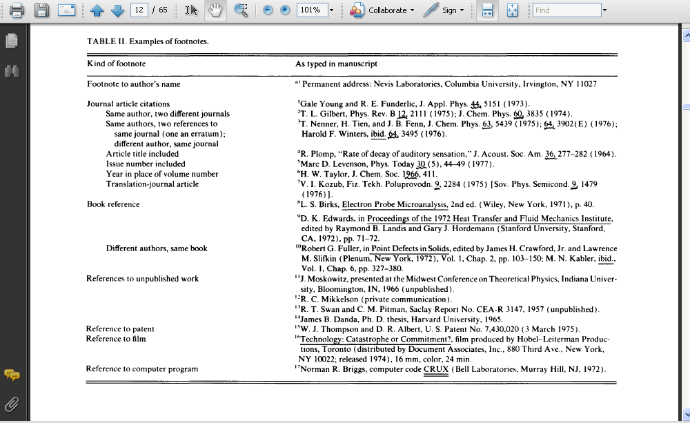
AIP Style Manual
Includes information on:
Writing a paper
Parts of a paper
Headings
Reference formats
Grammar and punctuation
Spelling and misspelled words
“I” and “we”
Capitalizations
Accepted abbreviations
Symbols
Units
Graph formats
Figures and figure captions
Tables and Table captions
Equations
Symbols
AIP Style Manual: http://www.aip.org/pubservs/style/4thed/toc.html

Slide 22
Intermediate Lab
PHYS 3870
CONVEYING INFORMATION
Gathering Information
References: PHYS 3870 Web Site
USU Library

Slide 23
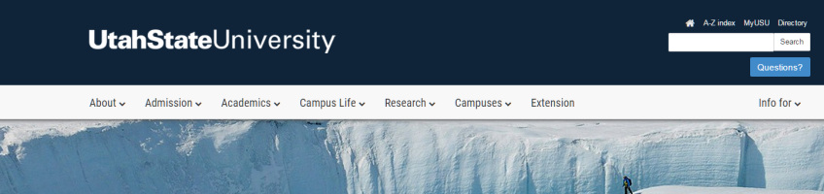


Access the USU Library Home Web Page
http://library2.usu.edu/howto/

Slide 24
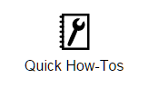
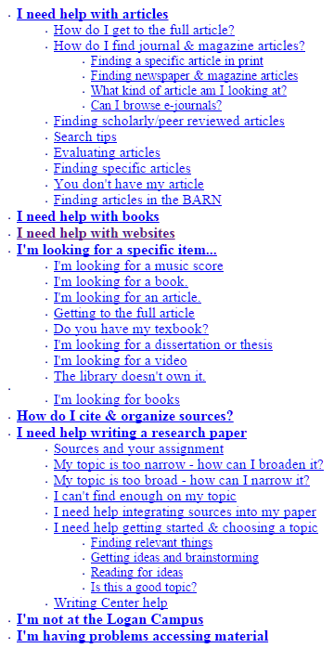
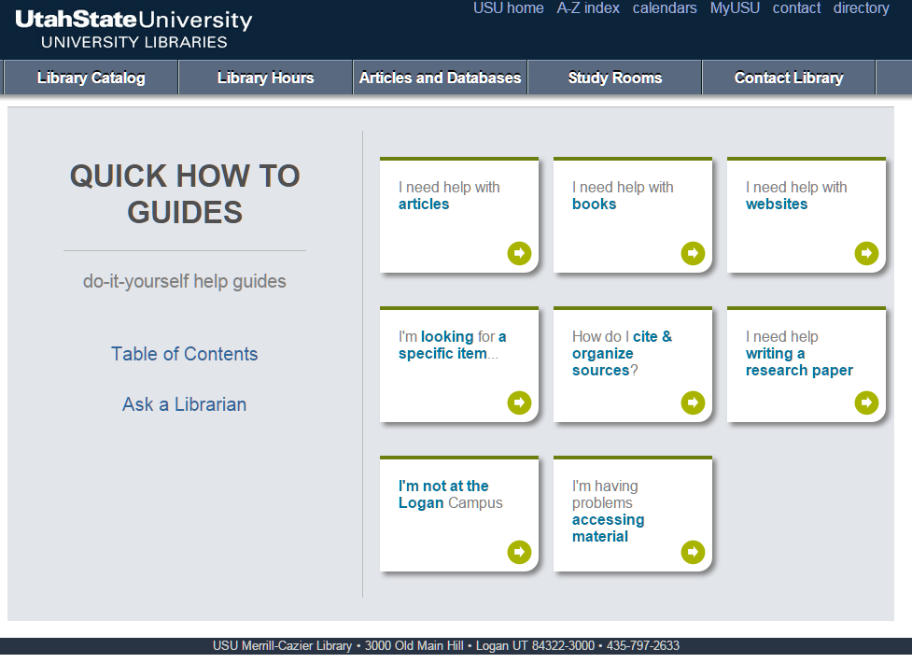
Access the USU Library How-Tos
http://library2.usu.edu/howto/
http://library2.usu.edu/howto/sitemap.php

Slide 25
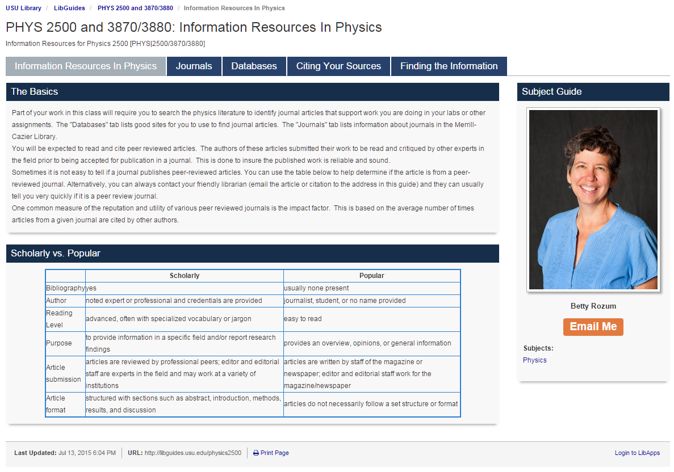
Access the USU Library Home Web Page
http://libguides.usu.edu/content.php?pid=246165

Slide 26
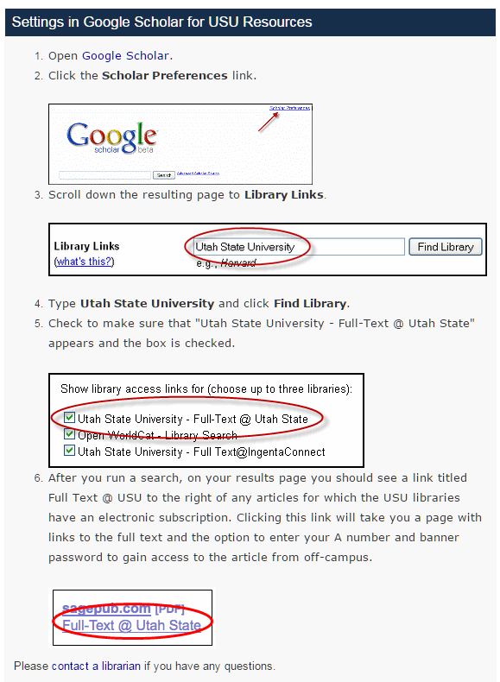
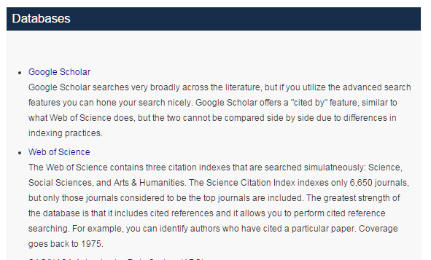
Setting Up Google Search at USU
Good information on electronic journals, Endnote and Google Scholar
http://libguides.usu.edu/c.php?g=52461&p=338450
USU set up instructions:
http://libguides.usu.edu/c.php?g=52461&p=338450
Google Scholar Home Page:
http://scholar.google.com

Slide 27
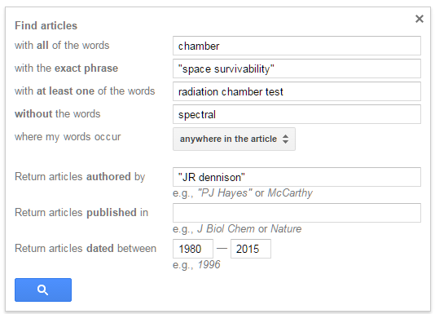
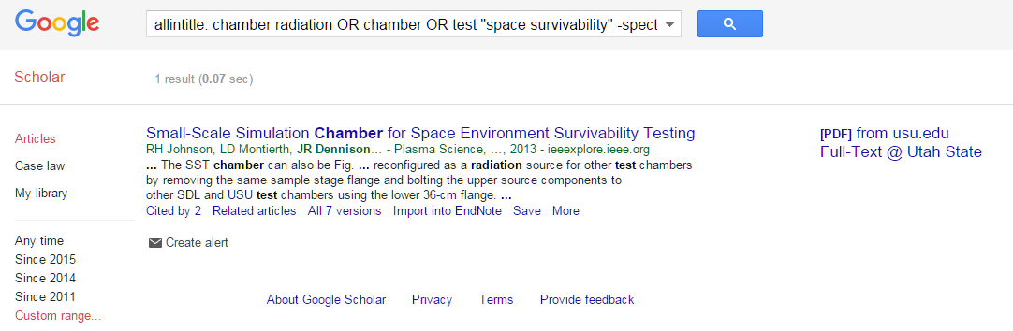
Searching with Google Scholar
1
Google Scholar Home Page:
http://scholar.google.com
5
Search Criteria
Select words
Select authors
Select journal
Select date
Select fields
2
3
4

Slide 28
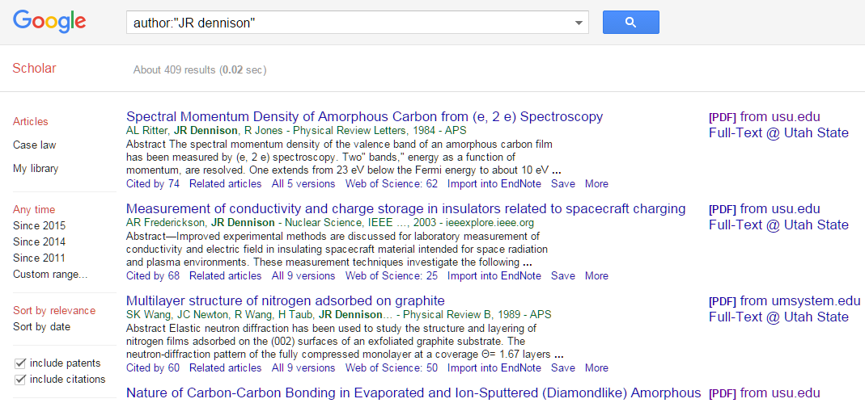
Articles from Google Scholar
Cited by
Related articles
Import into Endnote
Get Text in PDF

Slide 29
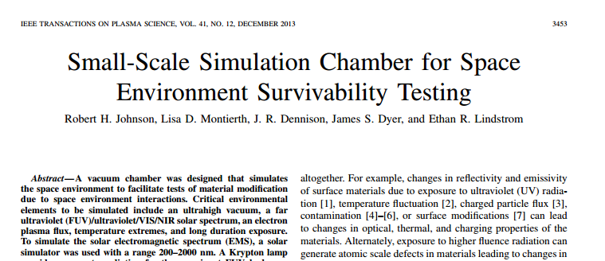


Getting the Article
Access article
Access Journal
Article as PDF

Slide 30
Intermediate Lab
PHYS 3870
An Exercise in Reference Management and Use
Use Google Scholar to find:
A physics related article by an author with your last name
An article in American Journal of Physics related to this topic
An article from within the last 2 years related to this topic
An article from before you were born related to this topic
(See additional parts to this Exercise related to EndNote Web below)

Slide 31

Intermediate Lab
PHYS 3870
CONVEYING INFORMATION
Gathering Information
References: PHYS 3870 Web Site
USU Library

Slide 32

Introduction to EndNote and EndNote Basic
EndNote is a software program that program that stores and organizes citations, and enables you to import citations directly into a Word document.
Endnote Basic is a version of this freely accessible to USU students, with almost all of the functionality of the main program.
Create Citation Library
Stores and organizes figures and equations
Tutorials
Can link papers to citations.
http://www.endnote.com/training/
Can search bibliographic databases
http://libguides.usu.edu/usingendnoteweb
Log On
Easy bibliography
http://www.endnoteweb.com/
http://endnote.com/training/WMVs/ENX2/enx2tutorial_download.asp

Slide 33
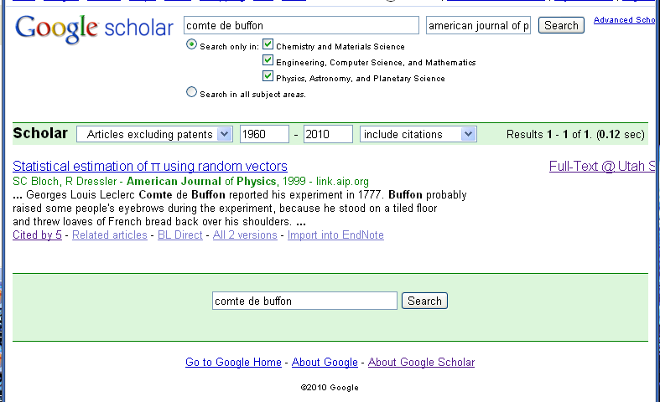
Importing Articles from Google Scholar to EndNote Basic
Import into Endnote
Import to RefMan

Slide 34
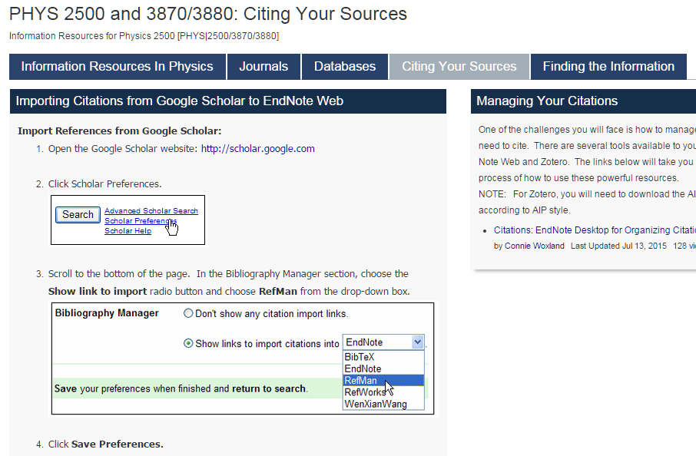
Importing Articles from Google Scholar to EndNote Web
Set up Goggle Scholar to Work with EndNote Web.
Import into Endnote
Import to RefMan

Slide 35
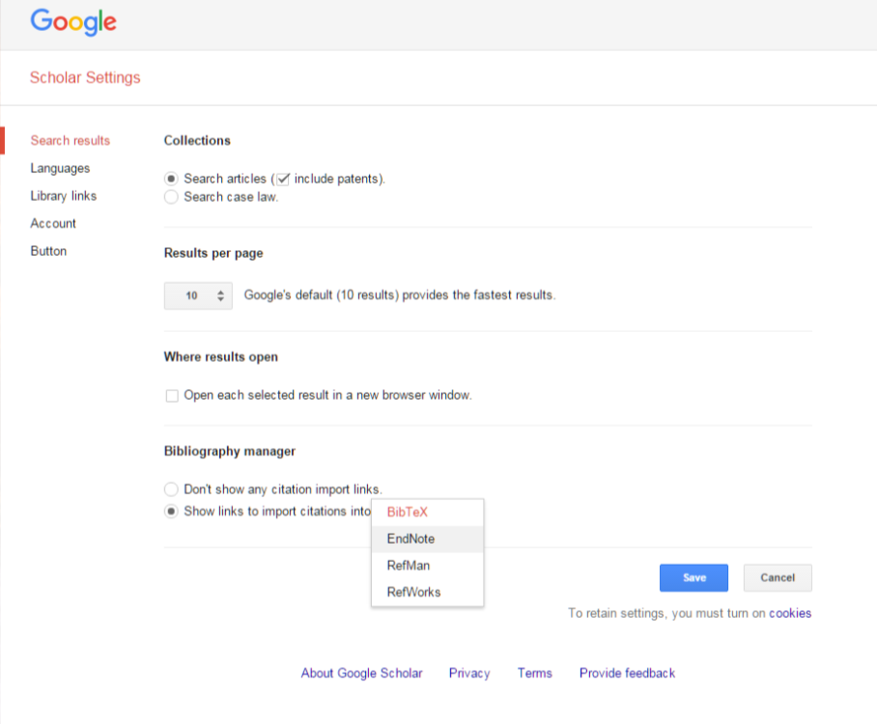
Importing Articles from Google Scholar to EndNote Web
Saving with
Goggle Scholar

Slide 36
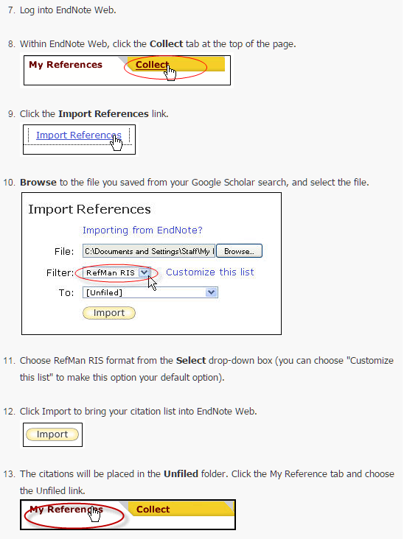
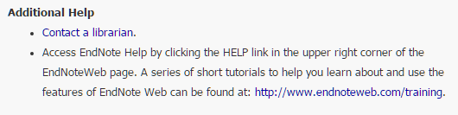
Importing Articles from Google Scholar to EndNote Web
Saving into EndNoteWeb
http://libguides.usu.edu/endnote

Slide 37

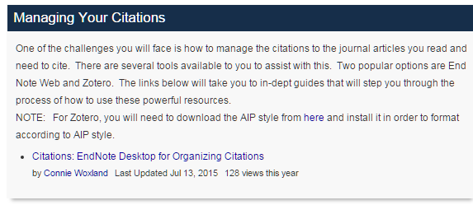
Importing Articles from Google Scholar to EndNote Web
Citations on EndNoteWeb
http://libguides.usu.edu/EndNoteBasic
http://libguides.usu.edu/endnote
http://www.endnoteweb.com/training

Slide 38
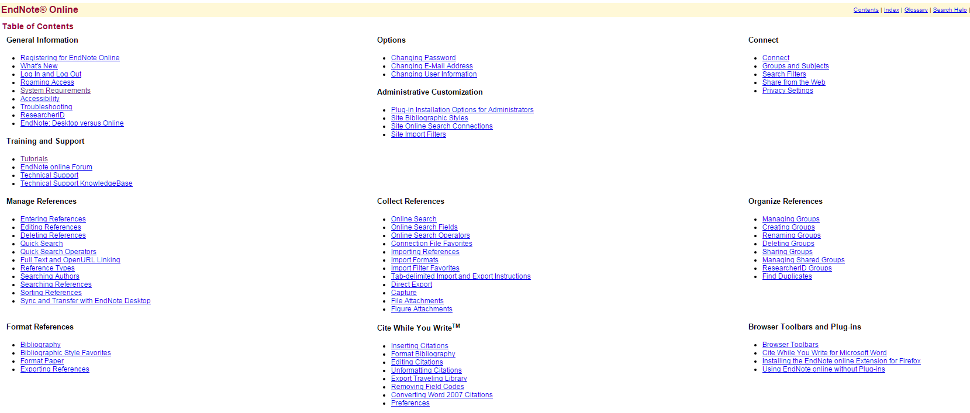

Help for EndNote Online
http://www.myendnoteweb.com/help/en_us/ENW/help.htm
http://endnote.com/sites/en/files/m/pdf/en-online-qrc.pdf

Slide 39
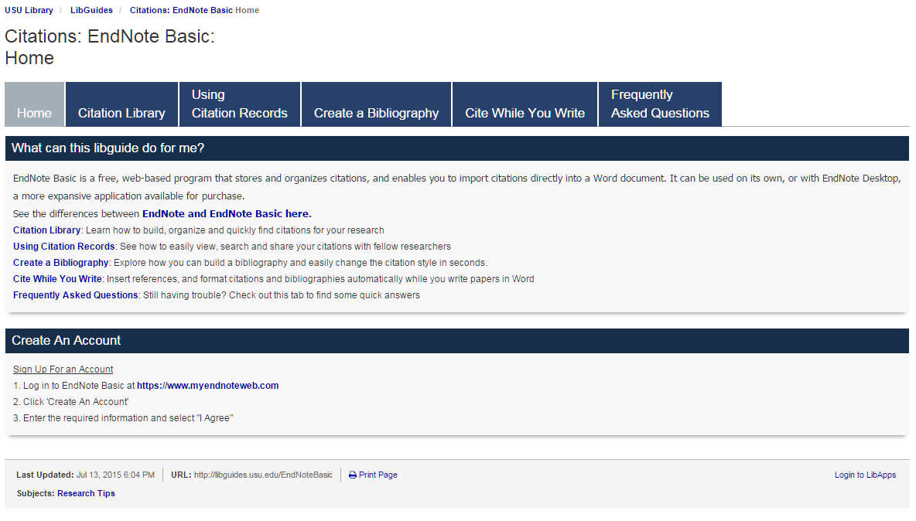
Importing Articles from Google Scholar to EndNote Web
Citations on EndNote Basic
http://libguides.usu.edu/EndNoteBasic
http://www.endnoteweb.com/training

Slide 40
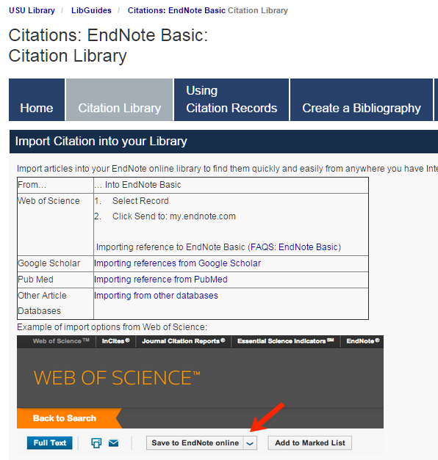
Cite While You Write
http://libguides.usu.edu/c.php?g=52841&p=339445

Slide 41
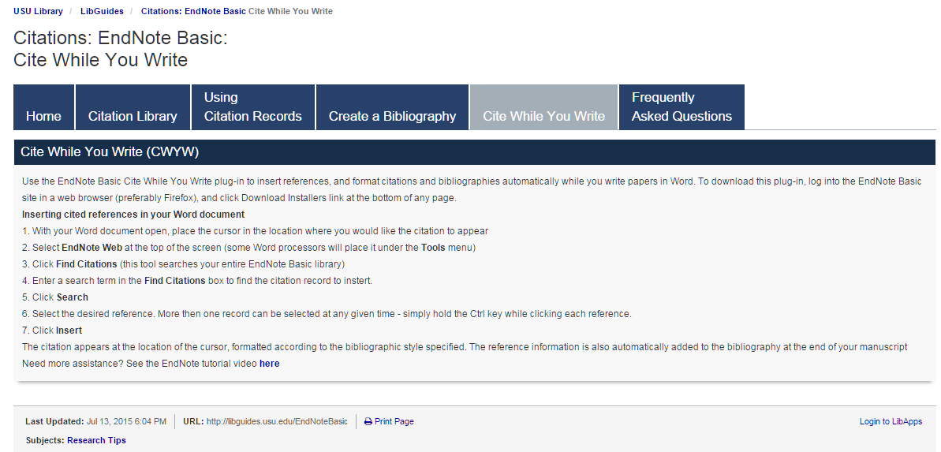


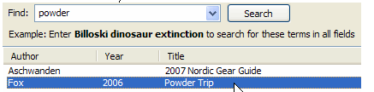
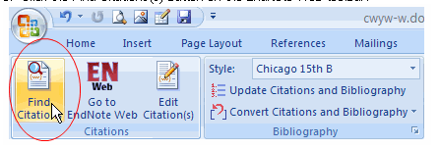


Cite While You Write
http://libguides.usu.edu/c.php?g=52841&p=339449

Slide 42
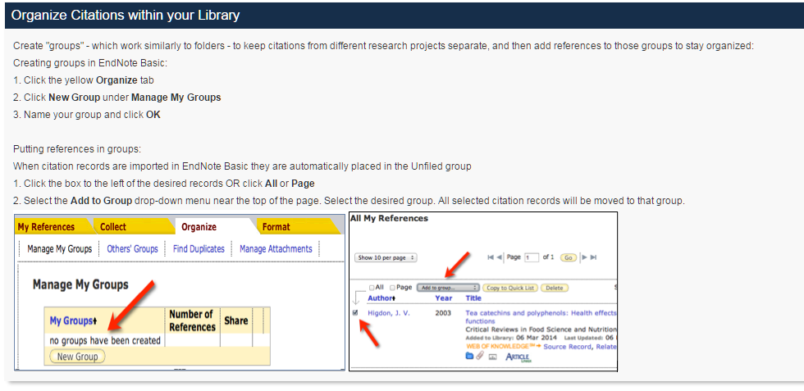
Cite While You Write
http://libguides.usu.edu/c.php?g=52841&p=339445

Slide 43
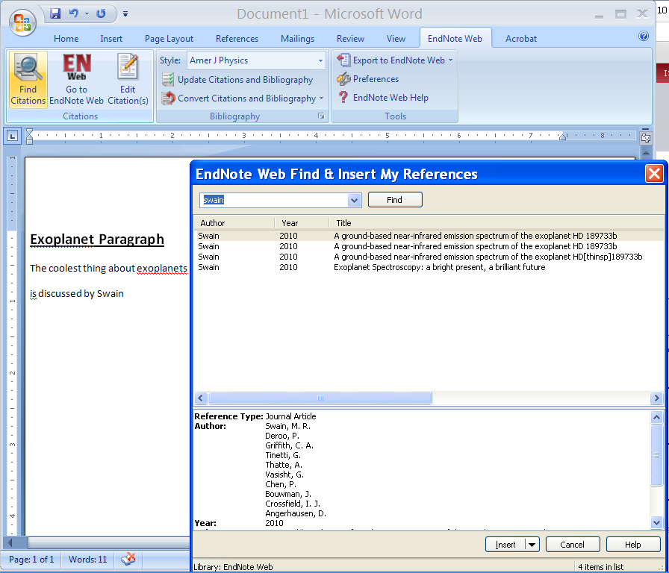
Cite While You Write

Slide 44
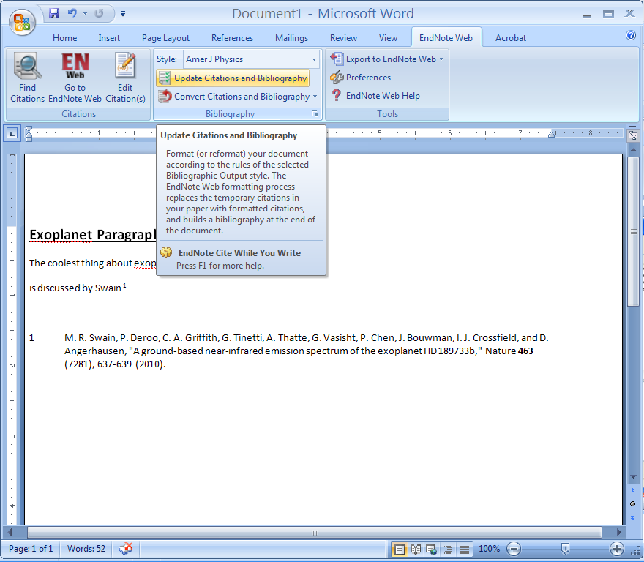
Format Bibliography
http://www.endnote.com/training/tutorials/enweb2/English/EndNote_Web-English/EndNote_Web.asp

Slide 45
Intermediate Lab
PHYS 3870
An Exercise in Reference Management and Use
Use Google Scholar to find:
A physics related article by an author with your last name
An article in American Journal of Physics related to this topic
An article from within the last 2 years related to this topic
An article from before you were born related to this topic
Use Google Scholar and EndNote to:
Use Google Scholar to save citations to these 4 articles in EndNote format
Write a sort paragraph about the physics topic.
Use EndNote Cite-While-You-Write to provide citations for your paragraph.
Use EndNote to create a bibliography for your paragraph using the AIP Style

Slide 46

Intermediate Lab
PHYS 3870
CONVEYIMG INFORMATION
Gathering Information
Installing and Using DataThief
References: PHYS 3870 Web Site
USU Library
DataThief Manual
DataThief Web Site

Slide 47
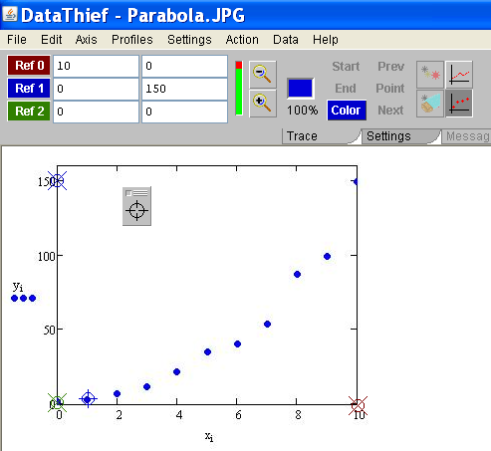
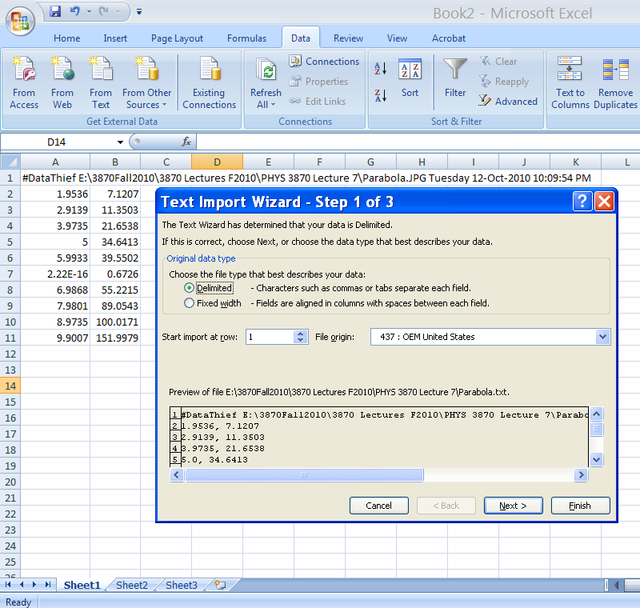

DataThief
DataThief III is program to digitize data in various forms for subsequent plotting and analysis. It is often used to “borrow” data from scanned graphs in articles. DataThief is a “free” shareware program and is very easy to use.
The presentation includes:
Instructions on how to download and install the program and where to get supporting documentation.
A detailed set of instruction on how to use the program to digitize data from a picture of a graph.
A simple example of acquiring digitized data from a photograph .
A simple exercise in use of DataThief is described in the file
PHYS 2500 Sec5-Graphing DataThief Exercise.ppt.

Slide 48
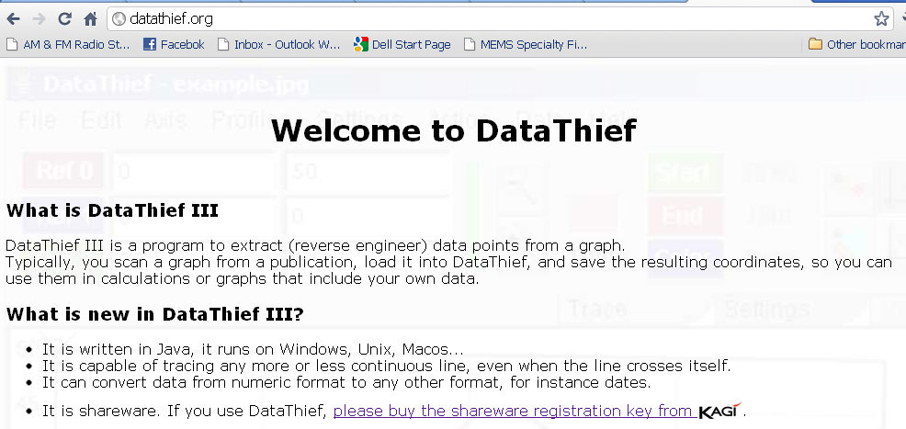
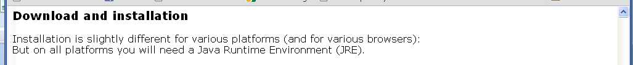
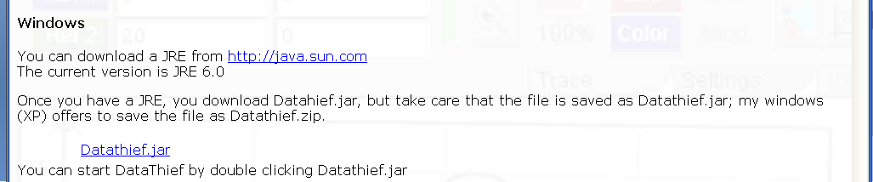
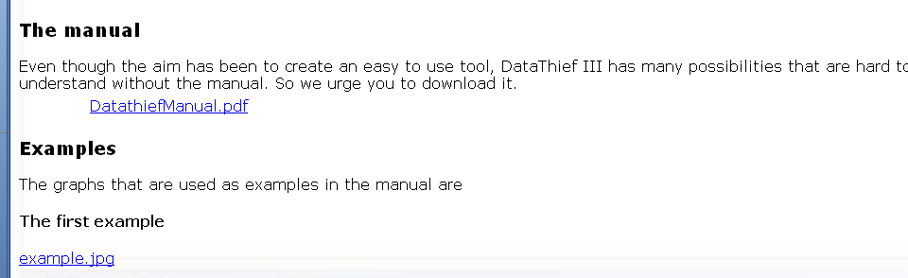
Acquiring DataThief III
DataThief III is already installed and running on the PHYS 2500 CITRIX page.
To acquire and install your own copy of the shareware program DataThief III and its accompanying documentation, simply follow the numbered steps listed here.
(1) Go to Datathief.com
(2) Review the program
Description
(3) (Download Java as well, if you need it.)
Download the executable program file Datathief.jar by
Clicking here
(4) Download the manual
(5) Review some examples, if you like.

Slide 49
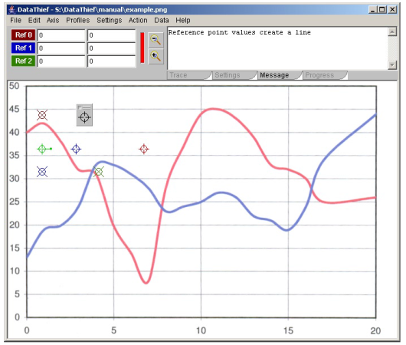
Orientation to DataThief III
DataThief III is written in Java. This means, that apart from the "executable" called Datathief.jar, you will have to have the Java Virtual Machine. The Java Virtual Machine can be downloaded from www.java.com. Follow the instructions that are appropriate for your machine.
Once the virtual machine is installed, you may start DataThief.
  On Windows, double click the Datathief.jar icon.
  On Macintoshes with MacOS 8 or MacOS 9, double click the Datathief application icon.
  On Macintoshes with MacOS X and on Linux or Unix either double click the Datathief icon, or go to the directory where you installed DataThief and type Datathief.
Once you have a running DataThief, select "Open..." from the File menu, and select the file you want to take data from. In this example, we used "example.png“. Key features of DataThief are shown below.
3 point indicators used to find the corresponding coordinate indicator
tool bar
menu bar
Start location indicator (green with a + through its center)
"Dump", used to define data points
Color location indicator (blue with a + through its center)
3 coordinate indicators have an X through there center
White area with the image in it is the image area
Stop location indicator (red with a + through its center)

Slide 50
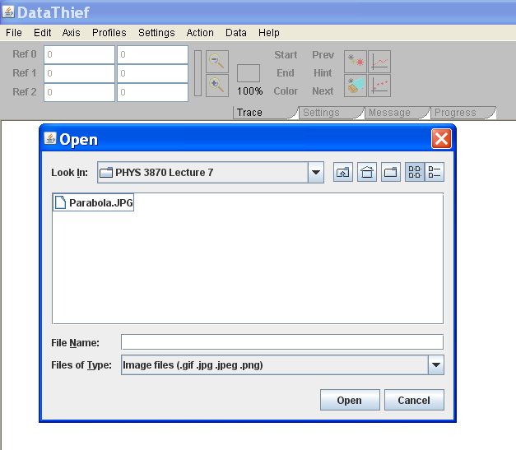
DataThief in Action
To use DataThiefIII to digitize data from a graph:
(1) Open DatathiefIII.
(2) Select an image file using Open from the File menu. Allowed file types include gif, jpg, and png.
(3) Select whether to digitize a point graph or line graph
(4) Define the graph axes by tagging 3 axis coordinate indicators by dragging and dropping the 3 circled X icons onto the axes points and entering the corresponding numerical values.
Note: If the 3 axes points are not visible on the graph, select Reset from the Actions menu. Click a colored button (e.g., Ref 0) to flash the corresponding axis point
Note: For pictures you can use this to put the digitized values in the correct units if you know the values of these three points.
Note: This can correct for skewed axes by selecting non-orthogonal axes.

Slide 51
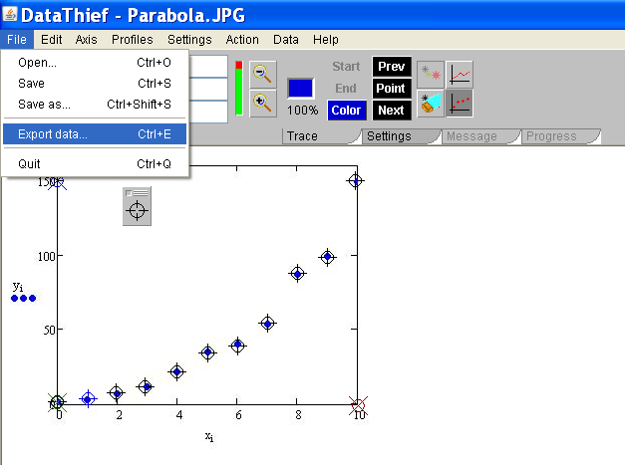
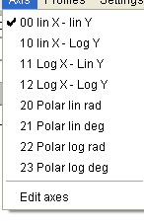
Setting DataThief
Simply follow the remaining numbered steps listed here.
(7) Export
The data to a file using the File menu
(5) Select axes
type using the Axis menu
(6) To “borrow” discrete data points, select the Point mode icon and then tag each data point by dragging crosshairs from the “Dump” on top of the point
(5 Alternate) To “borrow” data from traces (lines):
Select the Trace mode icon,
Tag the beginning and end of the trace to “steal” with the green and red icons, respectively
Set the color of the line by dropping the blue icon on a well isolated portion of the trace
Use the three point indicators “Start”, “End” and “Color” to locate the icons to drag.
The density of data points digitized can be adjusted using the “Output Distance” selection from the Settings tab.

Slide 52
Reading DataThief Txt Files
(8) Read into an Excel file as comma delimited text using the Excel Text Import Wizard called up from the “From Text” icon on the Data ribbon in Excel.

Slide 53
Intermediate Lab
PHYS 3870
CONVEYIMG INFORMATION
Gathering Information
An Example of Using DataThief and Mathcad
References: PHYS 3870 Web Site
USU Library
DataThief Manual
DataThief Web Site

Slide 54
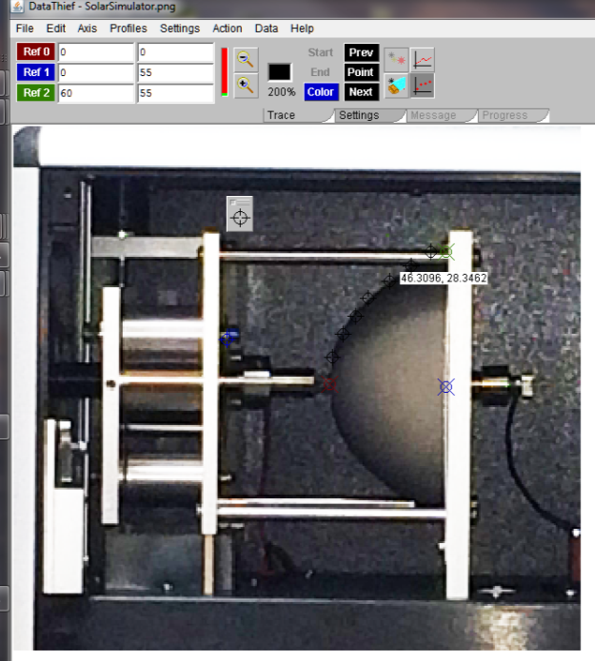
DataThief--Fitting Example
This example uses Mathcad to fit the digitized coordinates of a photograph to a mathematical model, leading to an analytical expression used for further analysis. The digitized results were produced using DataThiefIII.
An ellipsoidal mirror used in a Class AAA Solar Simulator needed to be adjusted to provide better focusing. This required a mathematical model of the mirror surface in terms of foci and radii. Direct measurement of the 3D mirror was difficult and was made even harder by the surrounding support structure and enclosure.
A photograph of the system was taken and the JPG file imported in to DataThiefIII (right).
The axes were identified. (The image was cropped in Photoshop to create a cleaner image. This step was not strictly necessary.).
Points on the mirror were then digitized using Datathief
Data were written to a two column, tab delimited text file.
The data file was then read in to Mathcad.

Slide 55
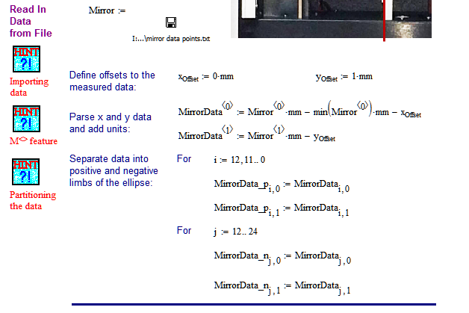
DataThief--Fitting Example

Slide 56

DataThief--Fitting Example

Slide 57

DataThief--Fitting Example

Slide 58

Intermediate Lab
PHYS 3870
CONVEYIMG INFORMATION
Analyzing and Plotting Data with Excel
References: PHYS 3870 Web Site

Slide 59

Instructions for an Excel Tutorial Exercise
Follow the detailed (if boring) instructions to create an Excel worksheet to analyze and plot a sample data set and prepare a simple report.

Slide 60

Report from an Excel Tutorial Exercise
Follow the detailed (if boring) instructions to create an Excel worksheet to analyze and plot a sample data set and prepare a simple report.

Slide 61

Intermediate Lab
PHYS 3870
CONVEYIMG INFORMATION
Analyzing and Plotting Data with IGOR Pro
References: PHYS 3870 Web Site

Slide 62

IGOR Pro Tutorials

Slide 63





Example of Publication Quality Graphs with IGOR Pro

Slide 64

Intermediate Lab
PHYS 3870
CONVEYIMG INFORMATION
Analyzing and Plotting Data with Mathcad
References: PHYS 3870 Web Site
PHYS 2500 Tutorial

Slide 65

PHYS 2500 Introduction to Scientific Computing
Mathcad Tutorials

Slide 66




PHYS 2500 Introduction to Scientific Computing
Mathcad Tutorials

Slide 67
Intermediate Lab
PHYS 3870
CONVEYIMG INFORMATION
Gathering Information
An Exercise in DataThief, Plotting and Curve Fitting
References: PHYS 3870 Web Site
USU Library
DataThief Manual
DataThief Web Site

Slide 68
Introduction to Scientific Computing
PHYS 2500
An Exercise In Data Analysis
Use DataThief to “steal” data from the graph in DennisonInFreefall.jpg and save the data in the file YOURNAMEInFreefall.txt:
In your favorite plotting and curve fitting program:
  Import the data from DennisonInFreefall.jpg stored in YOURNAMEInFreefall.txt
  Import the data from FreefallLab.txt
  Create a single graph of position vs time with:
    Data points and error bars from FreefallLab.txt
    Data points (the slacker has no error estimates here!) from DennisonInFreefall.jpg
    A mathematical model for free fall plotted as a line
    List your best estimates for values and errors for you model fitting parameters
  BONUS:
    Lineraize your model, that is plot the dependant variable versus some function (e.g., square, square root) of the dependant variable such that the plot yields a straight line
    Plot both data sets (with appropriate errors) and your linear model on a linearized graph
    Do an automated fit with your linear model to the FreefallLab data. List your best estimates of the slope and intercept (with errors) and from these the best estimates (with errors) for you original model fitting parameters.

Slide 69


Data for An Exercise In Data Analysis
Freefall.txt
DennisonInFreefall.jpg

Slide 70

Results for An Exercise In Data Analysis
Model is y(t)=(1/2)at² + v_{o}t + y_{o}

Slide 71
Intermediate Lab
PHYS 3870
An Exercise in Reference Management and Use
Use Google Scholar to find:
A physics related article by an author with your last name
An article in American Journal of Physics related to this topic
An article from within the last 2 years related to this topic
An article from before you were born related to this topic
Use Google Scholar and EndNote to:
Use Google Scholar to save citations to these 4 articles in EndNote format
Write a sort paragraph about the physics topic.
Use EndNote Cite-While-You-Write to provide citations for your paragraph.
Use EndNote to create a bibliography for your paragraph using the AIP Style

