Slide 1
The Search for the Higgs Boson
The recent detection of the Higgs Boson at CERN is the culmination of over 100 years of exploration of the fundamental nature of matter. I will describe some highlights of this search, touching on a few important insights of relativity and quantum physics, and the development of our modern picture of particle physics elegantly described by what is called The Standard Model. Finally, I will describe the importance of what was, until now, the missing link: the Higgs Boson.

Slide 2
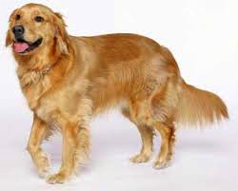
Prefix | 10^{n} | Decimal
(none) | 10⁰ | 1 | Dog size: 1 meter
1 meter
We will use the meter as our basic unit of measure and look at fractions
of a meter to characterize the sizes of the things that make up our world.

Slide 3
The Human Eye
Prefix | 10^{n} | Decimal
 | 10⁰ | 1 | Human height: 1.6 meters
milli | 10⁻³ | .001 | Grain of sand: 1millimeter Animal Cell: 0.1 millimeter Resolution of human eye: 0.04 millimeter
The human eye can see things much smaller than one meter.
We easily see
a grain of sand.
We can also see
the thickness of
a sheet of paper:
.07 millimeter

Slide 4
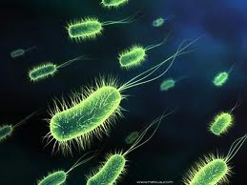
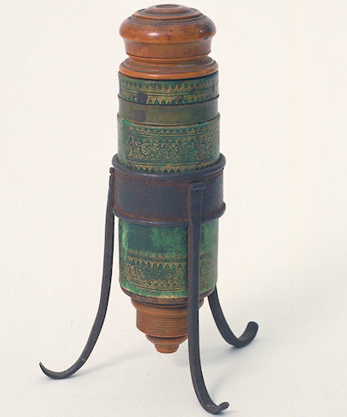
The Light Microscope
Prefix | 10^{n} | Decimal
 | 10⁰ | 1 | Human height: 1.6 meters
milli | 10⁻³ | .001 | Grain of sand: 1millimeter Animal Cell: 0.1 millimeter
micro | 10⁻⁶ | .000 001 | Smallest Bacteria: 1 micrometer Wavelength of red light: 0.65 micrometer Resolution of light microscope: 0.2 micrometer
Using lenses, Galileo discovered the
moons of Jupiter, the craters on
Earth’s moon, and using this
microscope could see
“the most minute animals"
Galileo’s microscope, 1610

Slide 5
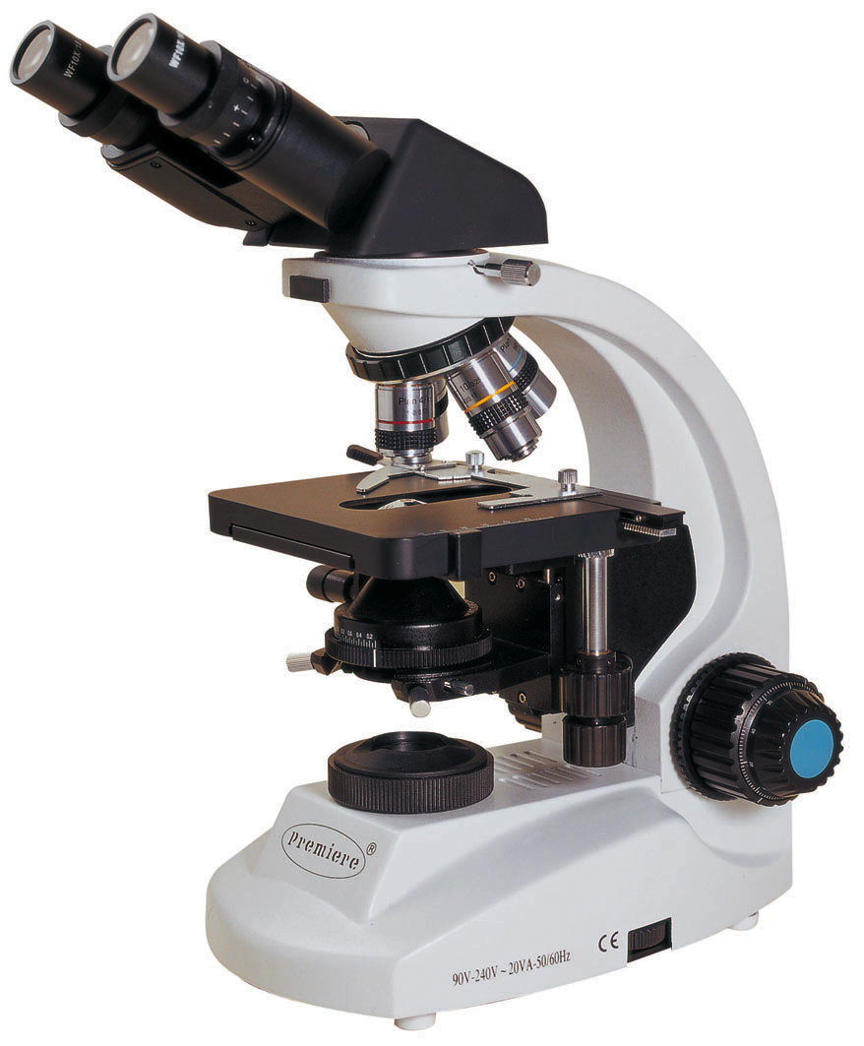
... a few days ago I heard . . . [Galileo] telling . . . how he distinguishes perfectly with his Telescope the organs of . . . the most minute animals; and particularly in a certain insect that has each eye covered by a thick membrane, which, however, is pierced by seven slits like the visor of a fully-armoured warrior . . .
J. Wedderburn, Padua, 1610.
To understand the discovery of the Higgs particle, we first look at the workings of microscopes.
A modern microscope

Slide 6
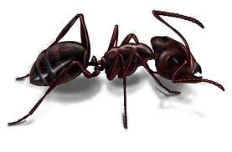
A simple light microscope
Picture light casting a shadow:
Light
Object (ant)
Shadow of ant

Slide 7
A simple light microscope
Now reflect the shadow through
a lens to magnify it.
Enlarged shadow of ant
Lens
Mirror

Slide 8
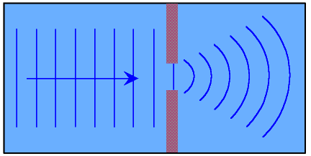
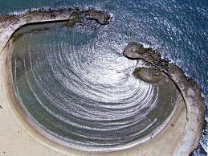
The limit of microscope resolution: diffraction
Diffraction allows waves to bend around corners:

Slide 9
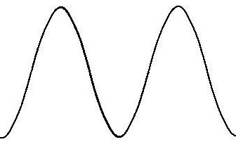
The limit of microscope resolution: diffraction
Wavelength much shorter than object:
distinct shadow
Wavelength similar to object:
diffracted shadow

Slide 10
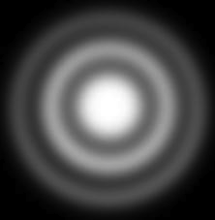
The limit of microscope resolution: diffraction
The key to seeing
small things is to use
a short wavelength

Slide 11
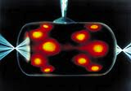
Prefix | 10^{n} | Decimal
 | 10⁰ | 1 | Human height: 1.6 meters
milli | 10⁻³ | .001 | Grain of sand: 1millimeter Animal Cell: 0.1 millimeter
micro | 10⁻⁶ | .000 001 | Smallest Bacteria: 1 micrometer Wavelength of red light: 0.65 micrometer Resolution of light microscope: 0.2 micrometer
nano | 10⁻⁹ | .000 000 001 | Water molecule: 0.28 nanometer Hydrogen atom: 0.1 nanometer Resolution of x-ray microscope: 15 nanometer
X-rays have a shorter wavelength
than visible light
X-ray microscopes can image
individual molecules

Slide 12
Moving smaller: Quantum Physics
Shorter wavelengths of light pass through matter, so are nearly impossible to focus or magnify.
Wavelengths of light short enough to probe the nucleus have never been seen in nature, even in the most energetic cosmic rays.
Quantum physics provides an answer
All basic particles also have wave properties.
We may think of a particle as a small
bunch of wave called a wave packet

Slide 13
Moving smaller: Quantum Physics
Using the wave properties of particles
The wavelength of a particle depends two things:
The mass of the particle
The velocity of the particle
Therefore, we want to move
a heavy particle very fast.

Slide 14
Moving smaller: Quantum Physics
All basic particles also have wave properties
Wavelength depends on mass and speed
Particle | Mass | Speed | Wavelength
Red Light | 0 keV | 300,000 km/s | 700,000,000 fm
Electron | 511 keV | 150,000 km/s | 338.95 fm
Proton | 938,000 keV | 150,000 km/s | 0.18 fm

Slide 15
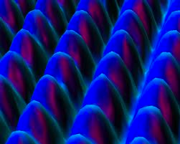
Prefix | 10^{n} | Decimal
 | 10⁰ | 1 | Human height: 1.6 meters
milli | 10⁻³ | .001 | Grain of sand: 1millimeter Animal Cell: 0.1 millimeter
micro | 10⁻⁶ | .000 001 | Smallest Bacteria: 1 micrometer Wavelength of red light: 0.65 micrometer Resolution of light microscope: 0.2 micrometer
nano | 10⁻⁹ | .000 000 001 | Water molecule: 0.28 nanometer Hydrogen atom: 0.1 nanometer Resolution of x-ray microscope: 15 nanometer
pico | 10⁻¹² | .000 000 000 001 | Size of Helium atom: 60 picometer Resolution of electron microscope: 50 picometer
Image of atoms in a crystal made
using a scanning tunneling electron microscope

Slide 16
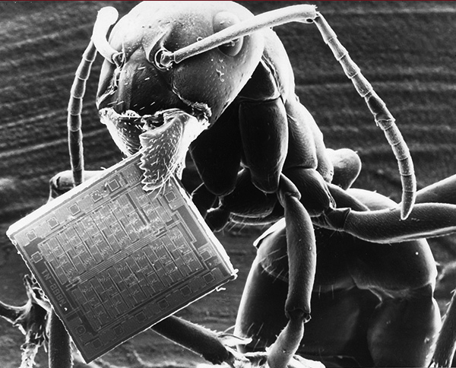
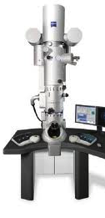
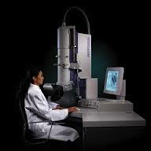
SEM image: Ant with microchip
Scanning Electron Microscope (SEM)

Slide 17
Accelerating electrons is easy; old style TVs and computer screens used accelerated electrons striking the back of the screen to make light.
An electron accelerated through 80,000 Volts will be traveling at half the speed of light.
A proton accelerated through 80,000 Volts is only traveling at 0.013 times the speed of light.
Q: How can we accelerate protons to high speed?
A: The cyclotron

Slide 18
The first cyclotron
The first cyclotron, built in spring 1930.
By Fall of 1930, M. Livingston, working in E. O. Lawerence’s lab, built a 5 inch version that could accelerate protons through a
total of 80,000 Volts
4.5 inches

Slide 19
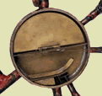
How a
cyclotron works
The shaded,
D-shaped region is called
a “dee”

Slide 20
There are two
dees, and a proton moves from one
to the other.
A large magnet
keeps the proton
moving in a circle.

Slide 21
There is a
voltage difference
between the tips
of the arrows.
This gives an proton
a speed boost when it
crosses the gap.

Slide 22
As the magnet curves the
path of the proton around the first dee . . .
. . . the voltage
across the gap switches direction.
The proton then crosses again and gets another
boost.

Slide 23
The faster the proton goes, the bigger the circle it makes, so it
spirals outward.
Each time is crosses the gap it gets a boost.
When it reaches the outer edge it flies off in a straight line at high speed.
It is then sent toward a target.

Slide 24
The interior of the world’s second largest cyclotron, TRIUMF, in Vancouver (520 Mev)

Slide 25
What do we see using a cyclotron?
A proton at TRIUMF travels at about ¾ c and has a wavelength of about 0.18 femtometer. This is smaller than a proton and 300,000 times smaller than an atom.
This is small enough to study details of the structure of the nucleus of an atom.
Using cyclotrons, scientists have produced and identified 253 stable nuclei (this includes all stable forms of the 117 elements), and a total of over 3300 different nuclei.
Detailed properties* of these stable or radioactive nuclei are known, with many used for medical or research purposes.
Properties: Half life, decay modes, branching ratios, energy of decay, all nuclear energy levels

Slide 26
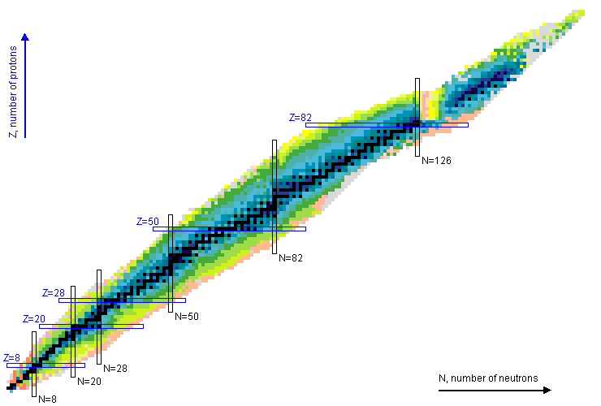
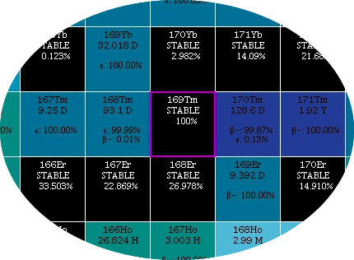
Nuclear chemistry:
Scientists have studied detailed properties of over 3300 different nuclei.
(Properties: Half life, decay modes, branching ratios, energy of decay, all nuclear energy levels)
Chart of the nuclides
http://www.nndc.bnl.gov/chart/
7 levels
of zoom

Slide 27
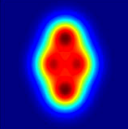
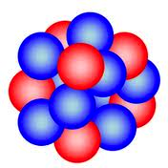
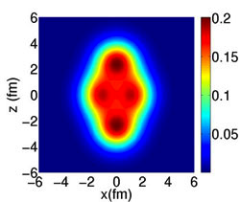
Prefix | 10^{n} | Decimal
 | 10⁰ | 1 meter | Human height: 1.6 meters
milli | 10⁻³ | .001 meter | Grain of sand: 1millimeter Animal Cell: 0.1 millimeter
micro | 10⁻⁶ | .000 001 meter | Smallest Bacteria: 1 micrometer Wavelength of red light: 0.65 micrometer Resolution of light microscope: 0.2 micrometer
nano | 10⁻⁹ | .000 000 001 meter | Water molecule: 0.28 nanometer Hydrogen atom: 0.1 nanometer Resolution of x-ray microscope: 15 nanometer
pico | 10⁻¹² | .000 000 000 001 meter | Size of Helium atom: 60 picometer Resolution of electron microscope: 50 picometer
femto | 10⁻¹⁵ | .000 000 000 000 001 meter | Proton: 1.75 femtometer Atomic nucleus: 1 – 10 femtometer Resolution of TRIUMF cyclotron: 0.18 femtometer
Actual proton and neutron
density in Neon nucleus
Cartoon of an
atomic nucleus

Slide 28
Cyclotrons allowed us to understand nuclei in great detail.
At higher energies, proton beams striking atomic nuclei are essentially
one proton striking another proton or a neutron.
The presence of the rest of the nucleus only confuses the data.
Interest turns to the neutron and proton themselves.
We now know, after much study, that it doesn’t matter whether the target is a
neutron, a proton, or some other heavy particle. This is because such collisions
are always a collision of two quarks.
However, there are limitations to the resolution of cyclotrons.

Slide 29
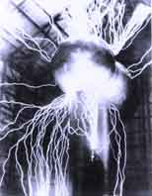
Limitations of cyclotrons
There are several things that require building larger machines:
The voltage is limited by sparking.
The bending of the path into a circle depends on the strength of the magnet.
There are limits to the strength of magnets. The wire that
makes the magnet will explode at larger fields.
The world’s strongest magnets develop pressure on the wire* of half a million pounds per square inch.
For a given voltage across the gap and a fixed magnet strength, the final speed is determined by the diameter of the cyclotron.
Since cyclotron magnets must be the diameter of the cyclotron, they get heavy. The weight limits the size. The world’s largest cyclotron, in Japan, is over 60 feet across and weighs 8,300 tons.
To get the wavelengths required to study quarks requires a more powerful
microscope: colliding beam, superconducting synchrotrons.
Limits on voltage
*The wire a special is a copper alloy inside a Kevlar corset, wrapped in a steel jacket, cooled to a few degrees above absolute zero to become superconducting.

Slide 30
Synchrotrons
We cannot easily change the electric and magnetic limits on the particle speed.
But we can overcome the weight problem:
Synchrotrons use a changing magnetic field
The solution is to increase the field as the proton moves faster, so that the
proton moves in the same circle over and over.

Slide 31
Colliders
Early particle “microscopes” sent a beam of particles into a target to understand the particles in the target:
However, the particles in the beam and in the target are often the same.
The more energy there is in the collision, the more we learn about the structure of that particle.
But lots of energy is lost just getting the target particles moving.

Slide 32
Colliders
In a colliding beam synchrotron, a beam is sent around the ring in both directions. When the two beams collide, no energy is wasted getting things moving.
The “laboratory frame” and the “center of mass frame” are the same.

Slide 33
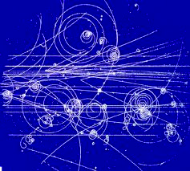
To understand the significance of the standard model and the Higgs particle requires understanding the data that it explains.
When, in the middle decades of the 20th century, the first synchrotrons began probing fundamental particles, many new particles were produced.
The spirals are electrons and
positrons, but
the V-shaped
tracks are often
new particles.
The many particles found were
grouped by their masses.

Slide 34
Thousand of particles have been found and grouped by their masses.
Hadrons | Heavy particles | p, n, lambda, delta
Mesons | Intermediate mass | pions, kaons, D, B
Leptons | Light particles | e, mu, tau, neutrinos
Dozens of properties of these are measured:
Mass
Spin (angular momentum)
Electric charge
New properties: Hypercharge, strangeness,
charm, bottomness, color
Magnetic moment
Electric dipole moment
Mean lifetime
All decay modes
Probability of each decay mode
Much of this work was done outside of Chicago at
Fermilab on the Tevatron.

Slide 35
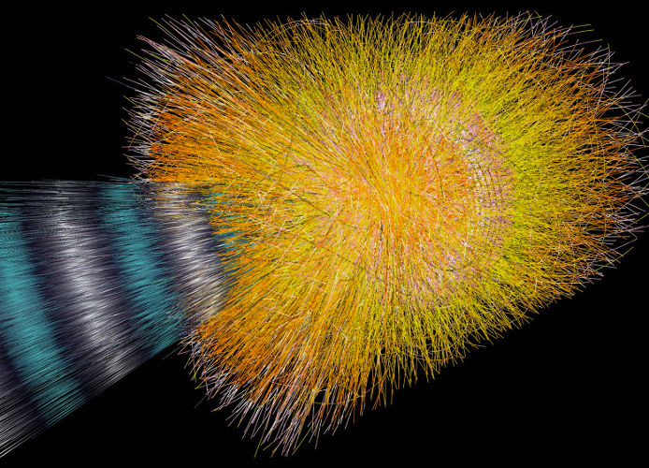
Sorting out the data is an enormous task. This is a reconstruction of the particles produced by the first collision at the Large Hadron Collider (LHC) at CERN.
The energy
is high enough
to produce
100,000 pions

Slide 36
Until the 1960s, it seemed that there were thousands of different fundamental particles.
These particle and their properties are updated constantly by:
Particle Data Group
http://pdg.lbl.gov/2012/listings/contents_listings.html

Slide 37
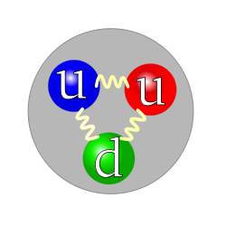
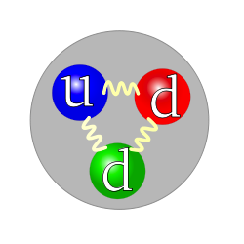
Prefix | 10^{n} | Decimal
 | 10⁰ | 1 | Human height: 1.6 meters
milli | 10⁻³ | .001 | Grain of sand: 1millimeter Animal Cell: 0.1 millimeter
micro | 10⁻⁶ | .000 001 | Smallest Bacteria: 1 micrometer Wavelength of red light: 0.65 micrometer Resolution of light microscope: 0.2 micrometer
nano | 10⁻⁹ | .000 000 001 | Water molecule: 0.28 nanometer Hydrogen atom: 0.1 nanometer Resolution of x-ray microscope: 15 nanometer
pico | 10⁻¹² | .000 000 000 001 | Size of Helium atom: 60 picometer Resolution of electron microscope: 50 picometer
femto | 10⁻¹⁵ | .000 000 000 000 001 | Proton: 1.75 femtometer Atomic nucleus: 1 – 10 femtometer Resolution of TRIUMF cyclotron: 0.18 femtometer
atto | 10⁻¹⁸ | .000 000 000 000 000 001 | Quark: 1 attometer Resolution at Fermilab: 0.2 attometer
The systematic description of these thousands of particles resulted in the
Standard Model
Proton structure
Neutron structure

Slide 38
These thousands of particles may be grouped into about 350 classes.
Each class has particles differing only in mass.
These are taken to be excited states of 350 basic particles.
For example, 29 different N particles are thought to be excited states of the neutron and proton.

Slide 39
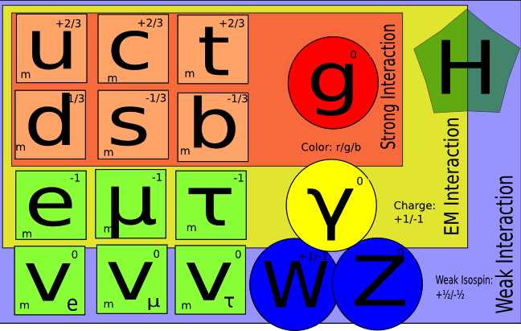
Particles of the Standard Model
Almost all of the remaining 350+ classes are understood as different combinations of six types of quark

Slide 40
Particles of the Standard Model
Baryons (heavy particles) are combinations
of three quarks.
For example, the proton is comprised of
two u and one d quark:
While the neutron is two d and one u:
Mesons (intermediate particles)
are combinations of
one quark and one anti-quark.
For example, the positive pion is comprised of
one u and one anti-d quark:

Slide 41
Particles of the Standard Model
The remarkable thing about the standard model is that for the last 45 years it has correctly predicted ALL of the detailed properties of ALL particles that have been detected. This is many
thousands of predictions.
From 1995 until 2012, there was only one particle required by the
standard model that had not been detected: the Higgs particle

Slide 42
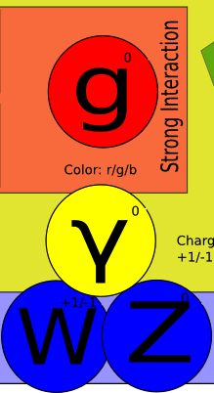
The role of the Higgs particle in the Standard Model
The detailed description of forces involves gluons, the photon, the W⁺, W⁻, and the
Z particle. Exchange of these produces forces.
This description requires
all of these particles to have zero mass.

Slide 43
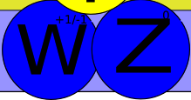
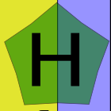
The role of the Higgs particle in the Standard Model
However, the W⁺, W⁻, and Z particles have large masses.
By adding one more particle to the mix – the Higgs – and writing the Higgs as a sum of a constant term, and a normal
particle-like term, the constant looks just like a mass for the other particles.

Slide 44
The role of the Higgs particle in the Standard Model
Picture a sea of Higgs particles, that interact with the W and Z particles but not the gluons or the photon

Slide 45
Where is the Higgs particle?
The Particle Data Group lists over 200 studies going back 25 years, attempting to detect the Higgs particle.
These studies look at all ways the Higgs might be produced in a collision, and test definite mass ranges for the Higgs particle.
Two decades ago it was only known that the Higgs should be heavier than the proton.
Gradually, the window of allowed energies was narrowed to the range 115 < M_{Higgs} < 127 times the mass of the proton, still with no clear detection of the particle itself.

Slide 46
Zeptoscope?
The world’s most powerful microscope is the superconducting synchrotron collider at CERN*
Synchrotron:
A fixed size ring with varying magnetic fields
Superconducting:
The magnets are produced by running current through
superconducting wires held at 1.9 degrees above absolute zero.
Collider:
Two beams of protons speed in opposite directions, then collide.
*CERN: http://cern.ch/public European Organization for Nuclear Research

Slide 47
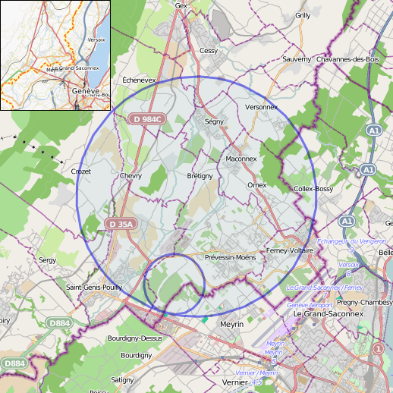
The accelerator
27-kilometer ring of superconducting magnets and structures to boost the particle energy.
Thousands of magnets direct the beams around the accelerator.
1232 dipole magnets, 15m long, bend the beams
392 quadrupole magnets, 5–7m long, focus the beams.
Other magnets squeeze the particles closer together to increase the chances of collisions.
All are cooled to -271º C.
Like firing needles from two positions 10 km apart with such precision that they meet halfway!

Slide 48
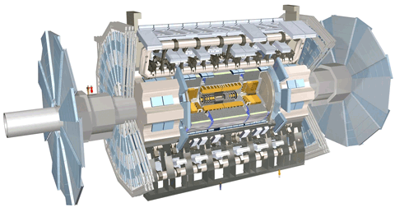
The detectors at CERN
The ATLAS detector is the largest volume particle detector ever constructed; 46 m long, 25 m high and 25 m wide.
Weight: 7000 tons, the same as the Eiffel tower.
Data: If all the data were collected it would fill 100,000 CDs every second.

Slide 49
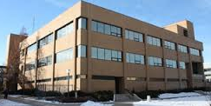
The detectors at CERN
The ATLAS detector is the largest volume particle detector ever constructed; 46 m long, 25 m high and 25 m wide.
Weight: 7000 tons, the same as the Eiffel tower.
Data: If all the data were collected it would fill 100,000 CDs every second.

Slide 50
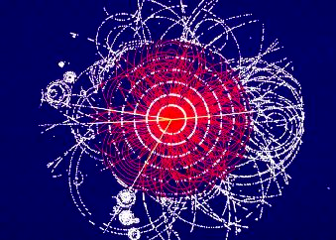
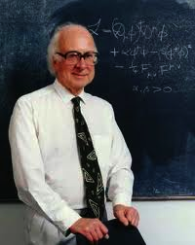
Prefix | 10^{n} | Decimal
 | 10⁰ | 1 | Human height: 1.6 meters
milli | 10⁻³ | .001 | Grain of sand: 1millimeter
micro | 10⁻⁶ | .000 001 | Smallest Bacteria: 1 micrometer Resolution of light microscope: 0.2 micrometer
nano | 10⁻⁹ | .000 000 001 | Water molecule: 0.28 nanometer Resolution of x-ray microscope: 15 nanometer
pico | 10⁻¹² | .000 000 000 001 | Size of Helium atom: 60 picometer Resolution of electron microscope: 50 picometer
femto | 10⁻¹⁵ | .000 000 000 000 001 | Atomic nucleus: 1 – 10 femtometer Resolution of TRIUMF cyclotron: 0.18 femtometer
atto | 10⁻¹⁸ | .000 000 000 000 000 001 | Quark: 1 attometer Resolution at Fermilab: 0.2 attometer
zepto | 10⁻²¹ | .000 000 000 000 000 000 001 | Higgs particle: 10 attometer Current resolution at CERN: 50 zeptometer Ultimate resolution at CERN: 14.3 zeptometer
Peter Higgs
ATLAS
Simulated decay of a Higgs particle

Slide 51
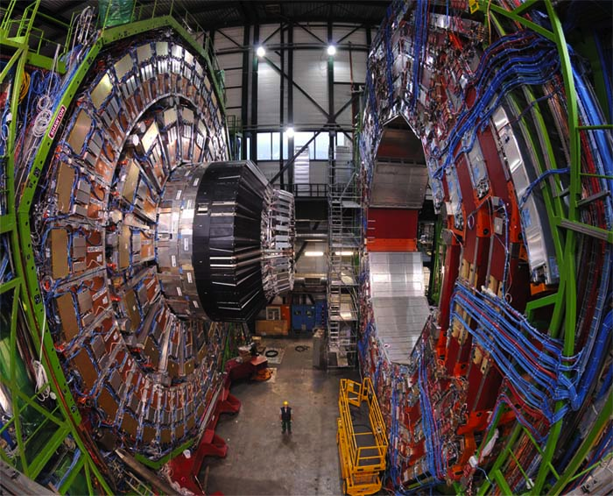

Slide 52
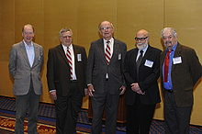
2010 J. J. Sakurai Prize for Theoretical Particle Physics Winners
The Higgs mechanism, also called the
Englert–Brout–Higgs–Guralnik–Hagen–Kibble mechanism
describes how the Higgs particle can give mass to the W and Z particles.
All six authors shared the prize.
Kibble, Guralnik, Hagen, Englert,
and Brout

Slide 53
The 2013 Nobel Prize for Physics
The Nobel Prize in Physics 2013 was awarded jointly to François Englert and Peter W. Higgs "for the theoretical discovery of a mechanism that contributes to our understanding of the origin of mass of subatomic particles, and which recently was confirmed through the discovery of the predicted fundamental particle, by the ATLAS and CMS experiments at CERN's Large Hadron Collider"
François Englert
Peter W. Higgs

Slide 54
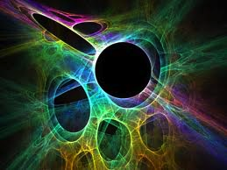
10^{n} | Decimal | Example
10⁰ | 1 | Dog size: 1.0 meters
10⁻³ | .001 | Grain of sand: 1 millimeter
10⁻⁶ | .000 001 | Smallest Bacteria: 1 micrometer Resolution of light microscope: 0.2 micrometer
10⁻⁹ | .000 000 001 | Water molecule: 0.28 nanometer Resolution of x-ray microscope: 15 nanometer
10⁻¹² | .000 000 000 001 | Size of Helium atom: 60 picometer Resolution of electron microscope: 50 picometer
10⁻¹⁵ | .000 000 000 000 001 | Atomic nucleus: 1 – 10 femtometer Resolution of TRIUMF cyclotron: 0.18 femtometer
10⁻¹⁸ | .000 000 000 000 000 001 | Quark: 1 attometer Resolution at Fermilab: 0.2 attometer
10⁻²¹ | .000 000 000 000 000 000 001 | Higgs particles Ultimate resolution at CERN: 14.3 zeptometer
 | .000 000 000 000 000 000 000 001 | ???
 | .000 000 000 000 000 000 000 000 001 | ???
 | .000 000 000 000 000 000 000 000 000 001 | ???
 | .000 000 000 000 000 000 000 000 000 000 001 | ???
10⁻³⁶ | .000 000 000 000 000 000 000 000 000 000 000 001 (.000 000 000 000 01 zeptometer) | Length of fundamental String String length: 100 trillion times smaller than CERN sees

