Slide 1
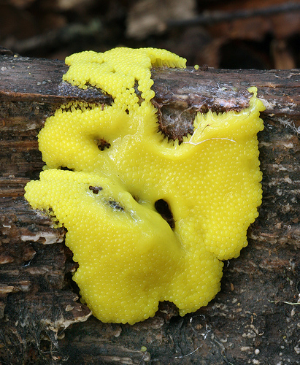
Physarum polycephalum
Slime mold
Mid: slime

Slide 2
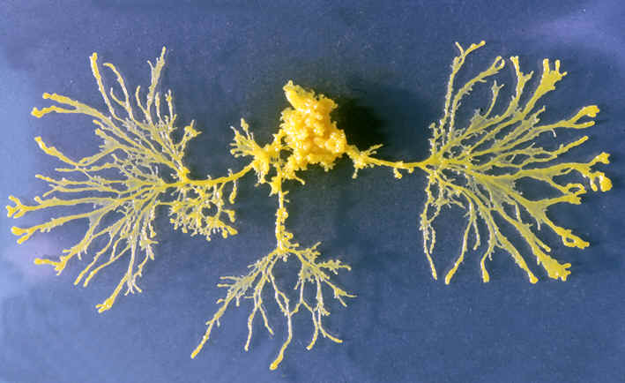
Many-headed (polycephalum) slime mold
Mid: slime

Slide 3
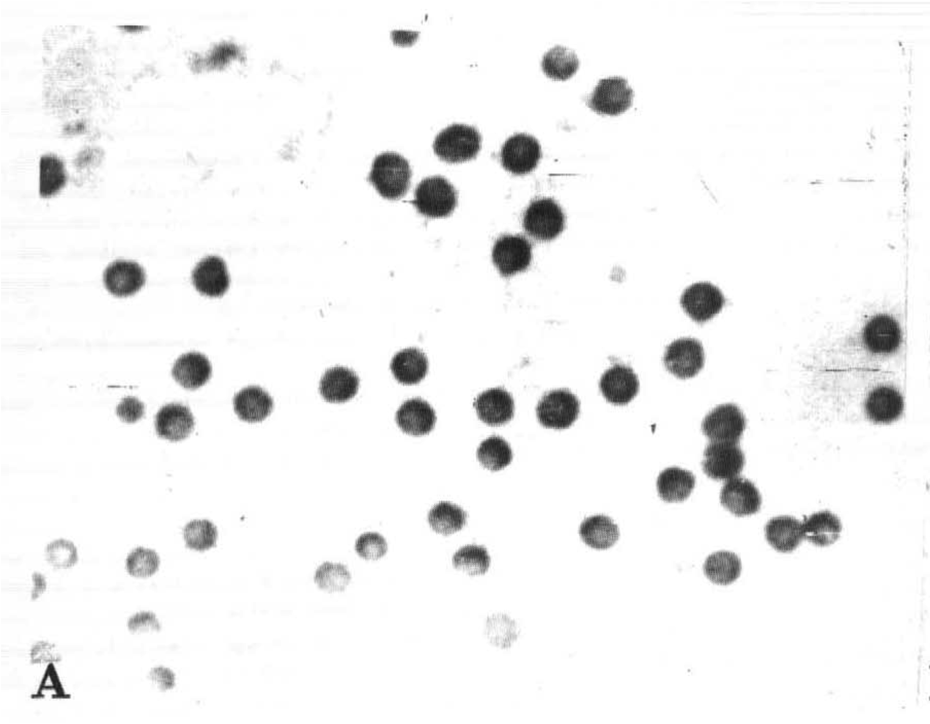
polycephalum is
a single cell
filled with many
interacting nuclei
Mid: slime

Slide 4
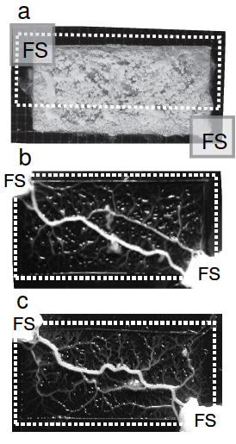
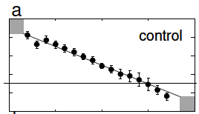
all dark
all dark
Mid: slime

Slide 5
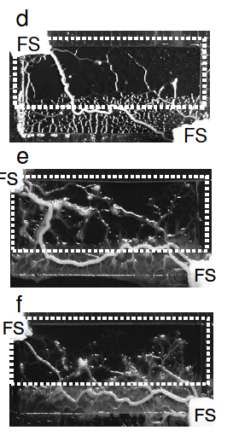
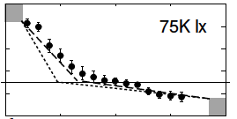
light
dark
light
dark
all dark
all dark
light
dark
Minimal
-risk-path
task
Nakagaki, et al., preprint
Mid: slime

Slide 6
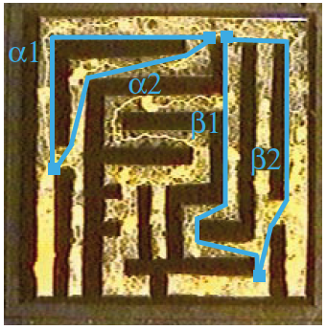
start
Mid: slime

Slide 7
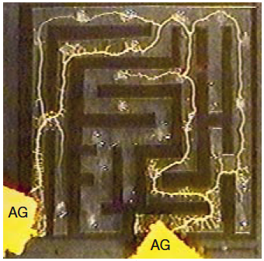
start
few hours later
Mid: slime

Slide 8
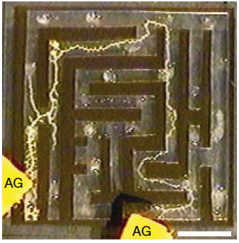
Shortest-path
-through-maze
task
start
few hours later
“finally”
NP hard
Nakagaki, et al., NATURE VOL 407 p470 28 SEPTEMBER 2000
Mid: slime

Slide 9
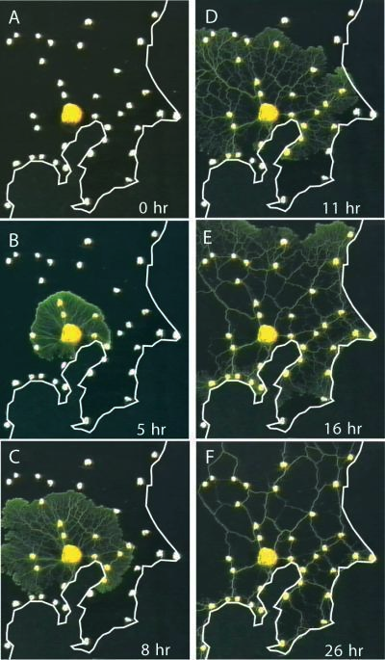
start
Tero, et al., SCIENCE VOL 327 p439 22 JANUARY 2010
Mid: slime

Slide 10
start
Tokyo
-railway-system
task
NP hard
end
Tero, et al., SCIENCE VOL 327 p439 22 JANUARY 2010
Mid: slime

Slide 11
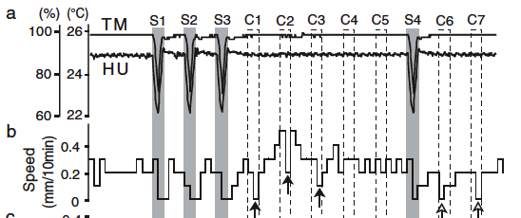
time
Saigusa, et al., PRL 100, 018101 (2008)
Mid: slime

Slide 12
time
Saigusa, et al., PRL 100, 018101 (2008)
Mid: slime

Slide 13
time
Learns
Saigusa, et al., PRL 100, 018101 (2008)
Mid: slime

Slide 14
time
Learns
Saigusa, et al., PRL 100, 018101 (2008)
Mid: slime

Slide 15
time
Learns
Recalls
Saigusa, et al., PRL 100, 018101 (2008)
Mid: slime

Slide 16
time
Learns
Recalls
Remember
-to-stop
task
Saigusa, et al., PRL 100, 018101 (2008)
Mid: slime

Slide 17
FISH Experiment

Slide 18
FISH Experiment

Slide 19
FISH Experiment
STUCK !

Slide 20
FISH Experiment

Slide 21
FISH Experiment
CONSENSUS !

Slide 22
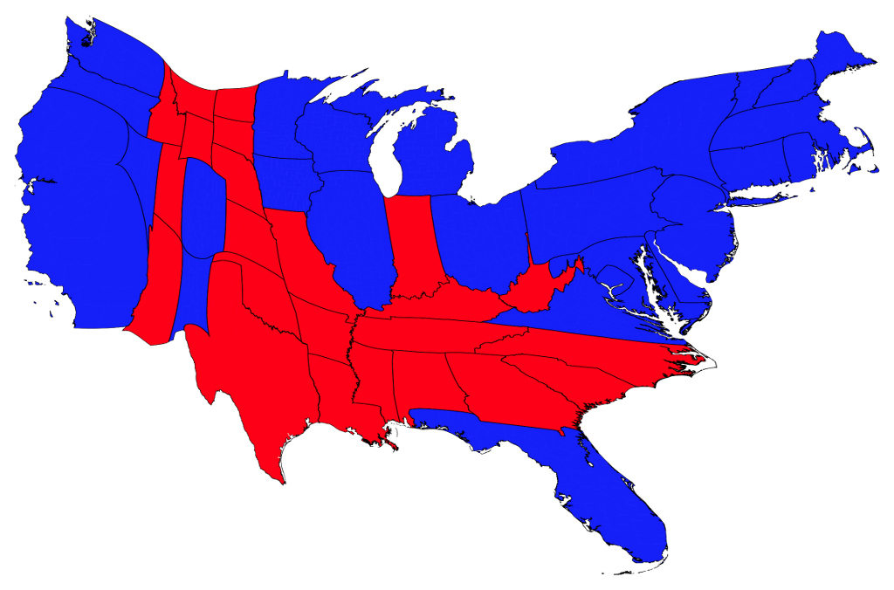
Stuck ?
Epi

Slide 23
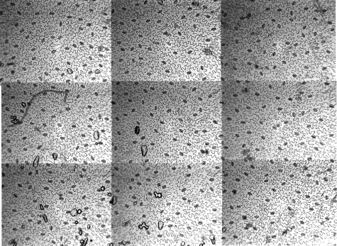
Stomata

Slide 24
Stomatal Patchiness
Mid: leaves

Slide 25
Brains make patches, too
Mid: nets

Slide 26
White?
or
Black?
Easy w CPU,
not so easy
w/o
Mid: nets

