Slide 1
Why do we do art?

Slide 2
We can’t help ourselves

Slide 3
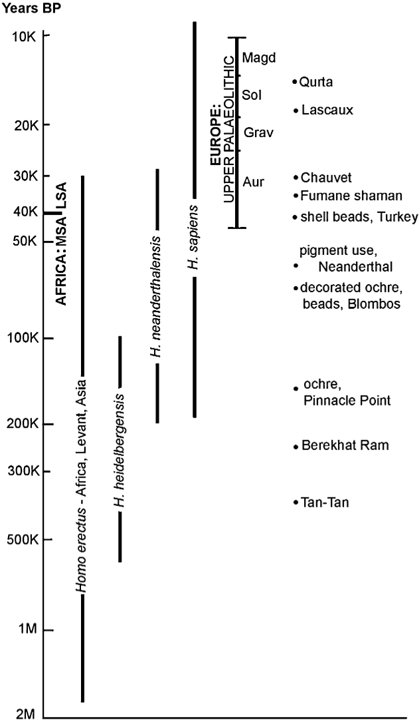

Slide 4
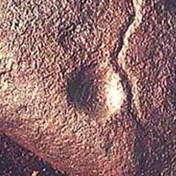
Oldest (290,000-700,000 years old) known “art object;” Auditorium Cave, India

Slide 5
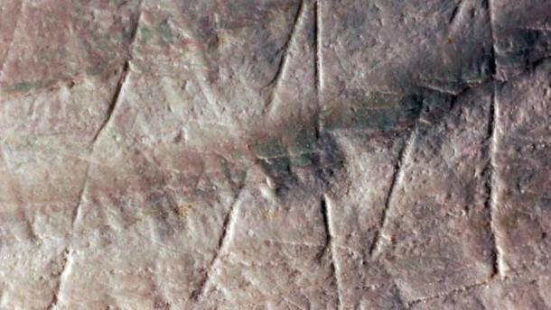
500,000 year old etched shell

Slide 6
Venus of Tan-Tan, 200,000 to 500,000 years old; Tan-Tan, Morocco

Slide 7
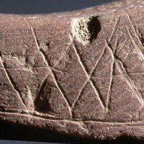
Engraved stone, 70,000 years old; Blombos Cave, South Africa

Slide 8
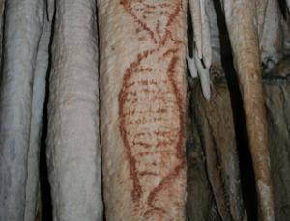
42,000 year old painting of a seal; Nerja Cave, Spain

Slide 9
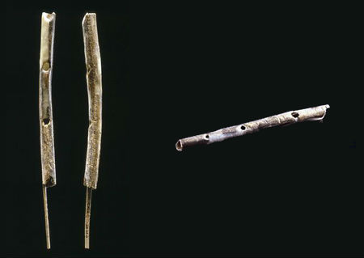
Musical instrument, 42,000 years old; Hohle Fels Cave, Germany

Slide 10
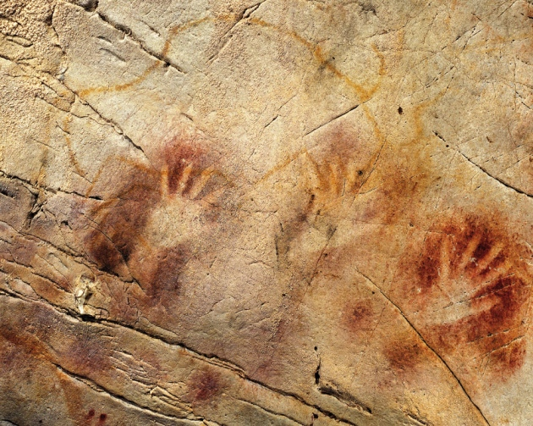
40,000 year old stenciled hand prints, El Castillo cave, Spain

Slide 11
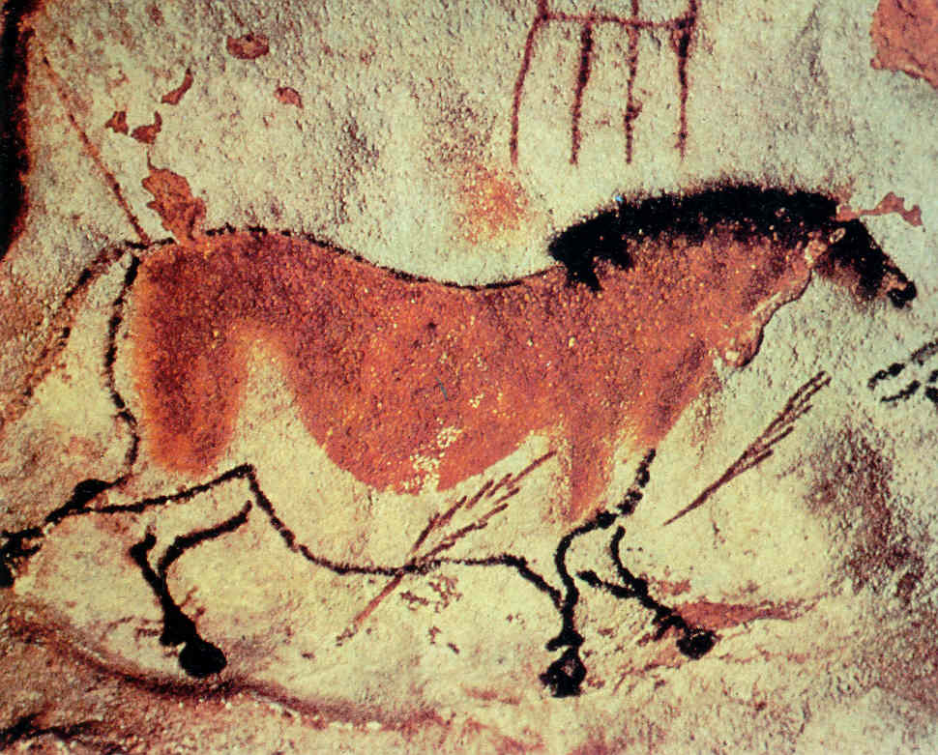
20,000 year old cave painting; Lascaux Cave, France

Slide 12
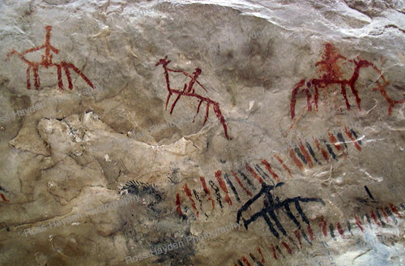
Oldest (14,000 years) known map; Abauntz Cave, Spain

Slide 13
Umm, it’s not just us

Slide 14
The Gorillas

Slide 15
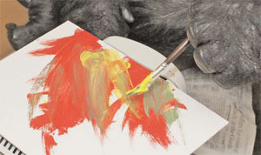
Koko: “Banana Slugs”

Slide 16
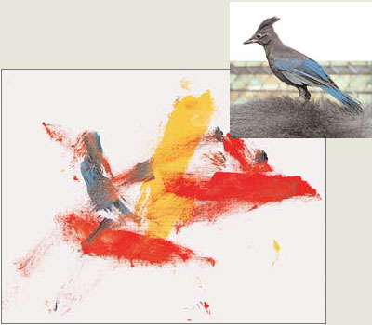
Koko: “Bird”

Slide 17
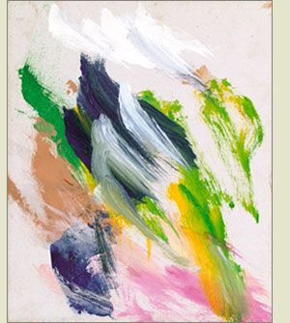
drink = water
stink = flowers
Koko: “Pink, pink, nice drink, stink”

Slide 18
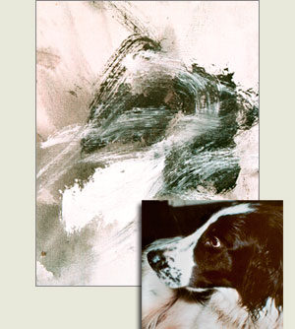
Michael: “Apple chase”

Slide 19
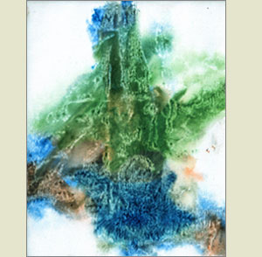
Michael: “Toy dinosaur”

Slide 20
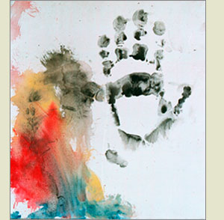
Michael: “Me, myself, good”

Slide 21
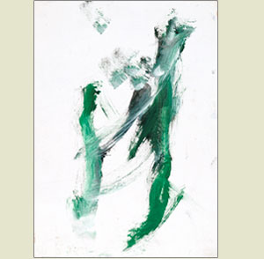
Michael: “Celery tree”

Slide 22
The Bowerbirds

Slide 23
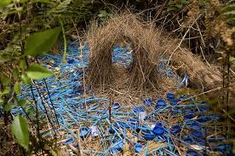
Bowerbird

Slide 24
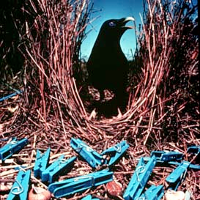
Bowerbird

Slide 25
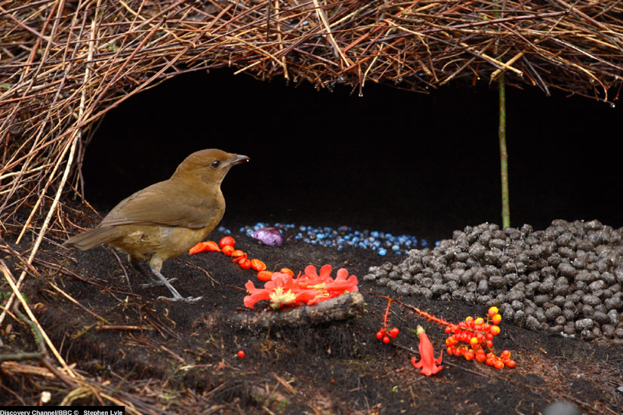
Bowerbird

Slide 26
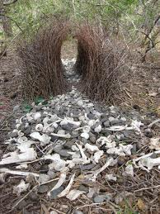
Bowerbird

Slide 27
Art makes us smarter

Slide 28
Earliest writing and number systems 3,000 to 4,000 years old, but WAY before

Slide 29
Lebombo Bone, 44,000 years old, “tally stick”; Lebombo Mountains, Swaziland

Slide 30
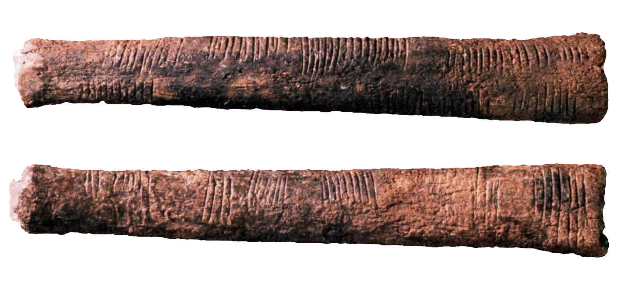
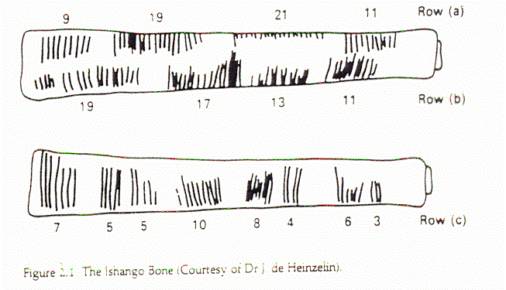
Ishango Bone, 28,000 year old “tally stick”; Ishango, Belgian Congo

Slide 31
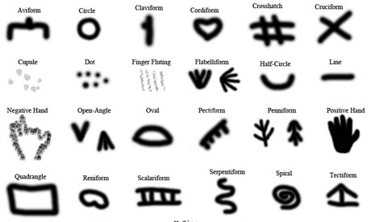
Symbols found in many cave paintings dating to 15,000 to 30,000 years ago

Slide 32
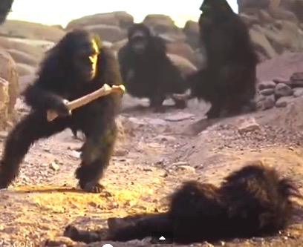
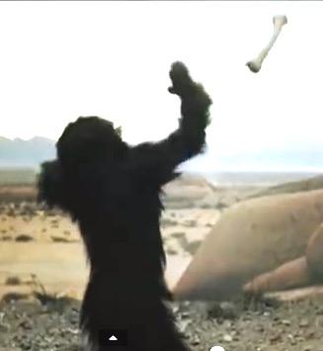
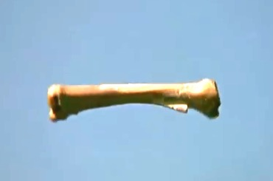
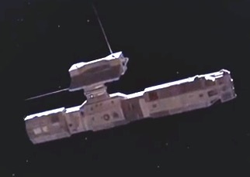
Has “2001” got it wrong?

