Slide 1
Quiz
Which of the following paintings was created and painted by a computer-based artist?
I’ll delete them one-at-a-time oldest-to-newest; the correct one is the newest

Slide 2
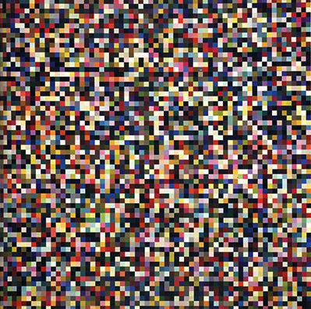
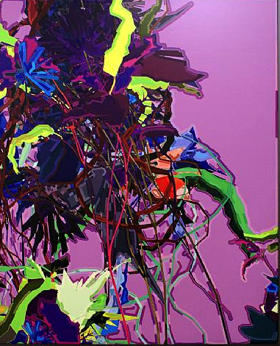
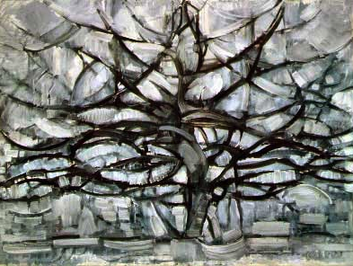
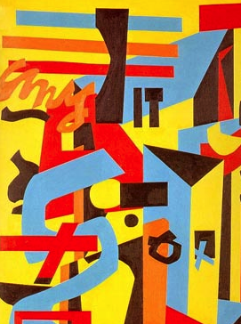
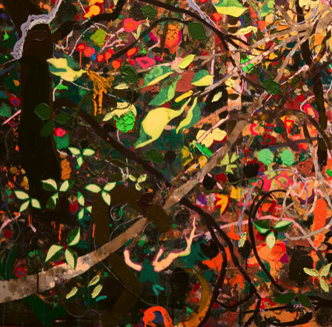

Slide 9
Piet Mondrian
1911

Slide 10
Piet Mondrian
1911
Stuart Davis 1953

Slide 11
Gerhard Richter 2004
Piet Mondrian
1911
Stuart Davis 1953

Slide 12
Gerhard Richter 2004
Piet Mondrian
1911
AARON 2007
Woody Shepherd
2006
Stuart Davis 1953

