Slide 1
Intermediate Lab
PHYS 3870
CONVEYING INFORMATION
Writing Reports
Gathering Information
References:
PHYS 3870 Web Site
USU Library Class Web Site

Slide 2
Intermediate Lab
PHYS 3870
CONVEYING INFORMATION
Writing Reports
References:
PHYS 3870 Web Site
USU Library Class Web Site

Slide 3
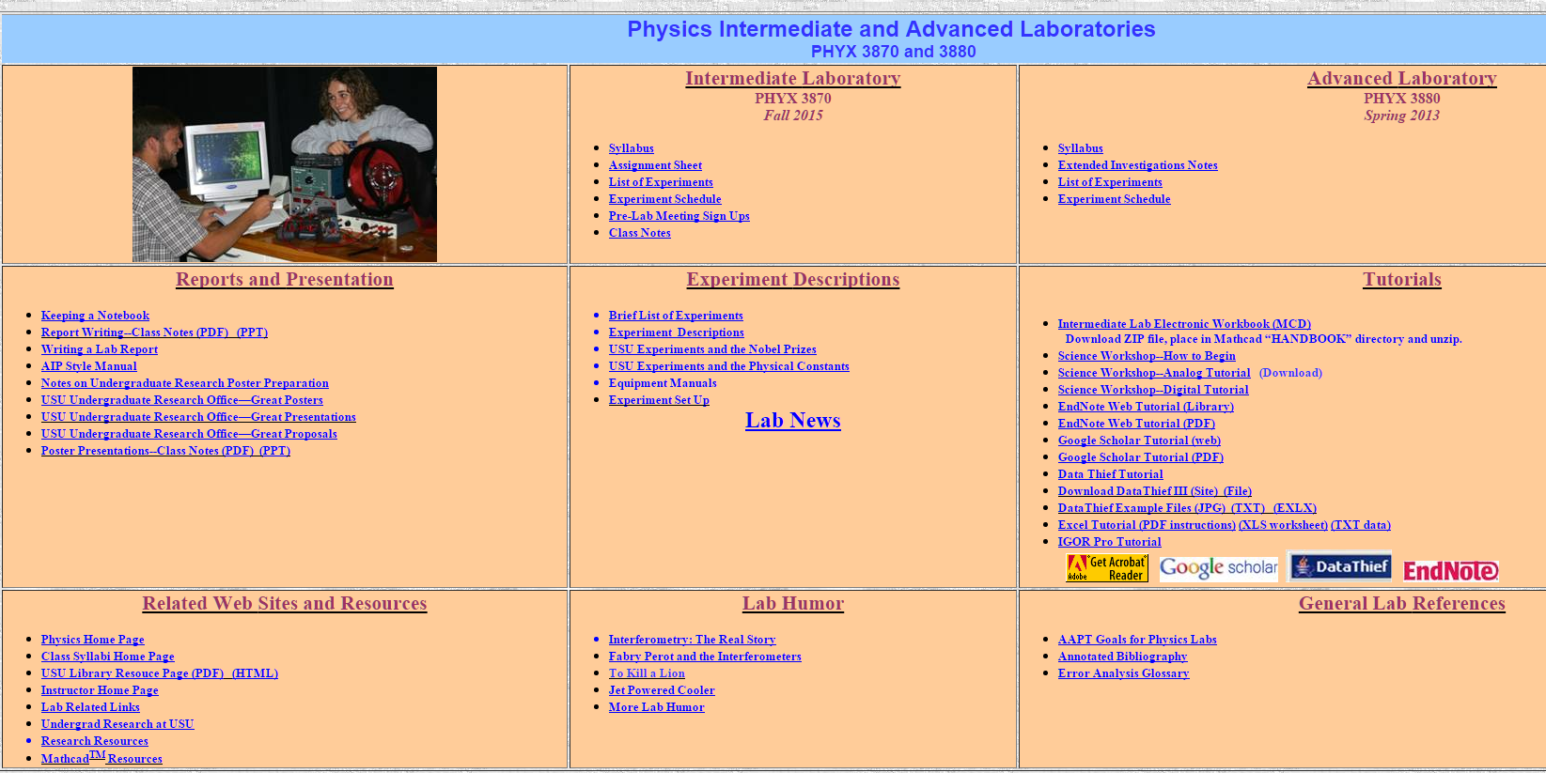
PHYS 3870 Web Site
Writing page
Poster page
But first…the most important page

Slide 4
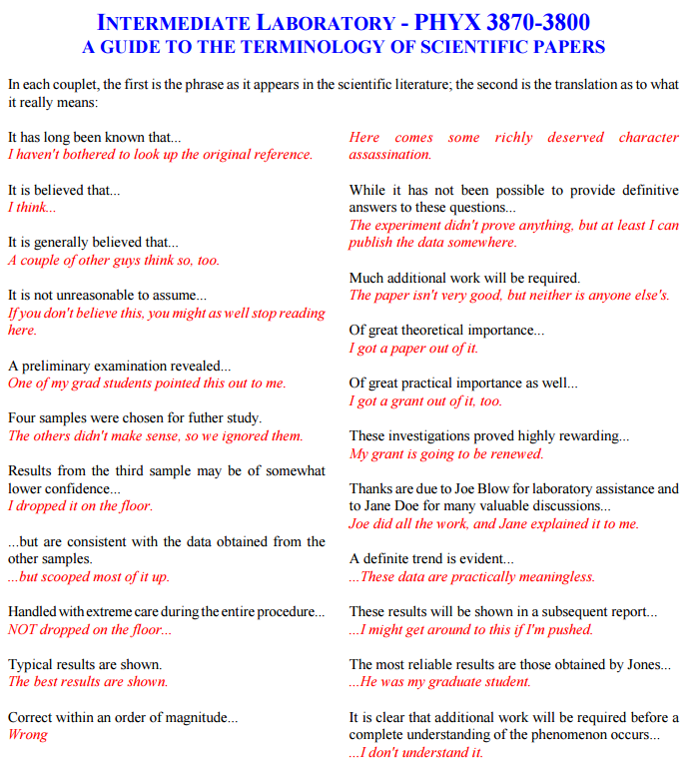
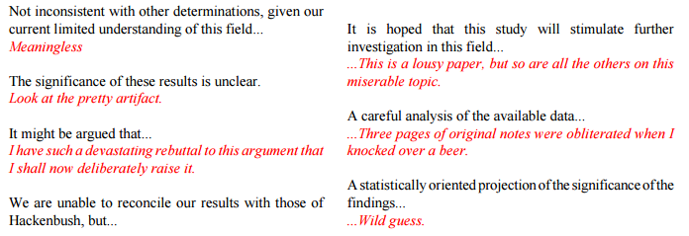
PHYS 3870 Web Site
The Real Story
http://www.physics.usu.edu/dennison/3870-3880/Humor/science%20terminology%20humor.pdf

Slide 5
Intermediate Lab
PHYS 3870
CONVEYIMG INFORMATION
Writing Styles
References:
PHYS 3870 Web Site

Slide 6
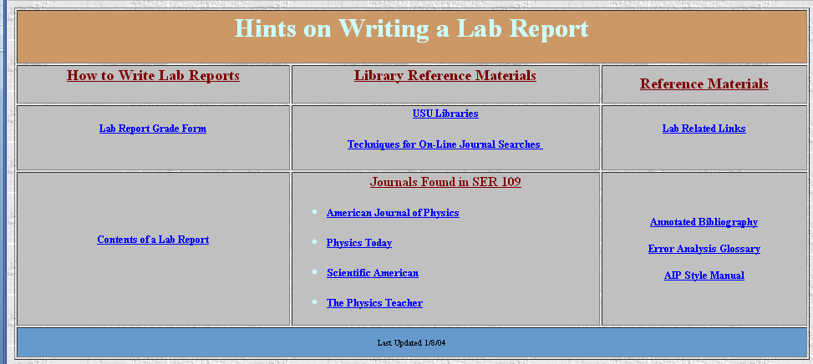
PHYS 3870 Web Site
Grade Rubric
Notes on contents of a lab report
The AIP Style Manual
AIP Style Manual: http://www.aip.org/pubservs/style/4thed/toc.html
AIP Journals: http://www.aip.org/pubservs/compuscript.html
American Journal of Physics: http://ajp.dickinson.edu/Contributors/manFormat.html

Slide 7
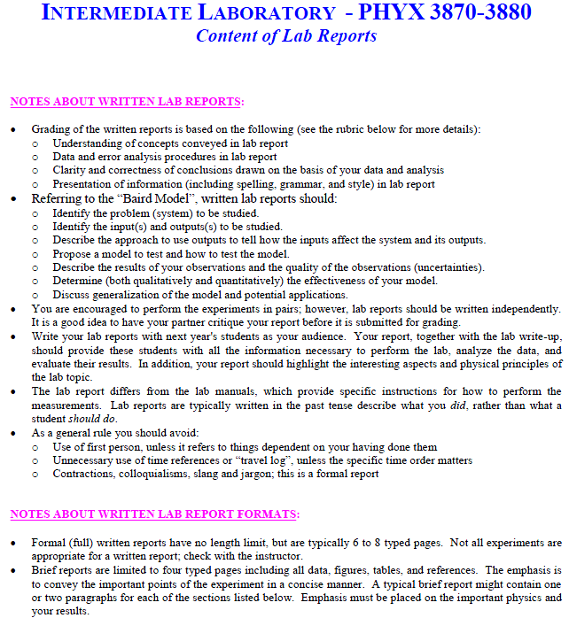
PHYS 3870 Web Site
Content of Lab Reports
Notes on contents of a lab report
http://www.physics.usu.edu/dennison/3870-3880/References/Content%20of%20Lab%20Report.pdf

Slide 8
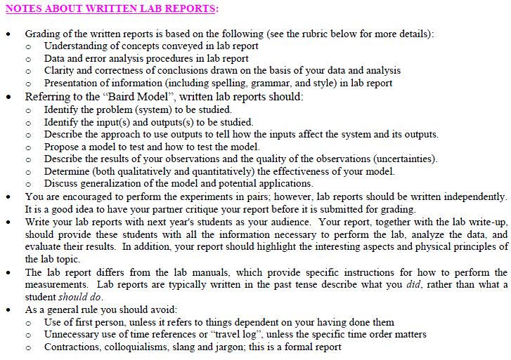
PHYS 3870 Web Site
Content of a Lab Report

Slide 9
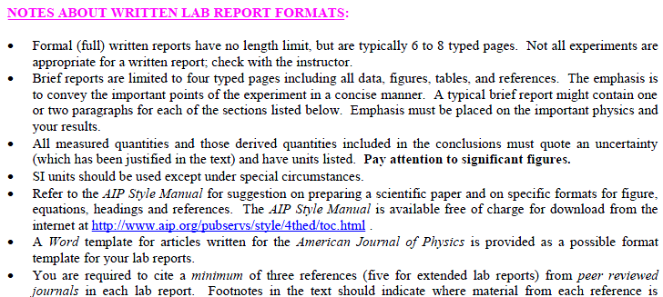
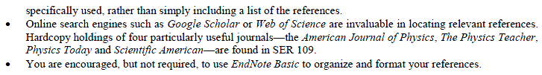
PHYS 3870 Web Site
Content of Lab Reports

Slide 10
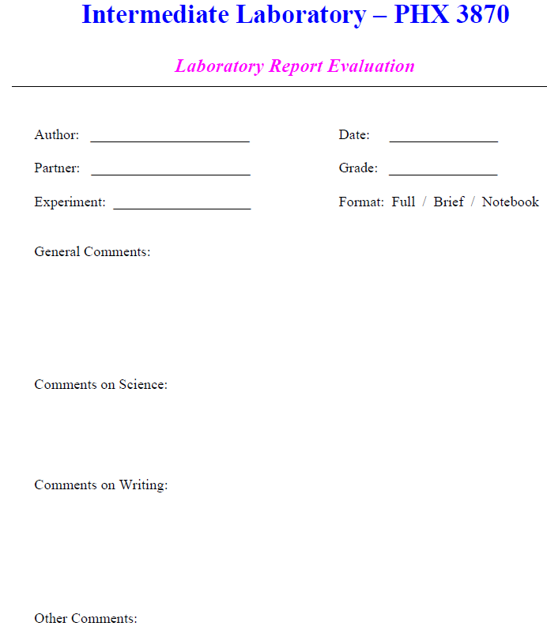
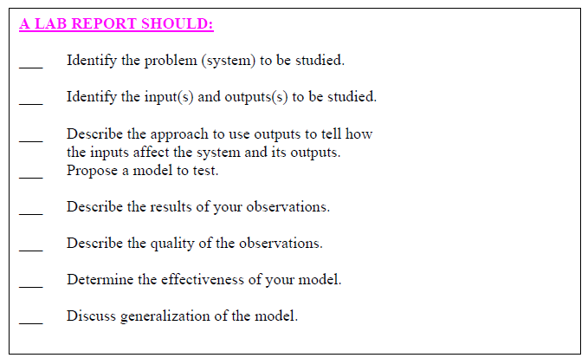
PHYS 3870 Report Rubric
Grade Rubric
http://www.physics.usu.edu/dennison/3870-3880/References/Lab_Report_Rubric.pdf

Slide 11
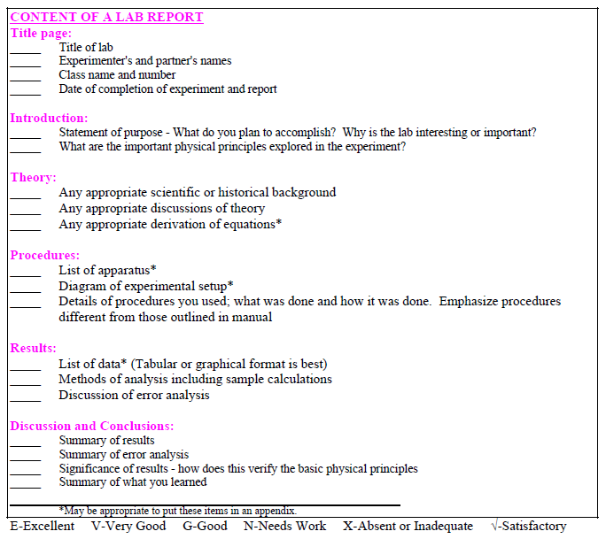
PHYS 3870 Report Rubric
Grade Rubric
http://www.physics.usu.edu/dennison/3870-3880/References/Lab_Report_Rubric.pdf

Slide 12
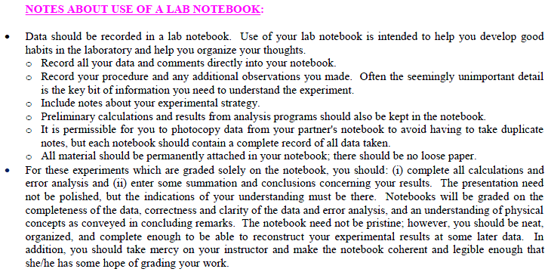
PHYS 3870 Web Site
Use of a Lab Notebook

Slide 13
PHYS 3870 Web Site
Writing Resources
Notes on “Old School” Technical Writing
“The Scientific Attitude”

Slide 14
PHYS 3870 Web Site
Writing Resources
Notes on “Old School” Technical Writing
Tense in Scientific Writing
Active Vs Passive Voice
Singulars and Plurals

Slide 15
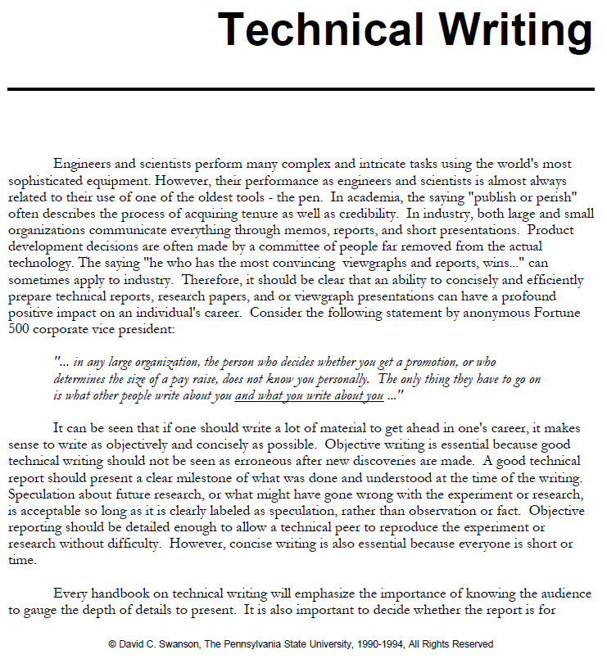
PHYS 3870 Web Site
Notes on Technical Writing

Slide 16
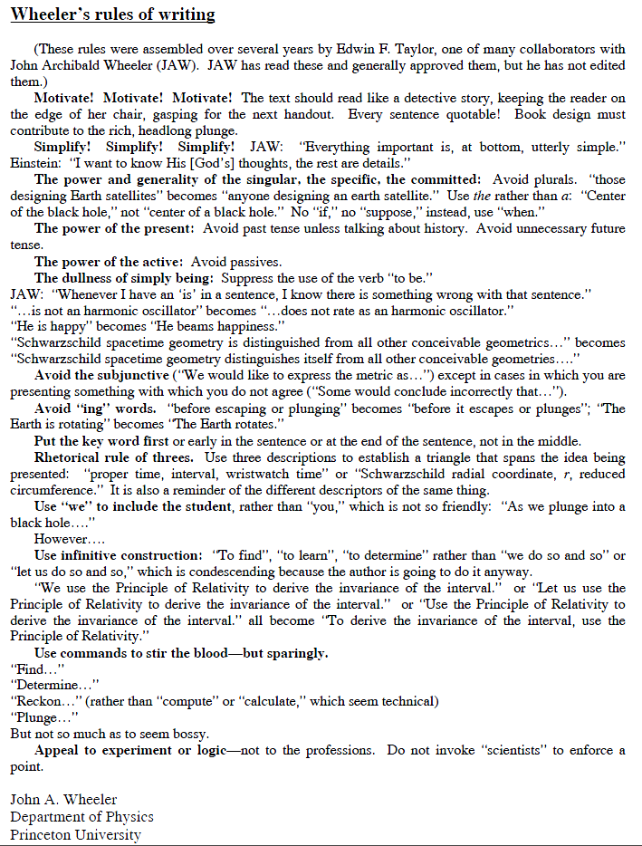
PHYS 3870 Web Site
Wheeler’s Rules of Writing

Slide 17

PHYS 3870 Web Site
Writing Resources
Review
"...a marvellous and timeless little book... Here, succinctly, elegantly and without fuss are the essentials of writing clear, correct English." John Clare, "The Telegraph"
From the Back Cover
Some acclaim for previous editions:
"Buy it, study it, enjoy it. It's as timeless as a book can be in our age of volubility."
— The New York Times
"No book in shorter space, with fewer words, will help any writer more than this persistent little volume."
— The Boston Globe
"White is one of the best stylists and most lucid minds in this country. What he says and his way of saying it are equally rewarding."
— The Wall Street Journal
"The book remains a nonpareil: direct, correct, and delightful."
— The New Yorker

Slide 18

PHYS 3870 Web Site
A New Writing Resource

Slide 19
PHYS 3870 Web Site
Style Manuals
Grade Rubric
Notes on contents of a lab report
The AIP Style Manual
AIP Style Manual: http://www.aip.org/pubservs/style/4thed/toc.html
AIP Journals: http://www.aip.org/pubservs/compuscript.html
American Journal of Physics: http://ajp.dickinson.edu/Contributors/manFormat.html

Slide 20

Intermediate Lab
PHYS 3870
CONVEYIMG INFORMATION
Journal Style Manuals
References: PHYS 3870 Web Site
AJP web site http://ajp.dickinson.edu/Contributors/contGenInfo.html
AIP Style Manual: http://www.aip.org/pubservs/style/4thed/toc.html

Slide 21
American Journal of Physics Style
Audience and Mission
The mission of the American Journal of Physics (AJP) is to publish articles on the educational and cultural aspects of physics that are useful, interesting, and accessible to a diverse audience of physics students, educators, and researchers who are generally reading outside their specialties to broaden their understanding of physics and to expand and enhance their pedagogical toolkits at the undergraduate and graduate levels.
AJP web site http://ajp.dickinson.edu/Contributors/contGenInfo.html

Slide 22
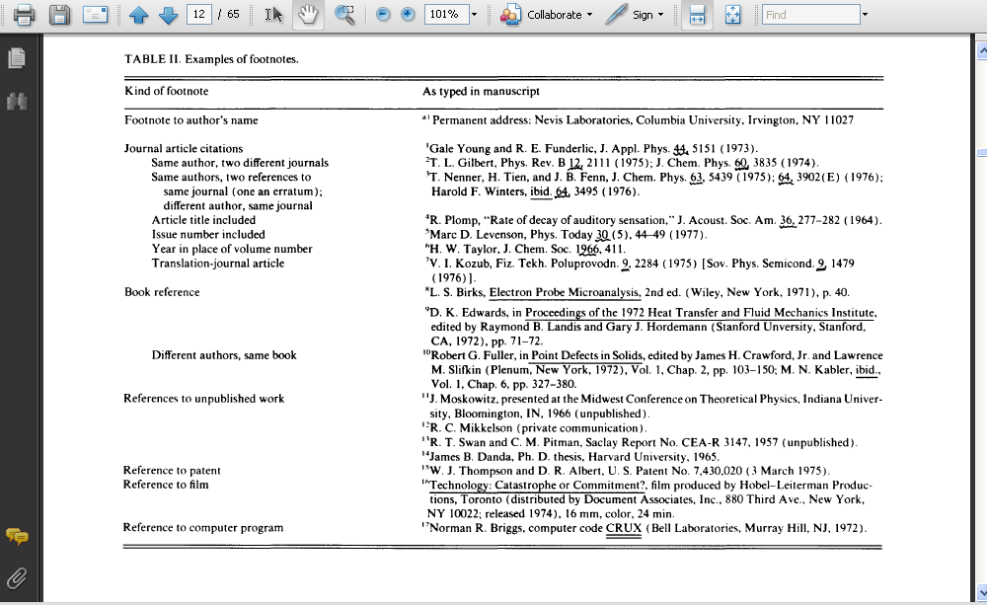
AIP Style Manual
Includes information on:
Writing a paper
Parts of a paper
Headings
Reference formats
Grammar and punctuation
Spelling and misspelled words
“I” and “we”
Capitalizations
Accepted abbreviations
Symbols
Units
Graph formats
Figures and figure captions
Tables and Table captions
Equations
Symbols
AIP Style Manual: http://www.aip.org/pubservs/style/4thed/toc.html

Slide 23
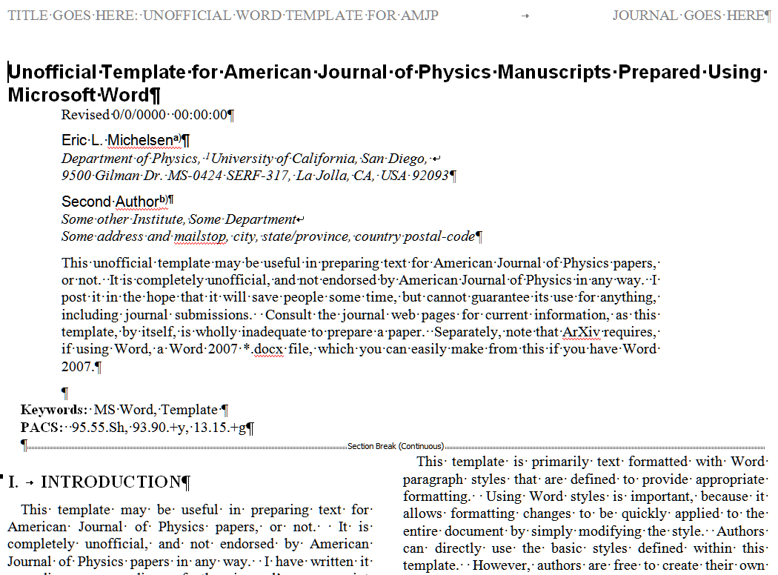
American Journal of Physics Word Template
Journal Templates
The Word template provides a relatively easy way to format lab reports using the style and format of articles in the American Journal of Physics. Other templates are available for other journals in both Word and LaTeX.
The templates can be loaded in to Word or you can simply start with a copy of the template document and overwrite with the content for your report.
physics.ucsd.edu/~emichels/AmJP.dot

Slide 24
Intermediate Lab
PHYS 3870
CONVEYING INFORMATION
Gathering Information
References:
PHYS 3870 Web Site
USU Library Class Web Site

Slide 25
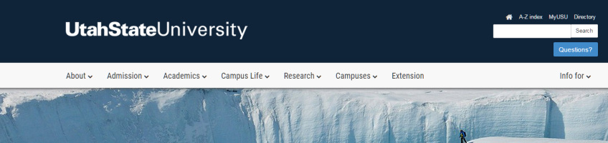


Access the USU Library Home Web Page
http://library2.usu.edu/howto/

Slide 26
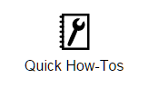
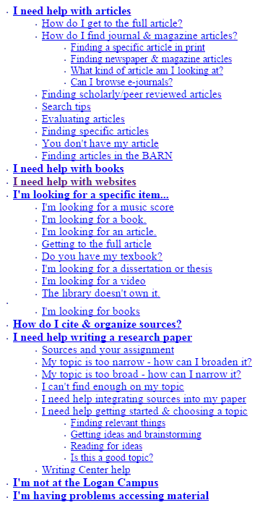
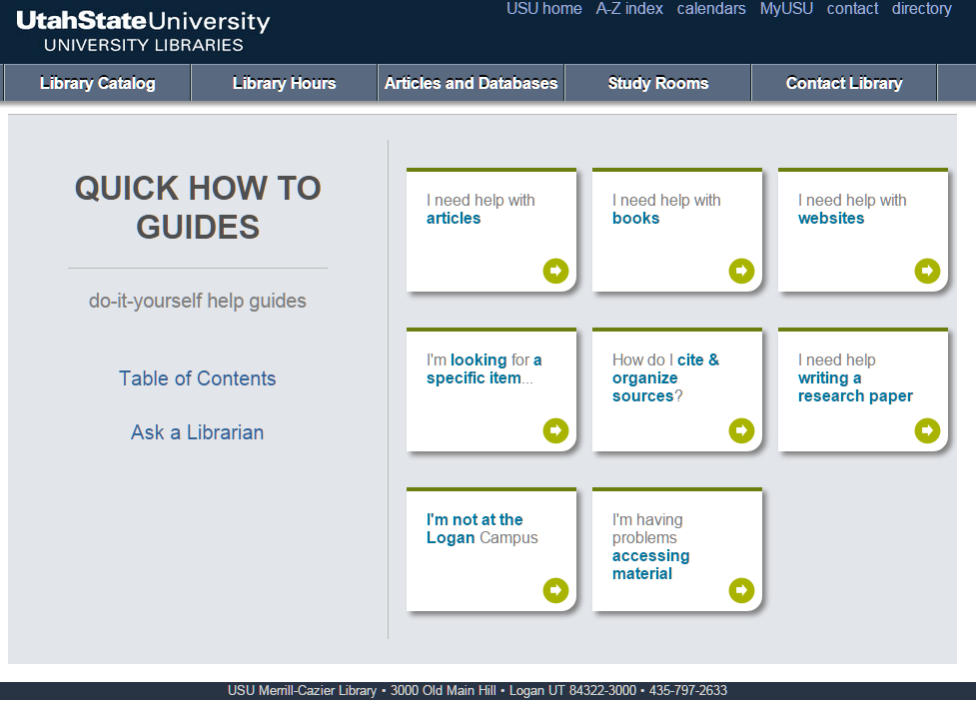
Access the USU Library How-Tos
http://library2.usu.edu/howto/
http://library2.usu.edu/howto/sitemap.php

Slide 27
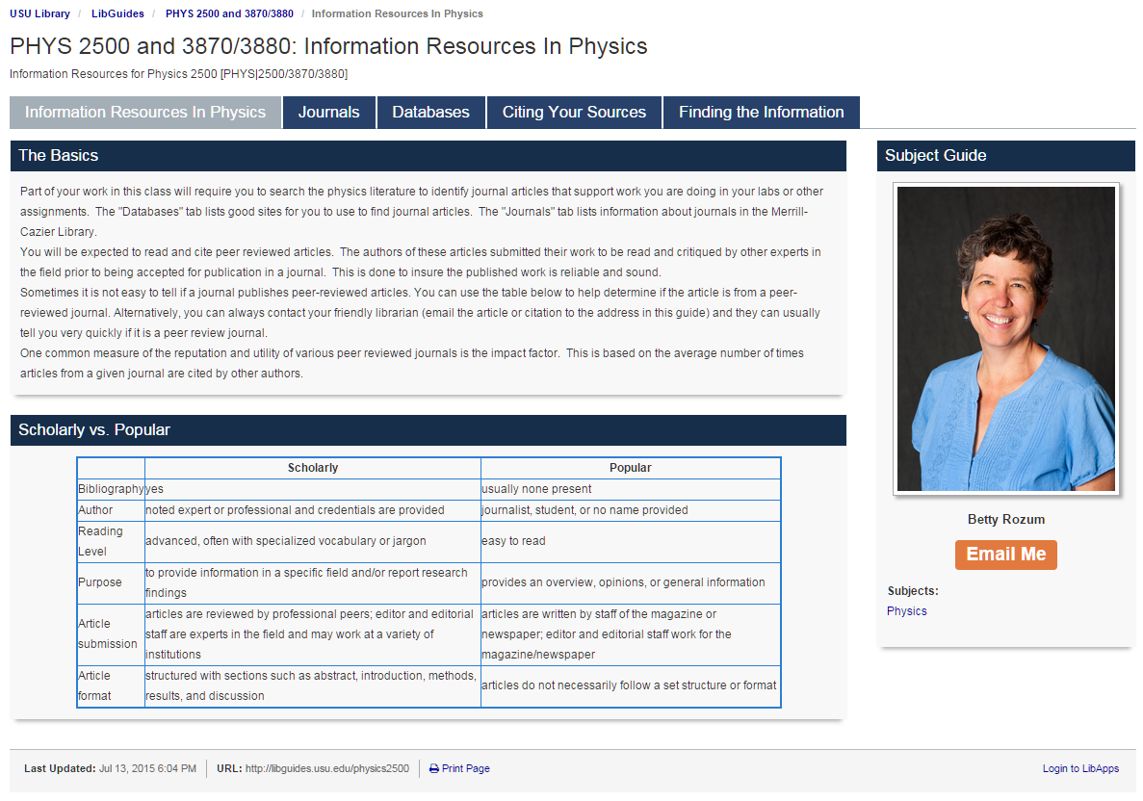
Access the USU Library Home Web Page
This page provides an up to date link to the USU library resources tailored to these classes!
http://libguides.usu.edu/content.php?pid=246165

Slide 28
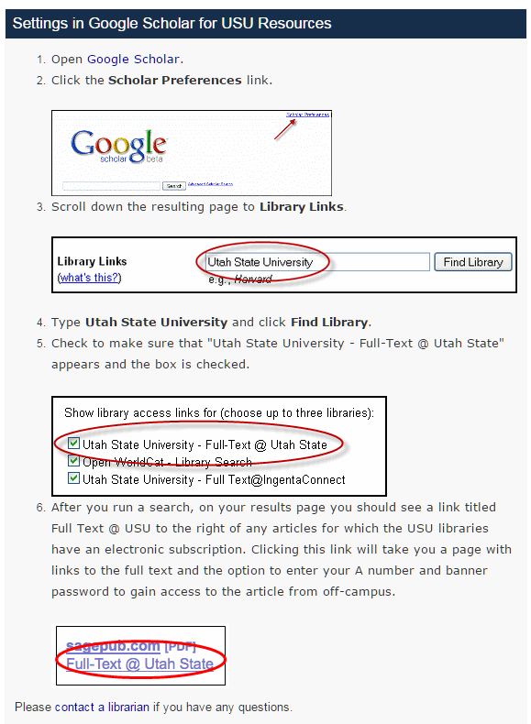

Setting Up Google Search at USU
Good information on electronic journals, Endnote and Google Scholar
http://libguides.usu.edu/c.php?g=52461&p=338450
USU set up instructions:
http://libguides.usu.edu/c.php?g=52461&p=338450
Google Scholar Home Page:
http://scholar.google.com

Slide 29
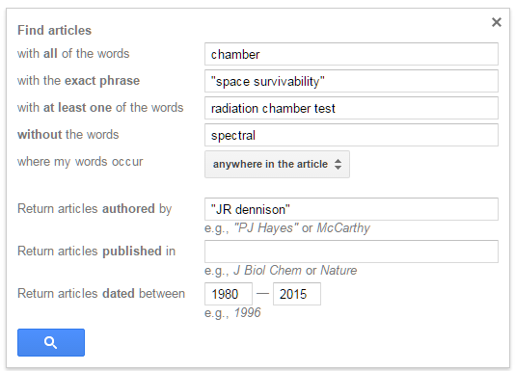
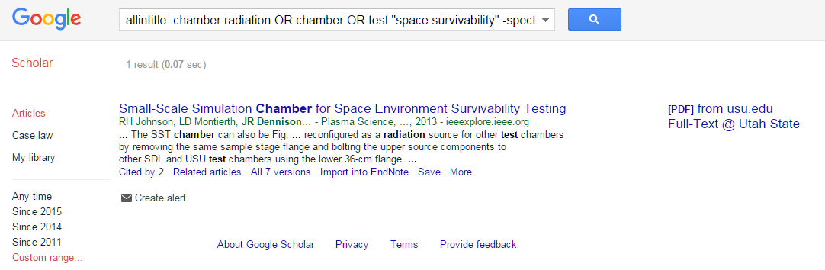
Searching with Google Scholar
1
Google Scholar Home Page:
http://scholar.google.com
5
Search Criteria
Select words
Select authors
Select journal
Select date
Select fields
2
3
4

Slide 30
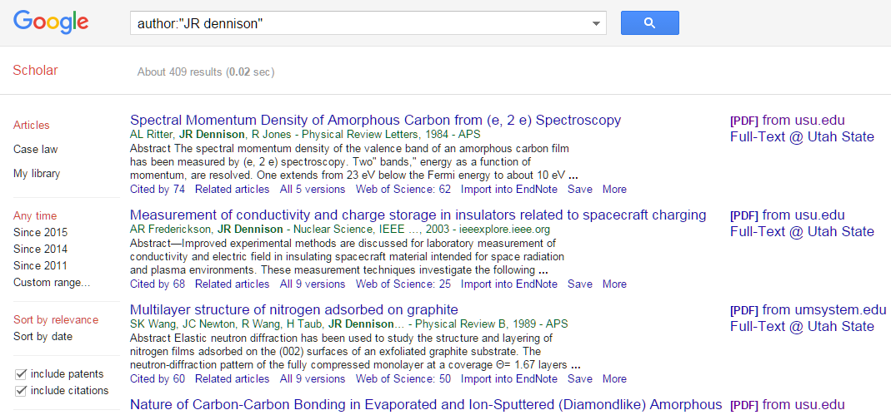
Articles from Google Scholar
Cited by
Related articles
Import into Endnote
Get Text in PDF

Slide 31
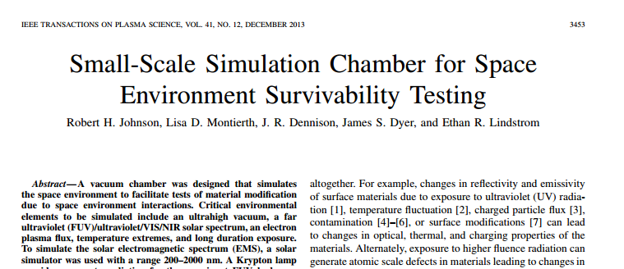

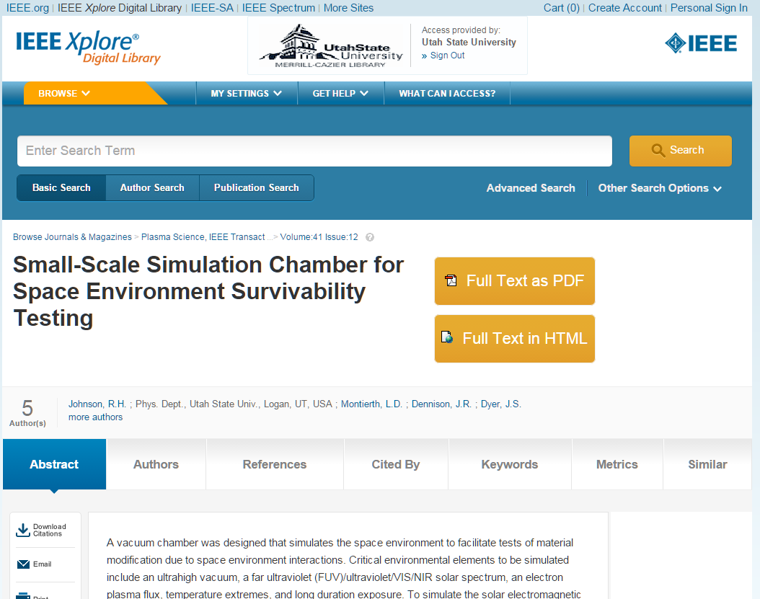
Getting the Article
Access article
Access Journal
Article as PDF

Slide 32
Intermediate Lab
PHYS 3870
An Exercise in Reference Management and Use
Use Google Scholar to find:
A physics related article by an author with your last name
An article in American Journal of Physics related to this topic
An article from within the last 2 years related to this topic
An article from before you were born related to this topic
(see extensions to this exercise using EndNote Basic below)

Slide 33

Intermediate Lab
PHYS 3870
CONVEYING INFORMATION
Gathering Information
References:
PHYS 3870 Web Site
USU Library Class Web Site

Slide 34

Introduction to EndNote and EndNote Basic
EndNote Desktop is a software program that program that stores and organizes citations, and enables you to import citations directly into a Word document. This extended version is expensive and note necessary.
Endnote Basic is a free version of this software accessible to USU students, with almost all of the functionality of the main program.
Create a Citation Library
Stores and organizes figures and equations
Can link papers to citations
Can search bibliographic databases
Log On
Tutorials
https://www.myendnoteweb.com/EndNoteWeb.html
http://libguides.usu.edu/EndNoteBasic
http://www.endnote.com/training/

Slide 35
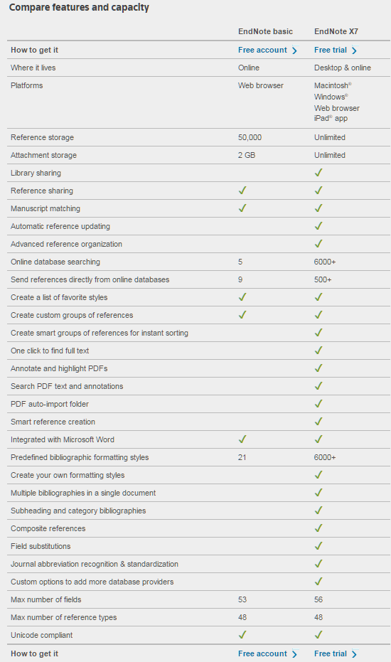

Comparing EndNote Desktop and EndNote Basic
http://endnote.com/product-details/basic

Slide 36
Access the USU Library Home Web Page
This page provides an up to date link to the USU library resources tailored to these classes!
http://libguides.usu.edu/content.php?pid=246165

Slide 37
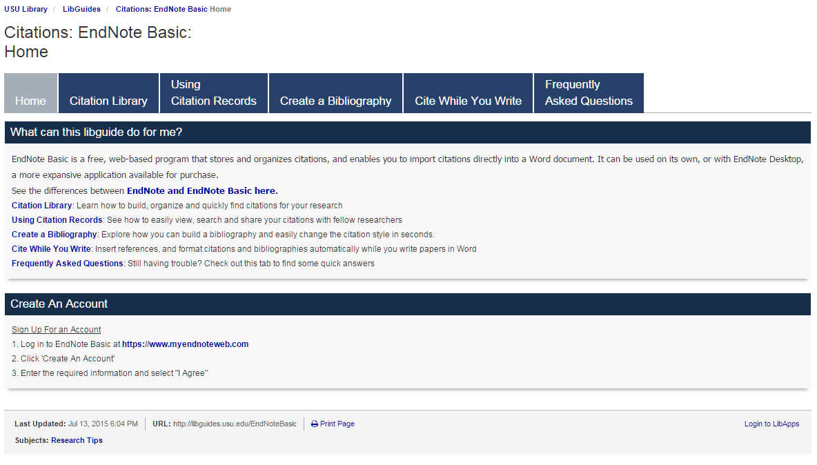
Using EndNote Basic at USU
This page provides an up to date link to the USU library resources for using EndNote Basic
http://libguides.usu.edu/EndNoteBasic

Slide 38
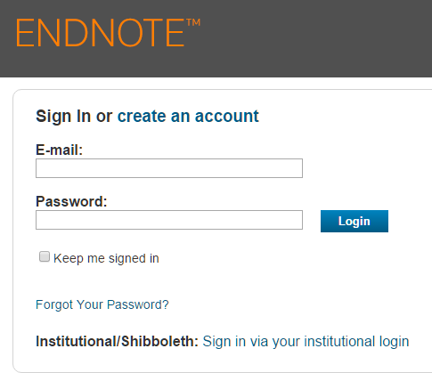
Creating an Account for EndNote Basic
(1) Begin on the USU EndNote Basic home page http://libguides.usu.edu/EndNoteBasic
(2) Create an EndNote account
Select “create and account”.
Enter your preferred email and a new password specifically for your EndNote Basic account.
https://www.myendnoteweb.com/EndNoteWeb.html

Slide 39
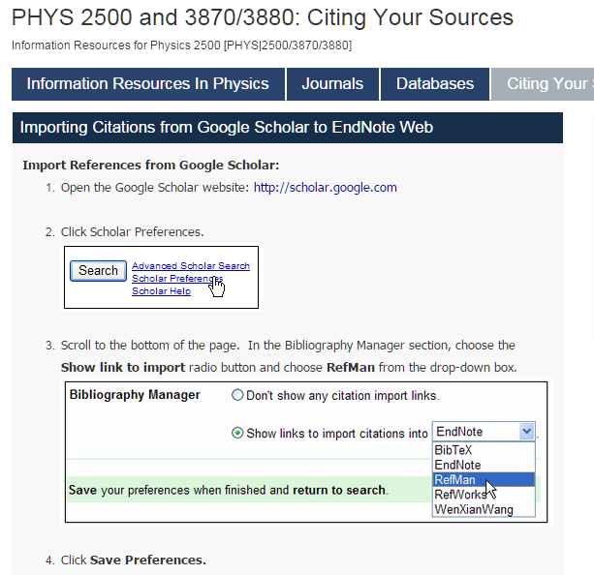
Setting Google Scholar to Work with EndNote Basic
(3) Set up Goggle Scholar to work with EndNote Basic.
Import to RefMan or EndNote
Video tutorial https://www.youtube.com/watch?v=35t9RB8G558

Slide 40
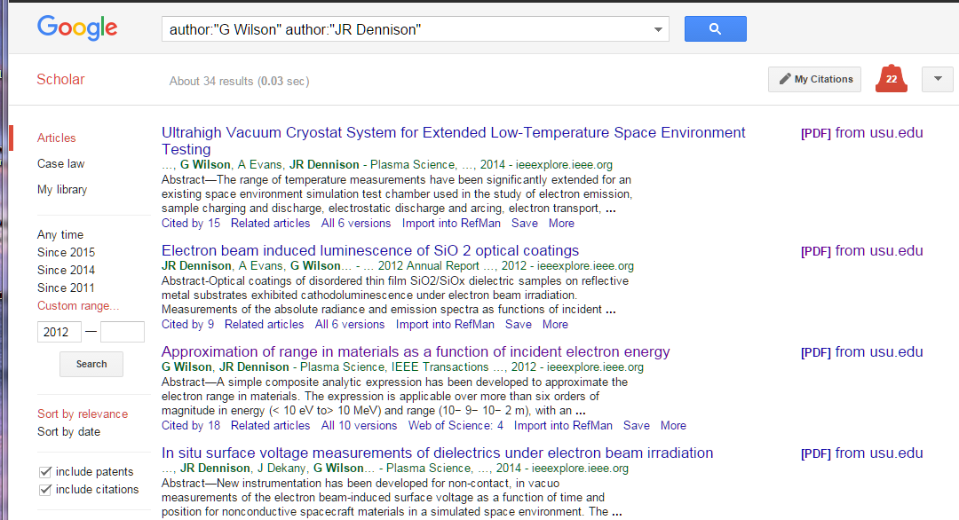
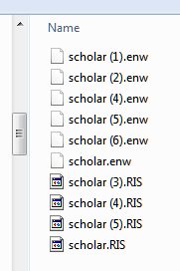
Importing Articles from Google Scholar into EndNote Basic
(4) Collect reference files for import into EndNote Basic
After performing a search on Google Scholar click on the "Import into RefMan“ or “Import to EndNote” link to import the reference you want.
This will download a RefMan file (file type .RIS) or EndNote file (file type .ENW). Collect these files in a temporary directory to upload into EndNote Basic.
Alternately, when you are presented with a window asking if you want to "Open" or "Save" the file, choose to Save the file.
Import to RefMan
or EndNote

Slide 41
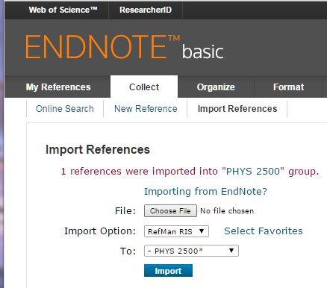
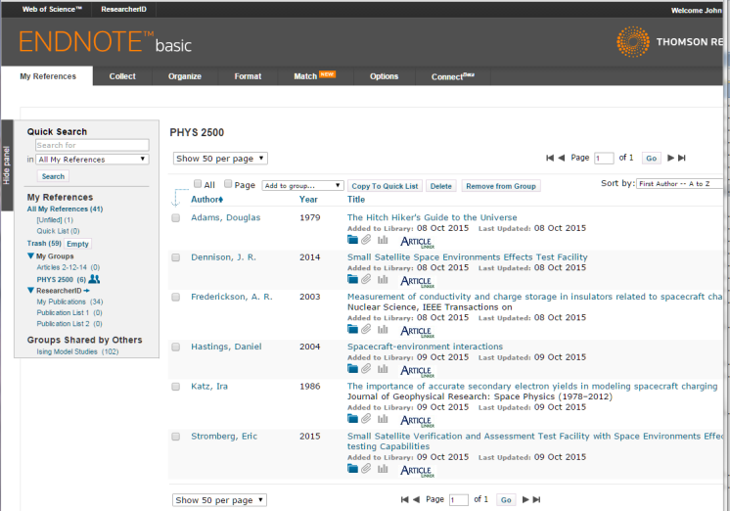
Importing Search Results from Google Scholar into EndNote Basic
https://www.myendnoteweb.com/EndNoteWeb.html
(5) Follow these steps to import search results into EndNote Basic:
Log into your EndNote Basic account
In EndNote Basic, click on Collect/Import Reference in the Import window
Select the .RIS or .ENW file you downloaded from your temporary by clicking on the Choose File button.
In the dropdown for Import Option, choose "RefMan (RIS)“ or “EndNote Import”.
Select the EndNote Basic reference folder to import To
Click the Import button and your references will be imported into the specified EndNote Basic folder.
Repeat this process for each new file.
Aside: You may have to add “EndNote Import” as an option using the Select Favorites button.
Import from RefMan or EndNote files

Slide 42
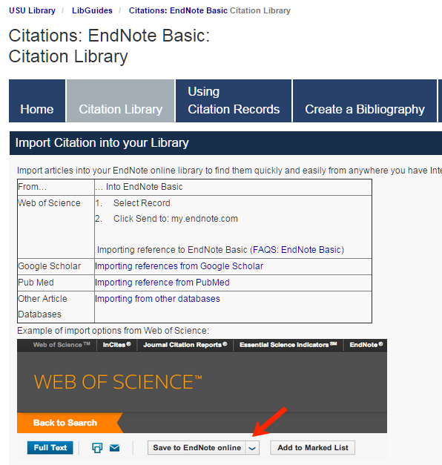
Importing Search Results into EndNote Basic
(5) Steps to import search results from alternate sources into EndNote Basic:
http://libguides.usu.edu/c.php?g=52841&p=339445
https://www.myendnoteweb.com/EndNoteWeb.html

Slide 43

Managing Your Citations within Your EndNote Basic Library
(6) The downloaded references are now available in the EndNote Basic library:
Log into your EndNote Basic account
Select My References and the subgroup from My Groups to view the references
https://www.myendnoteweb.com/EndNoteWeb.html

Slide 44
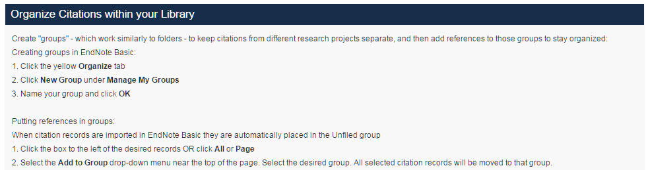
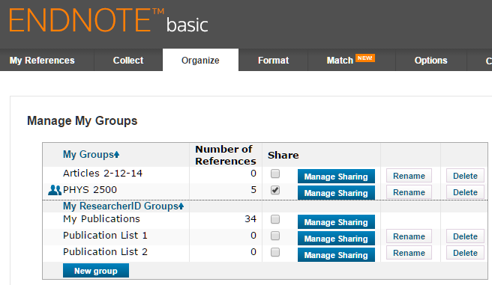
Managing Your Citations within Your EndNote Basic Library
(6) The downloaded references are now available in the EndNote Basic library:
Detailed instructions for organizing and managing your references are shown at right
The EndNote Basic Organize tab is shown below.
http://libguides.usu.edu/c.php?g=52841&p=339445
https://www.myendnoteweb.com/EndNoteWeb.html

Slide 45
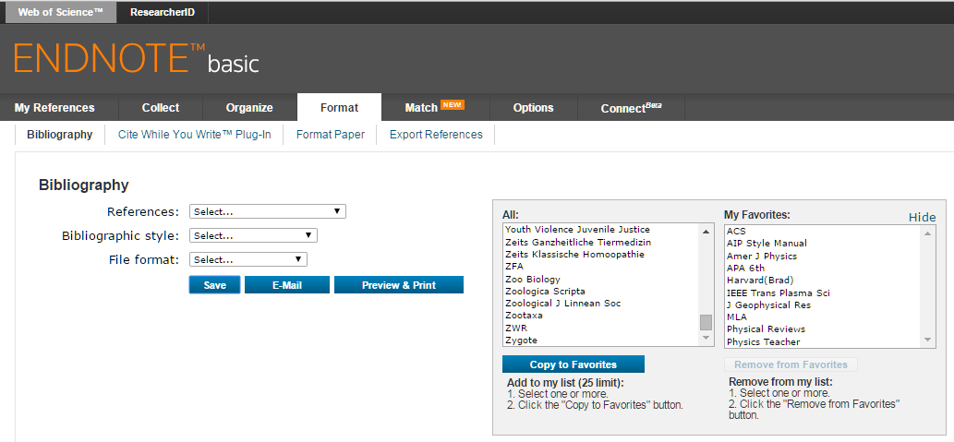
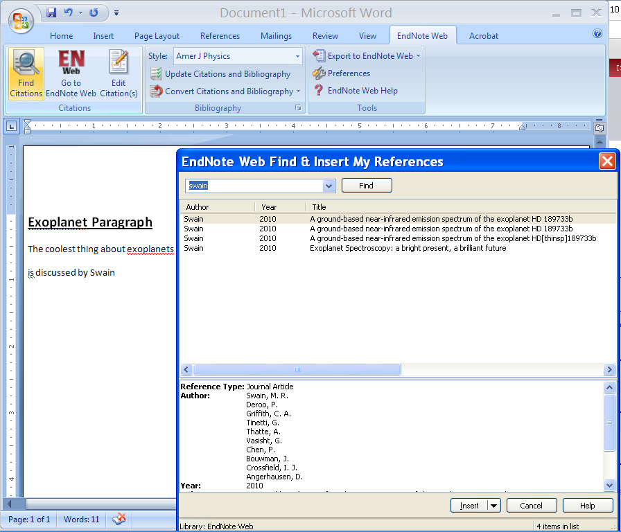
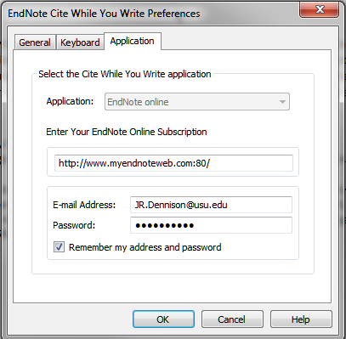
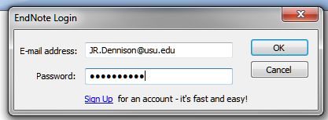
Setting Up Cite While You Write
Aside: The bibliographic styles selected here include:
American Chemical Society
American Institute of Physics (APS)
American Journal of Physics
IEEE Transactions on Plasma Science
Journal of Geophysical Research
Physical Review
Physics Teacher
(8) To use EndNote Basic in Word:
Select your choices on the EndNote Basic web site for Bibliographic Styles
  Click on “Select Favorites” next to Bibliographic Styles
  Highlight your choices and click Copy to Favorites
  These choices will show up in Word in the Style pulldown list in the EndNote tab.
  When you first open the EndNote tab in Word you will be prompted to enter the email address and password you associated with EndNote. You can save this in Word using the Preferences selection

Slide 46
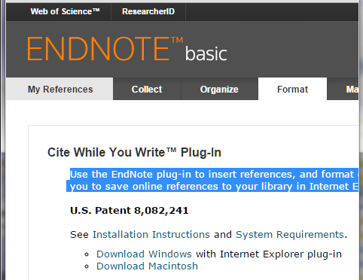
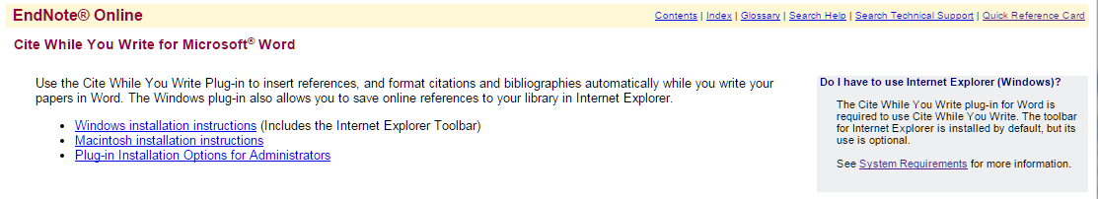
Cite While You Write Plug In for Word
(7) To use EndNote Basic in Word:
Download the appropriate plug in using the links in the Format tab
See the Installation Instructions for different operating systems below
Select your choices for Bibliographic Styles (see next slide)
Use the EndNote plug-in to insert references, and format citations and bibliographies automatically while you write your papers in Word. This plug-in also allows you to save online references to your library in Internet Explorer for Windows.
http://libguides.usu.edu/c.php?g=52841&p=339445
https://www.myendnoteweb.com/EndNoteWeb.html

Slide 47
Cite While You Write in Word
(8) Use the EndNote Basic Cite While You Write plug-in to insert references, and format citations and bibliographies automatically while you write papers in Word.
Inserting cited references in your Word document
With your Word document open, place the cursor in the location where you would like the citation to appear
Select EndNote Web at the top of the screen (some Word processors will place it under the Tools menu)
Click Find Citations (this tool searches your entire EndNote Basic library)
Enter a search term in the Find Citations box to find the citation record to insert.
Click Search or Find
Select the desired reference. More than one record can be selected at any given time - simply hold the Ctrl key while clicking each reference.
Click Insert

Slide 48
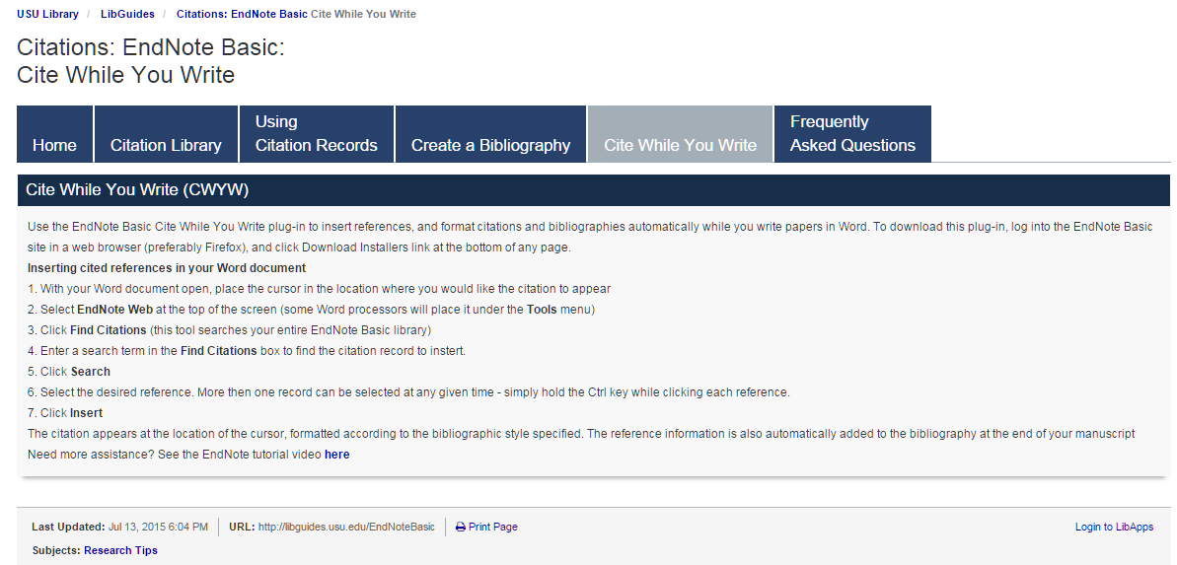


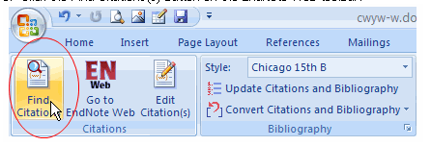
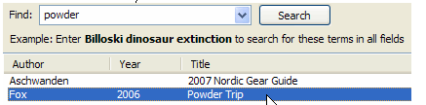


Cite While You Write
http://libguides.usu.edu/c.php?g=52841&p=339449

Slide 49
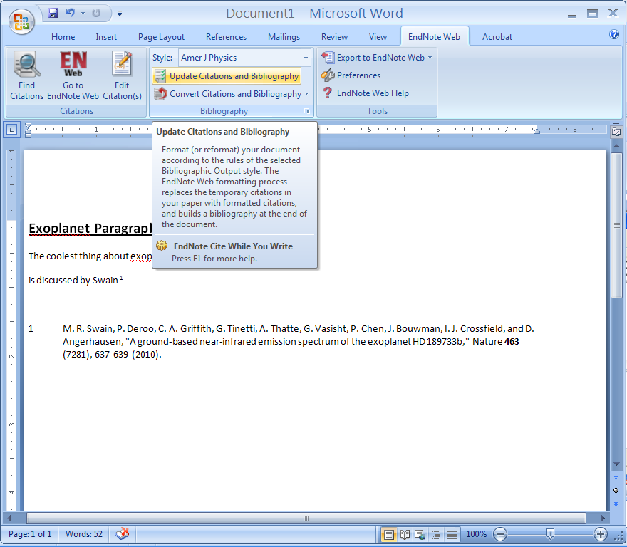
Formating the Bibliography with EndNote Basic
(9) Use the EndNote Basic Cite While You Write plug-in to format citations and bibliographies in Word.
Inserting cited references in your Word document
Select EndNote at the top of the screen (some Word processors will place it under the Tools menu)
Select the style for citations and the bibliography from the pull down menu.
Click on Update Citations and Bibliography.
http://www.endnote.com/training/tutorials/enweb2/English/EndNote_Web-English/EndNote_Web.asp

Slide 50
Intermediate Lab
PHYS 3870
An Exercise in Reference Management and Use
Use Google Scholar to find:
A physics related article by an author with your last name
An article in American Journal of Physics related to this topic
An article from within the last 2 years related to this topic
An article from before you were born related to this topic
Use Google Scholar and EndNote to:
Use Google Scholar to save citations to these 4 articles in EndNote Basic format
Write a sort paragraph about the physics topic in Word.
Use EndNote Basic Cite-While-You-Write to provide citations for your paragraph.
Use EndNote Basic to create a bibliography for your paragraph using the AIP Style.
Save your Word file as a PDF file, with a filename LastnameFirstInitial_Endnote.pdf (e.g., DennisonJ_EndNote.pdf).

Slide 51
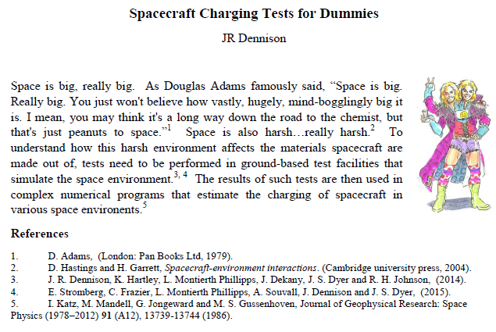
Intermediate Lab
PHYS 3870
An Example of an Exercise in Reference Management and Use

Slide 52

Intermediate Lab
PHYS 3870
CONVEYIMG INFORMATION
Gathering Information
Installing and Using DataThief
References:
PHYS 3870 Web Site
USU Library Class Web Site
DataThief Manual
DataThief Web Site

Slide 53
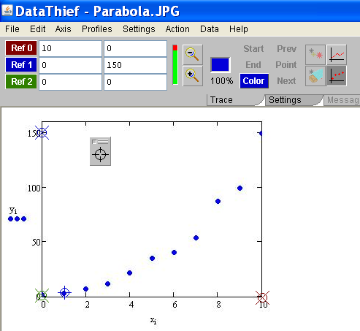


DataThief
DataThief III is program to digitize data in various forms for subsequent plotting and analysis. It is often used to “borrow” data from scanned graphs in articles. DataThief is a “free” shareware program and is very easy to use.
The presentation includes:
Instructions on how to download and install the program and where to get supporting documentation.
A detailed set of instruction on how to use the program to digitize data from a picture of a graph.
A simple example of acquiring digitized data from a photograph .
A simple exercise in use of DataThief is described in the file
PHYS 2500 Sec5-Graphing DataThief Exercise.ppt.

Slide 54




Acquiring DataThief III
DataThief III is already installed and running on the PHYS 2500 CITRIX page.
To acquire and install your own copy of the shareware program DataThief III and its accompanying documentation, simply follow the numbered steps listed here.
(1) Go to Datathief.com
(2) Review the program
Description
(3) (Download Java as well, if you need it.)
Download the executable program file Datathief.jar by
Clicking here
(4) Download the manual
(5) Review some examples, if you like.

Slide 55

Orientation to DataThief III
DataThief III is written in Java. This means, that apart from the "executable" called Datathief.jar, you will have to have the Java Virtual Machine. The Java Virtual Machine can be downloaded from www.java.com. Follow the instructions that are appropriate for your machine.
Once the virtual machine is installed, you may start DataThief.
  On Windows, double click the Datathief.jar icon.
  On Macintoshes with MacOS 8 or MacOS 9, double click the Datathief application icon.
  On Macintoshes with MacOS X and on Linux or Unix either double click the Datathief icon, or go to the directory where you installed DataThief and type Datathief.
Once you have a running DataThief, select "Open..." from the File menu, and select the file you want to take data from. In this example, we used "example.png“. Key features of DataThief are shown below.
3 point indicators used to find the corresponding coordinate indicator
tool bar
menu bar
Start location indicator (green with a + through its center)
"Dump", used to define data points
Color location indicator (blue with a + through its center)
3 coordinate indicators have an X through there center
White area with the image in it is the image area
Stop location indicator (red with a + through its center)

Slide 56

DataThief in Action
To use DataThiefIII to digitize data from a graph:
(1) Open DatathiefIII.
(2) Select an image file using Open from the File menu. Allowed file types include gif, jpg, and png.
(3) Select whether to digitize a point graph or line graph
(4) Define the graph axes by tagging 3 axis coordinate indicators by dragging and dropping the 3 circled X icons onto the axes points and entering the corresponding numerical values.
Note: If the 3 axes points are not visible on the graph, select Reset from the Actions menu. Click a colored button (e.g., Ref 0) to flash the corresponding axis point
Note: For pictures you can use this to put the digitized values in the correct units if you know the values of these three points.
Note: This can correct for skewed axes by selecting non-orthogonal axes.

Slide 57


Setting DataThief
Simply follow the remaining numbered steps listed here.
(7) Export
The data to a file using the File menu
(5) Select axes
type using the Axis menu
(6) To “borrow” discrete data points, select the Point mode icon and then tag each data point by dragging crosshairs from the “Dump” on top of the point
(5 Alternate) To “borrow” data from traces (lines):
Select the Trace mode icon,
Tag the beginning and end of the trace to “steal” with the green and red icons, respectively
Set the color of the line by dropping the blue icon on a well isolated portion of the trace
Use the three point indicators “Start”, “End” and “Color” to locate the icons to drag.
The density of data points digitized can be adjusted using the “Output Distance” selection from the Settings tab.

Slide 58
Reading DataThief Txt Files
(8) Read into an Excel file as comma delimited text using the Excel Text Import Wizard called up from the “From Text” icon on the Data ribbon in Excel.

Slide 59
Intermediate Lab
PHYS 3870
CONVEYIMG INFORMATION
Gathering Information
An Example of Using DataThief and Mathcad
References:
PHYS 3870 Web Site
USU Library Class Web Site
DataThief Manual
DataThief Web Site

Slide 60

DataThief--Fitting Example
This example uses Mathcad to fit the digitized coordinates of a photograph to a mathematical model, leading to an analytical expression used for further analysis. The digitized results were produced using DataThiefIII.
An ellipsoidal mirror used in a Class AAA Solar Simulator needed to be adjusted to provide better focusing. This required a mathematical model of the mirror surface in terms of foci and radii. Direct measurement of the 3D mirror was difficult and was made even harder by the surrounding support structure and enclosure.
A photograph of the system was taken and the JPG file imported in to DataThiefIII (right).
The axes were identified. (The image was cropped in Photoshop to create a cleaner image. This step was not strictly necessary.).
Points on the mirror were then digitized using Datathief
Data were written to a two column, tab delimited text file.
The data file was then read in to Mathcad.

Slide 61

DataThief--Fitting Example

Slide 62

DataThief--Fitting Example

Slide 63

DataThief--Fitting Example

Slide 64
Intermediate Lab
PHYS 3870
CONVEYIMG INFORMATION
Gathering Information
An Exercise in DataThief, Plotting and Curve Fitting
References:
PHYS 3870 Web Site
USU Library Class Web Site
DataThief Manual
DataThief Web Site

Slide 65
Introduction to Scientific Computing
PHYS 2500
An Exercise In Data Analysis
Use DataThief to “steal” data from the graph in DennisonInFreefall.jpg and save the data in the file YOURNAMEInFreefall.txt:
In your favorite plotting and curve fitting program:
  Import the data from DennisonInFreefall.jpg stored in YOURNAMEInFreefall.txt
  Import the data from FreefallLab.txt
  Create a single graph of position vs time with:
    Data points and error bars from FreefallLab.txt
    Data points (the slacker has no error estimates here!) from DennisonInFreefall.jpg
    A mathematical model for free fall plotted as a line
    List your best estimates for values and errors for you model fitting parameters
  BONUS:
    Lineraize your model, that is plot the dependant variable versus some function (e.g., square, square root) of the dependant variable such that the plot yields a straight line
    Plot both data sets (with appropriate errors) and your linear model on a linearized graph
    Do an automated fit with your linear model to the FreefallLab data. List your best estimates of the slope and intercept (with errors) and from these the best estimates (with errors) for you original model fitting parameters.

Slide 66


Data for An Exercise In Data Analysis
Freefall.txt
DennisonInFreefall.jpg

Slide 67

Results for An Exercise In Data Analysis
Model is y(t)=(1/2)at² + v_{o}t + y_{o}

Slide 68

Intermediate Lab
PHYS 3870
CONVEYIMG INFORMATION
Analyzing and Plotting Data with Mathcad
References:
PHYS 3870 Web Site
USU Library Class Web Site

Slide 69

PHYS 2500 Introduction to Scientific Computing
Mathcad Tutorials

Slide 70




PHYS 2500 Introduction to Scientific Computing
Mathcad Tutorials

Slide 71

Intermediate Lab
PHYS 3870
CONVEYIMG INFORMATION
Analyzing and Plotting Data with Excel
References:
PHYS 3870 Web Site
USU Library Class Web Site

Slide 72

Instructions for an Excel Tutorial Exercise
Follow the detailed (if boring) instructions to create an Excel worksheet to analyze and plot a sample data set and prepare a simple report.

Slide 73

Report from an Excel Tutorial Exercise
Follow the detailed (if boring) instructions to create an Excel worksheet to analyze and plot a sample data set and prepare a simple report.

Slide 74

Intermediate Lab
PHYS 3870
CONVEYIMG INFORMATION
Analyzing and Plotting Data with IGOR Pro
References:
PHYS 3870 Web Site
USU Library Class Web Site
IGOR Pro https://www.wavemetrics.com

Slide 75

IGOR Pro Overview
IGOR Pro 6 is an extraordinarily powerful and extensible scientific graphing, data analysis, image processing and programming software tool for scientists and engineers. It combines both a graphical interface for quick plotting and a command line interface that can be easily used to create script macros for repeated analysis of similar data. The outputs are extremely versatile and of the highest publication quality.
Refer to https://www.wavemetrics.com/products/igorpro/Igor6Brochure.pdf for a summary of the capabilities of IGORPro.
Additional information is available at https://www.wavemetrics.com/ .

Slide 76
Program Installation
The USU Physics Department has a department Coursework License site IGOR Pro 6.3
The special coursework license is intended to facilitate the use of Igor as a teaching tool and to introduce students to Igor under the following conditions:
  The software may be used only by students and only for assigned coursework. It may not be used for research.
  All technical support must go through a single individual who is usually the instructor/ registered licensee.
  The license covers both Macintosh and Windows operating systems.
  Igor Pro can be installed on multiple computers. All that is required is that you make a good-faith effort to ensure that the license is used for coursework only. The terms of the license require that if they want to use Igor for research, they can purchase a student or academic license.
  WaveMetrics offers an inexpensive student personal purchase copy of IGOR Pro which students can purchase with their own personal funds for their own personal work when their use of IGOR extends beyond assigned coursework.
To install the software, please visit the Wavemetrics web page to download the latest version of IGOR Pro 6.3 at https://www.wavemetrics.com/order/order_igordownloads.htm
The activation information for our IGOR Pro license is available from the USU Physics Department.

Slide 77

IGOR Pro Web Site
Additional information is available at the Wavemetrics web site https://www.wavemetrics.com/ shown at right.
This is an excellent resource!

Slide 78

IGOR Pro Tutorials
IGOR Pro offers excellent tutorials accessed through the Help menu of the program under Getting Started.
For PHYS 2500 the recommended tutorials include:
Introduction to IGOR Pro
Guided Tour 1: General Tour (up to Offsetting a Trace)
Guided Tour 2: Data Analysis
The same material in the written tutorials is available in video (YouTube) format at the Wavemetrics web site https://www.wavemetrics.com/.
There is an extensive manual available in PDF format accessible from the IGOR Pro Help menu.
This same menu offers:
A Help Browser
Explanation of shortcut key strokes
Command help
Example files
Access to excellent User Group
Wavemetric support (they actually respond to your queries!)

Slide 79

IGOR Pro Tutorials
IGOR Pro offers excellent tutorials accessed through the Wavemetrics web site at https://www.wavemetrics.com/.
For PHYS 2500 the recommended video (YouTube) tutorials include:
Introduction to IGOR Pro (Part of the General Tour) (~13 min)
Guided Tour 1: General Tour (Through Video 2.1 and Video 3.0 (~30 min)
Guided Tour 2: Data Analysis (~15 min)

Slide 80





IGOR Pro Manual
http://www.wavemetrics.net/doc/igorman/IgorMan.pdf

Slide 81

See Igor6Brochure.pdf at https://www.wavemetrics.com/products/igorpro/Igor6Brochure.pdf

Slide 82

See Igor6Brochure.pdf at https://www.wavemetrics.com/products/igorpro/Igor6Brochure.pdf

Slide 83




Example of Publication Quality Graphs with IGOR Pro
More examples at
https://www.wavemetrics.com/products/igorpro/gallery/user.htm

Slide 84
Introduction to Scientific Computing
PHYS 3870
An Exercise in Analyzing and Plotting Data
with IGOR Pro
References:
PHYS 3870 Web Site
USU Library Class Web Site
IGOR Pro https://www.wavemetrics.com

Slide 85
Introduction to Scientific Computing
PHYS 2500
An Exercise In Data Analysis
Using IGOR Pro
In the IGOR Pro plotting and curve fitting program:
  Import the data derived from the DataThief exercise from DennisonInFreefall.jpg stored in YOURNAMEInFreefall.txt.
  Import the data from FreefallLab.txt
  Do an automated fit with a quadratic model to the FreefallLab data.
  Create a single graph of position vs time with:
    Data points and error bars from FreefallLab.txt
    Data points from DennisonInFreefall.jpg
    A mathematical model for free fall plotted as a line
    List your best estimates for values and errors for you model fitting parameters
  Create an IGOR Pro layout displaying the graph, data table and annotations exactly as shown on the next page. Print the layout page as a pdf file.
  Save the IGOR Pro experiment.
  Submit the IGOR Pro experiment file (LastnameFI_IGOR.pxp) and the layout page printout (LastnameFI_IGOR.ppt).

Slide 86
Data for An Exercise In Data Analysis
Using IGOR Pro
Freefall.txt
DennisonInFreefall.jpg

Slide 87

Results for An Exercise In Data Analysis
Using IGOR Pro
Model is y(t)=at² + v_{o}t + x_{o}

